Slide 1
MAKERERE UNIVERSITY BUSINESS SCHOOL
FACULTY OF BUSINESS ADMINISTRATION
Business Communication Skills
FOR BACHELORS STUDENTS
©2024 - DEPARTMENT OF COMMUNICATION

Slide 2
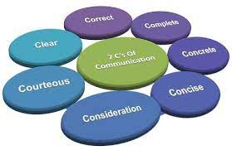
TOPIC 2(d):
BASIC BUSINESS ENGLISH IN RELATION TO PRINCIPLES OF COMMUNICATION

Slide 3
Topic Outline
Introduction to the principles of communication
Learning outcomes
Principles of communication;
Principle
What it means
How its achieved
Demonstration using examples
Benefits of each principle(Students to discuss)
Dangers of not adhering to each principle(students to discuss)
Formal Workplace Vocabulary Exercise

Slide 4
Introduction
Communication is an imperative that can be compared to a precious stone in life but effective communication does not happen overnight.
It is a skill that has to be cultivated and nurtured and one way is by incorporating the 7Cs into all communication..
The 7 Cs of Communication is a checklist to ensure effective communication. These principles of communication are guidelines for action.
They apply to all methods of communication that is oral , written and nonverbal messages.

Slide 5
Learning Outcomes
At the end of this topic, the student should be able to;
Explain and interpret the 7Cs adequately with ease
Construct grammatically correct sentences using the 7Cs model
Use the different 7Cs in both personal and professional lives by applying the principles in all methods of communication
Develop better communication skills.
Formally express themselves appropriately and professionally in various workplace scenarios.

Slide 6
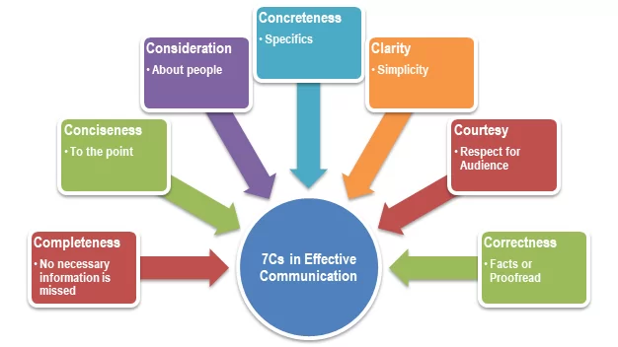
Principles Of Communication
Consideration
Courtesy
Completeness
Conciseness
Clarity
Concreteness
Correctness
NB. The first two Cs affect the feelings of the audience or receiver and the last
five Cs relate to the message being sent to the receiver.
PLEASE NOTE THAT THE ABOVE 7Cs MODEL IS THE ORIGNAL MODEL WE TEACH AND EXAMINE

Slide 7
1. Consideration
It entails being mindful or putting yourself in the audience’s place as one composes the message.
Implies “Stepping into the shoes of others”
The capacity to have your audience’s needs, requirements, emotions, and problems in mind as you compose the message
Develop an empathetic attitude towards the receivers.
Empathy takes note of the audience’s viewpoints, background, mindset and education level.
Modify your words to suit the audience's needs.
Implies assignment of due importance to the knowledge, level of understanding, purpose and feelings of the recipient

Slide 8
How to Achieve Consideration
Stress the “You” attitude and not the “me” attitude.
Me-attitude: I am delighted to announce that we will be extending our hours to make shopping more convenient.
You-attitude: You will be able to shop in the evenings with the extended hours.
Don’t lose your temper.
Don’t accuse.
Don’t Judge them without facts
Emphasize positive, pleasant facts. This means stressing what can be done instead of what cannot be done. Also you must focus on words your recipient considers favorable.
Show audience the benefit or interest this will enable the audience react positively when benefits are shown to them.

Slide 9
Consideration Cont’d…
Benefits of consideration
Consideration helps build a quick rapport
Improves effectiveness of the communication
(Students to brainstorm)
Failure to adhere results in;
Strained relationships
Loss of customers and suppliers due to negative comments

Slide 10
2. Courtesy
Courteous communication goes beyond being polite or having good manners to having genuine concern and respect for your audience
It is friendly, open and honest communication.
It not only means knowing the receiver’s ideas and thoughts, but also their feelings.
Acknowledge your audience by showing respect, making eye contact and speaking politely.
You can engage your audience with relatable humour, levity and stories when appropriate.

Slide 11
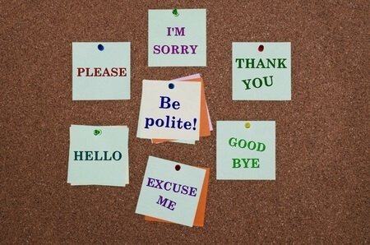
How to generate a courteous tone
Use key courtesy words such as please, sorry, excuse me, may I, and thank you among others
Know your audience.
A good rule of thumb is to treat your clients' time as if it is as valuable as your own.
Give feedback
Answer mail promptly
Use expressions that show respect for the others. Omit expressions that annoy, distress, or disparage.
Choose non-discriminatory expressions.
Use a courteous and sincere tone because it builds good will and increases the likelihood that your message will achieve its objective.
Avoid exaggeration, flattery or lecturing the reader.

Slide 12
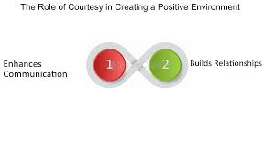
Courtesy cont’d
Benefits of courtesy
A courteous message strengthens relations.
It builds goodwill
It increases the likelihood that your message will achieve its objective
Dangers of failure to adhere to courtesy
(by the students)

Slide 13
3. Completeness
Message should convey all details required by the audience to react as desired.
The sender of the message must take into consideration the receiver’s mindset and convey the message accordingly
A complete communication has the following features: (How to achieve completeness)
Provide all information. ‘What’ questions must be answered for this purpose.(WHO? WHAT? WHEN? WHERE? and WHY? And H )
Answer all questions. (Direct or indirect)
Add something extra when required

Slide 14
Completeness Cont’d…
Examples
1. You are a customer, order for goods through a phone call.
2. Asking for direction, first time in office.
3. You are a Manager, invite staff for a meeting to discuss welfare issues.
4. Want to buy a laptop?
Benefits of completeness
Complete Messages are more likely to bring the desired response.
It builds Goodwill. In general “omissions cast suspicions” whether you are answering an inquiry about your product or recommending a former employee to a new job.
Complete messages are likely to avert costly lawsuits.
Motivate and persuade the receiver than a message that is vague or obscure.

Slide 15
4. Conciseness
Convey message in least possible words without forgoing the other C’s of communication
Stick to the point and keep your messages short and simple.
The message should be brief and condensed and should consist of relevant information.
A very important ingredient of effective communication is brevity.
NB
Conciseness is a prerequisite to effective business communication since all businessmen have busy schedules.
It means saying all that needs to be said and no more.

Slide 16
How to achieve
Go straight to the point
Use shorter names after you have mentioned the long one once e.g. Makerere University Business School (MUBS).
Omit information obvious to the reader. Etc.

Slide 17
Conciseness Cont’d…
Letter that is not concise
Dear SARAH,
I wanted to talk about the video editing ideas we sort of planned out the other day. Don’t you think it would make a lot of sense to also add additional elements to the videos? I mean, I think that would sort of improve the quality of the videos as well as have a stronger impact on the client’s message.
For instance, we could add a dissolve transition to each movie, which would then give it a seamless flow. This would then make the video cleaner and be more appealing in the minds of the people. The impact would just be a lot greater. This makes a lot more sense according to me.
What do you think?
Regards
Aaron

Slide 18
Conciseness Cont’d…
A Concise Letter.#
Dear SARA:
I wanted to discuss the video editing ideas we planned out yesterday. It would be better to add additional elements to the video in order to have a stronger impact on the client’s message.
A dissolve transition would give a seamless flow to each movie and make the videos cleaner and appealing in the minds of the target audience.
What do you think?
Regards
Aaron
Benefits of conciseness ???
Dangers of failure to adhere to conciseness ???

Slide 19
5. Concreteness
It means that a message is definite, specific, and vivid rather than general or vague.
Be particular and clear rather than fuzzy and general
Vividness of expressions is very much required while transmitting information to the others.
Abstractions or abstract statements can cloud the mind of the sender
NB:
It strengthens the confidence
Concrete messages are not misinterpreted
Misunderstanding of words creates problems for both parties (sender and receiver).

Slide 20
Concreteness Cont’d…
How to achieve concreteness
Use facts and figures instead of generic or irrelevant information
Whenever possible, use exact words and figures rather than general words, as general words may have meanings for the sender different from those of the receiver of the communication.
Strong verbs in the active voice help make sentences definite. Concrete rather than abstract nouns and well-chosen modifiers can make messages vivid and forceful.
Choose vivid image-building words.
Examples to indicate the need for concreteness
Marketing or advertising campaigns.

Slide 21
Concreteness Cont’d…
Benefits of concreteness
Your reader knows exactly what is required or desired.
The reader interprets the message in the way you intend.
Concrete messages help make everything certain and definite, so they promote the communication by sparing the sender further explanations and the receiver repeated questions about the same message etc.
Dangers of not adhering to clarity (Students)

Slide 22
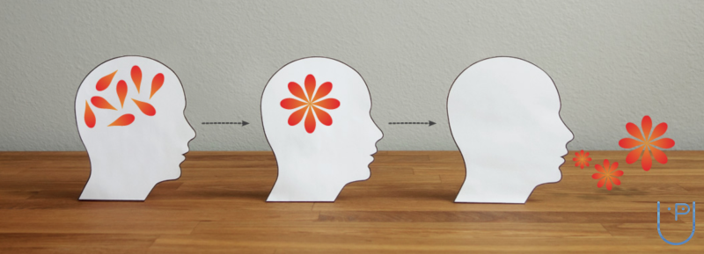
6. Clarity
The message should be easy to understand.
Getting the meaning from your head accurately to the reader is the purpose of clarity
Clarity in communication means to minimize the quantity of ideas in each sentence, use exact, suitable and simple words and construct effective sentences and paragraphs.
Effective communication depends on the choice of right words, simple and precise terminology to express ideas.
This choice is based on the recipient’s knowledge level and understanding of the issue at hand.

Slide 23
Clarity Cont’d…
The message must be so clear that even the dullest man in the world should readily understand it.
In oral messages
Speak slowly and clearly, neutralize accent; that is avoiding mother tongue influence.
It is important to find out the correct pronunciation of different words and work on accent neutralization.
In case of written messages
One must follow the rule, ‘one paragraph-one idea.’ This will ensure a natural and logical progression between the paragraphs.

Slide 24
Clarity Cont’d…
Important characteristics to consider are;
Length: Generally, short sentences are preferred.
Unity: unity means that you have one main idea and any other ideas in the sentence must be closely related to it.
Coherence: in a coherent sentence the words are correctly arranged so that the ideas clearly express the intended meaning.
Emphasis: the quality that gives force to important parts of sentences and paragraphs is emphasis.

Slide 25
Clarity Cont’d…
How to achieve clarity
You should always choose precise words rather longer statements.
Always choose familiar and easy to understand words.
Construct effective sentences and paragraphs.
Proper punctuation makes the writing clear.
Avoid usage of cliché
Use the right level of language
Do not use acronyms and jargons
Check the Accuracy of facts, figures and Words
Benefits of clarity(students)
Dangers of not adhering to clarity(students)

Slide 26
7. Correctness
The message should be free from any error
Correctness is the sum of all the principles of communication. The message sent has to be correct in all respects.
NB:
The understanding of your audience is directly proportional to the correctness of your ideas.
The intended message should be correct in various ways

Slide 27
How to ensure correctness
Ensure proper grammar, punctuation, spelling and paragraphing. Incorrect language spoils the message and distracts the reader.
In appearance and form of layout- Poor & untidy layout, uneven space, tone and style of expression create a poor impression.
the use of an appropriate level of language (formal, informal, substandard)
the employment of acceptable writing mechanics and usage practices
the accuracy of thoughts, figures, and words.
Benefits of correctness (students)
Dangers of not adhering to correctness (students)

Slide 28
Grammatical Structures
Grammar is the study of how words come together to form sentences. English words form various parts of a speech.
Parts of speech
Pronoun: A word used in place of a noun. e.g. them, they, him, her, she
Adverb: modifies a verb, an adjective or another adverb. Deals with the when, where, how or to what extent. e.g. now, there, fast, fully, very, too, often
Verb: A word that expresses action or state of being e.g. is, was, look, sit, read, should
Preposition: It shows the relationship between a noun or pronoun with another word in the sentence e.g. with, from, to, for, on. (I put the book on the table)

Slide 29
Cont’d…
Adjective: Modifies or describes a noun or pronoun. They answer the questions what number? What kind? And which one? e.g. a Dozen eggs, a tall boy, the first lecture, frequent interruptions
Noun: Names people, places, things, ideas (Jackie, classroom, marker, concentration. Used with a, an or the in front of the word.
Conjunctions: Joins words or groups of words. e.g. and, or, but
Interjections express strong emotions and are used mostly in oral communication. E.g. Wow! Oh! Alas! Ouch! Oops!
Articles and Determiners: Words that come at the beginning of a noun phrase. Examples of articles: a, an, the while examples of determiners include: these, that, those, enough, much, few, etc
NB: The different parts of speech are used in sentence construction. When used appropriately, communication is effective.

Slide 30
Exercise on Parts of a Speech
The young girl brought me a very long letter from the Teacher, and then she quickly disappeared. Oh my!
Questions
Identify the various parts of the speech
Determine the role each part of the speech plays in this sentence

Slide 31
Sentence Construction
A sentence is a group of words with meaning
To have meaning, it should contain a subject and predicate.
Subject is a word that does something, has something done to it or is identified or described while a predicate is a word that tells what the subject does, what is done to it or how it is identified or described.
Example: color blue favorite is my’ Vs ‘My favorite color is blue’

Slide 32
Sentence Construction
Types of sentences
1. Assertive or declarative sentence (a statement)
States, asserts, or declares a fact, opinion or idea.
Such sentences are simple statements.
Followed by a period (.).
Example: Jan is a student. She lives in a big city.
2. Imperative sentence (a command)
Gives a command or a request or expresses a wish.
Do not have a subject as you is the implied subject.
Usually followed by a period (.).
Very strong commands may be followed by an exclamation point (!).
Examples: Go to your room. Stop! (An order)

Slide 33
Sentence Construction
3. Interrogative sentence (a question)
Such sentences ask a question.
Followed by a question mark (?).
Examples: Have you ever seen a flying fish? Would you like another piece of pie?
4. Exclamatory sentence (an exclamation)
Expresses sudden and strong feeling, such as surprise, wonder, pity, sympathy, happiness, or gratitude.
Always ends with an exclamation point.
Examples: That sounds incredible! I can’t believe that you didn’t show up!

Slide 34
Sentence Errors to avoid
Avoid fragments of sentences. It should be complete. (The students all busy with their books Vs. The students were all busy with their books).
Avoid run on sentences. (Jayson is a fast worker he is not very accurate. Vs. Jayson is a fast worker but he is not very accurate).
It should be of a reasonable length. Avoid too long sentences especially if it can be broken into a number of them.
Example: I fell sick last week that is why I could not make it for the appointment and in any case I believe you could not make it too since it was raining cats and dogs hence not conducive weather to go out. Vs.
I fell sick last week that is why I could not make it for the appointment. In any case I believe you could not make it too, since it was raining cats and dogs hence not conducive weather to go out).

Slide 35
Other Areas to Pay Attention to:
Punctuation: Serves as a road map to guide the reader through the message pointing out: what is important (Italics); subordinate (commas); quoted or needs special attention (quotation marks); explained further or after salutation (colon)
It aids in comprehension since it impacts on the meaning of the sentence
Proper use of Pronouns (I Vs Me, They Vs Them
Contractions and Possessive Pronouns (You’re vs Your, It’s vs its
Tenses; Present, Past, Future
Capitalization
Use the right Level of Language Proper Use of Confusing Words (a vs an, accept vs except, anxious vs eager, saloon vs salon)
Punctuation

Slide 36
Formal Work Place Vocabulary
It is a personal initiative to build your vocabulary.
It is important to own/have an electronic dictionary and learn at least a word each day and ensure that you utilize it in your day to day communication.
However, for business purposes learn what vocabulary should be used in official circumstances.
Exercise
Demonstrate the following workplace scenarios using appropriate vocabulary. Randomly students will be picked to present during class using role plays
Formally greet
introduce yourself
welcome visitors
ask for help
show appreciation and others
Meeting someone you do not know etc

Slide 37
References
https://www.youtube.com/watch?v=7JZ1v-VwTXg
https://www.youtube.com/watch?v=-Xl94nEJWaw
Krishna, D. K. (2018). Decoding 7cs in effective communication. International Journal Of Communication, 28(1-2), 37-46.
https://youtu.be/MpiIsKakX1g?si=Gpo2tkec2Fd47ZDZ

Slide 38
Thank you for being a great audience
Address
Main building , first floor Room 1.0
Contacts
Facilitator:
Team Leader: +256-772-156-003
Email
hodcommunication@mubs.ac.ug/ jodiya@mubs.ac.ug
©2024 - FACULTY OF BUSINESS ADMINISTRATION, Department of Communication

