Slide 1
Corporate Entrepreneurship

Slide 2
The Nature of Corporate Entrepreneurship
Defining Corporate Entrepreneurship
Activities that receive organizational sanction and resource commitments for the purpose of innovative results.
A process whereby an individual or a group of individuals, in association with an existing organization, creates a new organization or instigates renewal or innovation within the organization.
A process that can facilitate firms’ efforts to innovate constantly and cope effectively with the competitive realities that companies encounter when competing in international markets.

Slide 3
The Corporate Entrepreneurship Process
Strategic Renewal
Innovation
Corporate Venturing
Corporate Entrepreneurship

Slide 4
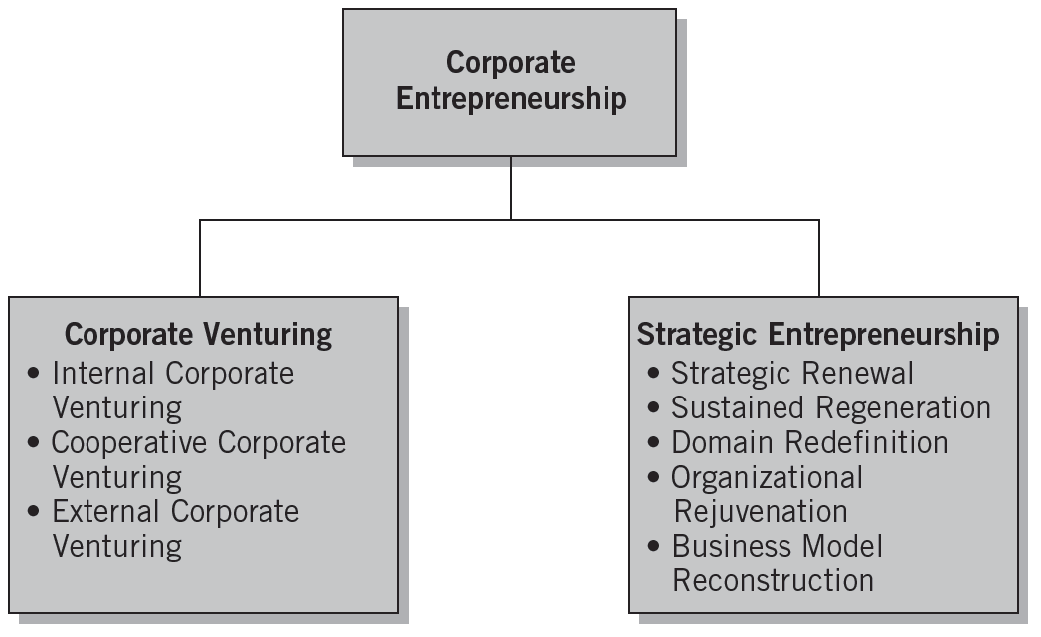
Dimensions of Corporate Entrepreneurship
Source: Michael H. Morris, Donald F. Kuratko, and Jeffrey G. Covin, Corporate Entrepreneurship & Innovation (Mason, OH, Thomson), 2008, p. 81.

Slide 5
Approaches to Corporate Entrepreneurship: FOCUSED
Focused Corporate Entrepreneurship
Administrative Corporate Entrepreneurship
Opportunistic Corporate Entrepreneurship
Acquisitive Corporate Entrepreneurship
Imitative Corporate Entrepreneurship
Incubative Corporate Entrepreneurship

Slide 6
Approaches to Corporate Entrepreneurship: DEEP
Organization-wide (Deep) Corporate Entrepreneurship
Entrepreneurship is a shared value expressed consciously and subconsciously .
Develops an entrepreneurial culture.
Entrepreneurial employees seek out opportunities to make their mark. Those who succeed move into bigger jobs where they explore opportunities on a larger scale.
Entrepreneurial contributions are rewarded with recognition and enhanced status
Failure is normal, and employees perceive low personal risk in trying.

Slide 7
The Need for Corporate Entrepreneurship
Rapid growth in the number of new and sophisticated competitors
Sense of distrust in the traditional methods of corporate management
An exodus of some of the best and brightest people from corporations to become small business entrepreneurs
International competition
Downsizing of major corporations
An overall desire to improve efficiency and productivity

Slide 8
Cultivating Corporate Entrepreneurship
Identify potential intrapreneurs, early
Sponsoring Intrapreneurial projects by Top management
Creating both diversity and order in strategic activities
Promoting intrapreneurship through experimentation
Developing collaboration

Slide 9
Rules for Corporate Entrepreneurship
Encourage action.
Use informal meetings whenever possible.
Tolerate failure and use it as a learning experience.
Persist in getting an idea to market.
Reward innovation for innovation’s sake.
Plan the physical layout of the enterprise to encourage informal communication.
Expect clever bootlegging of ideas—secretly working on new ideas on company time as well as personal time.
Put people on small teams for future-oriented projects.
Encourage personnel to circumvent rigid procedures and bureaucratic red tape.
Reward and promote innovative personnel.

Slide 10
Sources of and Solutions to Obstacles in Corporate Venturing
Traditional Management Practices | Adverse Effects | Recommended Actions
Enforce standard procedures to avoid mistakes | Innovative solutions blocked, funds misspent | Make ground rules specific to each situation
Manage resources for efficiency and ROI | Competitive lead lost, low market penetration | Focus effort on critical issues (e.g., market share)
Control against plan | Facts ignored that should replace assumptions | Change plan to reflect new learning
Plan for the long term | Nonviable goals locked in, high failure costs | Envision a goal, then set interim milestones, reassess after each
Manage functionally | Entrepreneur failure and/or venture failure | Support entrepreneur with managerial and multidiscipline skills
Avoid moves that risk the base business | Missed opportunities | Take small steps, build out from strengths
Protect the base business at all costs | Venturing dumped when base business is threatened | Make venturing mainstream, take affordable risks
Judge new steps from prior experience | Wrong decisions about competition and markets | Use learning strategies, test assumptions
Compensate uniformly | Low motivation and inefficient operations | Balance risk and reward, employ special compensation
Promote compatible individuals | Loss of innovators | Accommodate “boat rockers” and “doers”

Slide 11
Corporate Entrepreneurship Strategy
A vision-directed, organization-wide reliance on entrepreneurial behavior that purposefully and continuously renews the firm and shapes the scope of its operations through the recognition and exploitation of entrepreneurial opportunity.
It requires the creation of synergy between the entrepreneurial vision of the organization’s leaders and the entrepreneurial actions of every stakeholder.

Slide 12
Model of the Corporate Entrepreneurship Strategy Process
Corporate entrepreneurship strategy is manifested through the presence of three elements:
An entrepreneurial strategic vision
A pro-entrepreneurship organizational architecture
Entrepreneurial processes and behavior as exhibited across the organizational hierarchy.

Slide 13
Critical steps of a corporate entrepreneurial strategy:
Developing the vision
Encouraging innovation
Structuring for an Intrapreneurial climate
Developing individual managers for corporate entrepreneurship
Developing venture teams.

Slide 14
Developing and Supporting Radical and Incremental Innovation
Radical | Incremental
Stimulate through challenges and puzzles. | Set systematic goals and deadlines.
Remove budgetary and deadline constraints when possible. | Stimulate through competitive pressures.
Encourage technical education and exposure to customers. | Encourage technical education and exposure to customers.
Allow technical sharing and brainstorming sessions. | Hold weekly meetings that include key management and marketing staff.
Give personal attention—develop relationships of trust. | Delegate more responsibility.
Encourage praise from outside parties. | Set clear financial rewards for meeting goals and deadlines.
Have flexible funds for opportunities that arise.
Reward with freedom and capital for new projects and interests.
Source: Harry S. Dent, Jr., “Growth through New Product Development,” Small Business Reports (November 1990): 36.

Slide 15
Structuring for a Corporate Entrepreneurial Environment
Reestablishing the drive to innovate:
Invest heavily in entrepreneurial activities that allow new ideas to flourish in an innovative environment.
Provide nurturing and information-sharing activities.
Employee perception of an innovative environment is critical.
Corporate Venturing
Institutionalizing the process of embracing the goal of growth through development of innovative products, processes, and technologies with an emphasis on long-term prosperity.

Slide 16
Preparing for Failure
“Learning from Failure”
Recognizing the importance of managing the grief process that occurs from project failure.
Understanding how organizational routines and rituals are likely to influence the grief recovery.
Ensuring that the organization’s social support system can encourage greater learning, foster motivational outcomes, and increase coping self-efficacy in affected individuals.

Slide 17
Corporate Entrepreneurship Assessment Instrument
Key Internal Climate Factors in an Organization’s Readiness for Entrepreneurial Activity
Management support
Autonomy/work discretion
Rewards/reinforcement
Time availability
Internal organizational boundaries

Slide 18
Facilitating Corporate Entrepreneurial Behavior
Organizations foster entrepreneurial behavior by:
Encouraging—not mandating—innovative activity
Human resource policies for “selected rotation”
Committing to projects long enough for momentum to occur.
Bet on people, not on analysis.
Rewarding Entrepreneurship:
Allow inventor to take charge of the new venture
Grant discretionary time to work on future projects
Make resources available for future research ideas

Slide 19
Corporate Innovator’s 10 Commandments
Come to work each day willing to give up your job for the innovation.
Circumvent any bureaucratic orders aimed at stopping your innovation.
Ignore your job description, do any job needed to make your innovation work.
Build a spirited innovation team that has the zeal to make it happen.
Keep your innovation “underground” until it is ready for demonstration.
Find a key sponsor (upper level manager) who believes in your ideas.
Permission is rarely granted, it is always easier to seek forgiveness for the “ignorance”.
Always be realistic about the ways to achieve the innovation goals.
Share the glory of the accomplishments with everyone.
Convey the innovation’s vision through a strong venture plan.

Slide 20
Constraints for the Corporate Entrepreneur
Lack of:
Political Savvy: Learning to work the system
Time: Crisis Management
Rewards for Innovation: Beyond Tokenism
Good Financial Proposals: Projecting the Numbers
People Development Skills: Autocracy Rules
Legitimacy: Untested Concept and Untested Entrepreneur
“Seed” Capital: The Problem of Early Resources
Open Ownership: Protecting Turf
Sponsor: Someone to Watch over You
Energy and Shared Enthusiasm: the Inertia Problem
Personal Renewal: the Issue of Reinforced Denial
Urgency: Fear as Good and Bad
Appropriate Timing: The Resource-Shift Dilemma

Slide 21
Overcoming the Obstacles and Limitations
Build Social Capital
Gain Legitimacy
Political Tactics
Resource Acquisition
Co-optation
Focus on the Right Obstacles at the Right Time

Slide 22
Assessing Support for Innovation
Does the firm encourage entrepreneurial thinking?
Does the firm provide ways for innovators to stay with their ideas?
Are people permitted to do the job in their own way, or are they constantly stopping to explain their actions and ask for permission?
Has the firm evolved quick and informal ways to access the resources to try new ideas?
Has the firm developed ways to manage many small and experimental innovations?

Slide 23
Assessing Support for Innovation (cont’d)
Is the system set up to encourage risk taking and to tolerate mistakes?
Are people in your company more concerned with new ideas or with defending their turf?
How easy is it to form functionally complete, autonomous teams in the firm’s corporate environment?

