Slide 1
MAKERERE UNIVERSITY MAKERERE UNIVERSITY BUSINESS SCHOOL FACULTY OF COMPUTING AND INFORMATICS DEPARTMENT OF APPLIED COMPUTING AND IT
BACHELOR OF BUSINESS ADMINISTRATION YEAR ONE (BUC 1213)
SEMESTER: ONE, ACADEMIC YEAR: 2018/19.
INFORMATION COMMUNICATION TECHNOLOGY I *PR
Lecturers: Ms. Nakalema S, Mr. Olupot C, Ms. Nakawooya F, Ms. Nansamba C.

Slide 2
Outline
Introduction to ICT and Key Concepts
ICT business Trends
ICT Hardware Components
ICT Software Components
Systems theory
The Internet

Slide 3
ICT business Trends
Artificial Intelligence Foundations,
Intelligent Apps and Analytics
Intelligent Things
Digital Twins
Cloud to the Edge,
Conversational Platforms
Immersive Experience
Block Chain,
Event Driven
Continuous adaptive risk and Trust
Mobile Payments,
Mobile Apps,
Mobile Computing,
Cloud Computing,
Internet of Things
Big Data

Slide 4
Gartner Top 10 Strategic Technology Trends for 2018

Slide 5
Intelligent
Digital
Mesh

Slide 6
AI Foundation
The ability to use Artificial Intelligence (AI) to enhance decision making, reinvent business models and ecosystems, and remake the customer experience…

Slide 7
Intelligent Apps and Analytics
Augmented analytics is a particularly strategic growing area that uses machine learning for automating data preparation, insight discovery and insight sharing for a broad range of business users, operational workers and citizen data scientists. Eg. virtual customer assistants and enterprise advisors and assistants.

Slide 8
Intelligent Apps and Analytics con’t…
AI add business value in form of advanced analytics, intelligent processes and advanced user experiences

Slide 9
Intelligent Things
Intelligent things use AI and machine learning to interact in a more intelligent way with people and surroundings.
Examples include a self-directing vacuum or autonomous farming vehicle.
multiple devices will work together, either independently or with human input.

Slide 10
Intelligent
Digital
Mesh

Slide 11
Digital Twins
A digital twin is a digital representation of a real-world entity or system. In the context of IoT, digital twins are linked to real-world objects and offer information on the state of the counterparts, respond to changes, improve operations and add value.
In the short term, digital twins offer help with asset management, but will eventually offer value in operational efficiency and insights into how products are used and how they can be improved.

Slide 12
Digital Twins con’t…
For example, future models of humans could offer biometric and medical data, and digital twins for entire cities will allow for advanced simulations.

Slide 13
Cloud to the Edge
Edge computing describes a computing topology in which information processing and content collection and delivery are placed closer to the sources of this information.
Edge computing speaks to a computing topology that places content, computing and processing closer to the user/things or “edge” of the networking.

Slide 14
Conversational Platforms
Conversational platforms will drive a paradigm shift in which the burden of translating intent shifts from user to computer.
These systems are capable of simple answers (How’s the weather?) or more complicated interactions such as book a reservation at the Italian restaurant.

Slide 15
Conversational Platforms Cont…
These platforms will continue to evolve to even more complex actions, such as collecting oral testimony from crime witnesses and acting on that information by creating a sketch of the suspect’s face based on the testimony.

Slide 16
Immersive Experience
Augmented reality (AR), virtual reality (VR) and mixed reality are changing the way that people perceive and interact with the digital world. Combined with conversational platforms, a fundamental shift in the user experience to an invisible and immersive experience will emerge.

Slide 17
Immersive Experience con’t…
mixed reality is emerging as the immersive experience of choice, where the user interacts with digital and real-world objects while maintaining a presence in the physical world.
Mixed reality exists along a spectrum and includes head-mounted displays (HMD) for AR or VR, as well as smartphone- and tablet-based AR.

Slide 18
Intelligent
Digital
Mesh

Slide 19
Blockchain
Blockchain is a shared, distributed, decentralized and tokenized ledger that removes business friction by being independent of individual applications or participants. It allows untrusted parties to exchange commercial transactions.
blockchain has many potential applications in government, healthcare, content distribution, supply chain and more.

Slide 20
Event-Driven
Digital businesses rely on the ability to sense and be ready to exploit new digital business moments. Business events reflect the discovery of notable states or state changes, such as completion of a purchase order.

Slide 21
Continuous Adaptive Risk and Trust
Digital business creates a complex, evolving security environment. The use of increasingly sophisticated tools increases the threat potential.
Continuous adaptive risk and trust assessment (CARTA) allows for real-time, risk and trust-based decision making with adaptive responses to security-enable digital business.

Slide 22
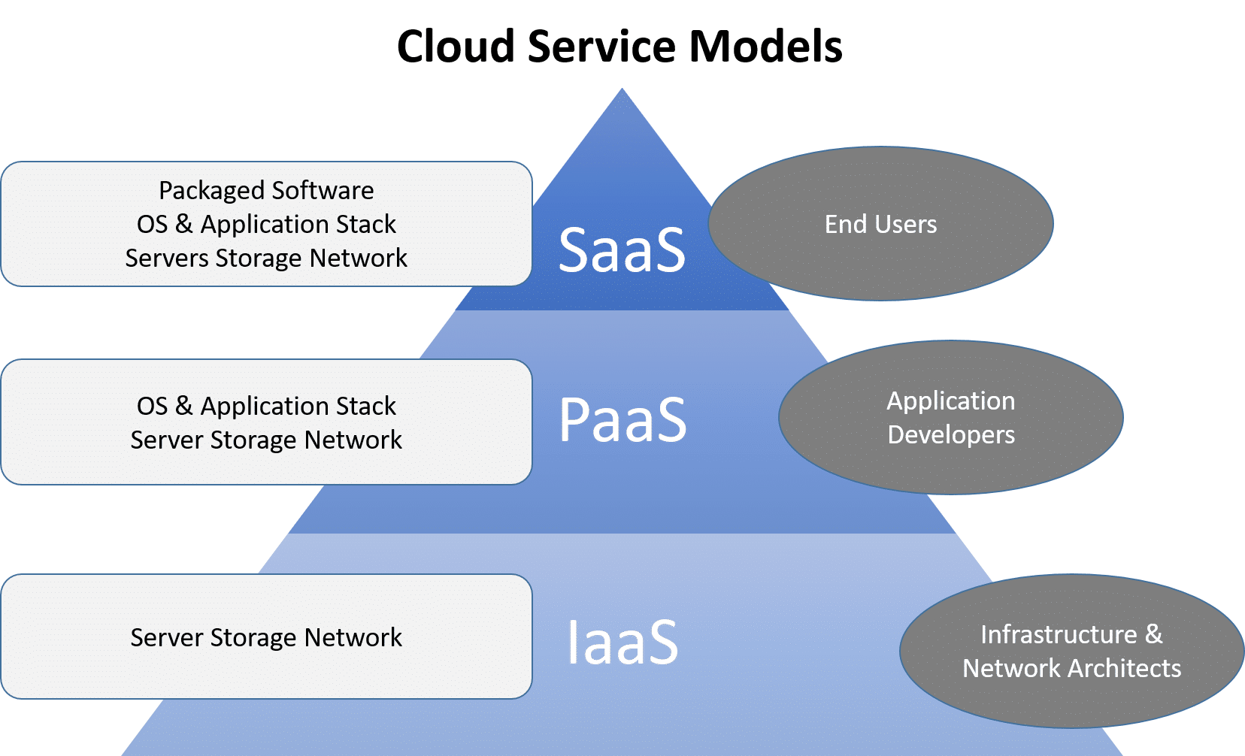
Cloud Computing
Cloud computing is internet-based computing in which large groups of remote servers are networked to allow the centralized data storage, and online access to computer services or resources.

Slide 23
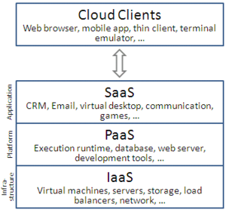
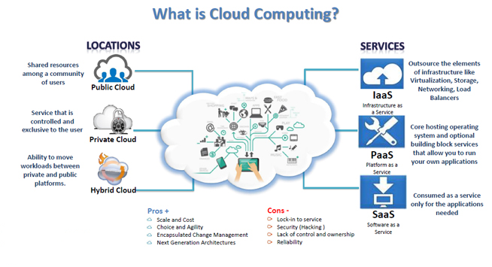
Cloud Computing

Slide 24
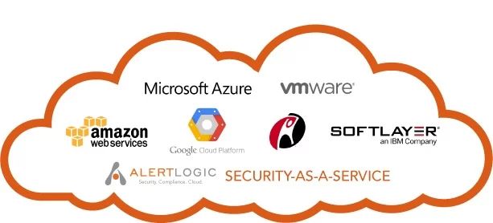
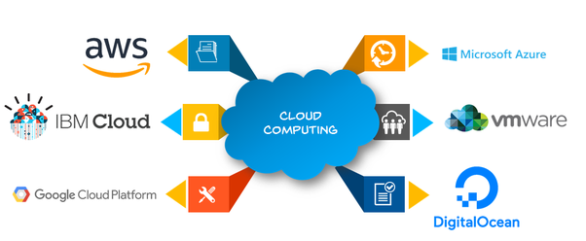

Slide 25
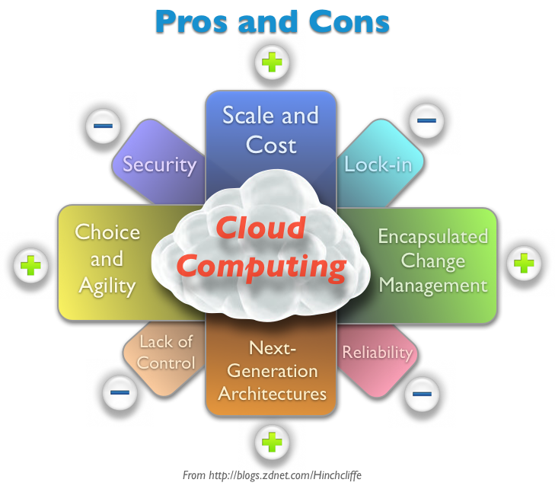

Slide 26
Software as a Service Applications (Saas)
Email
Amazon EC2 — Virtual IT.
Google App Engine — Application hosting.
Google Apps and Microsoft Office Online — SaaS.
Apple iCloud — Network storage.
DigitalOcean — Servers (Iaas/PaaS)
Dropbox,
Salesforce,
Cisco WebEx,
Concur,
GoToMeeting
Etc…

Slide 27
Platform as a Service (Paas)
AWS Elastic Beanstalk,
Windows Azure,
Heroku,
Force.com,
Google App Engine,
Apache Stratos,
OpenShift
etc

Slide 28
Factors to consider when choosing cloud computing
Pricing of Cloud Options
Shoot fit within the available budget
Storage space options
Should suite your storage requirements
Scalability of the selected service
Storage needs might change as your business grows and it would be ideal to initially choose a service that can support your business’s requirements as they change.
Physical location of the servers and Data Center
This factor plays a role in several legal issues facing businesses.
Security of data stored in the cloud
Frequency of backups

Slide 29
Mobile Computing
Mobile computing is human–computer interaction by which a computer is expected to be transported during normal usage. Mobile computing involves mobile communication, mobile hardware, and mobile software.

Slide 30
Common Mobile Computing devices
Laptop
Smartphones and tablets
Wearable computer
Carputer (a computer with specializations to run in a car)
Smart cards

Slide 31
Main Principle of Mobile Computing
Portability: Facilitates movement of device(s) within the mobile computing environment.
Connectivity: Ability to continuously stay connected with minimal amount of lag/downtime, without being affected by movements of the connected nodes
Social Interactivity: Maintaining the connectivity to collaborate with other users, at least within the same environment.
Individuality: Adapting the technology to suit individual needs

Slide 32
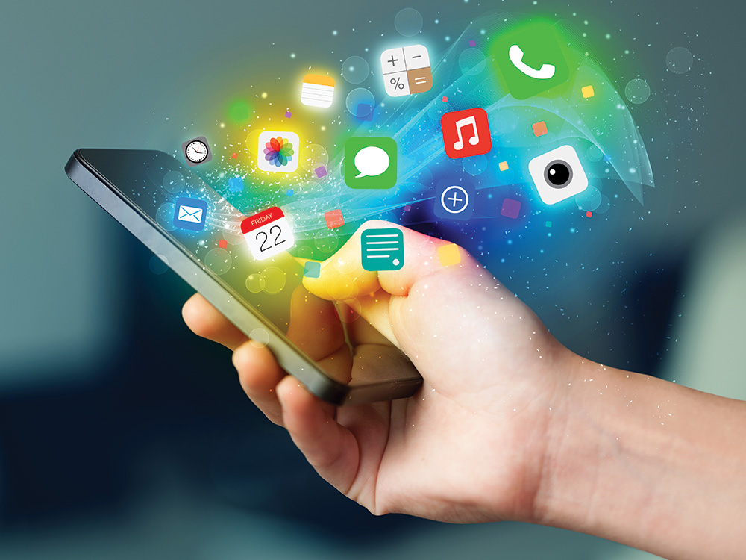
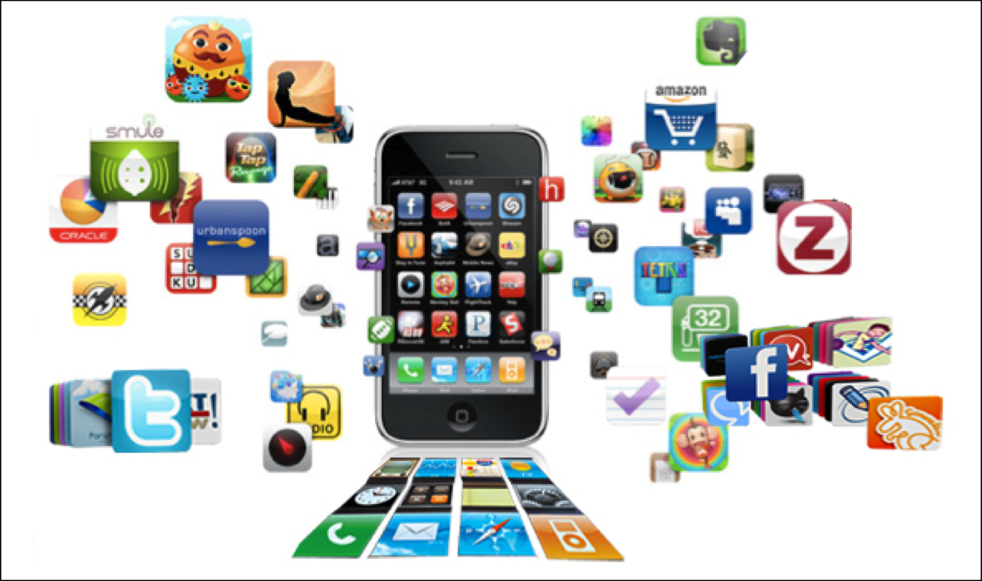
Mobile Applications (Apps)
Mobile applications (also known as mobile apps) are software programs developed for mobile devices such as smartphones and tablets. They turn mobile devices into miniature powerhouses of function and fun

Slide 33
Types of Apps
Native apps
iOS on Objective-C or Swift
Android on Java
Windows Phone on Net
Hybrid apps for all platforms
Web apps: These are software applications that behave in a fashion similar to native applications and they use a web browser

Slide 34
Categories of Apps
Business apps
Also referred to as productivity apps and used for Billing, buying, booking, sending emails, tracking working progress. Examples include;
Indeed Job Search (Android & IOS)
Facebook Pages Manager (Android & IOS)
Adobe Acrobat Reader (Android & IOS)
Students to name others????
Educational apps
TED (Android & IOS)
Quizlet: Flashcard & Language App to Study & Learn (Android & IOS)
Students to name others???

Slide 35
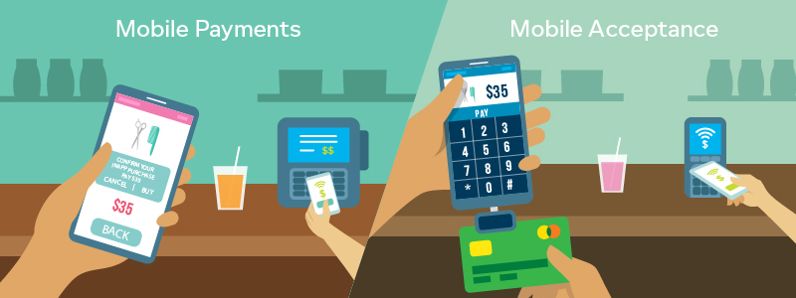
Mobile Payments
Mobile payment/mobile money/mobile money transfer/mobile wallet generally refers to payment services operated under financial regulation and performed from or via a mobile device.

Slide 36
Mobile Payment Models
Operator-Centric Model: The mobile operator acts independently to deploy mobile payment service. The operator could provide an independent mobile wallet from the user mobile account (airtime).
Bank-Centric Model: A bank deploys mobile payment applications or devices to customers and ensures merchants have the required point-of-sale (POS) acceptance capability. Mobile network operator are used as a simple carrier

Slide 37
Mobile Payment Models con’
Collaboration Model: This model involves collaboration among banks, mobile operators and a trusted third party.
Peer-to-Peer Model: The mobile payment service provider acts independently from financial institutions and mobile network operators to provide mobile payment.

Slide 38
Cloud Computing Limitations
Range and bandwidth: Mobile Internet access is generally slower than direct cable connections.
Security standards: Security is a major concern while concerning the mobile computing standards on the fleet.
Power consumption: mobile computers must rely entirely on battery power
Transmission interferences: Reception in tunnels, some buildings, and rural areas is often poor.
Potential health hazards:
Human interface with device: Screens and keyboards tend to be small, which may make them hard to use

Slide 39
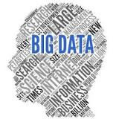
Big data
Big data refers to data sets that are too large and complex for traditional data processing and data management applications.
Big Data became more popular with the advent of mobile and IoT technology, with people producing more and more data (geolocation, social apps, fitness apps, etc…) and accessing digital data on their devices.
It refers to the gathering, analyzing, and using massive amounts of digital information to improve business operations

Slide 40
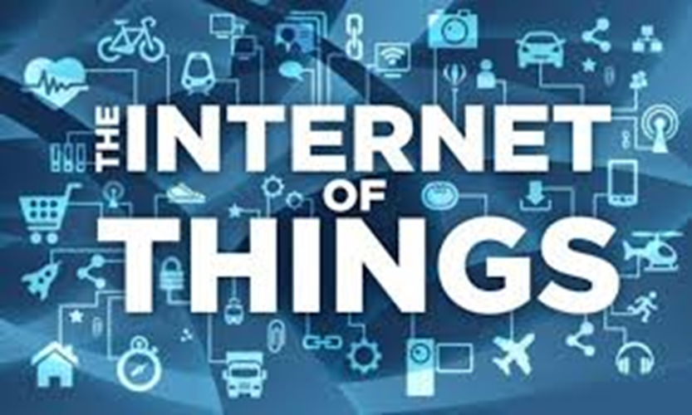
Internet of all things
The Internet of Things (IoT) is the network of physical objects or "things" embedded with electronics, software, sensors and connectivity to enable it to achieve greater value and service by exchanging data with the manufacturer, operator and/or other connected devices.

