Slide 1
Knowledge, Intelligence, Thinking & Creativity

Slide 2
Knowledge and intelligence
The information that gets absorbed in individual’s brain is called knowledge.
An individual’s ability to absorb information and use it to solve problems is called intelligence
Intelligence and knowledge have a critical role to play in individual’s creativity. HOW?
Creativity is dependent on an individual’s knowledge and how he or she combines his or her knowledge to create new perspectives.

Slide 3
Read the following paragraph
"Aoccdrnig to rscheearch at Maerekre Uinvervtisy, it deosn’t mttaer in waht oredr the litteers in a wrod are, the olny iprmoetnt tihng is taht the frist and lsat ltteer be at the rghit pclae. The rset can be a ttoal mses and you can sitll raed it wouthit a porbelm. Tihs is besauae ocne we laren how to raed we bgien to aargnre the lteerts in our mnid to see waht we epxcet to see. The huamn mnid deos not raed ervey lteter by istlef, but preecsievs the wrod as a wlohe. We do tihs ucnsoniuscoly wuithot tuhoght."

Slide 4
Read aloud the colours of the following words
Red | Green
Blue | Orange
Black | Blue
Yellow | Gray
Red | Pink

Slide 5
Explicit & Tacit Knowledge
Formal knowledge transmitted through education undergoes profound changes and becomes transformed to informal or tacit knowledge.
Through using metaphors and analogies, various personal hunches and insights may be explicated and further elaborated and new ideas and innovations created.

Slide 6
Knowledge Conversion

Slide 7
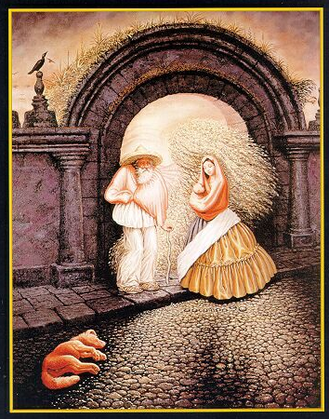
What do you see?

Slide 8
Expertise
A well-organized body of accessible and useful domain-specific knowledge.
Allows identification of promising solutions among an infinite number of other alternatives.
Creativity presupposes expertise:
conceptual spaces cannot be effectively explored without knowing one’s way around them!

Slide 9
Types of expertise
Routine expertise
Quick and accurate solving of familiar problems
Little capacity of dealing with new types of problems
Adaptive expertise
Effective solving of new problems
Generation of new procedures and practices from expert knowledge
Deep conceptual understanding

Slide 10
Crystallized & fluid competence
Crystallized competence - partially automated patterns of problem solving developed in practical experience.
Fluid competence - processes of deriving knowledge and skills needed for solving new problems from an expert’s knowledge base.
Need to balance Crystallized and fluid competence

Slide 11
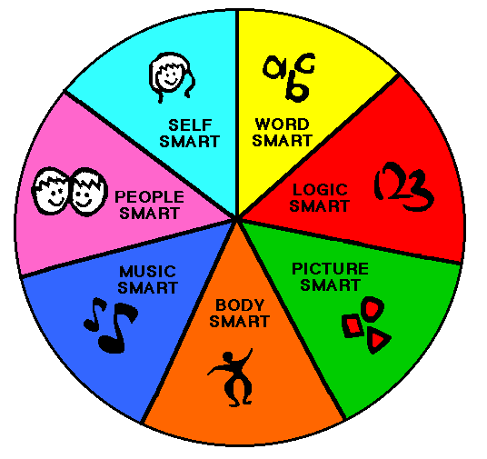
Multiple Intelligence
Howard Gardner
7 types of intelligences
linguistic
musical
logical-mathematics
spatial
bodily-kinesthetic
intrapersonal
interpersonal
Notes:
Linguistic intelligence - The ability to use language to excite, please, convince, stimulate or convey information.
Logical /mathematical intelligence. - The ability explore patterns categories and relationships by manipulating objects or symbols
Intra-personal intelligence. - ability to understand, express and control ones inner feeling and ideas
Inter-personal intelligence. - ability understand other people their goals, motivations, intensions and to communicate with them.
Body intelligence - ability to use the body in sports , performance arts and other physical tasks.
Spatial intelligence - The ability to perceive objects and direction.
Musical intelligence - The ability to perfume, compose or appreciate musical piece

Slide 12
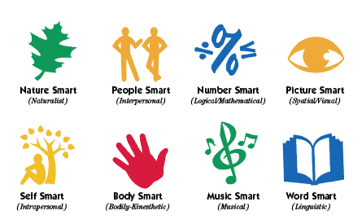
Notes:
Linguistic intelligence - The ability to use language to excite, please, convince, stimulate or convey information.
Logical /mathematical intelligence. - The ability explore patterns categories and relationships by manipulating objects or symbols
Intra-personal intelligence. - ability to understand, express and control ones inner feeling and ideas
Inter-personal intelligence. - ability understand other people their goals, motivations, intensions and to communicate with them.
Body intelligence - ability to use the body in sports , performance arts and other physical tasks.
Spatial intelligence - The ability to perceive objects and direction.
Musical intelligence - The ability to perfume, compose or appreciate musical piece

Slide 13
Thinking Styles
Creation of Ideas
Internal thinkers express themselves through writing & take longer to develop & express ideas
External thinkers express themselves through speech & are faster at developing & expressing ideas
Application of Ideas
Detailed thinkers focus on specific, existing situations. Start small & work towards conquering the greater whole
Visionary thinkers focus on broad, potential situations. Start big & work towards solving the more specific parts of a given problem

Slide 14
DIVERGENT AND CONVERGENT THINKING
Divergent
Thinking
Convergent
Thinking

Slide 15
Types of Problematic Thinking
Filtering: magnifying negatives while filtering out all positives
Polarized Thinking: no middle ground
Overgeneralization:
Mind Reading:
Catastrophizing: Always expecting disaster.
Personalization: Thinking that everything people do or say is some kind of reaction to you.
Control Fallacies: Feeling externally controlled, helpless, and a victim of fate.
Fallacy of Fairness: Assuming knowledge of what's fair but others won't agree with you.
Blaming Yourself or others for your pain. without regard to external causes.
Shoulds: a list of “rules” about how you and other people should act.
Emotional Reasoning: Believing that feelings must be true- automatically.
Fallacy of Change: Expecting others to change to suit you.
Global Labelling: Generalizing incidents into negative global judgment.
Obsession with Being Right: Always trying to prove that your opinions and actions are correct.
Heaven's Reward Fallacy: Expecting sacrifices & self-denials to pay off, and feeling bitter if they don't .

Slide 16
WHOLE BRAIN MODEL
Cerebral System
Analytical, mathematical, technical problem solving
Imaginative, synthesising, artistic, holistic, conceptual
Controlled,
conservative,
planned, organised, administrative
Interpersonal,
emotional,
musical,
spiritual
Limbic System

Slide 18
Thinking Styles
Too much emphasis is put on teaching students to think critically
Critical thinking is about how to understand claims, follow or create a logical argument, figure out the answer, eliminate the incorrect paths and focus on the correct one.
Creative thinking focuses on exploring ideas, generating possibilities, looking for many right answers rather than just one,.
Creative thinking is generally considered to be involved with the creation or generation of ideas, processes, experiences or objects; critical thinking is concerned with their evaluation.

Slide 19
Critical Thinking | Creative Thinking
Analyses existing ideas | Generates new ideas
Converges on probable solutions | Diverges to new possibilities
Vertical | Lateral
Probability is most emphasized | Possibilities are most emphasized
Judgment | Suspended judgment
Focused on the probable solutions | Diffuse – multiples possibilities
Objective – not influenced by an individual’s personal feelings | Subjective – depends on the individuals’ views or tastes.
Verbal – can be expressed in words | Visual – can only be visualised
Linear | Associative
Reasoning | Richness, novelty
Yes but | Yes and

Slide 20
CONDITIONS OF CREATIVE THINKING
Receptivity
Immersion
Seeing questions
Utilisation of errors
Detached devotion

Slide 21
Some Creative thinking Techniques
Brainstorming
The Questioning Technique
Assumption Smashing:
Attribute Analysis.
Morphological Analysis.
Manipulative Verbs.
Problem Reversal.
Forced Analogy.
Metaphorical thinking.
Trigger Concepts.

Slide 22
Thinking Strategies

Slide 23
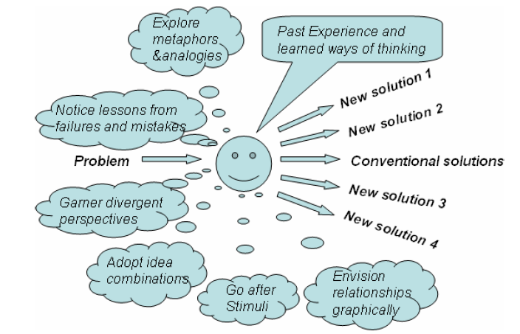

Slide 24
DIVERGENT AND CONVERGENT THINKING
Divergent
Thinking
Convergent
Thinking

Slide 25
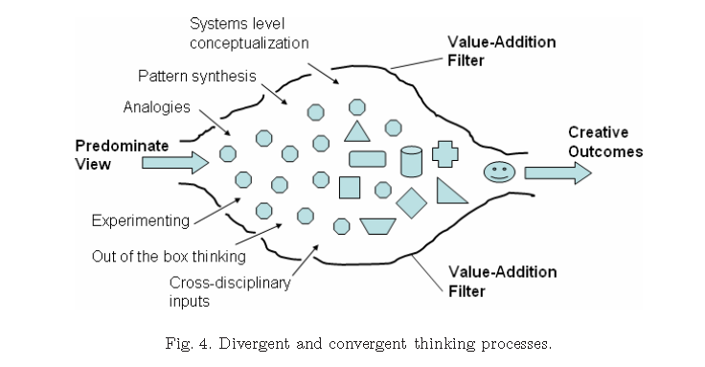

Slide 26
WALLA’S MODEL OF THE CREATIVE PROCESS
Preparation (A)
Incubation (D)
Illumination (C)
Verification (B)

