Slide 1
MAKERERE UNIVERSITY BUSINESS SCHOOL
FACULTY OF BUSINESS ADMINISTRATION
Business Communication Skills
FOR BACHELORS STUDENTS
©2024 - DEPARTMENT OF COMMUNICATION

Slide 2
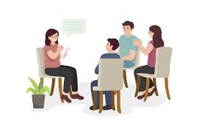
TOPIC FOUR:INTERPERSONAL COMMUNICATION

Slide 3
Topic Outline
Introduction to interpersonal communication.
Understanding different personalities: Hans Eysenck’s Theory
Relating with people with different personalities
Introduction to Emotional management.
Elements of emotional management
Developing emotional management skills.
Video

Slide 4
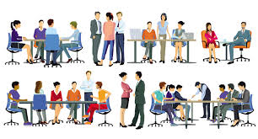
Introduction
Interpersonal communication involves the exchange of information, ideas, and emotions between two or more individuals. It encompasses both verbal and nonverbal communication and takes place in diverse contexts.
Interpersonal communication refers to how well one interacts with others effectively.
Components of Interpersonal Communication
There are two vital components of interpersonal communication.
These include;
Understanding different personalities
Emotional management

Slide 5
Topic Learning Outcomes
At the end of this course, learners shall be able to:
Define the concepts of interpersonal communication, personality traits and emotional management.
Relate with different personalities
Manage their emotions
Support others in managing their emotions

Slide 6
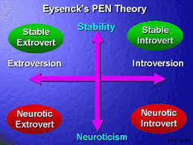
Understanding Personality
According to Han’s Theory of Personality.
He focused on three dimensions:
Extraversion-introversion
Neuroticism-emotional stability
Psychoticism
He believed that these dimensions could explain a wide range of personality traits and behaviors.

Slide 7
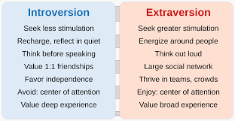
Introversion
Extraversion
Introversion is characterized by reserved and meditative behavior.
According to Eysenck’s theory introverts, have a higher level of cortical arousal than extraverts
Extraversion is a personality trait characterized by outgoing and sociable behaviour,
According to Eysenck’s theory, extraverts have a lower level of cortical arousal than introverts, which causes them to seek out stimulating environments and social interactions.

Slide 8
Extroverts
People who are extroverts get their energy from social interactions and frequently feel more alive when they are among other people.
They are often gregarious, chatty, and vivacious. Unlike introverts, who frequently experience energy depletion, social events tend to replenish introverts' reserves.
Extroverts often find it simple to establish new friends and acquaintances, and they frequently like group activities and public events.

Slide 9
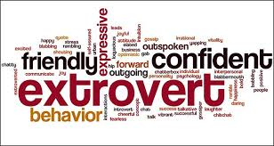
Characteristics of Extroverts
Enjoying social settings
Energized by being with others
Friendly to many people
They are outgoing
Enjoy group work
Prefer talking over writing
Not so thoughtful

Slide 10
How to Relate with Extroverts
Engage in Conversation
Participate in Social Activities
Show Enthusiasm
Communicate Clearly
Embrace Their Energy
Offer Support
Respect Their Need for Social Interaction
Be Patient and Open-Minded
Foster Mutual Interests

Slide 11
Introverts
Introverts are diverse and unique individuals, and while these traits can describe many introverts, everyone’s personality is a blend of various characteristics.
An introvert is someone whose personality is characterized by a preference for quiet, reflective environments and who often finds social interactions draining.
This term is commonly used in psychology and personality studies to describe individuals who typically recharge their energy through solitary activities rather than social engagement.

Slide 12
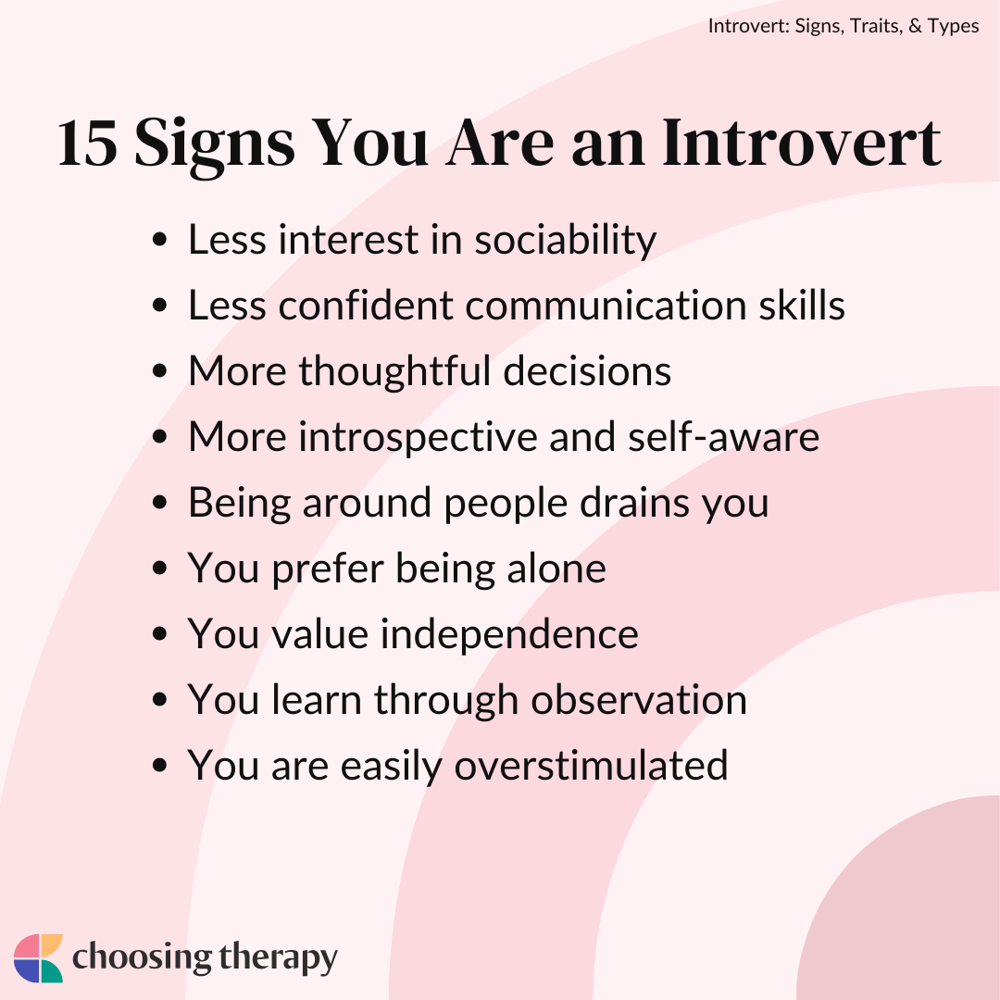
Introverts
These traits include:
Have a small group of close friends
Energized by being alone
Tends to keep emotions private
Quiet and reserved in large groups or around unfamiliar people
Feel drained by people, and need privacy
Learns well through observation
Process their thoughts in their head rather than talk them out

Slide 13
Building Meaningful Relationships with Introverts
Respect their space
Listen actively
Be patient
Value quality over quantity
Respect their preferences
Encourage without pressuring
Offer written communication
Be mindful of social overload
Build trust gradually

Slide 14
Neuroticism
According to Han’s theory, it refers to the tendency to experience negative emotions and emotional instability. Individuals high in neuroticism are more prone to experiencing feelings such as anxiety, mood swings, irritability, and sadness.
Their traits include:
Emotional Instability
Anxiety:
Self-Consciousness
Mood Swings
Sensitivity to Stress.
Emotional Reactivity

Slide 15
How to relate with Neurotic people
Practice patience and empathy
Provide reassurance
Communicate clearly and gently
Set realistic boundaries
Encourage professional help
Be mindful of triggers
Foster positive interactions
Be consistent and reliable
Encourage problem-solving skills

Slide 16
Psychoticism
Psychoticism is a personality trait characterized by aggression, impulsivity, and a lack of empathy. Is a trait characterized by a tendency towards unusual, unconventional, or extreme behavior and thinking. Individuals high in psychoticism may display traits such as aggressiveness, egocentricity, and a disregard for social norms and conventions.
Key Characteristics:
Impulsivity: People high in psychoticism may act impulsively and take risks without fully considering the consequences.
Aggression: There can be a higher propensity for aggression or hostility towards others.
Unconventional Thinking: This trait may include a tendency towards unconventional or eccentric ideas and behaviors.
Lack of Empathy: Individuals with high psychoticism might exhibit reduced empathy or emotional warmth.

Slide 17
Introduction to Emotional Management
Emotions are how individuals deal with matters or situations they find personally significant.
Emotional management is a set of skills that can help you react constructively to people or events.
Learning how to manage your emotions can benefit your career by helping you make rational choices and develop relationships with others.
Professionals who regulate their emotions might find it easier to act rationally in high-stress situations and make effective professional choices

Slide 18
Examples of Positive Emotions
Joy: A feeling of great pleasure and happiness, often experienced during moments of success or celebration.
Gratitude: A warm, appreciative feeling towards someone or something, often resulting from receiving help or kindness.
Love: Deep affection and care for someone or something, encompassing romantic, familial, or platonic relationships.
Pride: A sense of accomplishment and satisfaction from one’s own or others' achievements.
Contentment: A state of peaceful satisfaction and acceptance with one's current situation.
Excitement: A high level of enthusiasm and eagerness, often about upcoming events or new experiences.
Hope: A positive expectation or desire for a favorable outcome in the future.

Slide 19
Examples of Negative Emotions
Sadness: A feeling of sorrow or unhappiness, often arising from loss or disappointment.
Anger: A strong feeling of displeasure or frustration, often in response to perceived wrongdoing or injustice.
Fear: An emotional response to a perceived threat or danger, which can be real or imagined.
Guilt: A feeling of remorse or responsibility for something perceived as a wrongdoing or failure.
Shame: A painful feeling of being inadequate or unworthy, often resulting from a perceived failure or wrongdoing.
Jealousy: A complex emotion involving envy, insecurity, and fear of losing something valued to someone else.
Frustration: A feeling of irritation or annoyance caused by obstacles or difficulties that hinder one's goals or desires.

Slide 21
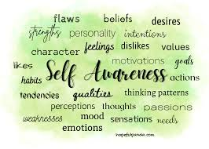
Elements of Emotional Management
Self-Awareness: This is a skill that allows you to predict how a situation or person might affect you by understanding your own emotional state. It can allow you to observe your emotional reactions to situations and learn how to improve your responses. For example, if you understand that being prepared allows you to feel calmer and more confident at work, then you can take steps to ensure that you're as prepared as possible for the workday.

Slide 22
Elements of Emotional Management cont.…
Self Regulation:
Emotional self-regulation is a skill that people learn and develop throughout childhood and adolescence and into adulthood. Feeling strong emotions is healthy. Learning how to process emotions and respond with appropriate behavior is essential to a person’s well-being.
Emotional self-regulation is the learned skill of applying conscious thought to events that prompt strong emotions. When people engage in it, it increases emotional responses, consider the consequences of different responses and thus choose responses that move toward a positive outcome.
Lacking emotional self-regulation can perpetuate negative emotions. It can also have social repercussions, such as damaging relationships with others.

Slide 23
Elements of Emotional Management
Empathy: Empathy is the ability to relate to how other people feel in a situation using your own experience. Using empathy in the workplace can help you build rewarding relationships with colleagues and prevent conflicts. For example, you can use empathy to recognize when a colleague needs help managing their workload and understand when they become frustrated by an obstacle or delay. Understanding their feelings can help you work with them to create a solution to the problem.

Slide 24
Elements of Emotional Management
Social Skills: This refer to the skills needed to handle and influence other people’s emotions effectively. This may sound like manipulation, but it can actually be as simple as understanding that smiling at people makes them smile back, and can therefore make them feel much more positive.
The social skills include: Persuasion and Influencing Skills, Communication Skills, Conflict Management Skills, Leadership Skills, Change Management Skills, Building Bonds (Rapport) and Team-Working Skills.
Only those who understand and regulate themselves and their emotions are able to work well and effectively with others.

Slide 26
How to Develop Emotional Management Skills
Find ways to express your emotions
Recognize what makes you feel good
Give yourself space
Explore mindfulness
Learn breathing techniques
Keep a journal for your moods
Listen to podcasts or read books about emotional management.
Consider speaking to a professional

Slide 27
Exercise
Reflect on a recent experience with a classmate or family member or any person superior to you that created negative emotions
Describe how you responded to that situation.
How does knowledge from this lecture help you respond more appropriately in a subsequent similar experience?
How can you better relate with a colleague who is an extravert, introvert, neurotic or psychotic?

Slide 29
Thank you for being a great audience
Address
Main building , first floor Room 1.0
Contacts
Facilitator:
Team Leader: +256-772-156-003
Email
hodcommunication@mubs.ac.ug/ jodiya@mubs.ac.ug
©2024 - FACULTY OF BUSINESS ADMINISTRATION, Department of Communication

