Slide 1
Introducing Accounting Information Systems
By Lovince Akurut
Makerere University Business School
Faculty of Commerce
Department of Accounting
0773758662/ lakurut@mubs.ac.ug

Slide 2
Content coverage
Basic concepts of Accounting Information Systems, business processes
Categorization of Accounting information system
Role & Purpose of Accounting Systems
Transaction Processing in the AIS
Management Concepts
Information System Concepts

Slide 3
Foundation Concepts of Accounting Information Systems
Accounting
Accounting has been defined as: the art of recording, classifying, and summarizing in a significant manner and in terms of money, transactions and events which are, in part at least, of financial character, and interpreting the results thereof.(AICPA)
It is a process of identifying, recording, summarizing, and reporting economic information to decision makers in the form of financial statements.
Accounting allows a company to analyze the financial performance of the business, and look at statistics such as net profit.
Introduction to Accounting Information Systems 1 BSA 1

Slide 4
Foundation Concepts of Accounting Information Systems
Information and Data
Data refers to streams of raw facts representing events occurring in organizations or the physical environment before they have been organized and arranged into a form that people can understand and use.
Therefore, data are facts that are collected, recorded, stored, and processed by an information system.
Organizations collect data about:
Events that occur
Resources that are affected by those events
Agents who participate in the events
Introduction to Accounting Information Systems

Slide 5
Foundation Concepts of Accounting Information Systems
Information and Data
Accounting Data: This comprise of numerical facts which only relate to those transactions and events that are financial and economic in character and nature.
This accounting data is disorganized and disjointed in its raw form. It is not capable of being understood and support financial decision making.
Sources of Accounting Data: Accounting data must be supported by documentary evidence, e.g. vouchers, receipts, invoices etc support the data.
Introduction to Accounting Information Systems

Slide 6
Foundation Concepts of Accounting Information Systems
Information and Data
Examples of Accounting Data: Raw accounting data may include but not limited to; vendor names, sales dates, amounts, hours worked, units processed or even planned, employee vacation days earned, and customer telephone numbers are all data that are entered into the accounting information system.
Accounting data are captured, processed, stored, and reported by the accounting system, and represent information used for decision making by managers.
Introduction to Accounting Information Systems

Slide 7
Foundation Concepts of Accounting Information Systems
Information and Data
Information is different from data. Information is data that have been organized and processed to provide meaning to a user. Hence information is refined data.
Usually, more information and better information translates into better decisions. For example Financial Statements (Balance Sheets, Income Statements etc).
Benefits of information may include:
Reduction of uncertainty
Improved decisions
Improved ability to plan and schedule activities.
Introduction to Accounting Information Systems

Slide 8
Foundation Concepts of Accounting Information Systems
Information and Data
Accounting Information is;
Is properly arranged, classified and organized.
Is in the finished form and is the output of accounting.
Is understood and used by the users of accounting information for taking their decisions.
Information is based upon and derived from data.
Forms of Accounting Information Accounting information is presented mostly in the form of financial statements like;
Income statement, Position statement, Statement of changes in equity and Cash flow statement
Introduction to Accounting Information Systems

Slide 9
Foundation Concepts of Accounting Information Systems
System:
A System is an entity consisting of interacting parts or components that are attempt to achieve one or more goals. A system must have organization, interrelationships, integration, and central objectives.
System has three basic interacting components or Functions, i.e. Input, processing and output.
Sub-system: A sub-system is the interrelated parts that have come together, or integrated, as a single system. Most systems are composed of smaller subsystems a part of a system.
Introduction to Accounting Information Systems

Slide 10
Foundation Concepts of Accounting Information Systems
System:
Role of the Systems Theory to AIS: The systems concept encourages integration (i.e., minimizing the duplication of recording, storing, reporting, and processing).
The Accounting System is a series of steps performed to analyze, record, quantify, accumulate, summarize, classify, report, and interpret economic events and their effects on an organization and to prepare the financial statements.
The accounting system involves; Methods, Procedures, and Standards followed in accumulating, classifying, recording, and reporting business events and transactions.
Introduction to Accounting Information Systems

Slide 11
Graphical Representation of an Accounting System
Business Transactions
Trial Balance
Financial Statements
Journal Entries
General Ledger
Inputted Data
Balance Sheets
Income Statements
Cash flow Statements
Financial & Accounting Processing
Introduction to Accounting Information Systems

Slide 12
Foundation Concepts of Accounting Information Systems
Information System (IS)
An Information system consists of an integrated set of computer-based and manual components established to collect, process, transform, manage and distribute output information to users for planning, decision making, and control.
Broad Classifications of IS: They are broadly categorized into; manual and computer-based information systems as seen below;
Manual Information Systems: These are systems where written data is input, processed, output and stored on paper and there is no usage of computer technologies and systems in these systems.
Introduction to Accounting Information Systems

Slide 13
Foundation Concepts of Accounting Information Systems
Information System (IS)
Broad Classifications of IS:
Manual Information Systems: Tasks are completed manually through practiced routines and there is limited reliance on information stored in, and retrieved from, either fixed computerized databases.
Computer-based information system: includes any organized combination of people, hardware, software, communications network and data resources to perform the activities of input, processing, output and control activities that collect transform data resources into information products in an organization or disseminate information in an organization.
Introduction to Accounting Information Systems

Slide 14
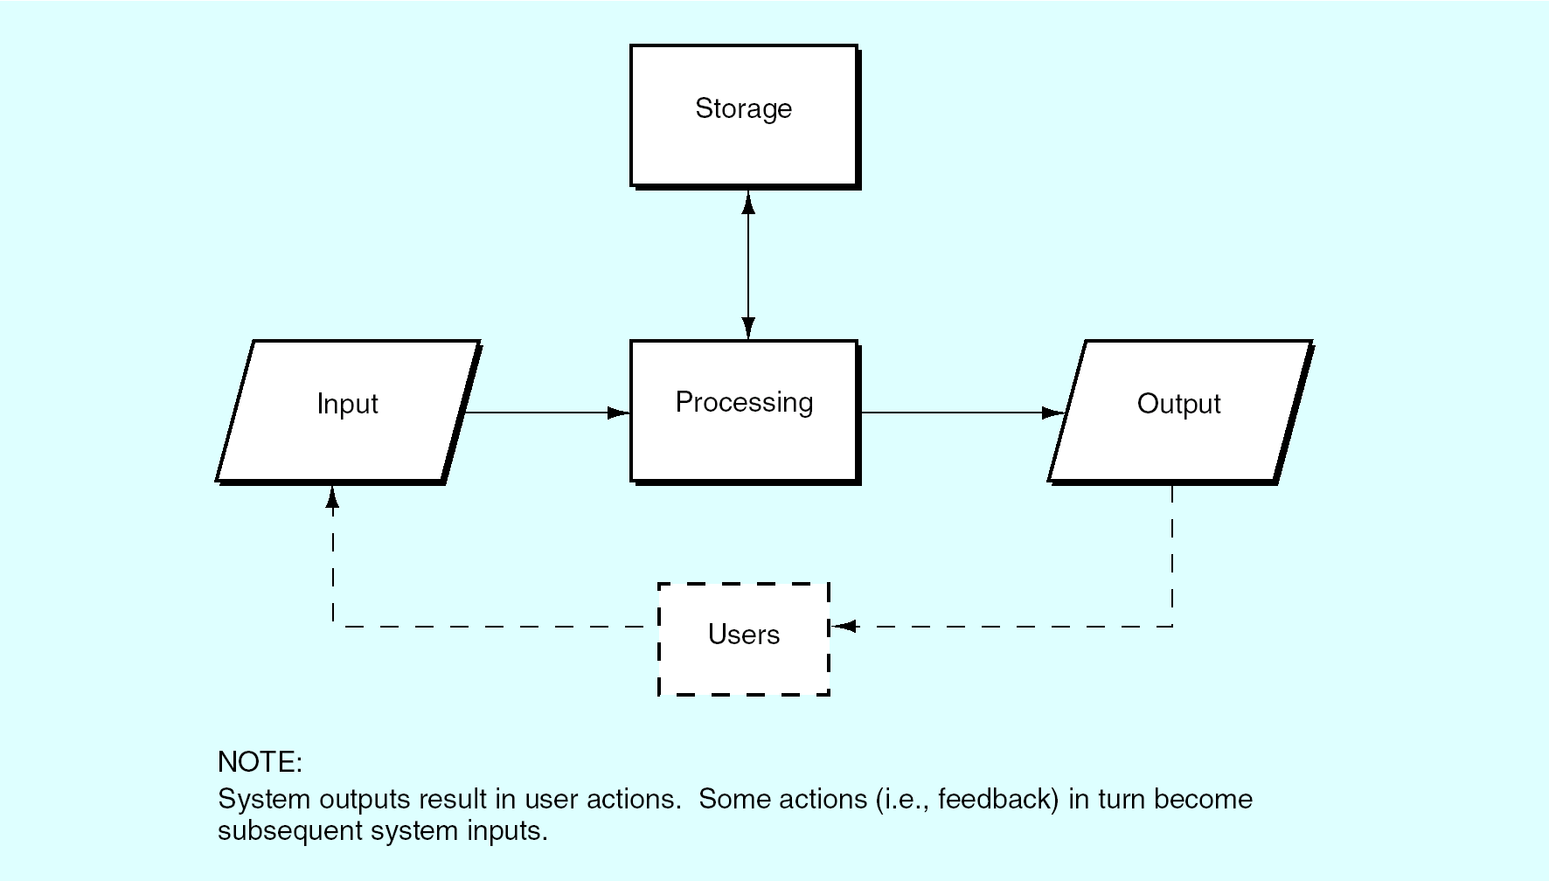
Foundation Concepts of Accounting Information Systems
Functional Model of an Information System (IS)
Introduction to Accounting Information Systems

Slide 15
Foundation Concepts of Accounting Information Systems
Information Technology Vs. Information System
Information Technology (IT): A combination of computer technology (hardware and software) with telecommunications technology (data, image, and voice networks) used to process data.
Information System (IS): Combinations of hardware, software, and telecom networks that people build and use to collect, create, and distribute useful data in organizations (for decision making)
Introduction to Accounting Information Systems

Slide 16
Defining An Accounting Information System (AIS)
AIS: At The Intersection Of Accounting And IS: Accounting information systems exists at the intersection of two important disciplines:
(1) accounting and
(2) information systems.
Accounting
financial accounting,
managerial accounting, and taxation
Information Systems
collect, process, store, transform, and distribute
Accounting
Information
Systems
Introduction to Accounting Information Systems

Slide 17
Defining An Accounting Information System (AIS)
The figure above suggests that;
Accounting information systems (AISs) stand at the crossroads of two disciplines: ‘‘accounting’’ and ‘‘information systems.’’ Thus, the study of AISs is often viewed as the study of computerized accounting systems. But because we cannot define an AIS by its size; it is better to define it by what it does. This latter approach leads us to the following definition:
An accounting information system is a collection of data and processing procedures that creates needed information for its users.
Introduction to Accounting Information Systems

Slide 18
What Is An Accounting Information System?
Definition of an (AIS): Is a specialized subsystem of the IS within an organization that accumulates financial/ economic information from the entity’s various subsystems and communicates it to the organization’s information processing subsystem.
Accounting information system is a collection of interrelated manual or computer parts & equipment plus people, records, and methods that collect and process accounting and economic data from transactions and events, organize them in useful forms, and communicate results to decision makers.
Introduction to Accounting Information Systems

Slide 19
Nature Of An Accounting Information System
Therefore from the above definition, it can be concluded that AIS;
Uses advanced technology; or be a simple paper-and-pencil system/ manual system; or be something in between, i.e. both. Technology is simply a tool to create, maintain, or improve a system.
Uses a set of interrelated and interdependent components called modules which include accounts payable (AP), accounts receivable (AR), general ledger (GL), etc.
It is an enterprise-wide information system, focused on business processes.
Introduction to Accounting Information Systems

Slide 20
Nature Of An Accounting Information System
Therefore from the above definition, it can be concluded that AIS;
Is a specialized subsystem of the information system or management information system.
The primary goal of an AIS is to aid in operations, management and decision making of financial events to achieve organizational goals.
Keeps track of the results of each of the various business activities (financing, investing, and operating).
AIS don’t just support accounting and finance business processes. They often create information that is useful to non-Accountants.
Introduction to Accounting Information Systems

Slide 21
Core Objective Of An Accounting Information System
The Ultimate/ Major Goal of An Accounting Information System
Whether manual or computer-based, the purpose of AIS is to gather and accumulate data to be processed in order to; provide internal reporting to managers for use in planning and controlling current and future operations for non-routine decision making; and lastly external reporting to outside parties such as to stockholders, creditors, and government agencies.
Introduction to Accounting Information Systems

Slide 22
Specific Objectives Of An Accounting Information System
The Specific Objectives of an AIS: Whether manual or computer-based system are to;
Record valid transactions,
Properly classify transactions,
Record the transactions at their proper values,
Record the transactions in the proper accounting period, and
Properly present the transactions and related information in the financial statements. (actual preparation of the financial statements may be manual)
Introduction to Accounting Information Systems

Slide 23
The Three Core Functions Performed By An AIS
The efficient and effective processing of data about a company’s transactions:
Capture transaction data on source documents.
Record transaction data in journals, which present a chronological record of what occurred.
Post data from journals to ledgers, which sort data by account type.
To provide management with information useful for decision making:
This information is provided in the form of reports that fall into two main categories: i.e. Financial statements and Managerial reports.
Introduction to Accounting Information Systems

Slide 24
The Three Core Functions Performed By An AIS
To provide adequate internal controls:
Ensure that the information produced by the system is reliable.
Ensure that business activities are performed efficiently and in accordance with management objectives.
Safeguard organizational assets.
Introduction to Accounting Information Systems

Slide 25
Basic Subsystem in the AIS
The expenditure cycle: involves activities of buying and paying for goods or services used by the organization.
The production cycle: involves activities converting raw materials and labor into finished goods.
The human resources/payroll cycle: involves activities of hiring and paying employees.
The revenue cycle: involves activities of selling goods or services and collecting payment for those sales.
The financing cycle: involves activities of obtaining necessary funds to run the organization, repay creditors, and distribute profits to investors.
Introduction to Accounting Information Systems

Slide 26
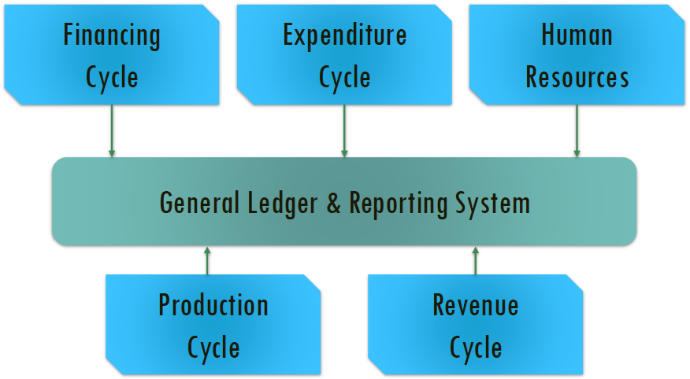
Basic Subsystem in the AIS
Introduction to Accounting Information Systems

Slide 27
2 Broad Categories Of Accounting Information Systems
According to Carl S. Warren, James M. Reeve and Jonathan E. Duchac in the book “Accounting,” accounting information systems can either be;
Manual or Computerized
Manual Accounting Information Systems: Before using computer-based accounting information systems, all the accounting data was and is still done manually, where the accountant posts/ records business transactions to the general ledger and worksheet by hand, i.e. all the data and information is processed and managed by paper and pencil technology.
Sometimes, this process is called non-computerized system.
These are systems which do not use any computer devices.
All data would be kept in other ways, mainly paper
Introduction to Accounting Information Systems

Slide 28
2 Broad Categories Of Accounting Information Systems
Computer-based Accounting Information Systems; Although an AIS can be a manual system, today most accounting information systems are computer-based.
Defined - A computer-based accounting information system refers set of components which include; hardware, software, databases, telecommunications, people, procedures and internal controls configured to collect, store and transform accounting data into accounting information that is made available to those who legitimately (Accountants, management, employees, gov’t, etc) need access to it, all while keeping data intact and secure. used by managers to make decisions.
Introduction to Accounting Information Systems

Slide 29
Computerized Accounting Information Systems
Basic Requirements For Computerized AIS
Every computerized accounting system has two basic requirements which include;
Accounting Framework: It consists a set of principles, coding and grouping structure of accounting. An accounting information systems that combines traditional accounting practices such as the Generally Accepted Accounting Principles (GAAP) with modern information technology resources
Operating Procedure: It is a well-defined operating procedure blended suitably with the operating environment of the organization.
Introduction to Accounting Information Systems

Slide 30
Components Of Computerized Accounting Information Systems
Components/ Parts/ Elements of a C-AIS: Every computerized accounting system has six basic components which include;
(a) People: The people in an AIS are simply the system users. Professionals who may need to use an organization's AIS include accountants, consultants, business analysts, managers, chief financial officers and auditors.
For example, consultants might use the information in an AIS to analyze the effectiveness of the company's pricing structure by looking at cost data, sales data and revenue. Also, auditors can use the data to assess a company's internal controls, financial condition and compliance.
The AIS should be designed to meet the needs of the people who will be using it. The system should also be easy to use and should improve, not hinder, efficiency.
Introduction to Accounting Information Systems

Slide 31
Components Of Computerized Accounting Information Systems
(b) Procedure and Instructions: The procedure and instructions of an AIS are the methods it uses for collecting, storing, retrieving and processing data.
These methods will be both manual and automated,
Procedures and instructions will be coded into AIS software; they should also be "coded" into employees through documentation and training.
Procedures and instructions must be followed consistently to be effective.
(c) Data: The data contained in an AIS is all the financial information pertinent to the organization's business practices. Any business data that impacts the company's finances should go into an AIS.
Introduction to Accounting Information Systems

Slide 32
Components Of Computerized Accounting Information Systems
(c) Data: The data included in an AIS will depend on the nature of the business, but it may consist of the following: sales orders, customer billing statements, sales analysis reports, purchase requisitions, vendor invoices, check registers, general ledger, inventory data, payroll information, timekeeping and tax information.
This data can then be used to prepare accounting statements and reports such as accounts receivable aging, depreciation/amortization schedules, trial balance, profit and loss, and so on.
Having all this data in one place - in the AIS - facilitates a business's recordkeeping, reporting, analysis, auditing and decision-making activities. For the data to be useful, it must be complete, correct and relevant.
Introduction to Accounting Information Systems

Slide 33
Components Of Computerized Accounting Information Systems
(d) Software: The software component of an AIS is the computer programs used to store, retrieve, process and analyze the company's financial data.
Before there were computers, AISs were manual, paper-based systems, but today, most companies are using computer software as the basis of the AIS.
Small businesses might use Intuit's Quickbooks, Sage Peachtree Accounting, or Microsoft's Small Business Accounting but there are many others.
Small to mid-sized businesses might use SAP's Business One.
Mid-sized and large businesses might use Microsoft's Dynamics GP, Sage Group's MAS 90 or MAS 200, Oracle's Peoplesoft etc.
Introduction to Accounting Information Systems

Slide 34
Components Of Computerized Accounting Information Systems
(e) Information Technology Infrastructure: Information technology infrastructure is just a fancy name for the hardware used to operate the accounting information system.
Most of these hardware items are things a business would need to have anyway. they include personal computers, servers, printers, surge protectors, routers, storage media, and possibly a backup power supply.
Perhaps most importantly, the hardware selected for an AIS must be compatible with the intended software.
A good AIS should also include a plan for maintaining, servicing, replacing and upgrading components of the hardware system, as well as a plan for the disposal of broken and outdated hardware so that sensitive data is completely destroyed.
Introduction to Accounting Information Systems

Slide 35
Components Of Computerized Accounting Information Systems
(f) Internal Controls: The internal controls of an AIS are the security measures it contains to protect sensitive data.
These can be as simple as passwords or as complex as biometric identification. An AIS must have internal controls to protect against unauthorized computer access and to limit access to authorized users which includes some users inside the company.
It must also prevent unauthorized file access by individuals who are allowed to access only select parts of the system.
All of the data in an AIS should be encrypted, and access to the system should be logged and surveilled.
An AIS also needs internal controls that protect it from computer viruses, hackers and other internal and external threats to network security. Furthermore, it must be protected from natural disasters and power surges that can cause data loss.
Introduction to Accounting Information Systems

Slide 36
Functional Operations Of Computerized AIS
The Functions of an AIS are to:
Inputs: Collect and store data about events, resources, and agents.
Processes: Transforms/ processes transaction data into information and delivers it to internal decision makers (managers) and external decision makers (investors and creditors) to make decisions about events, resources, and agents.
Outputs: Delivers processed information to internal decision makers (managers) and external decision makers (investors and creditors).
Introduction to Accounting Information Systems

Slide 37
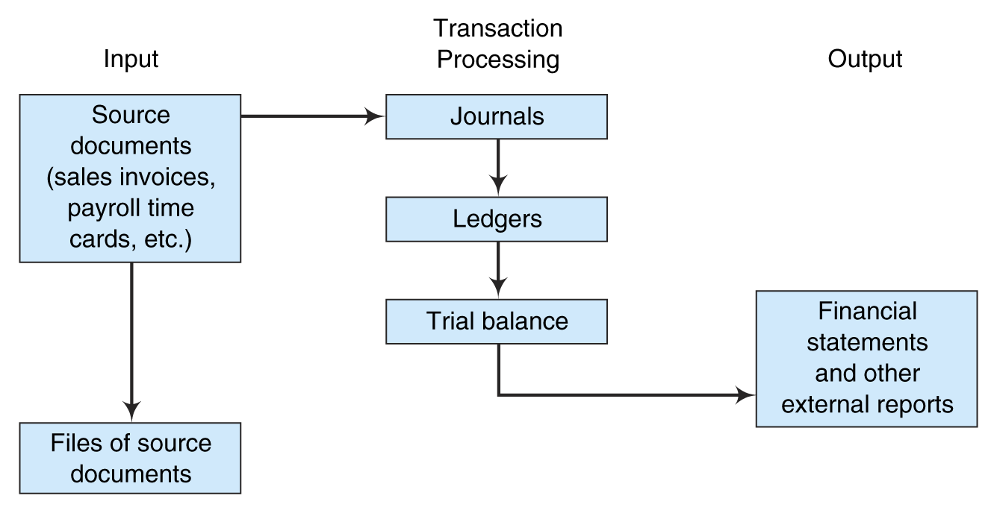
Functional Operations Of Computerized AIS
Introduction to Accounting Information Systems

Slide 38
Questions

