Slide 1
ACC 7212: Business Intelligence and Data Analytics
TOPIC 2
Introduction to Data Mining
ACC 7212

Slide 2
Module outline
Concepts and fundamentals of data mining and business intelligence
Data mining process: cross Industry standard processing (CRISP) for data mining
Data preparation and graphical exploration:
Visualizing large data sets, data cleaning, outlier detection, variable transformation
Prediction and classification methods for business Intelligence: decision trees, logistic regression and neural network models
Mining relationships among records: cluster analysis, association analysis (‘market basket analysis’)
Forecasting time series for business intelligence
Model evaluation and predictive performance

Slide 3
Overview of terms
Data: a set of facts (items) D, usually stored in a database
Pattern: an expression E in a language L, that describes a subset of facts
Attribute: a field in an item i in D.
Interestingness: a function I_{D,L} that maps an expression E in L into a measure space M
The Data Mining Task:
For a given dataset D, language of facts L, interestingness function I_{D,L} and threshold c, find the expression E such that I_{D,L}(E) > c efficiently.

Slide 4
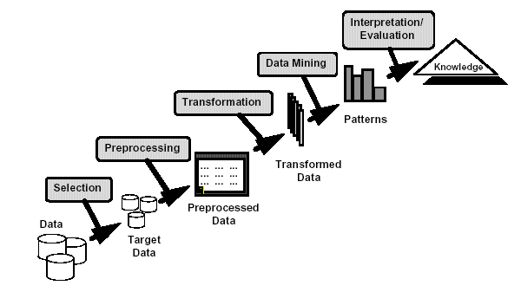
Knowledge Discovery

Slide 5
Data Mining Overview
Data warehouses and OLAP (On Line Analytical Processing.)
Association Rules Mining
Clustering: Hierarchical and Partition approaches
Classification: Decision Trees and Bayesian classifiers
Sequential Pattern Mining
Advanced topics: graph mining, privacy preserving data mining, outlier detection, spatial data mining

Slide 6
What is Data Mining?
Data Mining is:
The efficient discovery of previously unknown, valid, potentially useful, understandable patterns in large datasets
The analysis of (often large) observational data sets to find unsuspected relationships and to summarize the data in novel ways that are both understandable and useful to the data owner
Examples of Large Datasets
Credit card companies
Stock exchange
Call centers

Slide 7
Data Mining and Business Intelligence
Increasing potential
to support
business decisions
Making
Decisions
End User
Data Presentation
Business
Analyst
Visualization Techniques
Data Mining
Data
Analyst
Information Discovery
Data Exploration
Statistical Analysis, Querying and Reporting
Data Warehouses / Data Marts
OLAP, MDA
DBA
Data Sources
Paper, Files, Information Providers, Database Systems, OLTP

Slide 8
Data Mining: Confluence of Multiple Disciplines
Database
Technology
Statistics
Machine
Learning
Data Mining
Visualization
Information
Science
Other Disciplines
(Domain knowledge)

Slide 9
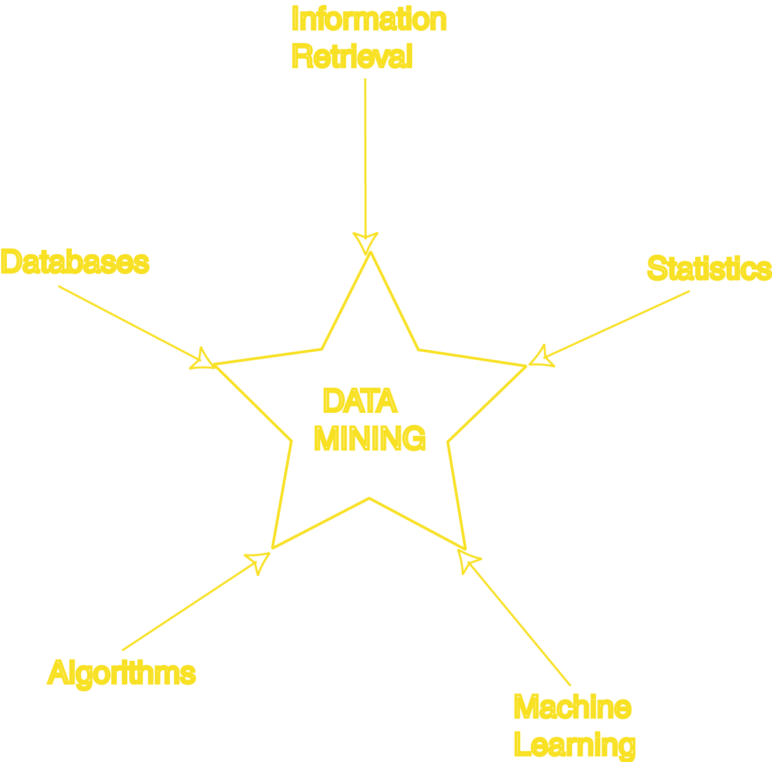
Data Mining Development
Similarity Measures
Hierarchical Clustering
IR Systems
Imprecise Queries
Textual Data
Web Search Engines
Relational Data Model
SQL
Association Rule Algorithms
Data Warehousing
Scalability Techniques
Bayes Theorem
Regression Analysis
EM Algorithm
K-Means Clustering
Time Series Analysis
Algorithm Design Techniques
Algorithm Analysis
Data Structures
Neural Networks
Decision Tree Algorithms

Slide 10
Examples of Data Mining Applications
Fraud detection:
credit cards, phone cards
Marketing:
customer targeting
Astronomy:
Dark Matter Mapping, Solar Activity Prediction:
Molecular biology:
Drug Discovery, Disease Biomarker Discovery, Pathway Analysis

Slide 11
How Data Mining is used
Identify the problem
Use data mining techniques to transform the data into information
Act on the information
Measure the results

Slide 12
The Data Mining Process
Understand the domain
Create a dataset:
Select the interesting attributes
Data cleaning and preprocessing
Choose the data mining task and the specific algorithm
Interpret the results, and possibly return to 2

Slide 13
Origins of Data Mining
Draws ideas from machine learning/AI, pattern recognition, statistics, and database systems
Must address:
Enormity of data
High dimensionality of data
Heterogeneous, distributed nature of data
AI /
Machine Learning
Statistics
Data Mining
Database systems

Slide 14
Data Mining Tasks
Classification:
Learning a function that maps an item into one of a set of predefined classes
Regression:
Learning a function that maps an item to a real value
Clustering:
Identify a set of groups of similar items
Dependencies and associations:
Identify significant dependencies between data attributes
Summarization:
Find a compact description of the dataset or a subset of the dataset

Slide 15
Data Mining Methods
Decision Tree Classifiers:
Used for modeling, classification
Association Rules:
Used to find associations between sets of attributes
Sequential patterns:
Used to find temporal associations in time series
Hierarchical clustering:
used to group customers, web users, etc

Slide 16
Classification:- Definition
Given a collection of records (training set )
Each record contains a set of attributes, one of the attributes is the class.
Find a model for class attribute as a function of the values of other attributes.
Goal: previously unseen records should be assigned a class as accurately as possible.
A test set is used to determine the accuracy of the model. Usually, the given data set is divided into training and test sets, with training set used to build the model and test set used to validate it.

Slide 17
Classification
Find ways to separate data items into pre-defined groups
We know X and Y belong together, find other things in same group
Requires “training data”: Data items where group is known
Uses:
Profiling
Technologies:
Generate decision trees (results are human understandable)
Neural Nets
“Route documents to most likely interested parties”
English or non-english?
Domestic or Foreign?

Slide 18
Classification:- Example
categorical
categorical
continuous
class
Test
Set
Learn
Classifier
Training
Set
Model

Slide 19
Example of a Decision Tree
categorical
categorical
continuous
class
Splitting Attributes
HO
Yes
No
NO
MarSt
Single, Divorced
Married
TaxInc
NO
< 80K
> 80K
NO
YES
Training Data
Model: Decision Tree

Slide 20
Another Example of Decision Tree
categorical
categorical
continuous
class
MarSt
Single, Divorced
Married
NO
HO
Yes
No
NO
TaxInc
< 80K
> 80K
NO
YES
There could be more than one tree that fits the same data!

Slide 21
Classification:- Application 1
Direct Marketing
Goal: Reduce cost of mailing by targeting a set of consumers likely to buy a new cell-phone product.
Approach:
Use the data for a similar product introduced before.
We know which customers decided to buy and which decided otherwise. This {buy, don’t buy} decision forms the class attribute.
Collect various demographic, lifestyle, and company-interaction related information about all such customers.
Type of business, where they stay, how much they earn, etc.
Use this information as input attributes to learn a classifier model.

Slide 22
Classification:- Application 2
Fraud Detection
Goal: Predict fraudulent cases in credit card transactions.
Approach:
Use credit card transactions and the information on its account-holder as attributes.
When does a customer buy, what does he buy, how often he pays on time, etc
Label past transactions as fraud or fair transactions. This forms the class attribute.
Learn a model for the class of the transactions.
Use this model to detect fraud by observing credit card transactions on an account.

Slide 23
Clustering:- Definition
Partitions data set into clusters, and models it by one representative from each cluster
Given a set of data points, each having a set of attributes, and a similarity measure among them, find clusters such that
Data points in one cluster are more similar to one another.
Data points in separate clusters are less similar to one another.
Similarity Measures:
Euclidean Distance if attributes are continuous.
Other Problem-specific Measures.

Slide 24
Clustering …
Find groups of similar data items
Statistical techniques require some definition of “distance” (e.g. between travel profiles) while conceptual techniques use background concepts and logical descriptions
Uses:
Demographic analysis
Technologies:
Self-Organizing Maps
Probability Densities
Conceptual Clustering
“Group people with similar travel profiles”
George, Patricia
Jeff, Evelyn, Chris
Rob

Slide 25
Clustering:- Illustration
Euclidean Distance Based Clustering in 3-D space.
Intra-cluster distances
are minimized
Inter-cluster distances
are maximized

Slide 26
Clustering:- Application 1
Market Segmentation:
Goal:
Subdivide a market into distinct subsets of customers where any subset may conceivably be selected as a market target to be reached with a distinct marketing mix.
Approach:
Collect different attributes of customers based on their geographical and lifestyle related information.
Find clusters of similar customers.
Measure the clustering quality by observing buying patterns of customers in same cluster vs. those from different clusters.

Slide 27
Clustering:- Application 2
Document Clustering:
Goal:
To find groups of documents that are similar to each other based on the important terms appearing in them.
Approach:
To identify frequently occurring terms in each document. Form a similarity measure based on the frequencies of different terms. Use it to cluster.
Gain:
Information Retrieval can utilize the clusters to relate a new document or search term to clustered documents.

Slide 28
Illustrating Document Clustering
Clustering Points: 3204 Articles of Los Angeles Times.
Similarity Measure: How many words are common in these documents (after some word filtering).

Slide 29
Association Rule Discovery: Definition
Given a set of records each of which contain some number of items from a given collection;
Produce dependency rules which will predict occurrence of an item based on occurrences of other items.
Rules Discovered:
{Milk} --> {Coke}
{Diaper, Milk} --> {Beer}

Slide 30
Association Rules …
Identify dependencies in the data:
X makes Y likely
Indicate significance of each dependency
Bayesian methods
Uses:
Targeted marketing
Technologies:
AIS, SETM, Hugin, TETRAD II
Find groups of items commonly purchased together
People who purchase fish are extraordinarily likely to purchase wine.
People who purchase Turkey are extraordinarily likely to purchase cranberries.

Slide 31
Association Rule Discovery:- Application 1
Marketing and Sales Promotion:
Let the rule discovered be
{Bagels, … } --> {Potato Chips}
Potato Chips as consequent => Can be used to determine what should be done to boost its sales.
Bagels in the antecedent => Can be used to see which products would be affected if the store discontinues selling bagels.
Bagels in antecedent and Potato chips in consequent => Can be used to see what products should be sold with Bagels to promote sale of Potato chips!

Slide 32
Sequential Associations
Find event sequences that are unusually likely
Requires “training” event list, known “interesting” events
Must be robust in the face of additional “noise” events
Uses:
Failure analysis and prediction
Technologies:
Dynamic programming (Dynamic time warping)
“Custom” algorithms
“Find common sequences of warnings/faults within 10 minute periods”
Warn 2 on Switch C preceded by Fault 21 on Switch B
Fault 17 on any switch preceded by Warn 2 on any switch

Slide 33
Deviation Detection
Find unexpected values, outliers
Uses:
Failure analysis
Anomaly discovery for analysis
Technologies:
clustering/classification methods
Statistical techniques
visualization
“Find unusual occurrences in IBM stock prices”

Slide 34
Types of Data Mining Output
Data dependency analysis - identifying potentially interesting dependencies or relationships among data items
Classification - grouping records into meaningful subclasses or clusters
Deviation detection - discovery of significant differences between an observation and some reference – potentially correct the data
Anomalous instances, Outliers
Classes with average values significantly different than parent or sibling class
Changes in value from one time period to another
Discrepancies between observed and expected values
Concept description - developing an abstract description of members of a population
Characteristic descriptions - patterns in the data that best describe or summarize a class
Discriminating descriptions - describe how classes differ

Slide 35
Major Issues in Data Mining
Mining methodology and user interaction
Mining different kinds of knowledge in databases
Interactive mining of knowledge at multiple levels of abstraction
Incorporation of background knowledge
Data mining query languages and ad-hoc data mining
Expression and visualization of data mining results
Handling noise and incomplete data
Pattern evaluation: the interestingness problem
Performance and scalability
Efficiency and scalability of data mining algorithms
Parallel, distributed and incremental mining methods

Slide 36
Major Issues in Data Mining …
Issues relating to the diversity of data types
Handling relational and complex types of data
Mining information from heterogeneous databases and global information systems (WWW)
Issues related to applications and social impacts
Application of discovered knowledge
Domain-specific data mining tools
Intelligent query answering
Process control and decision making
Integration of the discovered knowledge with existing knowledge: A knowledge fusion problem
Protection of data security, integrity, and privacy

Slide 37
Data Mining Issues
Human Interaction
Overfitting
Outliers
Interpretation
Visualization
Large Datasets
High Dimensionality
Multimedia Data
Missing Data
Irrelevant Data
Noisy Data
Changing Data
Integration
Application

Slide 38
Data Mining Functionalities
Concept description: Characterization and discrimination
Generalize, summarize, and contrast data characteristics, e.g., dry vs. wet regions
Association (correlation and causality)
Diaper à Beer [0.5%, 75%]
Classification and Prediction
Construct models (functions) that describe and distinguish classes or concepts for future prediction
E.g., classify countries based on climate, or classify cars based on gas mileage
Presentation: decision-tree, classification rule, neural network
Predict some unknown or missing numerical values

Slide 39
Data Mining Functionalities …
Cluster analysis
Class label is unknown: Group data to form new classes, e.g., cluster houses to find distribution patterns
Maximizing intra-class similarity & minimizing interclass similarity
Outlier analysis
Outlier: a data object that does not comply with the general behavior of the data
Noise or exception? No! useful in fraud detection, rare events analysis
Trend and evolution analysis
Trend and deviation: regression analysis
Sequential pattern mining, periodicity analysis
Similarity-based analysis
Other pattern-directed or statistical analyses

Slide 40
Social Implications of DM
Privacy
Profiling
Unauthorized use

Slide 41
Data Mining Metrics
Usefulness
Return on Investment (ROI)
Accuracy
Space/Time

Slide 42
Thank you

Slide 43
Thank you

