Slide 1
STRATEGIC MANAGEMENT: AN INTRODUCTION
By
Dr Godfrey Tumwesigye, PhD

Slide 2
Outline
What is Strategic Management?
Key concepts in strategic management: vision, mission, values, goals, objectives
Steps in the strategic management process
Advantages, Rationale of strategic management
Limitations of strategic management

Slide 3
Important quotes
"Without a strategy, an organization is like a ship without a rudder, going around in circles. It’s like a tramp; it has no place to go.“ —Joel Ross and Michael Kami
"If we know where we are and something about how we got there, we might see where we are trending—and if the outcomes which lie naturally in our course are unacceptable, to make timely change.“ —Abraham Lincoln
"The formulation of strategy can develop competitive advantage only to the extent that the process can give
meaning to workers in the trenches.“ —David Hurst

Slide 4
Definitions: Strategic Management
Strategic management is a process, an approach to addressing the competitive challenges an organization faces.
Strategic management is a branch of management that is concerned with the development of strategic vision, setting out objectives, formulating and implementing strategies and introducing corrective measures for the deviations (if any) to reach the organization’s strategic intent.

Slide 5
Definitions: Strategic management
SM refers to a set of managerial decisions and actions that determine the long term and short term performance of an organisation
Strategic Management can also be defined as the determination of the basic long term goals and objectives of an organization, and adoption of courses of action and allocation of resources necessary to carry out these goals.

Slide 6
Definitions: Strategic management
Strategic management involves the formulation and implementation of the major goals and initiatives of a company's top management on behalf of owners, based on consideration of the internal and external environments in which the organization competes.

Slide 7
Definitions: Strategic management
Strategic management is the art and science of formulating, implementing, and evaluating cross-functional decisions that enable an organization to achieve its objectives. (Fred David).
SM focuses on integrating management, marketing, finance/accounting, production/operations, research and development, and information systems to achieve organizational success.
The purpose of strategic management is to exploit and create new and different opportunities for the organisations future.

Slide 8
Definitions: Strategic management
SM involves various departments and levels across the organization.
It is an ongoing process that includes implementation, evaluation and control issues.
SM is that set of managerial decisions and actions that determines the long run performance of a company.

Slide 9
IMPORTANT TO REMEMBER
Strategic management involves deciding what is important for the long-range success of your business and focusing on it.
Strategic management asks, "How should I position my business to meet management and business goals?"
A business strategy is a series of business decisions that lead to achieving a business goal.
Strategic management involves the "big picture" of your business.
Strategic management involves planning, analyzing and implementing a business strategy.
Strategic management is most effective if you can step back far enough and say "all things are possible."
The essence of strategic management is matching business resources to market opportunities

Slide 10
Definitions: Strategic planning
Strategic planning is a subset of business management that involves the organisation setting long term and short term goals.
Strategic planning decides the way the organization should lead along with its objectives.
Strategic management plans the process to follow to achieve the defined objective and implements and evaluates that process.

Slide 11
Strategic management Vs Strategic planning

Slide 12
Strategic management Vs Strategic planning
Strategic management is wider that strategic planning.
Strategic Planning involves:
Goal setting,
Environment analyis and
Strategy formulation and selection
Strategic Implementation process involves:
Strategy implementation
Strategic evaluation and control
Strategic Management involves both strategic planning and strategic implementation process

Slide 13
Definition: competitive advantage
Competitive advantage is a condition or circumstance that puts a company in a favourable or superior position compared to its competitors.
Among the various managerial functions, nothing affects the success of an organisation than how effective the management charts a the direction, develops effective strategies and implements the chosen strategy.

Slide 14
Definitions: strategic decision-making
Strategic decision-making is a process of understanding the interaction of decisions and their impact upon the organization to gain competitive advantage.
Wrong decisions taken, may result in disastrous consequences. Thus, the power of strategic thinking lies in combining the power of the right decision with the right time

Slide 15
History of Strategic Management
Initially the term strategic planning was used.
The term strategic planning originated in the 1950s and was very popular between the mid-1960s and the mid-1970s.
During those years, strategic planning was widely believed to be the solution for all problems. American companies were “obsessed” with strategic planning.
Later strategic planning was cast aside during the 1980s as various planning models did not yield higher returns.

Slide 16
History of Strategic Management
Porter (1987): Although strategic planning had gone out of fashion in the late 1970s, it needed to be re-discovered. It would have to be “re-thought” and “recast”
Competitive strategy (1980)Competitive advantage (1985)
Formation of the Strategic Management Society (1981)
Launch of the Strategic Management Journal (1982)
By the 1990s, there was the revival of strategic planning, and the process is widely practiced today in the business world.

Slide 17
History of Strategic Management
Drucker (1954): What is our business and what should it be?
Chandler (1962): What is strategy? Structure follows strategy
Andrews (1965) – corporate strategy
Ansoff (1965) – corporate strategy
Boston consulting group (1965) – Henderson B.

Slide 18
Key Questions in SM
Where is the organization now?
If no changes are made, where will the organization be in 1, 2, 5 or 10 years?
What specific actions should management undertake?
What are the risks and payoffs?

Slide 19
Summary: History of SM
1950s - 1960s: Emergence of strategic management as an academic and professional field
1970s: Disenchantment with strategic management
1980s: Maturity of strategic management
1990s: SM becomes an integral part of business operations

Slide 20
Stages in SM Process
Goal-setting ( strategic Direction
Environmental analysis
internal environment
External environment
SWOT analysis
Strategy formation,
Strategy implementation, and
Strategy monitoring, Evaluation and control

Slide 21
THE STRATEGIC MANAGEMENT CYCLE
Strategic Intent
Environmental analysis
Strategy formulation
Strategy implementation
Evaluation and Control
Vision
Mission
Goals/Obj.
Core values
Internal Analysis
External Analysis
SWOT Analysis
SWOT Analysis
Corporate strategy
Business level strategy
Functional level strategy
Project skills
Plans and procedure
Org. structure
Leadership, human behaviour, conflict mgt
Continuous assessment.
Objective feedback and learning
Taking corrective action

Slide 22
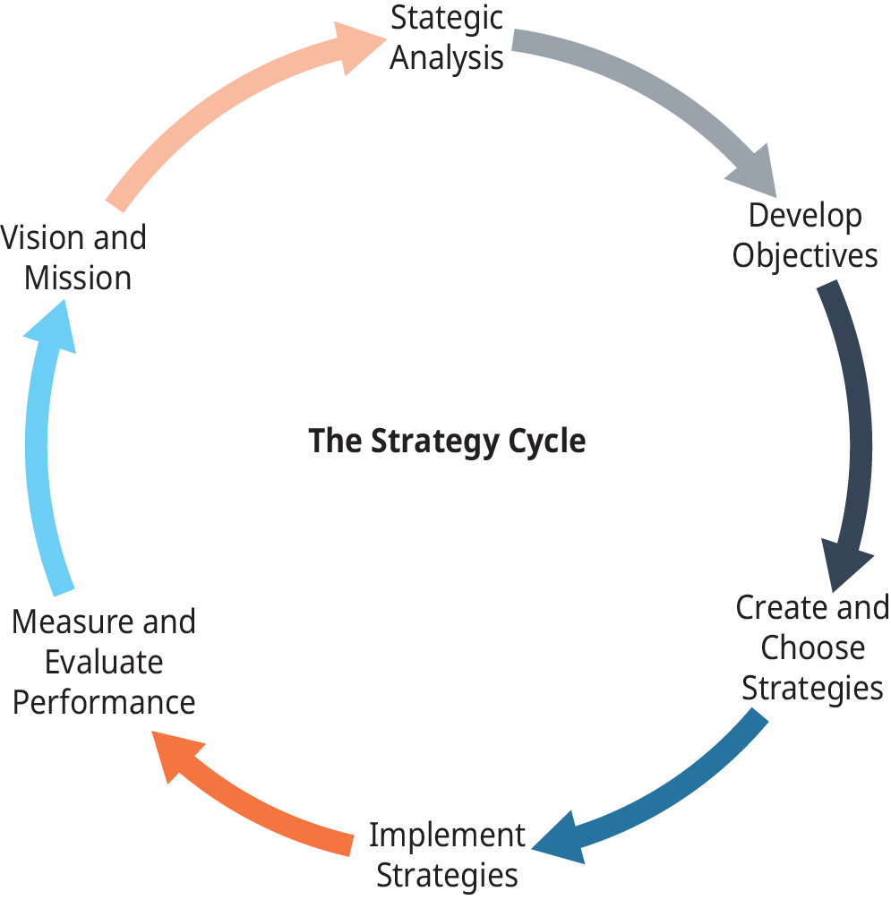

Slide 24
STRATEGIC INTENT

Slide 25
Vision and Mission
Vision: A Vision Statement describes the desired future position of the company; what the organisation intends to become in the long run.
It reveals what the company aspires to be or hopes to achieve in the long-term. The vision statement is inspirational and motivational but also provides direction, mapping out where the organization is headed. In this regard, it serves as a guide for choosing current and future courses of action.

Slide 26
Vision and Mission
When writing a vision statement, consider these questions:
Where are we going moving forward?
What do we want to achieve in the future?
What kind of future society do we envision?

Slide 27
Examples of Vision Statements
LinkedIn: To create economic opportunity for every member of the global workforce.
GoDaddy: To radically shift the global economy toward independent entrepreneurial ventures.
Wikimedia Foundation: Imagine a world in which every single human being can freely share in the sum of all knowledge. That’s our commitment.
Habitat for Humanity: A world where everyone has a decent place to live.
Southwest Airlines: To be the world’s most loved, most efficient, and most profitable airline.
MUBS: The benchmark for Business and Management Education, Research and Training in the region.

Slide 28
Vision and Mission
Mission: A Mission Statement defines the company’s business, its objectives and its approach to reach those objectives. A means of competing.
The mission statement defines an organization’s purpose or reason for being. It guides the day-to-day operations of the organization, communicates to external stakeholders the core solutions the organization provides in society and motivates employees toward a common near-to-medium term goal.
In short, the mission statement paints a picture of who the company is and what the company does.

Slide 29
Examples of Mission Statements
LinkedIn: To connect the world’s professionals to make them more productive and successful.
Starbucks: To inspire and nurture the human spirit – one person, one cup and one neighborhood at a time.
Twitter: To give everyone the power to create and share ideas and information, instantly, without barriers.
TripAdvisor: To help people around the world plan and have the perfect trip.
Tesla: To accelerate the world's transition to sustainable energy.
Sweetgreen: To inspire healthier communities by connecting people to real food.
MUBS: To enable the future of our clients through creation and provision of knowledge.

Slide 30
Vision and Mission
Companies use Mission & Vision Statements to:
Internally
Guide management’s thinking on strategic issues, especially during times of significant change
Help define performance standards
Inspire employees to work more productively by providing focus and common goals
Externally
Enlist external support
Create closer linkages and better communication with customers, suppliers and alliance partners
Serve as a public relations tool

Slide 31
Values Statements
A Values statement highlights an organization’s core principles and philosophical ideals. It is used to both inform and guide the decisions and behaviors of the people inside the organization and signal to external stakeholders what’s important to the company.
An organization’s core values shape daily culture and establish standards of conduct against which actions and decisions can be assessed.

Slide 32
Values Statements
A values statement should be memorable, actionable and timeless.
The format of the values statement depends on the organizations; some organizations use one, two or three words to describe their core values while others provide a short phrase.

Slide 33
Values Statements
When drafting a values statement, some questions to consider include:
What do we stand for?
What behaviors do we value over all else?
How will we conduct our activities to achieve our mission and vision?
How do we treat members of our own organization and community?

Slide 34
Some Examples of Value Statements
Gusto:
Ownership mentality.
Don’t optimize for the short term.
We are all builders.
Go the extra mile.
Do what’s right.
Be transparent.

Slide 35
Some Examples of Value Statements
Etsy:
We commit to our craft.
We minimize waste.
We embrace differences.
We dig deeper.
We lead with optimism

Slide 36
Some Examples of Value Statements
MUBS
Internationalism and cross-cultural awareness.
Service to MUBS stakeholders.
Advancement of MUBS vision and mission.
Innovation and creativity.
Professionalism and flexibility

Slide 37
Goals and Objectives
Goals and Objectives: These are the base of measurement. Goals are the end results, that the organization attempts to achieve.
On the other hand, objectives are time-based measurable actions, which help in the accomplishment of goals. These are the end results which are to be attained with the help of an overall plan, over the particular period

Slide 38
Definitions: Strategic Business Unit (SBU)
Strategic Business Unit (SBU) implies an independently managed division of a large company, having its own vision, mission and objectives, whose planning is done separately from other businesses of the company. The vision, mission and objectives of the division are both distinct from the parent enterprise and elemental to the long-term performance of the enterprise.

Slide 39
Importance of strategic management
Logical decisions: SM helps managers/the organisation make logical decisions and develop new goals quickly in order to keep pace with the changing environment, markets and business conditions.
SM coordinates various functions of the organisation effectively and to assure that these functions are organised and get together well.
Sense of purpose: SM provides each member of the organisation with a sense of purpose which serves as a motivation for the to work.
Allows an organisation to measure its success

Slide 40
IMPORTANCE OF STRATEGIC MANAGEMENT
Discharges board responsibility - board delegates management of the organisation to CEO and top management team who are fulltime employees.
Strategy provides a framework for decision making: nothing is worth expending resources and energy on unless it is in line and renders support to the strategy, goals.
Enabling the organisation to measure its success.
Looks at organisation as a whole; Cross functional understanding of the organisation.

Slide 41
Importance of strategic management
Shows the right direction to the organization
Helps companies to turn proactive rather than reactive
Guides the companies to prepare and face the challenges which may occur in future
Plays an important part in decision making

Slide 42
Importance of strategic management
Makes business fight the competitions and have long term survival assurance (Have a competitive edge over the market)
Helps in business development and success

Slide 44
How can a manager benefit from the strategic management discipline?
Ability to analyze strategic situations, craft appropriate business strategies and implement them
Stimulates critical thinking about the future
Ensures full exploitation of opportunities
Points the way for employees to follow
Ability to build competitive superiority
To develop a competitive advantage
Objective resource allocation
To provide a sense of direction
Enhances strategic analytical skills
Combines skills, knowledge and experience from other disciplines
Higher chances of success

Slide 45
Limitations of SM
Uncertainty of the future – we are never sure that the future will unfold as anticipated.
SM is expensive: may require external consultant to develop a strategy which small organisations may not afford.
May ignore short term issues: It focuses on long term benefits, rather than the short term. May not adequately handle crisis situations
Complexity: It is a complex process, involving many stakeholders, assessing both internal and external environment. Competition, globalisation, liberalisation, world trade order make it even more complex.

Slide 46
Limitations of SM
SM is time consuming; planning process, scanning environment, inter-functional coordination, all consume time.
Rigour and alertness: There must be active participation among the employees and the employees have to be accountable for their work. (Have you encountered new public management –NPM, managerialism – in the public service?)

