Slide 1
General PC Maintenance
Notes:
NOTE:
To change the image on this slide, select the picture and delete it. Then click the Pictures icon in the placeholder to insert your own image.

Slide 2
Power Supply and PC Protection
Power Supply Units (PSU)
Function: Converts AC (alternating current) from the wall outlet into DC (direct current) that the computer components use.
Components:
Transformer: Steps down the high-voltage AC to lower-voltage AC.
Rectifier: Converts AC to DC.
Regulator: Ensures stable output voltage.
Cooling Fan: Prevents overheating of the PSU.

Slide 3
Types of Power Supply
ATX PSU: Commonly used in desktop computers, with standardized connectors.
SFX PSU: Smaller form factor for compact PCs.
Important Specifications:
Wattage: The total power output available to components.
Efficiency Rating: Indicates how effectively the PSU converts power, e.g., 80 PLUS certification.

Slide 4
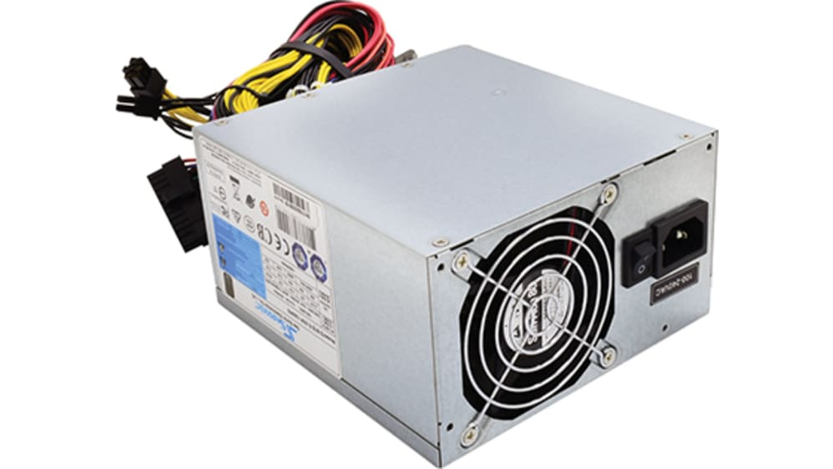

Slide 5
Power Protection Devices
Surge Protectors: Protects against power surges by diverting excess voltage.
Uninterruptible Power Supply (UPS): Provides backup power during outages and protects against power fluctuations.
Power Conditioners: Regulate voltage and remove electrical noise from the power supply.

Slide 6
Uninterruptible Power Supply (UPS)
Function: Provides backup power and surge protection in case of power failure or fluctuations.
Types:
Offline/Standby UPS: Activates only during power failure.
Line-Interactive UPS: Regulates minor power fluctuations and provides battery backup.
Online/Double-Conversion UPS: Constantly provides power from its battery, ensuring seamless protection.

Slide 7
Proper Use and Maintenance
Adequate Ventilation: Ensure proper airflow around the PSU to prevent overheating.
Regular Checks: Inspect cables for wear and tear, and ensure connections are secure.
Battery Maintenance for UPS: Replace UPS batteries as recommended by the manufacturer to ensure backup power is available.

Slide 8
Safety Guidelines and Procedures
Electrical Safety
Avoid Water: Keep liquids away from computers to prevent electrical shock and damage.
Power Off: Always turn off and unplug the computer before opening the case or handling components.
Grounding: Use anti-static wrist straps or mats to prevent electrostatic discharge (ESD) when handling internal components.

Slide 9
Physical Safety
Lifting: Use proper lifting techniques to avoid injury when moving heavy equipment.
Cable Management: Keep cables organized and out of the way to prevent tripping hazards.
Ventilation: Ensure proper airflow around the computer to avoid overheating.

Slide 10
Handling Components
Proper Handling: Hold components by the edges, avoid touching the pins or circuits directly.
Use of Tools: Use appropriate, non-magnetic tools to avoid damaging sensitive components.

Slide 11
Environmental Safety
Proper Disposal: Dispose of electronic waste according to local regulations to prevent environmental damage.
Ergonomics: Set up workstations ergonomically to prevent strain injuries.

Slide 12
Preventive Maintenance
Regular Cleaning
Dust Removal: Use compressed air to remove dust from fans, vents, and components.
Component Cleaning: Gently clean external surfaces with a microfiber cloth and isopropyl alcohol.

Slide 13
Software Maintenance
Operating System Updates: Regularly update the OS to patch security vulnerabilities and improve performance.
Antivirus Scans: Perform regular scans to detect and remove malware.
Disk Cleanup: Use built-in utilities to clear temporary files and defragment drives.
Drivers: Keep hardware drivers up to date to maintain compatibility and functionality.
Firmware: Update the firmware of components like the motherboard and SSD for better stability and performance.

Slide 14
Backup and Data Integrity
Regular Backups: Use external drives or cloud storage to back up important data regularly.
Check Disk Health: Monitor the health of storage drives using diagnostic tools like SMART.
System Image: Create a system image to restore the entire system in case of failure.

Slide 15
Maintaining Display Devices
Screen Cleaning: Use a soft, dry microfiber cloth for regular cleaning, and a screen-safe cleaner for stubborn smudges.
Avoid Pressure: Do not press too hard on the screen to avoid damaging pixels.
Environmental Considerations: Avoid exposing displays to direct sunlight and extreme temperatures.

Slide 16
Adjustments and Calibration
Brightness and Contrast: Adjust settings to reduce eye strain and improve image clarity.
Color Calibration: Use software tools or built-in utilities to ensure accurate color representation.

Slide 17
Types of Display Devices
Monitors: LCD, LED, and OLED displays are the most common types used with PCs.
Projectors: Used in presentations; requires regular cleaning of lenses and filters.

Slide 18
Preventing Burn-In (for OLED/Plasma)
Screen Savers: Use screen savers or power-saving modes to prevent static images from burning into the screen.
Adjust Brightness: Lowering brightness can help reduce the risk of burn-in.

Slide 19
Maintaining Disk Drives
Types of Disk Drives
HDD (Hard Disk Drive): Mechanical drives with moving parts, susceptible to physical damage.
SSD (Solid State Drive): Faster, with no moving parts, but still requires regular health checks.

Slide 20
Disk Maintenance Practices
Defragmentation: Regularly defragment HDDs to optimize file storage (not required for SSDs).
Error Checking: Use tools like CHKDSK in Windows to check for and repair file system errors.
Cooling: Ensure adequate cooling to prevent overheating, which can shorten the lifespan of the drive.

Slide 21
Backup and Redundancy
RAID Configurations: Implement RAID for redundancy and improved performance (e.g., RAID 1 for mirroring, RAID 0 for striping).
Cloud Backup: Regularly back up important files to the cloud for additional protection.

Slide 22
General Disk Maintenance
Disk Cleanup: Regularly delete unnecessary files and use disk cleanup tools to free up space.
SMART Monitoring: Use SMART (Self-Monitoring, Analysis, and Reporting Technology) tools to monitor drive health.

Slide 23
Cleaning Inside the Case
Opening the Case
Preparation: Power down the PC, unplug all cables, and use an anti-static wrist strap.
Access: Use the correct tools (usually a screwdriver) to open the case.

Slide 24
Cleaning Procedures
Dust Removal: Use compressed air to blow dust out of the case, starting from the top to the bottom.
Fan Cleaning: Hold fans in place to prevent them from spinning while cleaning.
Component Cleaning: Gently brush dust from components like the motherboard, GPU, and RAM.

Slide 25
Reassembly
Recheck Connections: Ensure all cables and components are securely reconnected.
Close the Case: Securely fasten the case cover and reconnect external cables.

Slide 26
Diagnostic Hardware and Software
Diagnostic Tools
Hardware Tools:
Multimeter: For testing power supply voltages and continuity.
POST Card: Used to diagnose POST errors when a system fails to boot.
Software Tools:
BIOS/UEFI Diagnostics: Built-in tools for testing hardware components.
Third-Party Utilities: Tools like HWMonitor, MemTest86, and CrystalDiskInfo for monitoring and testing components.

Slide 27
Software Diagnostic Tools
MemTest86: A tool for testing the health and stability of RAM.
HWMonitor: Monitors system temperatures, voltages, and fan speeds.
CrystalDiskInfo: Provides detailed information and health status of storage drives

Slide 28
Using Diagnostic Tools
Temperature Monitoring: Regularly monitor CPU and GPU temperatures to prevent overheating.
Memory Testing: Use MemTest86 to test RAM for errors.
Disk Health Monitoring: Use SMART data to check for signs of HDD/SSD failure.

Slide 29
Troubleshooting Computer Hardware
Memory Issues
Symptoms: Frequent crashes, slow performance, failure to boot.
Diagnosis: Run MemTest86, check if RAM is properly seated, and test with different modules.
Solutions: Replace faulty RAM, and ensure compatibility with the motherboard.

Slide 30
Keyboard and Mouse Problems
Symptoms: Non-responsive keys, erratic mouse movement.
Diagnosis: Check connections, test with a different USB port, or on another computer.
Solutions: Replace faulty devices, update drivers.

Slide 31
Video Problems
Symptoms: No display, Flickering, or low resolution.
Diagnosis: Check monitor connections, test with a different cable or monitor, ensure GPU is properly seated.
Solutions: Replace faulty cables, update graphics drivers, or replace the GPU.

Slide 32
Troubleshooting POST (Power-On Self-Test)
Understanding POST
Definition: POST (Power-On Self-Test) is a diagnostic testing sequence performed by the BIOS or UEFI firmware when a computer is powered on. It checks the hardware components to ensure they are functioning correctly before loading the operating system.
Purpose: The main purpose of POST is to identify and report hardware issues that could prevent the computer from booting properly.

Slide 33
POST Process
Power Up: When the computer is turned on, power is supplied to the motherboard, and the CPU begins executing the POST routine.
BIOS/UEFI Initialization: The BIOS or UEFI initializes and identifies the hardware components, including the CPU, RAM, storage devices, and video card.
Hardware Tests: POST performs a series of tests on hardware components, including memory tests, CPU tests, and video card checks.
Error Reporting: If POST encounters an issue, it will usually signal this through beep codes, error messages on the screen, or LED indicators on the motherboard.

Slide 34
Common POST Issues
No Power: The computer doesn’t turn on at all, indicating possible issues with the power supply or motherboard.
Beep Codes: Different beep codes indicate various hardware failures (e.g., RAM, video card, or motherboard issues).
Error Messages: POST error messages on the screen may point to specific hardware issues like "No boot device found" or "Memory failure."

Slide 35
Troubleshooting POST Issues
Check Power Supply: Ensure the power supply is functioning correctly and all connections are secure.
Reseat Components: Reseat RAM, video cards, and other components to ensure they are properly connected.
Listen to Beep Codes: Refer to the motherboard manual to interpret beep codes and identify the failing component.
Swap Components: Swap out suspected faulty components with known good ones to isolate the issue.
Use Diagnostic Tools: Utilize POST cards or motherboard diagnostic LEDs to get more detailed information on the failure.

Slide 36
Troubleshooting/Repairing Tools
Hardware Tools
Screwdrivers: A variety of screwdrivers (Phillips, flathead, Torx) are essential for opening cases and securing components.
Anti-Static Wrist Straps: Used to prevent electrostatic discharge (ESD) when handling sensitive components.
Multimeter: A tool for measuring voltage, current, and resistance, useful in diagnosing power supply and electrical issues.
Compressed Air: Used for cleaning dust and debris from inside the computer, especially around fans and heatsinks.
Cable Testers: Test network cables to ensure they are functioning correctly.

Slide 37
Software Tools
Diagnostic Software: Utilities like MemTest86 (for RAM), CrystalDiskInfo (for hard drives), and CPU-Z (for CPU details) help identify hardware issues.
Live CDs/USBs: Bootable media containing diagnostic tools that can be run without loading the operating system, useful for troubleshooting systems that won’t boot.
Benchmarking Software: Tools like 3DMark and Cinebench can stress-test hardware to check for stability and performance issues.
Data Recovery Software: Tools like Recuva or TestDisk are used to recover data from failing storage devices.

Slide 38
Advanced Tools
Oscilloscope: For more advanced diagnostics, an oscilloscope can be used to analyze electronic signals within the computer.
POST Card: A diagnostic tool that plugs into the motherboard to display POST codes, helping to identify issues during the boot process.
Thermal Camera: Identifies overheating components by visualizing temperature differences inside the system.

Slide 39
Upgrading and Optimizing Hardware
Planning an Upgrade
Assessment of Current System: Evaluate the existing hardware to determine what components need upgrading. This includes assessing CPU, RAM, storage, GPU, and power supply.
Compatibility Checks: Ensure the new hardware is compatible with the existing system, including the motherboard, power supply, and case.
Cost-Benefit Analysis: Determine the cost versus the performance benefit of the upgrade. Prioritize upgrades that offer the most significant performance improvements.

Slide 40
Common Hardware Upgrades
RAM: Increasing the amount of RAM can improve multitasking and overall system performance. Ensure the new RAM is compatible with the motherboard and existing RAM modules.
Storage: Upgrading to an SSD from an HDD can dramatically improve boot times and application load times. Consider adding a larger SSD or NVMe drive for faster storage solutions.
CPU: Upgrading the CPU can improve processing power, but ensure the motherboard supports the new CPU’s socket and power requirements.
GPU: A more powerful GPU can enhance gaming and graphic-intensive tasks. Ensure the power supply can handle the increased power draw.
Power Supply: Upgrade the power supply if additional power is needed for new components or if the existing power supply is insufficient.

Slide 41
Optimization Techniques
Overclocking: Increase the clock speed of the CPU or GPU for better performance, but be cautious of overheating and stability issues. Proper cooling solutions should be in place.
Cooling Solutions: Optimize cooling by adding more fans, using better thermal paste, or installing a more effective CPU cooler or liquid cooling system.
Cable Management: Improve airflow within the case by organizing and securing cables to reduce clutter and heat buildup.
BIOS/UEFI Updates: Update the BIOS/UEFI to ensure compatibility with new hardware and take advantage of performance improvements and new features.
Driver Updates: Keep drivers for all components up to date to ensure optimal performance and compatibility.

Slide 42
Testing After Upgrades
System Stability: After upgrading, stress-test the system to ensure stability under load. Tools like Prime95 (for CPU) and FurMark (for GPU) can be used.
Benchmarking: Run benchmarks to compare the performance before and after the upgrade. This will quantify the improvements made.
Monitoring: Use monitoring software to keep an eye on temperatures, voltages, and clock speeds to ensure everything is operating within safe limits.

Slide 43
End

