Slide 1
Operating Systems

Slide 2
Introduction to Operating Systems
An operating system is a program that acts as an
intermediary between a user of a computer and the computer hardware.
The purpose of an operating system is to provide an
environment in which a user can execute programs.
An operating system is a software that manages the computer hardware. The hardware must provide appropriate mechanisms to ensure the correct operation of the computer system and to prevent user programs from interfering with the proper operation of the system.

Slide 3
Definition of Operating System:
An Operating system is a program that controls the execution of application programs and acts as an interface between the user of a computer and the computer hardware.

Slide 4
Cont’d
In brief, an operating system is the set of programs that controls a computer. Some examples of operating systems are UNIX, Mach, MS-DOS, MSWindows, Windows/NT, OS/2 and MacOS.
A large number of operating systems have been developed over the years; each designed with a certain kind of computer in mind. For instance:
Windows or Linux - for personal computers
MacOS - for Macs
Unix - for mainframes
Symbian, Android - for mobile phones
An operating system is an important part of almost
every computer system.
A computer system can be divided roughly into four components: the hardware, the operating system,the application programs and the users (Figure 1.1).

Slide 5
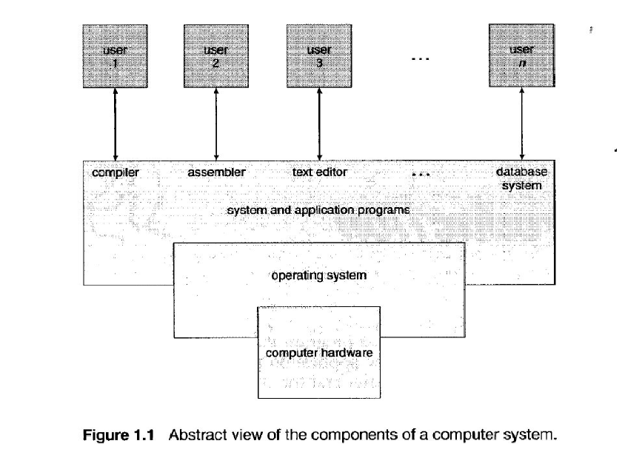

Slide 6
Operating System Objectives
Convenience. Makes the computer more convenient to use
Efficiency. Allows computer system resources to be used in an efficient manner
Ability to evolve. Permit effective development, testing, and introduction of new system functions without interfering with service

Slide 7
Operating System Design components
There are three basic elements that make up the major design components of any operating system. These components are:
User interface – A user interacts with the computer's OS through the user interface. Simply put, the user interface is the part of the operating system that a person can use to issue commands.
2. Kernel – This is the core of the OS. The kernel is responsible for loading and running programs (processes) and for managing input and output. It’s a portion of operating system that is in main memory. It’s also called the nucleus.
Contains most frequently used functions
Hardware abstraction layer (HAL). Isolates the operating system from platform-specific hardware differences
Device drivers. Translate user I/O function calls into specific hardware device I/O requests
Windowing and graphics systems. Implements the graphical user interface (GUI)

Slide 8
File management system – The file management system is what the OS uses to organize and manage files.
Most operating systems use a hierarchical file system in which files are organized into directories under a tree structure. The beginning of the directory system is referred to as the root directory

Slide 9
Major functions of operating systems
Process Management
A process is only ONE instant of a program in execution.
There are many processes can be running the same program.
The five major activities of an operating system in regard to process management are:
Creation and deletion of user and system processes.
Suspension and resumption of processes.
A mechanism for process synchronization.
A mechanism for process communication.
A mechanism for deadlock handling.

Slide 10
Main-Memory Management
Main-Memory is a large array of words or bytes. Each word or byte has its own address. Main memory is a repository of quickly accessible data shared by the CPU and I/O devices.
The major activities of an operating system in regard to memory-management are:
Keep track of which part of memory are currently being used and by whom.
Decide which processes are loaded into memory when memory space becomes available.
Allocate and deallocate memory space as needed.

Slide 11
File Management
A file is a collected of related information defined by its creator. Computer can store files on the disk (secondary storage), which provide long term storage.
The creation and deletion of files.
The creation and deletion of directions.
The support of primitives for manipulating files and directions.
The mapping of files onto secondary storage.
The backup of files on stable storage media.

Slide 12
I/O System Management
One of the purposes of an operating system is to hide the peculiarities of specific hardware devices from the user.
Secondary-Storage Management
Generally speaking, systems have several levels of storage, including primary storage, secondary storage and cache storage. Instructions and data must be placed in primary storage or cache to be referenced by a running program.

Slide 13
Operating Systems Services
• Program Execution
The system must be able to load a program into memory and to run
it. The program must be able to end its execution, either normally or
abnormally (indicating error).
• I/O Operations
A running program may require I/O. This I/O may involve a file or an
I/O device.
File System Manipulation
The output of a program may need to be written into new files or
input taken from some files. The operating system provides this service.
Error Detection
An error is one part of the system may cause malfunctioning of the
complete system. To avoid such a situation the operating system constantly monitors the system for detecting the errors.

Slide 14
Major Functions summerised
Providing an interface to the user. e.g. command line, graphical user interface (GUI
Managing system resources. resources such as computer's memory and sharing of the central processing unit (CPU) time by various applications or peripheral devices
Managing security and access rights.
Running applications

Slide 15
Process Management
Memory Management
Booting the computer.
Performs basic computer tasks eg managing the various peripheral devices eg mouse, keyboard.
Provides file management which refers to the way that the operating system manipulates, stores, retrieves and saves data.

Slide 16
Operating System Choices and Issues
Here are some of the critical issues to keep in mind regarding operating system choice and your new PC:
Special Application Compatibility: Not all applications will run on all operating systems. If you have a special application that is the primary reason for purchasing the machine, you should let that guide your operating system decision: it may require a particular OS.

Slide 17
Choices and Issues cont’d
General Application Compatibility:
Some operating systems support a wider variety of software applications than others. Microsoft is trying to get all new Windows software to be written so that it will run on both the "consumer" and "professional" operating systems, and most applications do work on both. There are, however, software programs that only work on the consumer operating systems.

Slide 18
Choices and Issues cont’d
Hardware Compatibility:
You need to ensure that the operating system you want to run will work with the hardware you are selecting, and vice-versa. Some PC manufacturers will not support some operating systems--in fact, the hardware may still work with an "unsupported" OS, but the company may not provide technical assistance. Be especially careful with notebook machines, which may not function properly at all if you install operating systems on them that haven't been tested and approved.

Slide 19
Choices and Issues cont’d
Specific Hardware and Driver Support:
On certain operating systems your PC may work, but certain hardware items may not function. This is usually either because no drivers have been written for them, or the operating system is incapable of making use of the hardware.

Slide 20
Choices and Issues cont’d
Hardware Requirements:
Some operating systems are much more demanding when it comes to the hardware needed to run them than others. In general, the newer the operating system, the more CPU power and system memory it needs to run effectively. It's also generally the case that the processional operating systems require more hardware than the consumer-level ones do, especially system memory.

Slide 21
Managing hardware
Hardware represents the physical and tangible components of a computer i.e. the components that can be seen and touched.
Examples of Hardware are following:
Input devices -- keyboard, mouse etc.
Output devices -- printer, monitor etc.
Secondary storage devices -- Hard disk, CD, DVD etc.
Internal components -- CPU, motherboard, RAM etc.
Relationship between Hardware and Software
Hardware and software are mutually dependent on each other. Both of them must work together to make a computer produce a useful output.
Software cannot be utilized without supporting hardware.
Hardware without set of programs to operate upon cannot be utilized and is useless.
To get a particular job done on the computer, relevant software should be loaded into the hardware
Hardware is a one-time expense.

Slide 22
Hardware driver
A driver is a specially written program, which understands the operation of the device it interfaces to, such as a printer, video card, sound card or CD ROM drive.
It translates commands from the operating system or user into commands understood by the component computer part it interfaces with.
It also translates responses from the component computer part back to responses that can be understood by the operating system, application program, or user.
The below diagram gives a graphical depiction of the interfaces between the operating system and the computer component.

Slide 24
Manage devices and drivers
Windows gives you several tools and utilities for configuring and managing hardware devices and printers.
You have several options for configuring devices and installing the necessary drivers, which is important, because without the proper drivers and the proper configuration, your devices won’t function properly
Windows automatically detects any hardware recently installed and attempts to automatically install the driver. After Windows setup is complete, if some drivers weren’t installed by default, Windows will attempt to find the device and its respective driver. The OS does this through Windows Updat

Slide 25
Install drivers with Windows Update
Windows detects hardware that wasn’t automatically installed with Windows setup. Most of the time, this will happen if the Windows didn’t include the driver for that piece of hardware.
The built-in hardware diagnostics generally detect whether hardware installed on the computer has the proper drivers installed.
The OS will attempt to identify the hardware, then use Windows Update to search for the correct driver. Windows Update will automatically download the driver, but won’t install it automatically.

Slide 26
Install drivers Device Manager
Device Manager is the central location from which to view, configure and manage hardware devices. It’s critical to understand how Device Manager works before working on hardware devices.
Devices with issues are displayed with a small
symbol next to the device icon. A red X indicates the device isn’t installed correctly or has been disabled. A yellow exclamation point indicates a problem with the device.
Double click the affected divice an update its drivers

Slide 27
Windows booting procedure
What is booting?
Booting is just the process of starting or resetting the computer. There are two types of booting: cold booting and warm booting. Cold booting is the booting process happening when we first turn on computer and warm booting is the processes happening when we reset the computer. During the booting process the computer loads the operating system to its memory and prepares it for use.

Slide 28
READ
WINDOWS BOOTING PROCESS/PROCEDURE

Slide 29
Procedure:
The first process starting when you turn on your computer is BIOS i.e, Basic Input Output ystem. BIOS has two functions, to conduct POST and read MBR.
a) POST - POST stands for Power On Self Test. POST checks all the hardware devices connected to a computer like RAM, hard disk etc and make sure that the system can run smoothly with those hardware devices. If the POST is a failure the system halts with a beep sound.
b) Now BIOS checks the boot priority. We can set the boot priority as CD drive, hard disk or floppy drive.
c) MBR - The next duty of BIOS is to read the MBR. MBR stands for Master Boot Record and its the first sector on a hard disk. MBR contains the partition table and boot loader.

Slide 30
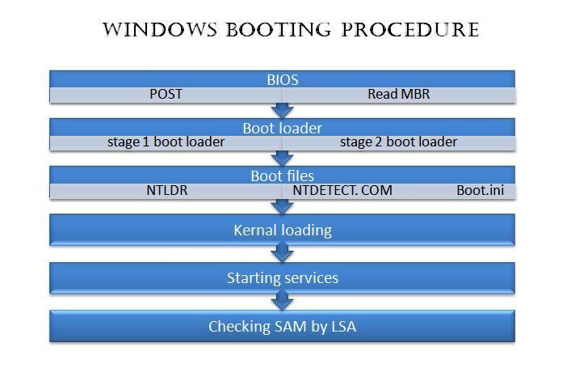

Slide 31
Windows errors & Boot Failures
BOOT FAILURE & ERROS
Invalid Boot Disk .
Floppy left in floppy drive during boot/cd left in cd-rom during boot
Failing hard drive
Inaccessible boot device
Corrupted boot volume
Corrupted device drivers
Boot Sector virus

Slide 32
Missing NTLDR
Computer is booting from a non-bootable source.
Computer hard disk drive is not properly setup in BIOS.
Corrupt NTLDR and/or NTDETECT.COM file.
Misconfiguration with the boot.ini file.
Attempting to upgrade from a Windows 95, 98, or ME computer that is using FAT32.
New hard disk drive being added.
Corrupt boot sector / master boot record.
Seriously corrupted version of Windows 2000 or Windows XP.
Loose or Faulty IDE/EIDE hard disk drive cable.

Slide 33
Operating system not found - A common cause of this error is booting a system with a non-bootable floppy in the floppy drive. It can also be caused by missing boot files. To correct this, boot with the startup disk and enter the command SYS C:\ which will copy the system files to the hard drive(Windows 9x only).

