Slide 1
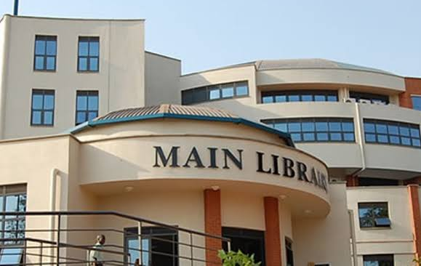
MAKERERE UNIVERSITY BUSINESS SCHOOL
FACULTY OF BUSINESS ADMINISTRATION
Business Communication Skills
FOR DIPLOMA
©2024 - DEPARTMENT OF COMMUNICATION

Slide 2
TOPIC 2b: BARRIERS
TO
EFFECTIVE COMMUNICATION

Slide 3
Topic Outline
Introduction
Defining a barrier to communication
Defining Effective communication
Types of barriers
Physical, physiological, socio-psychological and Semantic barriers.
Solutions to the barriers to communication
Technological barrier
Definition
Types of technological barriers

Slide 4
Topic Learning outcomes
By the end of this topic, the learners will be able:
To define barriers to effective communication.
To define effective communication.
To understand the different types of barriers.
Apply strategies on how to overcome the barriers to effective

Slide 5
Barriers to Effective Communication
Barriers to effective communication are any obstacles that prevent clear, accurate, and effective exchange of ideas, information, or feelings between individuals or groups.
Barriers exist between all people, making communication much more difficult than most people seem to realize.
It is false to assume that if one can talk, he can communicate. Because so much of our education misleads people into thinking that communication is easier than it is, they become discouraged and give up when they run into difficulty.

Slide 6
Types of Barriers
1. Physical or Environmental Barriers
These are environmental factors which limit the sending and receiving of messages.
Noise
Time and distance
Wrong choice of medium
Surroundings
Inadequacy of message design/ poorly expressed message

Slide 7
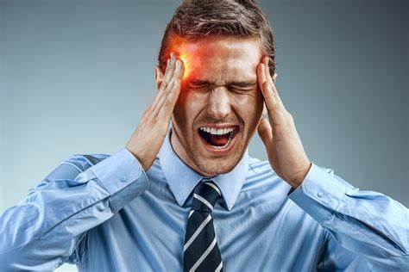
Conti………………….
2. Physiological or Biological barriers
These are related to a person’s health and fitness.
These may arise due to disabilities that may affect the physical capability of the sender or the receiver.
Proper functioning of the vocal chords, hands, fingers, eyes is necessary for effective communication.

Slide 8
Conti………………….
3. Semantic barriers/ Language Barriers
The term ‘semantic’ refers to the systematic study of meaning of the words. Semantic barriers are barriers related to language. They cause obstructions in the process of receiving or understanding of the message during the process of encoding or decoding ideas and words
Misinterpretation of words
Use of technical language
Vocabulary deficiency of both the sender and the receiver may cause semantic barrier to communication.
Multiple meaning of the words in different context:

Slide 9
Conti………………….
4. Psychological barriers
These are mental blocks or obstacles that hinder a person's ability to communicate effectively, perform tasks, or achieve goals. These barriers can be conscious or subconscious and often stem from various internal factors. Some common psychological barriers include:
Fear and Anxiety
Low Self-Esteem
Negative Thinking Perfectionism
Stress and Overwhelm
Prejudice and Stereotypes
Lack of Motivation
Emotional Barriers
Cognitive Dissonance
Resistance to Change
Cultural and Social Influences

Slide 10
How to Overcome the Barriers of Effective Communication
Eliminating differences in perception
Use of Simple Language
Reduction and elimination of noise levels
Active Listening
Emotional State
Simple Organizational Structure
Avoid Information Overload
Give Constructive Feedback
Proper Media Selection
Flexibility in meeting the targets

Slide 11
Technological Barriers in Communication
What are technological barriers in communication?
These refer to the obstacles and challenges that arise from the use or misuse of technology in exchanging information.
These barriers can range from simple issues like poor internet connectivity to more complex problems such as digital literacy gaps or platform incompatibility. Identifying and understanding these barriers is crucial for effective communication in today’s technology-driven world.

Slide 12
Types of Technological Barriers in Communication

Slide 13
Exercise
Using clear examples, analyse communication at your former High School and identify barriers that could have contributed to ineffective communication in a given scenario.
Advise the school management or any responsible personnel in the scenario above, what can be done to avoid ineffective communication from reoccurring.

Slide 14
References
https://youtu.be/f5Tao6KHV5w?si=E0znFDMEdC0Dk764
http://dx.doi.org/10.6007/IJARBSS/v13-i11/19498
http://doi.org/10.2307/3587028
www.mrcet.ac.in (Digital notes professional communication skills R20MBA10)

Slide 15
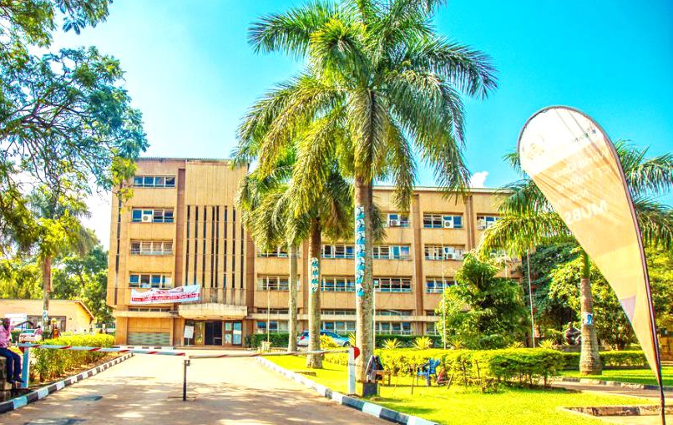
Thank you for being a great audience
Address
Main building , first floor Room 1.0
Contacts
Team leader: +256-777-899-582
Facilitator:
Email
hodcommunication@mubs.ac.ug /snakyeyune@mubs.ac.ug
©2024 - FACULTY OF BUSINESS ADMINISTRATION, Department of Communication

