Slide 1
PROJECT LIFE CYCLE
Project Life Cycle
Overview
To Cover
Definition
Project phases
The importance of project phases and management reviews

Slide 2
Project Phases and the Project Life Cycle
A project life cycle is a collection of project phases that defines:
What work will be performed in each phase.
What deliverables will be produced and when.
Who is involved in each phase.
How management will control and approve work produced in each phase.
A deliverable is a product or service produced or provided as part of a project.

Slide 3
Project Phases and the Project Life Cycle...
In the early phases of a project life cycle:
Resource needs are usually lowest.
The level of uncertainty (risk) is highest.
Project stakeholders have the greatest opportunity to influence the project.
In the middle phases of a project life cycle:
The certainty of completing a project increases.
More resources are needed.
In the final phase of a project life cycle:
The focus is on ensuring that project requirements were met.
The sponsor approves completion of the project.

Slide 4
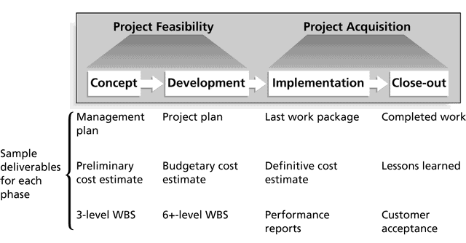
Phases of the Traditional Project Life Cycle

Slide 5
Product Life Cycles
Products also have life cycles.
A systems development life cycle (SDLC) is a framework for describing the phases involved in developing information systems.
Systems development projects can follow:
Predictive life cycle: The scope of the project can be clearly articulated and the schedule and cost can be predicted.
Adaptive Software Development (ASD) life cycle: Projects are mission driven and component based, and use time-based cycles to meet target dates.

Slide 6
Predictive Life Cycle Models
Waterfall model: Has well-defined, linear stages of systems development and support.
Spiral model: Shows that software is developed using an iterative or spiral approach rather than a linear approach.
Incremental build model: Provides for progressive development of operational software.
Prototyping model: Used for developing prototypes to clarify user requirements.
Rapid Application Development (RAD) model: Used to produce systems quickly without sacrificing quality.

Slide 7
Adaptive Software Development (ASD) life cycle
Evolved from RAD practices
Provides ability to adapt change where products are evolving with little planning.
Phases are;
Speculate
Collaborate
Learn

Slide 8
The Importance of Project Phases and Management Reviews
A project should successfully pass through each of the project phases in order to continue on to the next.
Management reviews, also called phase exits or kill points, should occur after each phase to evaluate the project’s progress, likely success, and continued compatibility with organizational goals.

Slide 9
Project life cycle is composed of five process groups, each with a number of processes involved. Note: A process group is different from a project phase.
At the end of each process group, a review is performed of the key deliverables and Project performance to date to determine if the Project should continue into the next stage or not (GO / NO GO status).
Planning
Initiation
Monitoring & Control
Close Out
Execution
Deliverable – Is a tangible verifiable work product. Eg. Feasibility study document/ business case, Scope of Work (SOW), Project plan, user requirements documents, detail design etc.
Linked by the results they produce (milestone(s)), the out put of one becomes the input to another.

Slide 10
Involves:
Definition of initial scope.
High level financial resources commitment.
Identification of high level stakeholders (internal & external)
Setting high level requirements (Business case analysis)
setting high level project duration
PM selection
Planning
Initiation
Monitoring & Control
Close Out
Output – Approved Project Charter
Execution
Note: A project team may help in writing charter, but approval is required

Slide 11
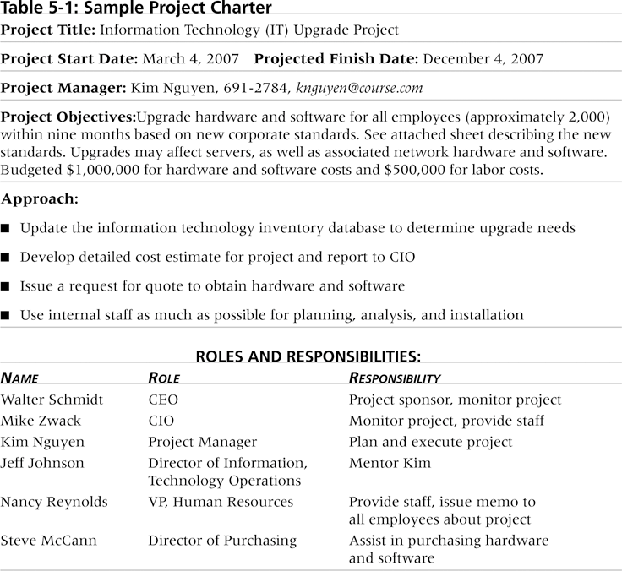
Sample Project Charter

Slide 12
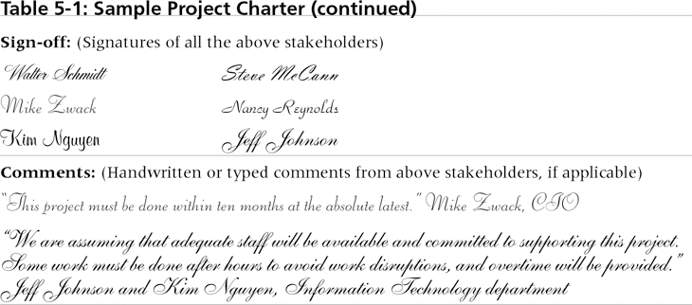
Sample Project Charter...

Slide 13
Involves:
Establish total project scope, defining and refining the high level objectives provided in the charter.
Example of tasks
Solicitation – obtaining quotations, bids or proposals as appropriate. (RFP, RFQ - Open bids or selectively)
Vendor selection – choosing from among potential sellers/vendor
Contracting process
Planning is an ongoing effort throughout the PJ life.
Planning
Monitoring & Control
Initiation
Close Out
Output – Project management plan
Execution
Planning is not an exact science, two different teams could generate different plans for the same Project. However, a well thought out plan contributes greatly to Project success

Slide 14
Project Management Plan
It is a description of how a project shall be carried out – integrating all process groups.
It is a living document (rolling wave planning), which can be updated as more information becomes clear.
PJ mgt section for serious bid
PJ Time Mgt
PJ
HR Mgt
PJ Scope Mgt
PJ procurement
Mgt
PJ Communication
Mgt
PJ
cost Mgt
PJ Quality
Mgt
PJ
Risk Mgt

Slide 15
Involves:
Performing work/activities defined in the PJ Mgt Plan to satisfy PJ specifications; coordinating people & resources. Including managing stakeholders expectations.
Quality assurance – evaluating PJ performance on a regular basis to provide confidence that the PJ will satisfy the required quality standards
Team development – developing skill/competencies to enhance PJ performance
Communication Mgt (Information distribution) – making needed information available to PJ stakeholders (accurately and timely) to guide their decisions
Contract management – legal counsel is required
Planning
Initiation
Monitoring & Control
Close Out
Output
– Deliverables
Change requests
Work performance information
PJ updates
Execution

Slide 16
Involves:
Tracking, reviewing, monitoring and measuring progress to identify variances (baseline- schedule, cost, quality) so that corrective action can be taken accordingly in order to meet performance objectives defined in the PJ Mgt Plan
Integrating change control – coordinating changes across the PJ
Schedule control – controlling changes to the PJ schedule
Cost control – controlling changes to the PJ budget
Quality control – monitoring specific PJ results to determine if they comply with set quality standards and identifying ways to eliminate causes of unsatisfactory performance
Status performance reporting – progress measurement and forecasting
Risk monitoring and control – keeping track of identified risks and how to reduce/eliminate risks
Planning
Initiation
Monitoring & Control
Close Out
Output
– Performance reports
Change requests
PJ Mgt Plan updates
Execution

Slide 17
Involves:
Formalizing acceptance of the PJ or phase and bringing it to an end.
Contract close out – completion and settlement of the contract, including resolution of any open tasks/items.
Administrative closure – documentation (As Built Doc - ABD, evaluating the PJ; and compiling lessons learned for use in planning future PJs
Planning
Initiation
Monitoring & Control
Close Out
Output
– Final product, service or result transition
Execution

Slide 18
Project Initiation
Innovations
Company strategy
Market demand/share
Service improvement
Technological advancement
Organizational Change initiatives
Legal requirements
Etc.
How/why are projects initiated?
How are projects scoped?
How are projects approved?
Business case
What does a business case contain?

Slide 19
Purpose of a Business Case
Its primary aim is to provide information on the benefits, costs and risks involved with a proposal. It forms the basis for effective decision making
It captures the reasoning for initiating an investment. Whenever resources are consumed, they should be in support of a specific business need. A compelling business case adequately captures both the business need and how the proposed investment meets that need.
The business case provides a basis for planning and implementation. It provides the justification for the investment, so the on-going viability of the investment should be measured against the business case.

Slide 20
Business cases are evaluated to ensure:
The investment has value, importance and relevance
The implementation will be properly managed
The organisation has the capability to deliver the benefits
The organisation’s resources are working on the highest value opportunities
Initiatives with inter-dependencies are undertaken in the optimum sequence

Slide 21
Business Case Sample
By using this Business Case you can:
Research the business problem or opportunity.
Identify the alternative solutions available.
Quantify the benefits and costs of each solution.
Provide a financial solution (NPV) for the business
Recommend a preferred solution to your sponsor.
Identify any risks and issues with implementation.
Present the solution for funding approval.

Slide 22
Output of Project Initiation
Project charter – A document that formally authorizes the project & its scope.
Key stakeholders must sign this document.
Project manager identification / assigned – should always be assigned prior to the start of project plan.
Assumptions and supporting details
In your assignment groups, develop templates for the following documents and include them in your report as attachments:
Project charter
Business case

Slide 23
The Triple Constraint
Every project is constrained in different ways by its:
Scope goals: What work will be done?
Time goals: How long should it take to complete?
Cost goals: What should it cost?
It is the project manager’s duty to balance these three often-competing goals.

Slide 24
The Triple Constraint
Scope, Time and Cost are very key to the project and its success is dependent on the success of these. They ultimately affect our Quality

Slide 25
The Triple Constraint
Scope: What work will be done as part of the project? What unique product, service, or result does the customer or sponsor expect from the project? How will the scope be verified?
Time: How long should it take to complete the project? What is the projects schedule? How will the team track actual schedule performance? Who can approve changes to the schedule?
Cost: What should it cost to complete the project? What is the project’s budget? How will costs be tracked? Who can authorize changes to the budget?

Slide 26
Practice Assignment
Assume your group was selected as a consulting team to advise on building a data center. Advise on;
The scope of building a complete data center (DC) within an existing new room, and a CRM system to be developed and implemented in the DC.
The scope of a website and a billing system to be deployed in this DC.

