Slide 1
YOUTH AND WOMEN ENTREPRENEURSHIP
BENT YEAR ONE – INTRODUCTION TO ENTREPRENEURSHIP
DEBORAH DIANA AGABA
DEPARTMENT OF ENTREPRENEURSHIP AND INNOVATION

Slide 2
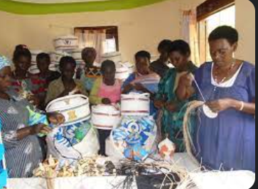
INTRODUCTION (who are they?)
Youth entrepreneurship, involves 18 - 35-year-olds and these are crucial in Uganda for income generation, economic development, job creation, and innovation. Therefore we are to explore its significance, the challenges faced by young entrepreneurs, and the impact it has on the nation's economy.
Women entrepreneurship looks at women taking the initiative to create, manage, and operate enterprises, whether in traditional or creative fields. Women's entrepreneurship is an important and quickly rising component of Uganda's economy and therefore we are to look at its relevance, analyze the particular problems faced by women entrepreneurs, and present pertinent examples to demonstrate the significant influence they have on the nation's economy.

Slide 3
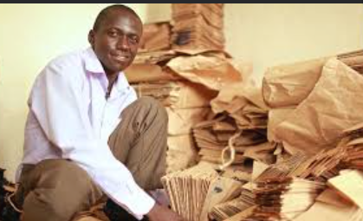
SIGNIFICANCE OF YOUTH ENTREPRENEURSHIP
Youth entrepreneurship is important not just for individual young entrepreneurs, but also for society and the economy as a whole as seen below;
Economic growth.
Innovation and creativity.
Job creation.
Skills development.
Reducing income inequality.
Community development.
Global competitiveness.
Cultural and social changes.
Adaptation to change.
Empowerment.
Utilization of idle resources.

Slide 4
SIGNIFICANCE OF WOMEN ENTREPRENEURSHIP
Women's entrepreneurship is important not just for individual women, but also for society and the economy as a whole as discussed below;
Global competitiveness.
Social empowerment.
Economic empowerment.
Diversity and Innovation.
Job creation.
Economic growth.
Poverty alleviation.

Slide 5
CHALLENGES FACED BY YOUTH ENTREPRENEURS
Regulatory hurdles.
Tax incentives.
Inadequate of required business skills.
Access to the required capital.
Risk aversion.
Market competition.
Price fluctuations.
High taxes.

Slide 6
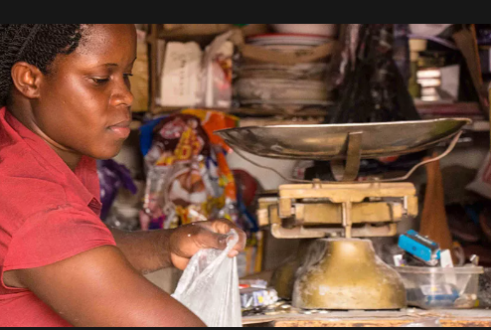
CHALLENGES FACED BY WOMEN ENTREPRENEURS
Gender stereotypes.
Access to capital.
Tax incentives.
Work life balance.
Legal and regulatory barriers.

Slide 7
IMPACT OF YOUTH ENTREPRENEURSHIP
Economic Growth: Youth-led firms such as SafeBoda and Yo-Waste have contributed considerably to Uganda's GDP by providing employment, boosting economic activity, and attracting investments.
Innovation: Young entrepreneurs frequently offer new ideas and technology-driven solutions to Uganda's market. They contribute to the country's competitiveness and innovation.
Job Creation: young entrepreneurship reduces the load on social assistance systems by addressing young unemployment. SafeBoda, for example, has provided employment possibilities for thousands of young riders.
Skills Development: Starting a firm teaches young people important skills such as problem-solving, leadership, and financial management, which improves their employability and entrepreneurial acumen.
Community Development: Many youth-led businesses target community impact. Farmers' earnings and lives are improved by initiatives such as the Jaguza Livestock
Cultural change: Successful young entrepreneurs act as role models, motivating more young people to pursue their dreams.

Slide 8
IMPACT OF WOMEN ENTREPRENEURSHIP
Economic Development: Women entrepreneurs such as those in the Mukwano Group contribute significantly to Uganda's GDP. Their firms cover several industries, propelling economic growth.
Gender Equality: Women entrepreneurship economically empowers women while fighting gender inequities and promoting gender equality in business and society.
Community Development: Many female entrepreneurs emphasize ventures that have a significant social impact. Maama Care's reusable sanitary pads solve an important women's health concern while also benefiting community development.
Job Creation: Women-led businesses employ both men and women, lowering unemployment and raising living standards. Women entrepreneurs contribute varied viewpoints and unique ideas to the market, increasing competitiveness and encouraging innovation.
Cultural and social change: Successful female entrepreneurs act as role models, encouraging other women and girls to pursue business and breaking gender stereotypes.

Slide 9
OPPORTUNITIES (youth entrepreneurship)
Innovation and Technology i.e. tech start-ups, E-commerce and online market places.
Agribusiness and agriculture i.e. Agri tech and value addition.
Renewable Energy i.e. solar energy, biogas production.
Tourism and Hospitality i.e. Eco-Tourism Initiatives, Cultural Tourism.
Education and Training i.e. EdTech Solutions, vocational Training Centers.
Health care i.e. telemedicine services, medical equipment manufacturing.
Export oriented businesses i.e. handicrafts and art crafts.
Financial start-ups i.e. fintech start-ups.
Social and environmental initiatives i.e. waste management, social enterprises.

Slide 10
OPPORTUNITIES (women entrepreneurship)
Environmental sustainability i.e. eco-friendly products.
Social enterprises i.e. social impact ventures, craft cooperatives.
Technology and digital services i.e. mobile payment solutions, digital marketing agencies.
Retail and e-commerce i.e. online retail/ businesses.
Tourism and hospitality i.e. catering services, eco-lodges and homestays.
Education and training i.e. adult education, vocational training.
Healthy and wellness i.e. nutrition and wellness products, healthcare services.
Fashion and textiles i.e. fashion design, textile production.
Agriculture and agri-business i.e. value addition, agri-tech.

Slide 11
SUCCESS STORIES AND ROLE MODELS (youth entrepreneurship)
SafeBoda: SafeBoda is a popular ride-hailing app in Uganda, developed by Maxime Dieudonne, Alastair Sussock, and Ricky Rapa Thompson. It began as a motorbike taxi business before expanding to incorporate food delivery and mobile payments. SafeBoda has not only provided employment for thousands of motorbike riders, but it has also become a symbol of successful Ugandan youth entrepreneurship.
Yo-Waste: This was created by Joseph Nkandu, is a waste management firm that offers innovative garbage collecting and recycling solutions. The firm uses technology to improve rubbish collection routes, decreasing environmental impact and providing employment chances for young waste collectors.
Jaguza Livestock App: The Jaguza Livestock App was created by a group of young Ugandans as an IoT-based solution for monitoring livestock health. This technology has assisted farmers in improving their livestock management techniques, resulting in improved revenue and a better way of life.

Slide 12
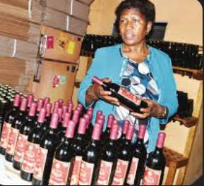
SUCCESS STORIES AND ROLE MODELS (women entrepreneurship)
Mukwano Group: Mrs. Amirali Karmali formed the Mukwano Group, one of Uganda's major conglomerates with holdings in manufacturing, agriculture, and real estate. Mrs. Karmali's success serves as an example for female entrepreneurs, proving that women can flourish in traditionally male-dominated industries.
Maama Care: Maama Care, founded by Alice Emasu Seruyange, is a social company that manufactures reusable sanitary pads to address menstrual hygiene issues among young girls and women in Uganda. Alice's commitment to women's health and her successful business make her a role model for female entrepreneurs.
Eco Brixs: Paige Balcom launched Eco Brixs, a waste management social company that focuses on recycling plastic waste. Paige's dedication to environmental sustainability and community development through garbage management is an inspirational example of women-led social business.

Slide 13
THANK YOU !!!

