Slide 1
OSI-AND PROTOCOLS
BY:
EELU SAMUEL
Computer science and engineering

Slide 2
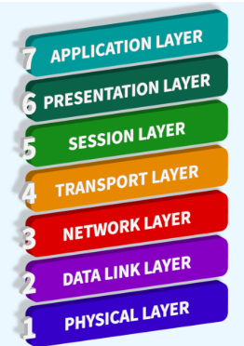
OSI MODEL
Defines how data is transferred from one computer to another a given network.

Slide 3
Application layer
Browsers
Protocols
functions
File transfer, emails, virtual net, telnet, browsing

Slide 4
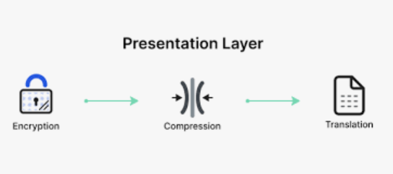
Presentation layer
Logic
Protocols
Functions
Encryption, decryption and compression

Slide 5
Session layer
Logic
Protocols
functions
Authorization, Authentication and session management

Slide 6
Transport layer
Logic
Protocols
functions
Segmentation, connection control, flow control, and error control

Slide 7
Network layer
Logic
Protocols
functions
Assigning logical address, Routing, host to host delivery, logical subnetting etc.

Slide 8
Data link layer
Logic
Protocols
Ethernet and other LAN protocols

Slide 9
Physical layer
Logic
Protocols
Ethernet,
USB,
Bluetooth
IEEE802.11
function
Synchronizing, data transfer, physical medium.

Slide 10
THANK YOU
END

