Slide 1
INTRODUCTION TO COMPUTER FUNDAMENTALS
Understanding these foundational concepts in IT essentials is critical for anyone pursuing a degree in Information Technology Related Fields.
They form the basis for more advanced topics and practical applications in the field of computing and digital communication.

Slide 2
COMPUTER
What is a computer?
What are the main components of a computer?
How does the computer process data?
Business Applications of Computers

Slide 3
Computer Signals
A signal is an electrical or electromagnetic current that carries data from one device or network to another.

Slide 4
Analog Signals
Analog Signals: Continuous signals that represent physical measurements.
Characteristics:
Vary smoothly over time.
Can have any value in a range.
Examples: Sound waves, temperature readings, etc.

Slide 5
Analog Signals Cont’d
Advantages:
More accurate representations of real-world phenomena.
Disadvantages:
Susceptible to noise and distortion.
Harder to store and process using digital systems.

Slide 6
Digital Signals
Discrete signals used in digital communication, representing data using binary (0s and 1s).
Characteristics:
Have specific values at specific points in time.
Represented as a sequence of 0s and 1s.
Examples: Computer data, digital audio.

Slide 7
Digital Signals
Advantages:
Easier to store, process, and transmit without degradation.
Less susceptible to noise.
Disadvantages:
May lose some information during analog-to-digital conversion.

Slide 8
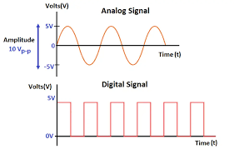
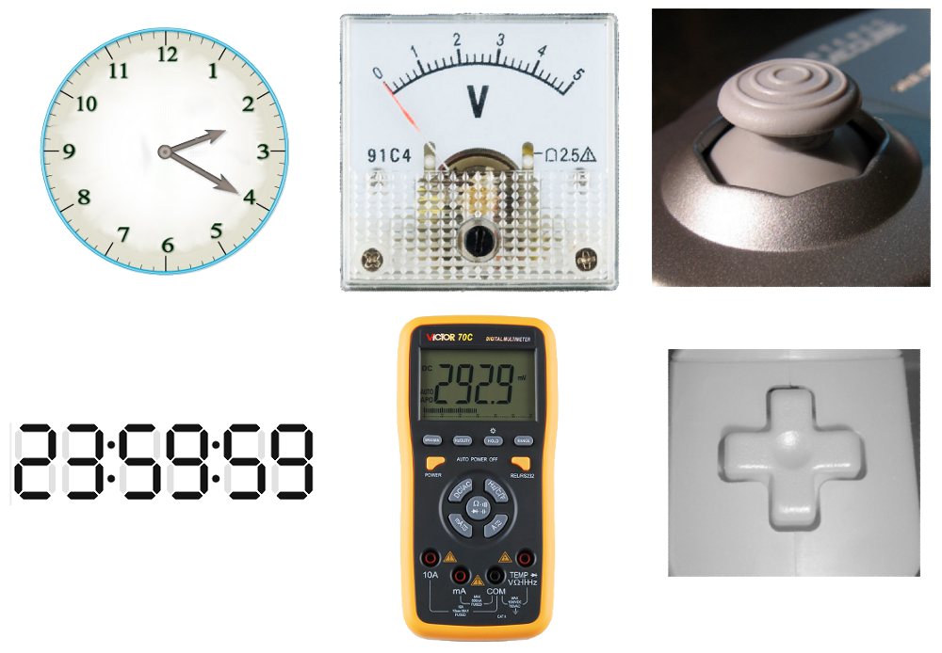

Slide 9
Analog-to-Digital Conversion (ADC)
Process: Converts analog signals into digital form.
Steps:
Sampling: Measuring the amplitude of an analog signal at regular intervals.
Quantization: Converting each sampled amplitude to the nearest value within a set of discrete levels.
Encoding: Representing quantized values in binary form.

Slide 10
Digital-to-Analog Conversion (DAC)
Process: Converts digital signals back into analog form.
Steps:
Decoding: Converting binary values to discrete levels.
Filtering: Smoothing the signal to form a continuous waveform.

Slide 12
Binary and Decimal Number System
Decimal Number System
Definition: Base-10 number system, using digits 0-9.
Characteristics:
Positional value increases by a factor of 10 from right to left.
Examples: 1234== (1*10^3 + 2*10^2 + 3*10^1 + 4*10^0).

Slide 13
Binary Number System
Binary Number System
Definition: Base-2 number system, using digits 0 and 1.
Characteristics:
Positional value increases by a factor of 2 from right to left.
Examples: 1010== (1*2^3 + 0*2^2 + 1*2^1 + 0*2^0).

Slide 14
Converting Between Binary and Decimal
Binary to Decimal:
Example: 1101 => 1*2^3 + 1*2^2 + 0*2^1 + 1*2^0 = 13.

Slide 15
Decimal to Binary:
Example: 13 => 1101 (repeated division by 2 until the quotient is zero (0) and recording remainders in reverse).
Number/2 | Quotient | Remainder
13 | 6 | 1
6 | 3 | 0
3 | 1 | 1
1 | 0 | 1

Slide 16
Significance of Binary in Computing
Foundation of Digital Electronics:
All data and instructions in computers are represented in binary.
Logical Operations:
Binary logic gates (AND, OR, NOT) perform operations on binary data.

Slide 17
ASCII (American Standard Code for Information Interchange)
ASCII: A character encoding standard for electronic communication.
Purpose: Represents text in computers, communications equipment, and other devices using text.
Details: https://www.ascii-code.com/

Slide 18
ASCII Structure
ASCII control characters (character code 0-31)
The first 32 characters in the ASCII-table are unprintable control codes and are used to control peripherals such as printers.
ASCII printable characters (character code 32-127)
Codes 32-127 are common for all the different variations of the ASCII table, they are called printable characters, represent letters, digits, punctuation marks, and a few miscellaneous symbols. You will find almost every character on your keyboard. Character 127 represents the command DEL.

Slide 20
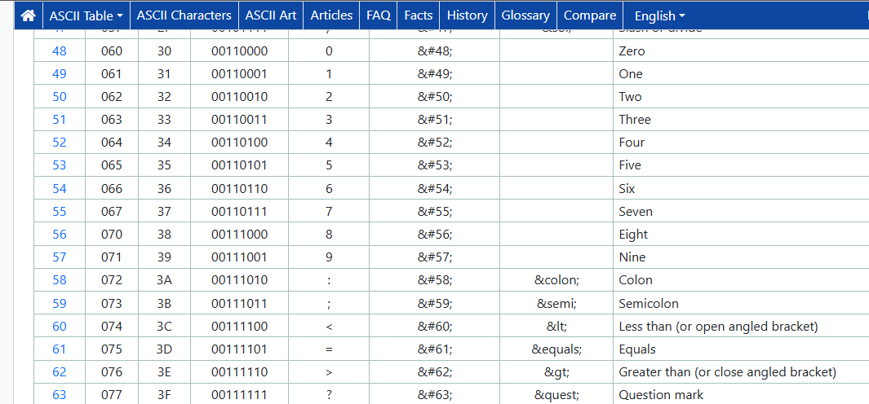

Slide 23
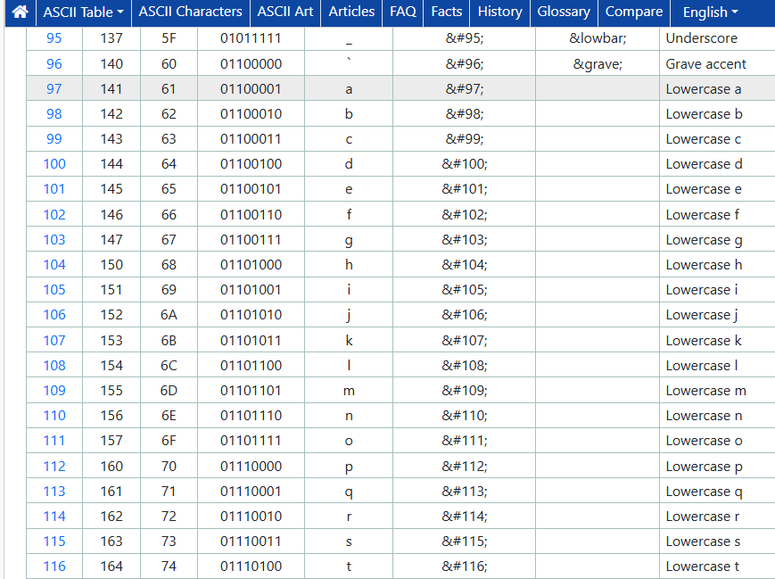

Slide 24
Usage
Text Files: Commonly used in plain text files, programming source code.
Communication Protocols: Used in protocols like HTTP, SMTP for data transfer.

Slide 25
Program Code
Program Code: A set of instructions written in a programming language to perform a specific task.

Slide 26
Types of Programming Languages
High-Level Languages: Python, Java, C++.
Closer to human language, easier to write and understand.
Requires compilation or interpretation.
Low-Level Languages: Assembly, Machine Code.
Closer to binary code, directly executed by the computer's CPU.
More efficient but harder to write and understand.

Slide 28
Structure of a Program
Source Code: Original code written by a programmer.
Compiler/Interpreter: Translates source code into executable code.
Compiler: Translates entire program before execution (e.g., C++).
Interpreter: Translates and executes line-by-line (e.g., Python).
Executable Code: Binary code executed by the computer's CPU.

Slide 29
Basic Constructs
Variables: Storage locations with a name and value.
Control Structures: If-else, loops (for, while).
Functions: Reusable blocks of code that perform a specific task.

Slide 30
User Data
User Data: Information provided by users to applications and systems.
Types of User Data
Personal Information: Name, address, email, phone number.
Credentials: Usernames, passwords.
Preferences: Settings, customizations.
Activity Data: Logs, usage patterns.

Slide 31
Storage and Management
Databases: Structured storage systems for efficient data retrieval and manipulation.
Examples: SQL databases (MySQL, PostgreSQL), NoSQL databases (MongoDB).
Data Encryption: Protecting data by converting it into an unreadable format.
Access Control: Restricting access to data based on user roles and permissions.

Slide 32
Data Privacy and Security
Privacy Policies: Guidelines on how user data is collected, used, and protected.
Regulations: Laws governing data protection.
Best Practices: Secure storage, regular updates, strong authentication, and encryption.

Slide 33
Importance of User Data
Personalization: Tailoring services and experiences to individual users.
Analytics: Gaining insights into user behavior and preferences.
Security: Protecting sensitive information from unauthorized access and breaches.

Slide 34
TYPES OF COMPUTER SYSTEMS
Supercomputers
Definition: High-performance computing systems designed for complex tasks requiring massive processing power.
Uses: Weather forecasting, scientific simulations, complex calculations, and cryptography.
Examples: IBM Summit, Fujitsu Fugaku.

Slide 35
Mainframe Computers
Definition: Powerful computers used by large organizations for bulk data processing and critical applications.
Uses: Banking, government databases, airline reservations, and enterprise resource planning (ERP) systems.
Examples: IBM Z series, Unisys ClearPath.

Slide 36
Minicomputers (Midrange Computers)
Definition: Multi-user computers that are more powerful than personal computers but less powerful than mainframes.
Uses: Small to medium-sized businesses for managing databases, enterprise applications, and industrial control.
Examples: DEC PDP-11, IBM AS/400.

Slide 37
Personal Computers (PCs)
Definition: General-purpose computers designed for individual use, typically found in homes, schools, and offices.
Uses: Word processing, web browsing, gaming, software development, and multimedia.
Examples: Desktops, laptops, and all-in-one PCs.

Slide 38
Workstations
Definition: High-performance personal computers designed for technical or scientific applications.
Uses: CAD (Computer-Aided Design), digital content creation, and software development.
Examples: Dell Precision, HP Z series.

Slide 39
Embedded Systems
Definition: Specialized computing systems that are part of larger devices and dedicated to specific tasks.
Uses: Consumer electronics (e.g., microwaves, washing machines), automotive systems, industrial machines.
Examples: Raspberry Pi, Arduino, automotive control systems.

Slide 40
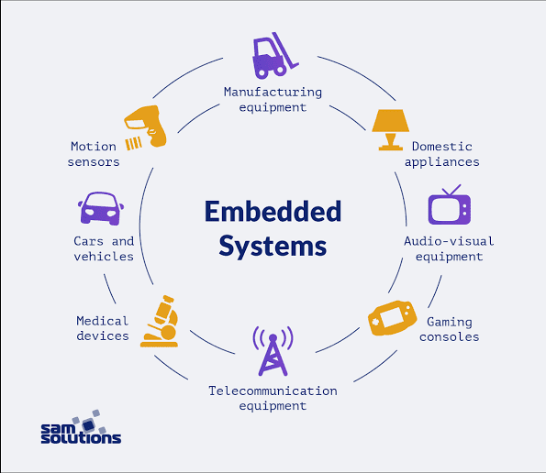

Slide 41
Servers
Definition: Computers designed to manage network resources and provide services to other computers (clients).
Uses: Hosting websites, managing databases, file storage, email hosting, and network management.
Examples: Rack servers, blade servers, and tower servers.

Slide 42
COMPONENTS OF THE COMPUTER SYSTEM
1. Hardware Components: The physical parts of a computer that can be touched and seen.

Slide 43
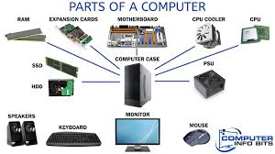
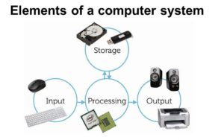

Slide 44
Central Processing Unit (CPU)
Definition: The brain of the computer that performs instructions defined by software.
Function: Executes instructions from software by performing basic arithmetic, logic, control, and input/output operations.

Slide 45
Memory (RAM):
Memory (RAM): Temporary storage used by the CPU to store data and instructions during processing.
Function: Stores data temporarily for quick access by the CPU.

Slide 46
Storage Devices
Function: Store data and programs permanently.
Types:
HDD (Hard Disk Drive): Traditional storage device that uses spinning disks to read/write data.
SSD (Solid State Drive): Faster and more reliable than HDDs, using flash memory to store data.
Optical Drives: Used to read/write data on optical discs like CDs, DVDs, and Blu-rays.

Slide 47
Input Devices
Keyboard: Primary device for text input.
Mouse: Pointing device for navigating the user interface.
Touchpad: Used in laptops as a mouse alternative.

Slide 48
Output Devices
Monitor: Displays visual output from the computer.
Printer: Produces physical copies of digital documents.
Speakers: Output sound generated by the computer.

Slide 49
Motherboard
Function: The main circuit board that holds the CPU, memory, and other essential components and allows them to communicate.

Slide 50
Motherboard Components
Bus: A communication system that transfers data between components.
Chipset: Manages data flow between the CPU, memory, and peripherals.
Expansion Slots: Slots for adding expansion cards like graphics cards, sound cards, or network cards.

Slide 51
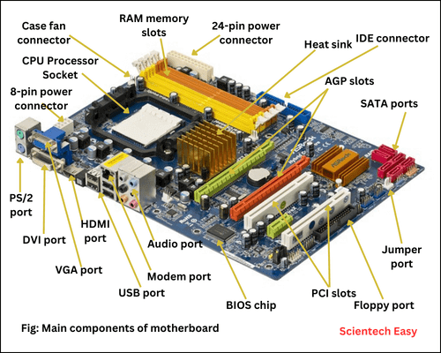

Slide 52
Software Component
Operating System (OS):
Function: Manages the computer’s hardware, provides a user interface, and serves as a platform for application software.
Examples: Windows 10/11, macOS, Linux distributions (e.g., Ubuntu, Fedora).

Slide 53
Application Software
Function: Performs specific tasks for the user, such as word processing, web browsing, or photo editing.
Examples: Microsoft Office Suite, Adobe Creative Suite, web browsers like Chrome and Firefox.

Slide 54
System Software
Function: Provides core services required for the functioning of application software and management of hardware.
Examples:
Device Drivers: Allow the OS to communicate with hardware devices.
Utilities: System maintenance tools like disk cleanup, antivirus software, and backup utilities.

Slide 55
Communication Component
Network Interface Card (NIC)
Function: Connects a computer to a network, allowing communication with other computers.
Types:
Ethernet NIC: For wired connections using Ethernet cables.
Wireless NIC: For wireless connections using Wi-Fi.

Slide 56
Modem
Function: Converts digital data from a computer into a format suitable for transmission over analog telephone lines and vice versa.
Types:
DSL Modem: For broadband internet over telephone lines.
Cable Modem: For broadband internet over cable TV lines.

Slide 57
Router
Function: Routes data between different networks, typically between a home network and the internet.
Functions:
IP Addressing: Assigns IP addresses to devices on a network.
NAT (Network Address Translation): Allows multiple devices on a private network to share a single public IP address.

Slide 58
THANK YOU

