Slide 1
Introduction to using social media for work as an individual

Slide 2
Introduction

Slide 3
What this session covers
Aim: “To equip you to select and use a social media channel to confidently and effectively promote your professional reputation and work”
Covers:
Personal social media accounts used for professional promotion
Identifying your aims, audience and channel
Outline of key features of the main social media channels
Principles of social media communication
Basic practical advice on setting up and using Twitter and LinkedIn
Doesn’t cover:
Using official social media accounts
Using purely personal social media accounts
Detailed practical instructions on using channels
Notes:
Covers:
Personal. Blended description – account which represents an individual (you) and talks about matters relating to your work/the College
Aims. Key to start here, as will inform the rest
Principles – applied broadly to all channels
Twitter/LinkedIn are what we see as the post popular for personal/profession work, so focusing on these
Doesn’t cover:
Official accounts – different approach and principles as constitutes official representation of the College. Thus there are different brand, reputation and legal considerations
Personal – none of our business, generally speaking – so won’t be covering how to promote your blog on your passion for gluten free baking
Detailed instructions – would take forever and the processes are frequently changing. Platforms will provide guidance on how to do this, don’t worry

Slide 4
Marketing and Communications directorate
Promote and protect reputation of Royal Holloway
PR
Internal Comms
Recruitment
Marketing
Events
Notes:
The Digital team sits in M&C
M&C supports promotion of courses, academic excellence, the student experience – everything we do which has relevance to external audiences. Do this at cross college level and working with individual teams/depts
Includes following teams…

Slide 5
Digital Communications team
Promote and protect
External website
Social media
Best practice
Four members
Notes:
Manage and develop content for the website – focus on core pages Coursefinder, homepage, etc but also assist with team and department content
Manage main social media channels
Best practice for website and social media – digital best practice toolkit on intranet covers setting up social media channels, CMS usage, creating video for digital
Small team with broad remit. 50,000 pages and well over 100 social media accounts associated with Royal Holloway, plus the thousands of users who have personal accounts – we focus on equipping and empowering colleagues rather than doing all activity
Equipping and empowering is what this presentation is intended to do – to help you be effective at promoting your work as an individual and this way contribute to the collective reputation of the College

Slide 6
Before you start

Slide 7
Three starter questions
1. What are your aims and who is your target audience?
2. Is social media right for you?
3. Which social media channel is best for you?
Notes:
Social sometimes perceived as quick and easy to do. This is not untrue, but you get what you give
So worth asking fundamental questions rather than just jumping in
<READ QUESTIONS>
All connected, sequential and dependent
Will inform the direction you take – shaping your focus and effort, and maximising your impact
Now let’s go into more detail and what your answers might be…

Slide 8
1. What are your aims and who is your audience?
Aims:
Promote a service, project or event
Enhance reputation
Form/join a community
Audience:
Academic peers
Enterprise
Research collaborators
Prospective students
Notes:
<READ EGS>
Aims can be multiple and blurred. What are your desired outcomes? – so that’s not ‘get a big following’ but what you want to achieve with that audience
Audience can also be blurred but are directly connected to aims. Which audiences will enable you to achieve your aims?
Eg promoting a business consultancy service is the aim – enterprise is the audience
Eg enhancing your academic reputation with regards to medieval poetry is the aim - academic peers with a similar specialism are the audience

Slide 9
2. Is social media right for you?
Can you aims be met on social media?
Are your audience on social media?
Do you really have the time?
Do you have content and something to say?
Notes:
Considering answers to previous slide
Aims – if you aim is to publish a paper, social media may not be right (although could promote that paper, of course)
Audience – seems almost everybody is on a social media (come to channel demographics later). Survey by communications consultancy Flint found that in 2018 83% of the UK adult population used social media. But if you have a very specialist or niche audience they may be in that 17% or may not use social media in a way that aligns with you aims
Time – get what you give. Especially from scratch, building a relevant audience is hard work. It requires regular posts and replies
Content – should be singular, compelling, original. Content types include opinions (only go so far), news articles, events, blogs, images, infographics, videos

Slide 10
3. What channel is best for you?
Notes:
We come to the final question…
Plethora of channels out there
Channels have different audiences, purposes, format and impact
So, again, drawing on answers to previous questions, which one bests matches your aims and audience?
Let’s move on to the channels overview…

Slide 11
Channels overview

Slide 12
Twitter
Format:
Bulletin service
Open network
Follow mechanism generates audience
Active users have high frequency of posts
Audience:
12.6 million UK-based users (down 2.5)
45% of 16-22 year olds are using Twitter
45-55 age range still biggest user group of channel
Notes:
12.6 million – survey by Flint
45% of 16-22 year olds – Ipsos Mori report
45-55 age range – Ofcom

Slide 13
Twitter – pros and cons
Pros:
Post media easily
Potential for mass impressions/exposure
Simple to use and post
Curated communities
Very current content
Cons:
Slacktivism
Building audience initially can be a challenge
Echo chamber
No native analytics
Ad service immature
Automated link previews
Mass audience means mass background noise

Slide 14
Facebook
Format:
Closed network
Can post multiple media types
Varied functionality
Multiple page/group types
Detailed profiles
Audience:
30 million people in UK actively using the site
84% vs 73%, female vs male usage
80% of 23-37 year olds use regularly
60% of 52-71 year use regularly
Notes:
All slide stats – Flint survey

Slide 15
Facebook – pros and cons
Pros:
Huge potential audience
Can post almost any type of content
Sophisticated analytics tool (pages)
Highly developed ad options
Flexible page/group options
Cons:
Despite huge audience organic reach is limited
Paid posts dominant
Content contained within the network
Can be complex understanding all functional options

Slide 16
Instagram
Format:
Image and video focus
Simple content editing options
Posts and stories
Open network
Audience:
Estimated 16.7 million UK users in 2017
Fast growing audience – 200m increase in 2017 to 700m
18-34 year olds account for 61% of the user base
Follow mechanism generates audience
Notes:
16.7 million – eMarketer report
200m increase – Flint survey
61% of 18-34 year olds – Flint survey

Slide 17
Instagram – pros and cons
Pros:
Potential for high levels of engagement
Simple to use
Showcases creativity well
Developed ad options
Some analytics options
Actively growing and well regarded
Cons:
Restricted format type
Effort/impact stakes higher
Content stays within the network
Difficult to link to other content

Slide 18
LinkedIn
Format:
Closed network for professionals
Originally specific sectors
Original focus networking and recruitment
Now includes thought leadership and collaboration
Group and community options
Audience:
Used by 33% of UK adults
37% vs 29%, male vs female
Biggest user age group is 25-44 year olds
50% of people earning £45k+ use compared to 22% earning up to £14k
only 21% of users were active on the platform once a day
63% use it just once a week or less
Notes:
All slide stats – Flint survey

Slide 19
LinkedIn– pros and cons
Pros:
Specialist communities/groups to join
Developed recruitment options
Varied functionality
Can post almost any type of content
Cons:
Restricted direct messaging options
Organic post restriction
Content contained within the network
Can be complex understanding all functional options

Slide 20
YouTube
Format:
Video streaming
Basic video editing options
Live broadcast option
Channels and subscribers
Audience:
37.1 million UK adults use the platform
97% of all 18-24 year-olds are active users
People 18-24 watched 486.6 videos each on average during July 2017
In same period those aged 55+ watched 96 videos
Average video viewing time 3.7 minutes
Videos can be embedded in other locations
Blanket licensing for some music
Completely open network
Notes:
37.1 million UK adults use the platform – Flint survey
97% of all 18-24 year-olds are active on the site down to just 40% of those 70+ - comScore report
people aged between 18-24 watched ‘a massive 486.6 videos each on average’ during July 2017 - comScore report

Slide 21
YouTube – pros and cons
Pros:
Popular, high impact format
Potential for lengthy engagement
Returns highly in search
Developed ad and analytics functionality
Cons:
Restricted to video
Can be time consuming to create content
Linking out of network restricted
Paid posts dominate organic

Slide 22
Social media principles

Slide 23
Summary
Relevance
Concision
Content factors
Frequency
Timeliness
Broadcast/dialogue
Authenticity
Be nice
Legal

Slide 24
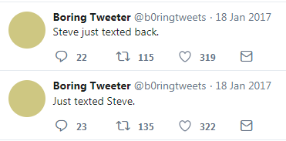
Relevance
Notes:
Misleading example, as this account is actually doing well with regards to:
Identifying your audience
Think not just about what you want to say, but what they want to hear
Be consistent in tone, subject etc to establish statue and maximise impact
This account is very popular on Twitter because it considered all these things

Slide 25
Concision
Notes:
People likely use multiple social media channels – add in other types of digital and non digital consumption and it’s a maelstrom of data
Ergo, people consume social media in short, staccato, distracted bursts
There attention skims over feeds so be concise and impactful
Posts should be like headlines to cut through the crowd and be digestible
Images, diagrams, infographics and gifs can help – more on content in next slide
Typically this should also apply to the destination content, if linking through

Slide 26
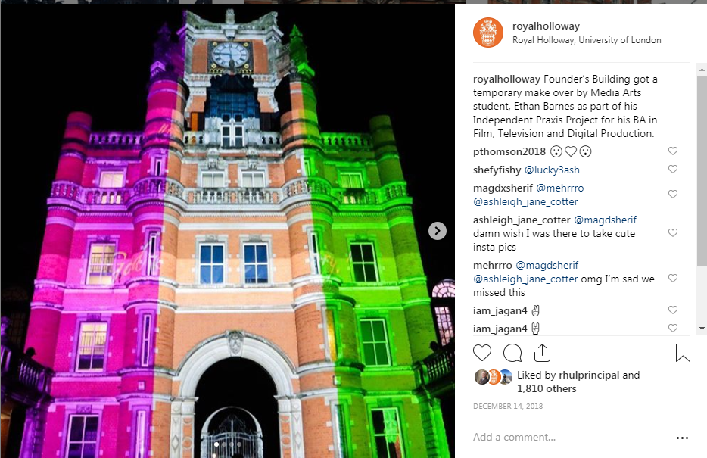
Content factors
Notes:
Across social media multimedia will do better
The core content doesn’t have to be multimedia, but consider what multimedia content can go with it
If it is original, it is also likely to do better – both in terms of content itself and concept
Different media types can be used to promote the same item
Eg Ethan Barnes, Media Art student. As part of a project for his BA
Projected suffragette flag onto founders
Posted on the centenary of women first voting in a general election
1,811 likes, 12 comments, 17,961 impressions, 1,866 engagements
This is our 5th most engaged post in the past 2 years
Used imagery and video footage in promotion
Striking image, but also unique concept combining two established and popular subjects in an unusual way

Slide 27
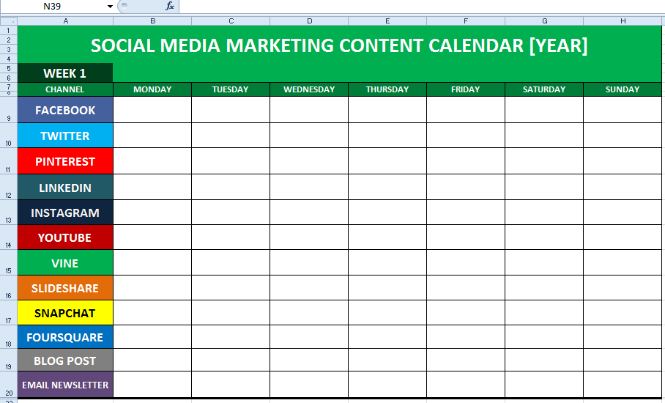
Frequency
Notes:
Impact, audience, reputation – all can be gained on social, but all are fragile
Users check social frequently – if you don’t post for a month, momentum will be lost
Equally, over posting can result in audience fatigue
Post regularly (frequency varies on channels) – you can fill in gaps with dialogue, shares, RTs etc (so the account is still active, even if you aren’t posting your own content)
Consider using a schedule (example in slide) and/or social media management platform (more on the latter in later slide) to enable and organise frequent posting

Slide 28
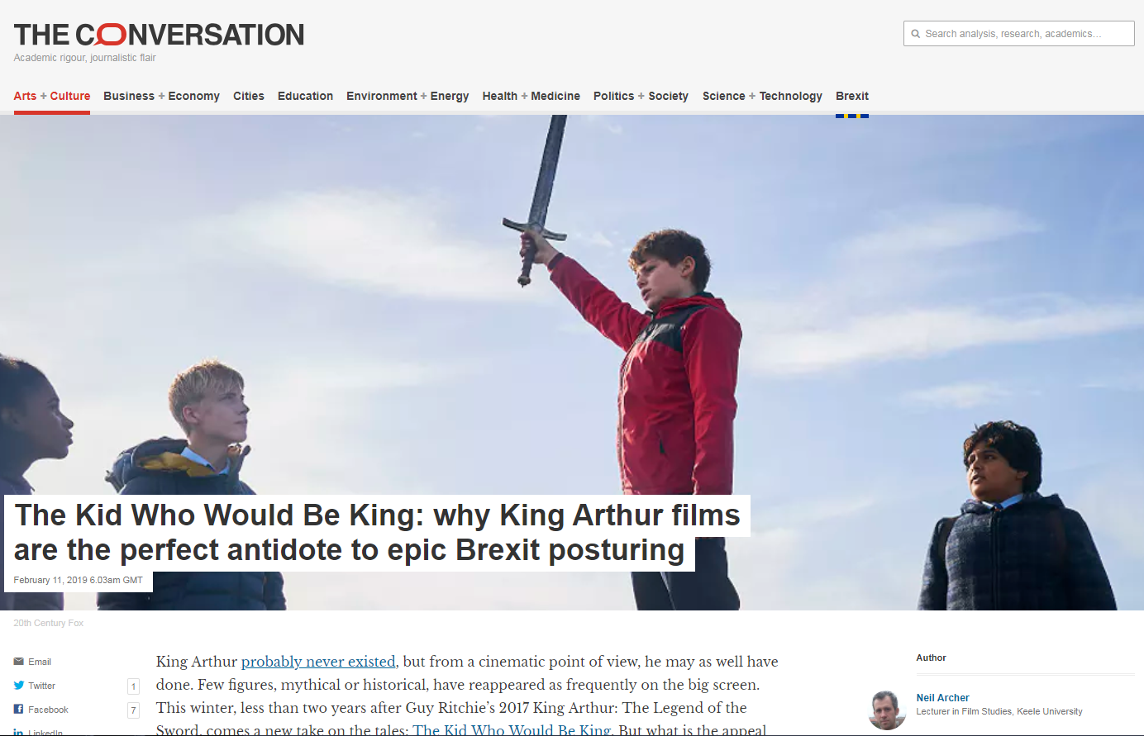
Timeliness
Notes:
Although topic focus will vary depending on audience, they all favour timely content
So what is your audience interested in at a given time?
Much like multimedia, timeliness can be harnessed for your posts, rather than constitute their substance
Conversation example – the model melds a current film and a current political topic using the academics area of expertise

Slide 29
Broadcast/dialogue
Broadcast
Posts
Dialogue
Shares
Replies
Likes
Notes:
Aim for a balance – if anything slightly in dialogue’s favour
Do not neglect dialogue- this is the strength of social media
Dialogue seems time consuming and narrow in terms of impact, but it is an investment for the future
Dialogue increases your connections and your reputation will increase your amplification and impact – somebody you have had dialogue with is much more likely to RT your broadcast tweet
Starts to convert people from lazy follower > advocate

Slide 30
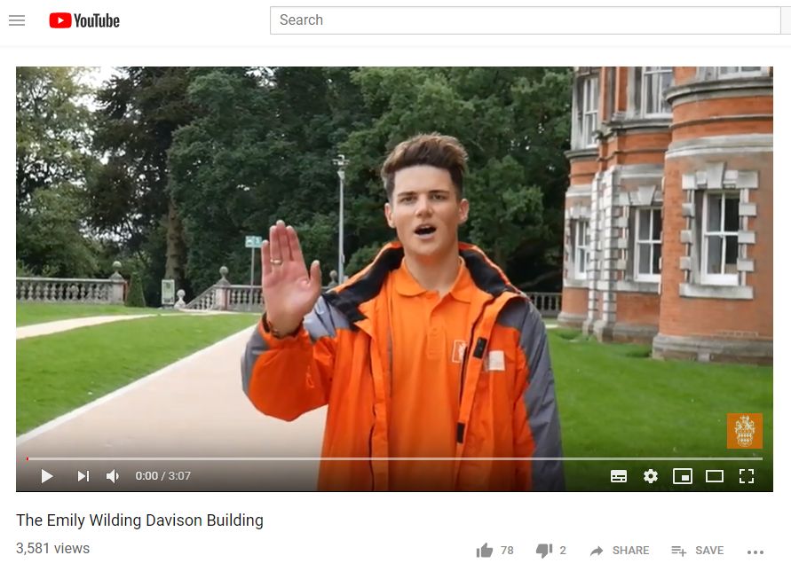
Authenticity
Notes:
Always been at the root of good social – indeed originally this was it’s core and only purpose. There were no org pages on Facebook – just personal profiles
In a current climate of fake news and ubiquitous, insistent advertising authenticity is more important than ever
Your personality should come through
What is unique in terms of your opinion and content? Try to bring this out in your activity and content
Rough edges are ok – this is part of authenticity. This could be manifest in the sub-professional quality of the content, humour, errors, admitting mistakes, being honest and transparent
Letting other people tell the story about your content
Example – Harry Ainsworth became an online hit when the Daily Mail covered a video he did about looking for a new housemate. Won’t show that one as it has a lot of expletives. It was a funny, rough around the edges, risqué, self deprecating video with an actual purpose. Following this, he did a video for us on opening of EWD which harnessed many of those same qualities

Slide 31
Be nice
Notes:
Moderator to the former principle – being authentic can sometimes go too far, especially when using humour or stating opinions
Seems obvious but anonymity of social can make for venomous environment
Tone difficult to read on social – especially when using humour or being ironic
Think about the likely impact on your audience before posting – if in doubt, don’t post. Admit when you are wrong, apologise, be transparent
The internet does not forget
Failure to consider this principle could result in loss of audience and reputation, blocking from followers or platform and legal repercussions in extreme cases
Don’t feed the trolls – winning online arguments is the philosopher’s stone
All platforms have reporting mechanisms – use them if others are not being nice and/or contravening the platforms terms of use/community guidelines

Slide 32
Legal
Notes:
Copyright – applied to all formats of content: words, images, videos, audio. If you don’t hold copyright and it’s not creative commons, you need permission
Fair use: Generally, something is considered fair use when the original material is used for a limited and “transformative” purpose, such as commentary, criticism or parody
Privacy – don’t share other people’s private details. Unless in public and difficult to personally identify, seek permission for images or video
Commercial sensitivity – if you are talking about your work, this is likely to also be the College’s work
GDPR – individual responsibility to understand this, especially if you are gathering personal data in any way
Libel and slander – hard to enforce, but applies as it would in other media types
Even with a personal account you could be considered to represent the college – please refer to the social media policy on the staff intranet

Slide 33
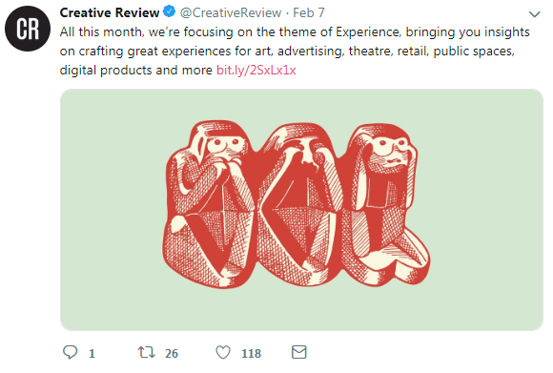
Engaging with other accounts
Notes:
Reply – public, direct response to the poster - @ing them. Will appear on your feed and in their notifications
Retweet – shares the post as is to your feed. Appears in their notifications
Like – poster notified but not much else. Adds to a list in your profile which could be used for bookmarking posts you like
Direct message – private 1-1 message. Have to be mutual follows in place

Slide 34
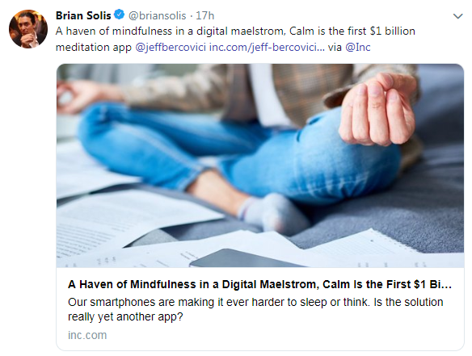
Composing a post
Notes:
Include something evocative and intriguing
Balance the former with clarification on what it actual is you’re clicking through to
Short link to article
@ing involved accounts
Inclusion of image – in this case automated
Hashtags still have some value but should be used sparingly – 2 max

Slide 35
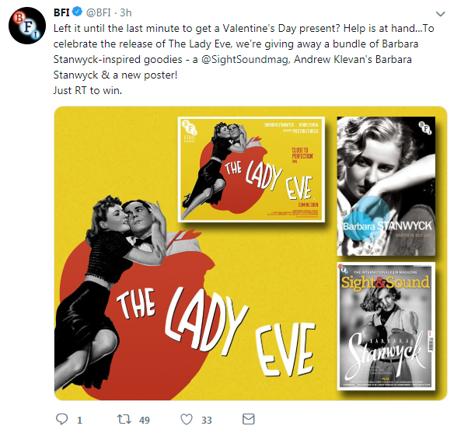
Measuring success
Notes:
You can see stats against each engagement publically on the front end
You will also get figures via your notifications
Anything more complex will require a social media management platform – links later

Slide 36
Creating a profile
Profile image
Background image
Intro
Background
Skills
Accomplishments
Additional info
Notes:
Profile image
Background image
Intro – headline description of you and what you do
Background – work exp, education, licenses and certifications, volunteer exp
Skills – skills tags which you can be endorsed for by others
Accomplishments – publications, patents, coursework, projects, honours and awards, etc – almost anything you can brag about
Additional info – recommendations from others

Slide 37
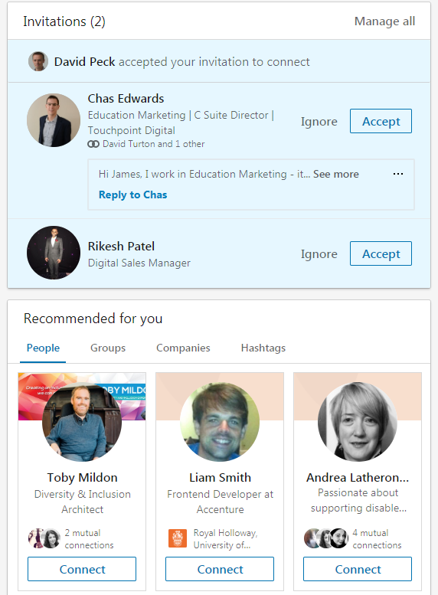
Connections
Notes:
LinkedIn will make some suggestions based on the info you provide – more comprehensive than twitter as it asks for more info on setup
The tailored recommendations will become more refined as you connect and engage with people
Curate who you follow – have fewer, more relevant so you can take in what they post and interact with meaning.
And crucially – you should have a genuine link with them (unlike twitter)

Slide 38
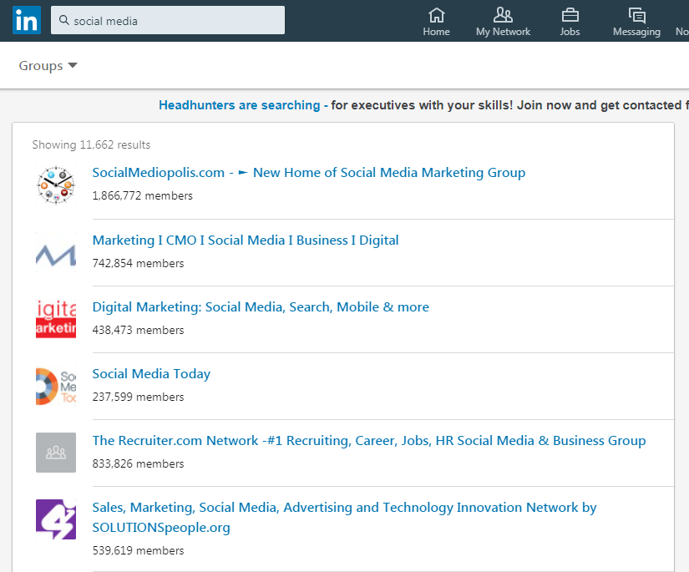
Joining groups
Notes:
Simply search by group for your topic of interest
Again, fewer is better as you will need to engage with these groups to see any benefit
Some will require you to request membership

Slide 39
Resources and information
Royal Holloway:
Social media policy
Digital Best Practice Toolkit
Cyber Security Moodle course
External tools:
Hootsuite
Tweetdeck
Buffer
External resources:
Social Media Examiner
Sprout Social insights
Hootsuite blog

Slide 40
End

