Slide 1
Employee Compensation Management

Slide 2
Definition of Compensation
Compensation is the pay given to an employee by an employer in appreciation for and in return for work done.
Employee compensation deals with the strategies, policies and processes required to ensure that the contribution of people to the organization is recognized by both financial and non-financial means.
Compensation management entails the implementation and maintenance of reward systems (reward processes, practices and procedures), which aim to meet the needs of both the organization and its stakeholders.

Slide 3
The overall objective is to compensate employees fairly, equitably and consistently in accordance with their value to the organization in order to further the achievement of the organization’s strategic goals.
Compensation management is not just about pay and employee benefits. It is equally concerned with non-financial rewards such as recognition, learning and development opportunities and increased job responsibility

Slide 4
Objectives of employee compensation
To reward people according to the value they create
To align reward practices with business goals and with employee values and needs
To convey the right message about what is important in terms of behaviours and outcomes
To help to attract and retain the high-quality people
To motivate people and obtain their engagement and commitment
To develop a high-performance culture.
etc

Slide 5
Components of employee compensation
Processes for measuring the value of jobs
Practices for motivating people by the use of financial and nonfinancial rewards
Structures for relating pay levels to the value of positions in the organisation and for providing a scope for rewarding people according to their performance, competence, skill and/or experience
Procedures for maintaining the system and for ensuring that it operates efficiently and flexibly and provides value for money.

Slide 6
Elements of employee compensation
Compensation can be in the form of fixed pay or variable pay;
Base pay, either an hourly wage or salary (Fixed pay)
Wage and salary add-ons.
Incentive pay for performance
Benefits
Bonuses
Allowances

Slide 7
Determinants of reward and compensation
These are two main categories of factors that organizations base on to determine pay;
Internal factors
External factors

Slide 8
External factors
Cost of Living (Economic Conditions)
Prevailing Wage rates
Influence of Labour Unions
Mobility of labour
Demand and supply of labour
Government Control through Legal regulations
Reputation of the organization

Slide 9
Internal Factors
Compensation Policy of the Organization
Worth of a Job
Employee’s Worth
The Organizational Ability to Pay
Job Analysis and Job evaluation
Employee Related Factors eg. Negotations
The influence of top Management and share holders

Slide 10
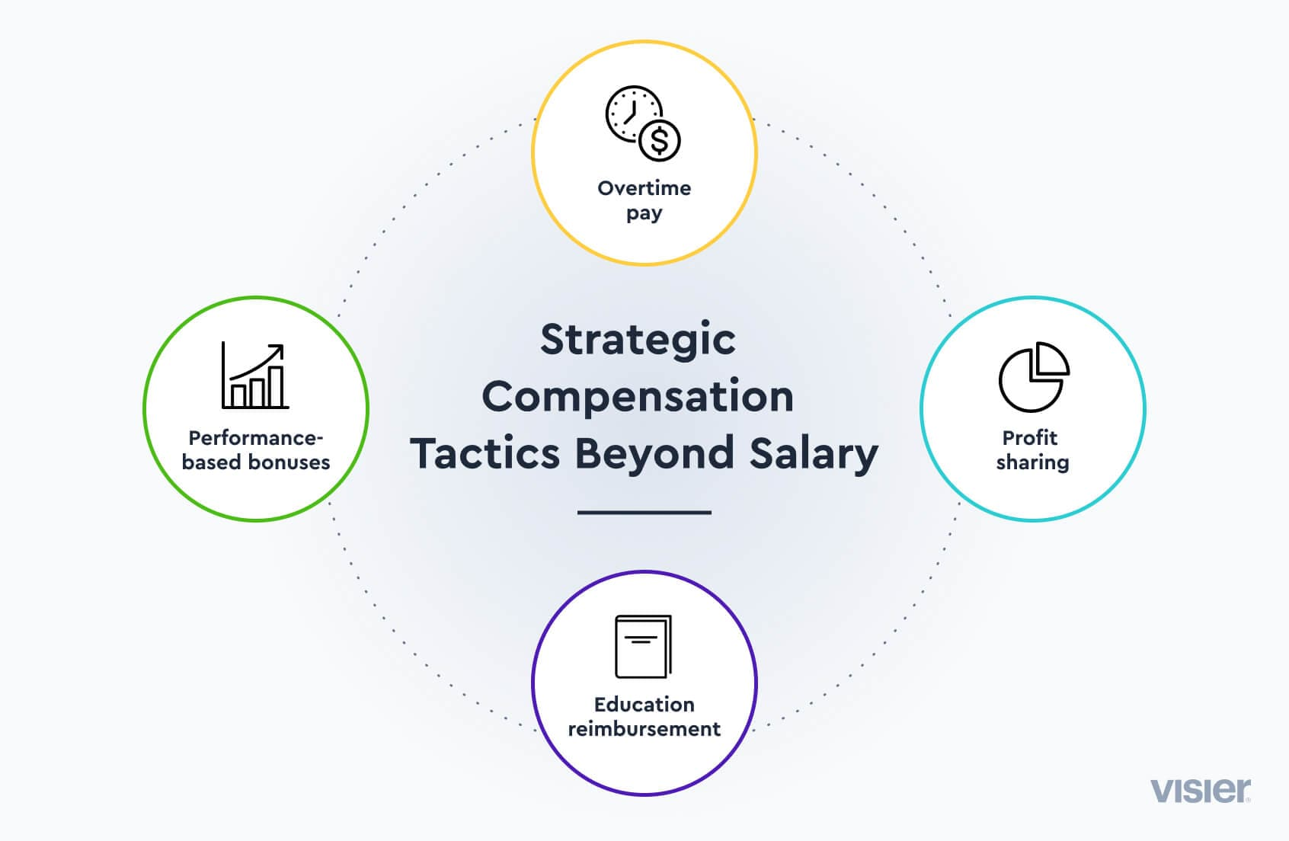
Strategic & Operational integration of compensation programs

Slide 11
Strategic compensation overview
Strategic compensation management is an approach to the development and implementation over the longer term of reward strategies and the guiding principles that underpin them
It provides answers to two basic questions: first, where do we want our reward practices to be in a few years’ time? and second how do we intend to get there? It therefore deals with both ends and means. As an end it describes a vision of what reward processes will look like in a few years’ time.
As a means, it shows how it is expected that the vision will be realized in the operationalization of the compensation strategy.

Slide 12
Guidelines for effective Strategic compensation
Review the compensation strategy to remain relevant
Employee involvement
Conduct market studies
Align compensation to the budget
Ensure legal compliance
Plan for rewards and bonuses beyond the salary
Communicate your strategy

Slide 13
Operationalizing Strategic compensation
Align reward strategies with the business and HR strategy.
Align reward policies with the culture of the organization
Value employees according to their competence and contribution.
Aim to achieve equity, fairness and consistency in the operation of reward policies and practices.
Incorporate transparency
Adopt an integrative approach that ensures that innovations and practices relate to other aspects of HRM
Provide managers with the authority and skills needed to use rewards to help achieve their goals.
Breakdown the components of the strategic compensation to specific tasks and behaviours which are to be compensated

Slide 14
The process of designing Compensation systems
Analyze & Evaluate the Jobs (required skills, education, hierarchy, responsibility etc).
Survey Wages & Salary (Internal and external)
3. Define Pay and Grade Structure
4. Implement the approved pay structures
5. Monitoring and evaluation

Slide 15
Likely challenges in establishing and implementing compensation systems?

