Slide 1
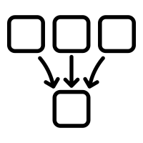
MERGERS
BY JULIET JOY APIO

Slide 2
Introduction
Mergers are becoming more common in Uganda as companies seek to expand their operations, improve efficiency and gain a competitive advantage
The specific terms and conditions of a merger can vary widelydepending on the companies involved, the industry they operate in and the strategic goals of the merger.

Slide 3
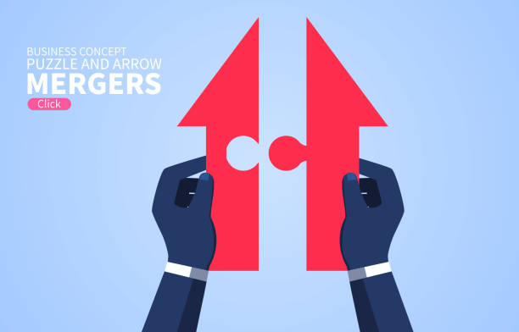
Definitions
Mergers occur when two or more companies combine to form a single entity with the aim of increasing their market share, gaining access to new markets or technologies, and achieving economies of scale
Is a business combination in which two or more companies join together to form a new larger company
Two firms of the approximately the same size join forces and evolve into a new entity with a new configuration of ownership.
Stock of both companies ceases to exist, and a new stock is issued.

Slide 4
Forms of Mergers
Horizontal
This occurs when two or more companies operatin in the same industry and at the same stage of production process merge to create a larger company. The goal is to increase economies of scale and increase market share
One firms mergers with another that produces and sells an identical or similar product in the same geographical area
Vertical
This is when two or more companies operating at different stages of the production process combine to create a larger company . The goal is to intergrate the production process and reduce transaction costs
This involves coupling of a customer and a supplier to gain better access to end users and market visibility
Conglomerate
This is where 2 or more companies operating in completely diferent industries merge to create a larger company. The goal is to diversify business operations and reduce risk
Forexample internet company merging with a chain of restuarants

Slide 5
Examples of Mergers
Coca-cola Beverages Africa
In 2017 Coca-cola Sabco, announced a merger with Century Bottling company and Rwenzori Bottling company and created a new entity Coca-Cola Beverages Africa Uganda.
NIC Holdings and Commercial Bank of Africa merged in 2019 to form NCBA Bank Uganda

Slide 6
Advantages of Mergers
Increased efficiency: Mergers can lead to improved efficiency by eliminating duplicate operations and reducing costs through combining resources and streamlining operations
Diversification of product and service offerings: Mergers can help to reduce risk and stabilize revenue streams
Improved market share: By combining their customer bases and expanding their reach, mergers can increase their market power and improve their competitive position
Access to new markets and customer segments: By combining their resources and expertise, merged companies can enter new geographies and expand their offerings to better meet the needs of customers
Synergy by combining the strengths of two companies to create a more powerful entity. This can lead to increased innovation, improved quality and better customer service

Slide 7
Advantages of Mergers-Continued
Economies of scale: By allowing companies to combine their resources , companies can benefit from increased purchasing power. This can result in lower costs and improved profitability
Enhanced innovation and R&D
Improved financial performance
Enhanced talent pool
Improved brand recognition
Improved access to capital
Reduced competition
Enhanced international presence
Improved supply chain management
Improved regulatory compliance

Slide 8
Disadvantages of Mergers
Intergration challenges: It is difficult to intergrate different corporate cultures, management styles which can lead to significant delays
Cultural differences: This can result in difficulties in communication, decision making and management
Employee morale: Mergers can can lead to uncertainty and anxiety among employees
Regulatory hurdles: Particularly if the two companies operate in highly regulated industries
Increased complexity in terms of organizational structure
Increased costs: legal fees, consulting fees, restructuring fees
Increased bureaucracy
Loss of identity
Misaligned goals and priorities between the merged companies

