Slide 1
Web Server Architecture: A Comprehensive Overview
This document provides a detailed exploration of web server architecture, covering both physical and logical aspects. We will delve into single-tier and multi-tier architectures, offering insights into their design, advantages, and use cases. This guide is tailored for IT professionals and students seeking a deeper understanding of web server infrastructure.

Slide 2
Web Server Architecture
Web server architecture refers to the design and structure of how a web server processes, manages, and delivers web content to users.
It includes hardware, software, protocols, and network configurations that ensure efficient and secure communication between clients (browsers, mobile devices) and servers.

Slide 3
Physical vs. Logical Architecture
Physical Architecture
Logical Architecture
Physical architecture refers to the tangible components of a web server system.
This encompasses the hardware, including servers, networking equipment, and storage devices.
Key considerations include server specifications (CPU, RAM, storage), network bandwidth, and physical security measures.
Logical architecture, on the other hand, focuses on the software and organizational structure.
This involves the operating system, web server software (e.g., Apache, Nginx), databases, and application code.
It also includes how these components interact and are managed.
Understanding both physical and logical architectures is crucial for designing and maintaining efficient and reliable web server systems. Physical resources must support the demands of the logical architecture to avoid bottlenecks and ensure optimal performance.

Slide 4
Physical Architecture:
This refers to the tangible hardware and network infrastructure that supports your web server. It includes:
Servers and Data Centers: The actual machines—whether physical or virtual—that host your web server software.
Networking Equipment: Routers, switches, firewalls, and cables that connect these servers to each other and the wider internet.
Storage Devices: Hard drives or SSDs where website data, databases, and files are stored.
Redundancy Systems: Backup power supplies, cooling systems, and failover hardware that ensure continuous operation.

Slide 5
Logical Architecture
This represents the conceptual or abstract layout of your web application:
Application Layers/Tiers: How the application is segmented into parts such as the user interface,application processing), and database management.
Software Components: The division of responsibilities among different software components, such as web servers, application servers, and database servers.
Communication Flow: How data flows between components, which protocols are used, and how requests and responses are handled.

Slide 6
Components of Web Server Architecture
Client (User Device):Any device (computer, phone, tablet) that requests web pages or services.
Web Server:Software that processes client requests and delivers web content.
Application Server (For Dynamic Content):Processes business logic for dynamic web applications.
Database Server:Stores and retrieves data requested by the web or application server.
Load Balancer (For High-Traffic Websites):Distributes client requests across multiple servers.

Slide 7
Types of Web Server Architectures
🔹Single-Tier Architecture (Single Server)
Everything runs on one server (Web, Application, and Database in one place).
Simple to set up but not scalable. 📌 Use Case: Small websites, personal blogs.
🔹 Two-Tier Architecture (Web Server + Database Server)
Web and Application Server handle requests, while Database Server stores data.
Reduces the load on a single machine, improving performance. 📌 Use Case: Small to medium business websites.

Slide 8
Single-Tier (Single Server) Architecture
All the components of the application (the web server, application logic, and database) reside on one machine.
Characteristics:
Simplicity
Cost-Effective
Performance Limitations
No Redundancy
Example Scenario: A small business website or a personal blog might start on a single-tier architecture. It’s straightforward but may need to evolve into a more robust system as traffic grows

Slide 9
Advantages of Single-Tier Architecture
1
Ease of Setup
2
Low Cost
3
Simple Management
Requires minimal configuration and technical expertise.
Reduces infrastructure expenses as it only involves one server.
Easier to manage and maintain due to its straightforward design.
Despite its limitations, single-tier architecture remains a practical option for small-scale projects or initial development stages where simplicity and cost-effectiveness are primary concerns.

Slide 10
Disadvantages of Single-Tier Architecture
It is not scalable, meaning it cannot handle increased traffic or data volume efficiently.
It also presents a single point of failure; if the server goes down, the entire website becomes unavailable.
Performance can also be a bottleneck, as all resources are shared.

Slide 11
Comparing Single-Tier and Multi-Tier Architectures
Feature
Single-Tier
Multi-Tier
Complexity
Simple
Complex
Scalability
Limited
High
Reliability
Low
High
Cost
Low
High
Management
Easy
Difficult
The choice between single-tier and multi-tier architecture depends on the specific needs of the application. Single-tier is suitable for small, low-traffic websites, while multi-tier is necessary for large, high-traffic applications that require scalability and reliability.

Slide 12
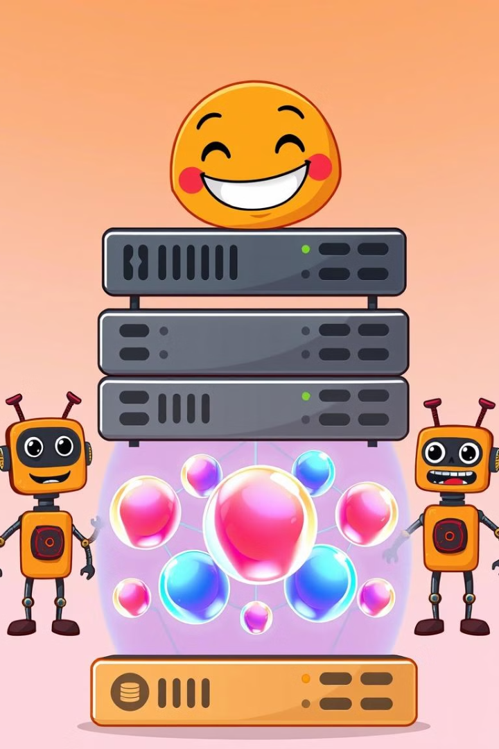
Types of Web Server Architectures
🔹 Three-Tier Architecture (Separate Web, Application, and Database Servers)
Each tier is independent, improving scalability and security.
The Web Server handles client requests.
The Application Server processes logic and connects to the database.
The Database Server stores and manages data. 📌 Use Case: Large e-commerce sites, SaaS applications.
🔹 Multi-Tier (Load-Balanced) Architecture
Uses multiple web servers behind a Load Balancer to handle high traffic.
Can include caching layers (Redis, Varnish) and CDNs (Content Delivery Networks). 📌 Use Case: Large-scale websites (Facebook, Amazon, Google).

Slide 13
Multi-Tier (Load-Balanced) Architecture
The multi-tier architecture separates the application into distinct layers—typically presentation, application logic, and data storage—which can run on different servers.
Load balancing is used to distribute incoming requests across multiple servers, enhancing performance and reliability.
Characteristics:
Scalability:
Reliability and Redundancy:
Enhanced Performance:
Complexity:

Slide 14
Benefits of Load Balancing in Multi-Tier Architecture
1
Improved Performance
2
High Availability
3
Scalability
Distributes traffic, preventing overload on any single server.
Ensures continuous service even if one or more servers fail.
Allows for easy addition of more servers to handle increased load.
Load balancing is a critical component of multi-tier architecture, ensuring optimal performance and uptime for web applications. Different load balancing algorithms (e.g., round robin, least connections) can be used depending on specific requirements.

Slide 15
Key Features of a Well-Designed Web Server Architecture
Scalability: Can handle increased traffic by adding more servers.
Redundancy & Fault Tolerance: Ensures uptime with backup servers.
Security: Uses SSL/TLS, firewalls, and authentication layers
Performance Optimization: Uses caching (Redis, Memcached), CDN (Cloudflare, Akamai), and compression.

Slide 16
Web Server Processing Workflow
Client (Browser) sends a request (e.g., GET /index.html) via HTTP/HTTPS.
DNS resolves domain to the web server's IP address.
Load Balancer (if used) distributes the request to an available web server.
Web Server processes the request:
If the request is for static content, the web server returns the file.
If it's for dynamic content, the request is forwarded to the Application Server.
Application Server processes business logic and retrieves data from the Database Server.
Web Server sends the response (HTML, CSS, JSON, etc.) back to the client.

Slide 17
What is Web Infrastructure?
The framework that enables web applications, websites, and services to function efficiently.
The structure supports everything from quick page loading to data security. Without a solid infrastructure, your site could slow down or even crash, leading to a poor user experience
Includes servers, databases, networking, security, and application layers.

Slide 18
Key Components
Web Servers – Handle HTTP requests and serve web pages.
Application Servers – Process business logic and dynamic content
Database Servers – Store and retrieve user data efficiently.
Networking (CDN, Load Balancers, DNS) – Optimize content delivery.
Security (Firewalls, Encryption, Authentication) – Protect web applications.

Slide 19
Why is Managing Web Infrastructure Important?
Ensures scalability and performance.
Improves security and reliability.
Optimizes user experience and uptime.

Slide 20
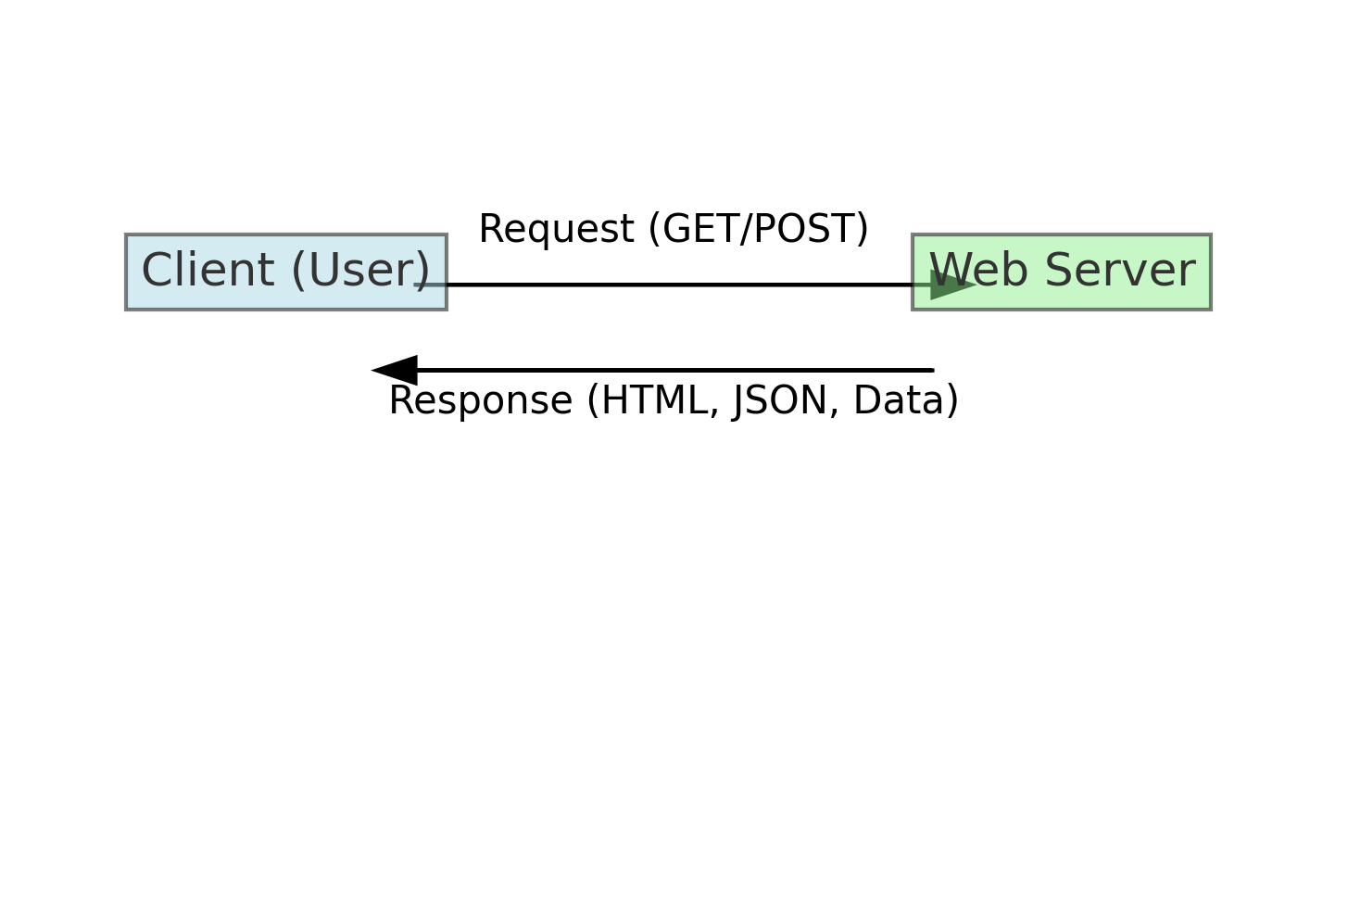
What is the Client-Server Model?
✔ A communication framework where the client (browser/device) requests services, and the server processes and responds. ✔ Used in web applications, cloud computing, and distributed networks.
📌 Key Elements: 🔹 Client: A browser or mobile app that requests web content. 🔹 Web Server: Responds to client requests with web pages or data. 🔹 Application Server: Processes dynamic logic (e.g., PHP, Node.js). 🔹 Database Server: Stores data (e.g., MySQL, MongoDB).
.

Slide 21
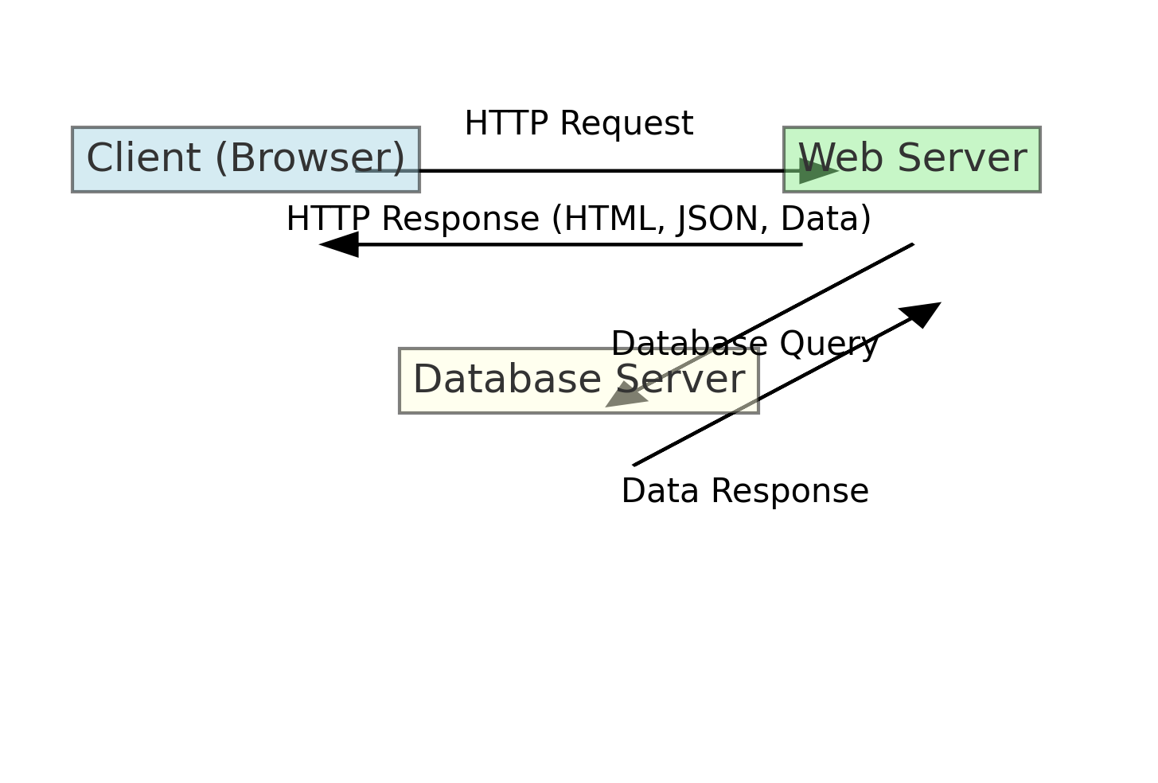
Example Workflow:
User enters www.example.com in a browser.
DNS translates the domain into an IP address(192.168.1.2).
The browser sends a request to the web server.
The web server processes the request and interacts with the application server if needed.
The application server fetches data from the database server and sends it back.
The web server returns the response (HTML, JSON, etc.) to the client

Slide 22
Request-Response Cycle
The process of communication between a client and a server.
The client sends a request, and the server responds with data.
📌 Steps in the Request-Response Cycle
Client makes an HTTP request (GET, POST, PUT, DELETE).
Web server receives the request and forwards it to the application server if necessary.
Application server processes the request (runs logic, queries database)
Database fetches data and returns it to the application server.
Application server formats the response (e.g., HTML, JSON, XML).
Web server sends the response back to the client.
Client renders the response (displays webpage, updates UI, etc.).

Slide 23
Request-Response Cycle
Example Request (HTTP GET Request):
Example Response:

Slide 24
Server-Side Scripting
A process where scripts run on the server, generating dynamic web content before sending it to the client.
Used to process form data, access databases, and create user sessions.
Key Server-Side Technologies: 1. Languages: PHP, Node.js, Python (Django, Flask), Ruby on Rails, Java (Spring Boot). 2. Databases: MySQL, PostgreSQL, MongoDB. 3. Frameworks: Express.js, Laravel, ASP.NET.

Slide 25
Example: PHP Server-Side Script
How It Works:
Client sends a request for a PHP file.
The web server processes the PHP script.
The script executes logic (e.g., fetches data from a database).
The server returns an HTML response to the client.

Slide 26
Difference Between Server-Side & Client-Side Scripting:
Feature | Server-Side Scripting | Client-Side Scripting
Execution Location | Runs on the server | Runs in the browser
Languages | PHP, Python, Node.js, Java | JavaScript, HTML, CSS
Security | More secure (code is hidden from users) | Less secure (code is visible)
Speed | Slower (depends on server response time) | Faster (runs on user’s device)

Slide 27
Managing Web Infrastructure Effectively
Use Load Balancers – Distribute traffic across multiple servers.
Implement Caching – Speed up response time (Redis, Varnish, CDN).
Monitor Performance – Use tools like Prometheus, Grafana, New Relic.
Enhance Security – Apply firewalls, SSL/TLS encryption, authentication.
Scalability & High Availability – Deploy cloud solutions (AWS, GCP, Azure) for seamless scaling.
Example Architecture to be used:
Frontend: React.js, Angular, or Vue.js.
Backend: Node.js, Python, or PHP.
Database: PostgreSQL, MySQL, or MongoDB.
Caching: Redis, Cloudflare CDN.
Cloud Hosting: AWS, DigitalOcean, Azure.

Slide 28
Conclusion and Recommendations
Understanding web server architecture is essential for building robust and scalable web applications. Single-tier architecture offers simplicity for small projects, while multi-tier architecture provides the scalability and reliability needed for larger applications.
For growing applications, it is recommended to adopt a multi-tier architecture with load balancing. This ensures that the application can handle increased traffic and remain available even in the event of server failures. Careful planning and monitoring are crucial for successful implementation and maintenance of web server architectures.

