Slide 1
Explore the Network
In today's digital age, computer networks have become an indispensable part of our personal and professional lives. From sharing files and communicating with loved ones to accessing information and conducting business, the network is the backbone that connects us all. In this comprehensive guide, we will embark on an exciting journey to uncover the ins and outs of computer networks, empowering you with the knowledge and understanding to leverage this powerful technological landscape.
by hajarah namuwaya

Slide 2
What a Computer Network Is
A computer network is a collection of interconnected devices, such as computers, servers, and other hardware components, that communicate and share information.
These devices are linked using various communication technologies, allowing them to exchange data, share resources, and collaborate effectively.
What are some of communication technologies you know?

Slide 3
Purpose of Networks
Why do we need a network?
Hardware Sharing:
Networks allow multiple devices to share hardware resources, such as printers, scanners, and storage devices, which reduces costs by eliminating the need for each device to have its own hardware.
Software Sharing:
Users can share software applications across a network, allowing multiple users to access and use the same program simultaneously.
File Sharing:
Networks enable users to share files and data across connected devices, facilitating easy access and collaboration on documents, spreadsheets, presentations, and other files.
Collaborative Work:
Tools such as shared calendars, project management software, and collaborative platforms (e.g., Google Workspace, Microsoft Teams) allow teams to work together more effectively, regardless of their physical location.
Centralized Data Storage:
Networks allow for centralized storage of data, which simplifies data management, backup, and security. This ensures that data is consistently available to authorized users.
Easy Expansion:
Networks can be easily scaled to include more devices or users as an organization grows, without the need for major infrastructure changes.
Remote Access:
Networks allow users to access resources and data from remote locations, providing flexibility in how and where people work.
Redundancy and Failover:
Networks can be designed with redundancy and failover mechanisms to ensure continuous operation even in the event of hardware or software failures.

Slide 4
Benefits of Computer Networks
What do we gain from having a network?
Cost Savings: Sharing resources like printers or storage devices over a network reduces the need for duplicate hardware, lowering costs.
Efficiency: Networks improve efficiency by allowing quick access to data and resources, reducing the time and effort needed for tasks.
Scalability: Networks allow easy addition of new devices and users, making it easier to scale operations.
Flexibility: Networks provide flexibility in how and where work is done, such as enabling remote work or accessing resources from different locations.

Slide 5
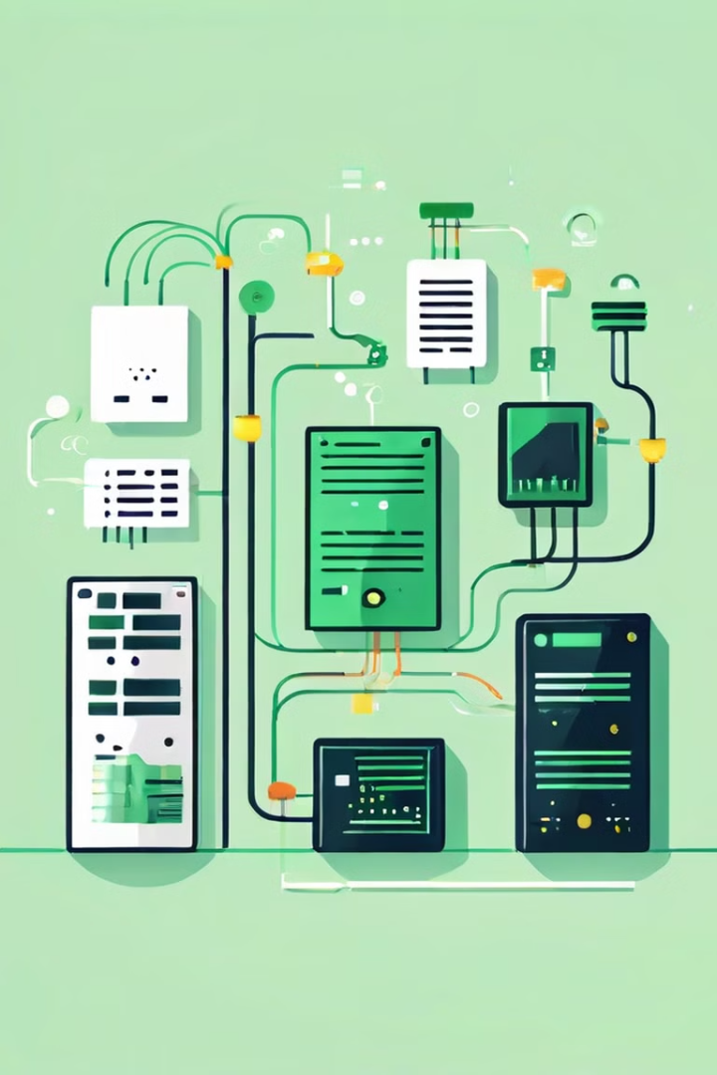
Components of a Network
1
Hardware
2
Software
The physical components of a network, such as computers, servers, routers, switches, and cables, form the backbone of the system. These hardware elements enable the transfer of data and ensure seamless connectivity between devices.
Network software, including operating systems, network management tools, and communication protocols, provides the necessary functionality and control mechanisms to facilitate data exchange and network operations.
3
Protocols
4
Services
Network protocols, such as TCP/IP, Ethernet, and Wi-Fi, define the rules and standards that govern how devices communicate with each other, ensuring the reliable and efficient transmission of data across the network.
Network services, such as file sharing, email, web hosting, and cloud storage, offer users and applications the ability to access and utilize shared resources, enhancing collaboration and productivity.

Slide 6
Components of a Network
1
Devices
2
Networking Devices
Computers, servers, printers, and other hardware components that are connected to the network.
Routers, switches, hubs, and bridges that facilitate the flow of data between network components.
3
Communication Media
4
Network Software
Cables, wireless technologies, and other physical or wireless connections that enable data transmission.
Operating systems, protocols, and applications that manage and control the network's functionality.

Slide 7
Examples of network Components
Network Interface Card (NIC)
Router
Switch
Hub
Modem
Firewall
Access Point
Cables
Server.
Client
Network Topology
DNS (Domain Name System)
Proxy Server
Repeater
Write short notes on each of these examples.

Slide 8
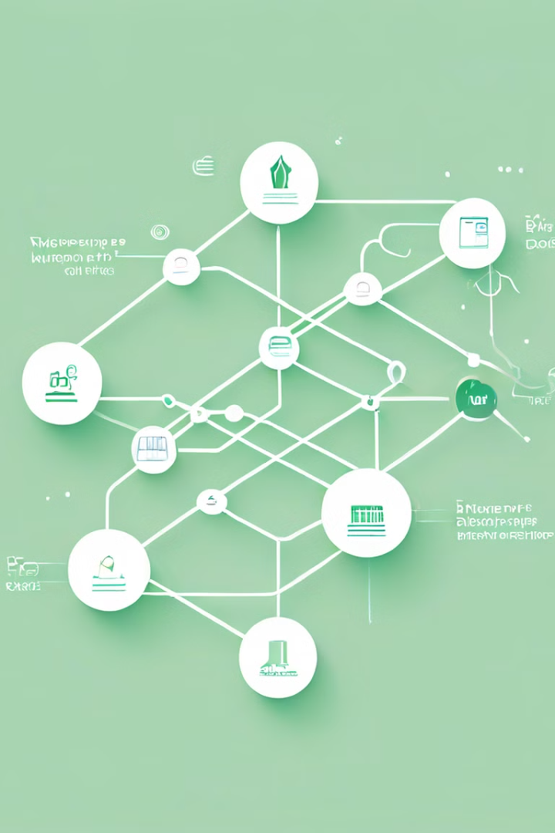
TYPES OF NETWORKS

Slide 9
Local Area Networks (LANs)
LANs are computer networks that are confined to a relatively small geographic area, such as a home, office, or school.
They enable high-speed, reliable communication between devices within a limited physical space, allowing for the efficient sharing of resources and collaborative work.
1
Use Case: Connecting computers and devices
within a limited area to share resources
like files, printers, and internet connections.
Examples: A home network where multiple
devices connect to a Wi-Fi router to access
the internet..

Slide 10
Wide Area Networks (WANs)
2
WANs are computer networks that span a larger geographical area, often connecting multiple LANs or remote locations. WANs utilize technologies like leased lines, satellite links, and the public telephone network to facilitate communication and data exchange over vast distances.
A WAN spans a broad area, potentially covering cities, countries, or continents. It connects multiple LANs or MANs, often using public or leased communication lines.
Use Case: A multinational corporation connecting its offices across different countries.
Example: The internet, which connects millions of private, public, academic, and government networks globally.
b

Slide 11
Virtual Private Network (VPN)
2
A VPN extends a private network across a public network, such as the internet, enabling secure communication and data transfer between remote users and the network.
Use Case: Employees working from home accessing their company's internal network securely.
Example: A remote worker using a VPN to securely access corporate resources while traveling.
b

Slide 12
Metropolitan Area Network (MAN)
2
A MAN covers a larger area than a LAN, typically spanning a city or a large campus. It connects multiple LANs within a region, allowing for greater data communication across distances.
Use Case: A city government network that connects different departments' buildings.
Example: The network infrastructure used by a university to connect different buildings across its campus ie MakAir.
b

Slide 13
Other types
2
Personal Area Network (PAN)
Campus Area Network (CAN)
Storage Area Network (SAN)
Enterprise Private Network (EPN)
Global Area Network (GAN)
Home Area Network (HAN)

Slide 14
Explain the origins of computer networks, starting from early communication systems like the telegraph, to the development of ARPANET, which eventually evolved into the modern internet.
Video to watch https://www.youtube.com/watch?v=3uhA8bdz8gI&list=PL1kr2FHR_uFHQk2hy2g8lr7ouBhSJFEk_&index=2

Slide 15
The Internet, Intranets, and Extranets
The Internet
Intranets
Extranets
The Internet is a vast, public network that connects billions of devices and users worldwide, enabling global communication, information sharing, and the delivery of a wide range of online services. It operates on open, standardized protocols, allowing anyone with an internet connection to access and contribute to the global digital ecosystem.
Intranets are private, internal networks within an organization, designed to facilitate communication, collaboration, and the sharing of resources among employees. Intranets leverage Internet technologies but are restricted to authorized users, providing a secure and controlled environment for the organization's digital activities.
Extranets are extensions of an organization's intranet, allowing selective access to external partners, suppliers, or customers. Extranets enable secure information sharing and collaboration between an organization and its authorized external stakeholders, enhancing business processes and fostering stronger relationships.

Slide 16
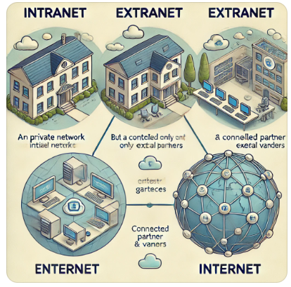
ILLUSTRATION OF AN INTRANET, EXTRANET AND INTERNET

Slide 17
The Changing Network Environment
Cloud Computing
Wireless Connectivity
The rise of cloud computing has revolutionized the way we store, access, and process data, enabling users to leverage remote server resources and on-demand services. This shift has led to increased flexibility, scalability, and cost-effectiveness in network-based applications and data management.
The widespread adoption of wireless technologies, such as Wi-Fi and cellular networks, has dramatically transformed the network environment, allowing users to access information and collaborate seamlessly from anywhere, without the constraints of physical wired connections.
Internet of Things (IoT)
Mobile Devices
The proliferation of the Internet of Things (IoT), where a vast array of devices and sensors are connected to the network, has transformed the way we interact with our environment. This interconnected ecosystem offers new opportunities for automation, data-driven decision-making, and the optimization of various systems and processes.
The widespread adoption of smartphones, tablets, and other mobile devices has significantly impacted the network environment, enabling users to access information, communicate, and collaborate on the go. This mobility has fostered new modes of work, learning, and entertainment, further blurring the boundaries between physical and digital spaces.

Slide 18
The Future of Computer Networks
Emerging Technologies
5G and 6G Wireless
Quantum Networking
Edge Computing
Impact
Faster speeds, lower latency, and increased connectivity, enabling new applications and use cases.
Secure, ultra-fast communication and the potential for quantum-based encryption, revolutionizing network security.
Bringing computing power and data processing closer to the source, reducing latency and improving responsiveness for real-time applications.

