Slide 1
THE ECONOMIC AND LIBERALIZATION REFORMS IN UGANDA
BY JULIET JOY APIO

Slide 2
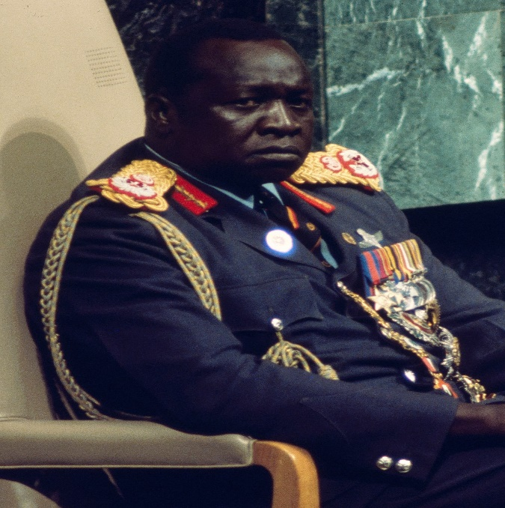
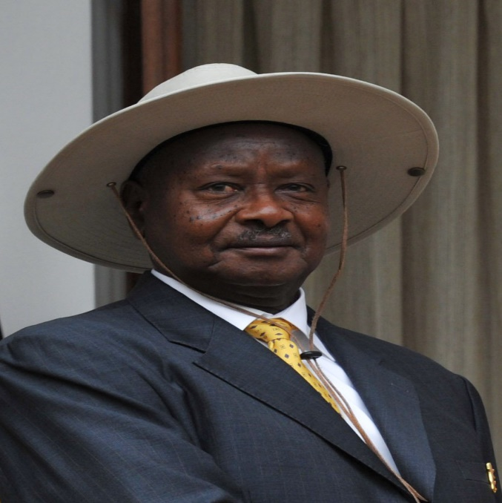
Liberation reforms
The liberation reforms in Uganda refer to the economic policies and programs implemented by the government following the overthrow of the Idi Amin regime in 1979 and the subsequent liberation of the country. These reforms aimed to rebuild the country's economy, which had been devastated by years of political instability and economic mismanagement.

Slide 3
Examples of Liberation Reforms
Political reforms: The NRM government introduced a new constitution in 1995 that provided for multiparty democracy, respect for human rights, and the establishment of an independent judiciary. This aimed to improve governance and promote political stability in the country.
Decentralization: The government introduced a policy of decentralization, which aimed to transfer power and resources from the central government to local governments. This aimed to promote local development and empower local communities.
Economic liberalization: The government implemented various policies aimed at liberalizing the economy, including the privatization of state-owned enterprises, trade liberalization, and the introduction of a market-based exchange rate system. This aimed to promote economic growth, attract foreign investment, and improve efficiency in the economy.
Agricultural sector reform: The government introduced policies aimed at promoting agricultural productivity, including the provision of agricultural extension services, the establishment of a commodity exchange, and the creation of marketing channels for farmers. This aimed to increase agricultural production, reduce poverty among rural communities, and promote food security.
Infrastructure development: The government invested in infrastructure development, including the construction of roads, bridges, and dams. This aimed to improve connectivity and reduce the cost of doing business in the country.
Education and health sector reform: The government invested in education and health sector reform, including the introduction of free universal primary education, the expansion of health facilities, and the provision of free health care for pregnant women and children under five. This aimed to improve access to basic services and promote human development

Slide 4
Economic Reforms in Uganda
Privatization: In the 1990s, the Ugandan government embarked on a program of privatization, which involved the sale of state-owned enterprises to private investors. This was done to increase efficiency and competition in the economy.
Trade liberalization: Uganda has implemented various policies aimed at reducing trade barriers and increasing trade openness. For instance, the government has reduced tariffs on imports, simplified trade procedures, and promoted regional integration through the East African Community.
Tax reforms: Uganda has implemented several tax reforms aimed at broadening the tax base, improving tax administration, and reducing tax evasion. For example, the government has introduced electronic tax filing and payment systems, increased tax compliance measures, and established tax incentives for investors.
Agricultural sector reforms: Agriculture is a critical sector in Uganda's economy, employing a significant portion of the population. The government has implemented various reforms to improve the sector's productivity, including the provision of agricultural extension services, subsidies for inputs, and the creation of market linkages for farmers.
Financial sector reforms: Uganda has implemented various reforms aimed at strengthening the financial sector, including the establishment of a central bank, the liberalization of interest rates, and the introduction of mobile banking and other digital financial services

Slide 5
Economic reforms continued
Infrastructure development: Uganda has invested heavily in infrastructure development, including roads, airports, railways, and electricity generation. These investments aim to improve the country's connectivity, reduce the cost of doing business, and attract investment.
Investment promotion: The government has implemented various policies and programs to attract foreign direct investment (FDI) into the country. This includes the establishment of investment promotion agencies, tax incentives for investors, and the creation of special economic zones.
Public sector reform: Uganda has implemented various reforms aimed at improving the efficiency and effectiveness of the public sector. This includes the introduction of performance-based management, civil service reform, and the decentralization of government services.
Education and skills development: The government has invested in education and skills development, aiming to improve the quality of the workforce and increase productivity. This includes the introduction of free universal primary education, vocational training programs, and partnerships with the private sector to improve skills training.
Health sector reform: Uganda has implemented various reforms aimed at improving the health sector, including the expansion of health facilities, the provision of free health care for pregnant women and children under five, and the introduction of a national health insurance scheme.
These reforms aim to create an enabling environment for economic growth and development in Uganda, improve the standard of living of the population, and reduce poverty

Slide 6
Monetary policies
Monetary policy in Uganda is primarily implemented by the Bank of Uganda, the country's central bank. The bank's primary objective is to maintain price stability, while also promoting economic growth and financial stability. Here are some of the key monetary policies implemented by the Bank of Uganda:
Interest rates: The Bank of Uganda sets the central bank rate, which is the interest rate at which commercial banks borrow from the central bank. Changes in the central bank rate have a ripple effect on the interest rates charged by commercial banks, influencing borrowing and lending in the economy.
Reserve requirements: The Bank of Uganda also sets reserve requirements for commercial banks, which is the amount of money that banks are required to hold in reserve. Changes in reserve requirements can affect the amount of money that banks can lend and can impact inflation and economic growth.
Open market operations: The Bank of Uganda also uses open market operations, such as buying or selling government securities, to manage the money supply in the economy. This can impact interest rates and influence economic activity.
Exchange rate policy: The Bank of Uganda also manages the country's exchange rate, aiming to promote stability and reduce volatility in the currency market. This involves buying or selling foreign currency reserves to maintain a stable exchange rate.
Financial sector regulation: The Bank of Uganda also regulates the financial sector, overseeing banks, microfinance institutions, and other financial institutions to promote financial stability and protect consumers.
Overall, the Bank of Uganda implements monetary policies aimed at promoting price stability, economic growth, and financial stability in the country.

Slide 7
Fiscal policies
Fiscal policy in Uganda refers to the government's use of revenue and expenditure to achieve its economic objectives. The government's fiscal policies are implemented through the national budget, which is presented annually to the parliament. Here are some of the key fiscal policies implemented in Uganda:
Taxation: The government collects revenue through various taxes, including income tax, value-added tax (VAT), and excise duties. The government also provides tax incentives to promote investment and economic growth.
Government expenditure: The government uses its revenue to finance its expenditure, which includes public services such as health, education, and infrastructure development. The government also allocates funds for social protection programs, such as cash transfers and food assistance, aimed at reducing poverty.
Public debt management: The government manages its public debt through borrowing and debt servicing. This involves prioritizing debt payments and managing the country's debt-to-GDP ratio to maintain fiscal sustainability.
Subsidies: The government provides subsidies to certain sectors, such as agriculture, to promote productivity and support rural development.
Public-private partnerships (PPPs): The government partners with the private sector to finance and implement infrastructure projects. This allows the government to leverage private sector resources and expertise to promote economic growth and development.
Overall, the government's fiscal policies aim to promote economic growth, reduce poverty, and improve the standard of living of the population. The government also aims to maintain fiscal sustainability and manage public debt to ensure macroeconomic stability.

Slide 8
Difference Between Economic Reforms and Economic Policies
Economic reforms and economic policies are related concepts that are often used interchangeably, but they refer to different aspects of economic management.
Economic reforms are typically broader in scope and refer to changes in the structure of the economy or the way that the economy is managed. Reforms are often implemented in response to major economic challenges, such as high inflation or low growth, and may involve significant changes to government policies and institutions. In Uganda, examples of economic reforms include the liberalization of trade and investment, the privatization of state-owned enterprises, and the introduction of market-oriented policies to encourage private sector growth.
On the other hand, economic policies refer to the specific measures that governments or other economic actors take to achieve particular economic objectives. Policies are often more targeted and short-term in nature than reforms, and they may be adjusted in response to changing economic conditions. In Uganda, examples of economic policies include fiscal policies such as taxation and government spending, monetary policies such as interest rate adjustments, and trade policies such as tariffs and import quotas.
In summary, economic reforms are broad, long-term changes that aim to improve the overall functioning of the economy, while economic policies are specific measures that are taken to achieve particular economic objectives and may be adjusted over time

Slide 9
Economic Policies
Agricultural policies: Uganda has implemented various agricultural policies aimed at improving agricultural productivity, increasing food security, and promoting rural development. Some of these policies include the National Agricultural Policy, the Agricultural Sector Development Strategy and Investment Plan, and the National Agricultural Research Policy.
Trade policies: Uganda has implemented trade policies aimed at promoting trade and investment, both domestically and internationally. These policies include the Trade Policy and Export Promotion Strategy, which aims to increase exports and promote trade liberalization.
Industrial policies: Uganda has implemented industrial policies aimed at promoting industrialization and economic diversification. These policies include the Industrial Policy and the Small and Medium Enterprises (SME) Policy, which aims to promote SME development and improve access to finance, technology, and markets.
Energy policies: Uganda has implemented energy policies aimed at increasing access to modern energy services, promoting renewable energy, and reducing reliance on traditional energy sources. These policies include the Renewable Energy Policy, the Rural Electrification Strategy, and the National Oil and Gas Policy.
Infrastructure policies: Uganda has implemented infrastructure policies aimed at improving infrastructure development and access to basic services, such as water and sanitation. These policies include the National Infrastructure Development Plan, the Water and Sanitation Sector Development Plan, and the National Transport Policy.

