Slide 1
MAKERERE UNIVERSITY BUSINESS SCHOOL
FACULTY OF BUSINESS ADMINISTRATION
Business Communication Skills
FOR BACHELORS
©2024 - DEPARTMENT OF COMMUNICATION

Slide 2
TOPIC 2c: PLANNING FOR COMMUNICATION

Slide 3
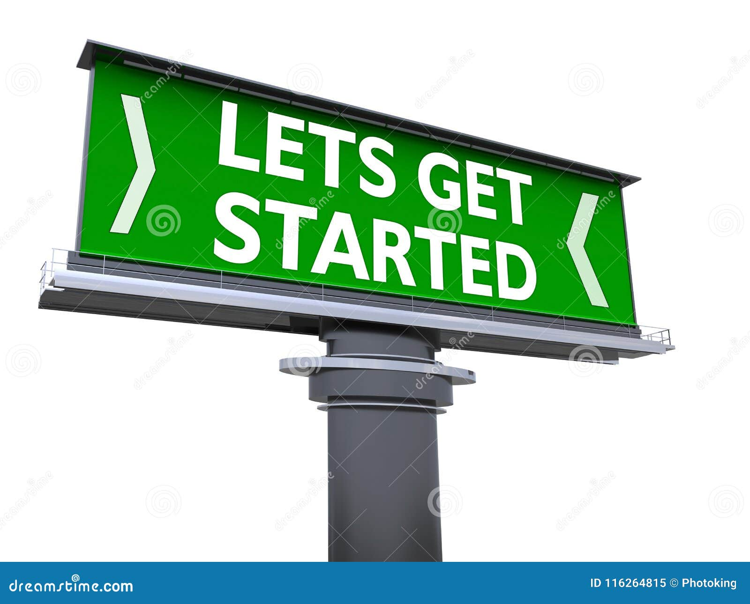
Topic Outline
Overview of Planning for communication
Objectives
Elements of planning for communication
Student Exercise

Slide 4
Introduction
Communication planning involves a structured approach to how information is shared and received in any context, be it personal, professional, or public.
The objective is to ensure the message is clear, effective, and reaches the intended audience.

Slide 5
Topic Learning Outcomes
At the end of this topic, students should be able to:
Define the main goal/purpose of planning for planning for communication.
Identify the key elements of planning for communication.
Develop feedback mechanisms to measure the effectiveness of any communication

Slide 6
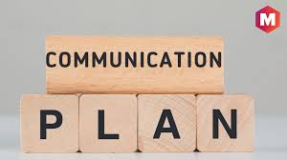
Planning for Communication
Planning entails the preparation done before communication takes place.
When planning to communicate, it is essential to consider several key elements to ensure the message is clear, effective, and reaches the intended audience appropriately. These include:
Purpose
Audience
Structure
Style
Timing
Resources
Message
Evaluation

Slide 7
1. Purpose / Objectives / Goal (Why)
What is the main goal or purpose of the communication?
What are the specific objectives you want to accomplish?
What do you hope to achieve through the communication?
Key Points:
Purpose: Inform, persuade, entertain, instruct
Outcome: Desired knowledge, feelings, actions.

Slide 8
2. Audience (Where / Whom/ Who)
Who is the target audience for the communication?
What are their demographics, knowledge levels, attitudes, and expectations?
How can you tailor the communication to engage and echo with the audience?

Slide 9
3. Structure (How)
The structure refers to how the content and information within the communication is organized and presented.
This also considers the element of the channel.
Key Points:
Introduction
Body
Conclusion

Slide 10
4. Style (How)
Influences how a message is perceived and understood by the audience.
Key Points:
Language
Format
Consistency

Slide 11
5. Timing (When)
When is the optimal time to deliver the communication?
How can you ensure the message reaches the audience right now?
Is there a need for any follow-up or ongoing communication?
How long should the communication take?
Key Points:
Optimal Timing
Frequency
Context

Slide 12
6. Resources (What)
This looks at what will enable you to communicate.
Allocating Necessary Resources:
Budget for materials, tools, platforms
-Personnel for managing the process

Slide 13
7. Message (What)
What information or ideas do you want to convey?
How can you structure the message as clear, concise, and compelling?
What supporting evidence, data, or examples can you include to strengthen the message?
Key Points:
- Clarity
- Relevance
- Tone

Slide 14
8. Mechanisms / Evaluation
How will you measure the effectiveness and impact of the communication?
What mechanisms will you use to gather feedback from the audience?
How can you use the feedback to improve future communications?
Key Points:
Methods: Surveys, Q&A, feedback forms
Adaptation

Slide 15
Exercise:
COVID 19 SCENARIO
During the COVID-19 pandemic, Uganda faced significant challenges in its communication strategy. The government implemented various public health measures, but the communication surrounding these measures faced criticism and revealed several flaws in the planning and execution. For example,
Mask Guidelines: Early on, the government mandated mask-wearing in public places but later released conflicting statements about mask quality and usage. This led to confusion about whether homemade masks were acceptable.
Lockdown Announcements: Sudden announcements about lockdowns left people scrambling for supplies. For instance, a lockdown announced in March 2020 gave people only a few hours to prepare for the lockdown
Social Media Engagement: Younger populations, who primarily get their information from social media, were less informed due to the government’s focus on radio and TV. This demographic group missed out on updates and guidelines.
Message coverage: urban populations received more detailed information than rural areas, where many people rely on local languages and oral communication.

Slide 16
Exercise Questions:
Based on the case, critique how communication was done during the COVID-19 pandemic.
From the critique in question (1) above, how best should the communication have been done?
What are the key elements the government needed to consider in planning to communicate the lockdown?

Slide 17
THANKS FOR LISTENING

Slide 18
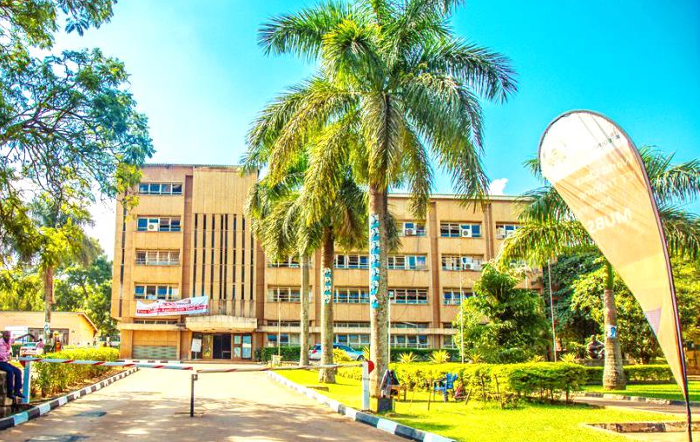
Thank you for being a great audience
Address
Main building , first floor Room 1.0
Contacts
Facilitator:
Team Leader: +256-772-156-003
Email
hodcommunication@mubs.ac.ug/ jodiya@mubs.ac.ug
©2024 - FACULTY OF BUSINESS ADMINISTRATION, Department of Communication

