Slide 1
Topic III:
VALUES AND ETHICS IN THE RESEARCH PROCESS

Slide 2
To cover..
Values in research
Ethics in research

Slide 3
RESEARCH VALUES
Values are fundamental individual beliefs that inform our attitudes, decisions and actions.
“Values are descriptive of the personal qualities we choose to embody to guide our actions; the sort of person we want to be; the manner in which we treat ourselves and others, and our interaction with the world around us.” Mintz, (2018, pp.1).

Slide 4
Research Values
Values encompass that which is good, desirable, or worthwhile. Values are the motive behind purposeful action.
If you value altruism and helping others, you might as well engage more in voluntary actions and charity.

Slide 5
Core Research Values
Integrity:
Researchers should uphold honesty and accuracy in their work.
Avoid fabrication, falsification, and plagiarism in all aspects of research.
Objectivity:
Strive for impartiality and neutrality in the collection, analysis, and interpretation of data.
Minimize biases and personal beliefs that may influence the research process.

Slide 6
Core Research Values…
Transparency:
Clearly communicate methodologies, procedures, and findings to allow for replication and verification by other researchers.
Disclose any potential conflicts of interest that may impact the research.
Respect for Participants:
Prioritize the well-being and rights of respondents.
Obtain informed consent and ensure confidentiality and anonymity when necessary.

Slide 7
Core Research Values…
Accountability:
Take responsibility for the design, implementation, and reporting of research.
Acknowledge errors and correct them promptly if they occur.
Openness to Critique:
Welcome constructive criticism and peer review to enhance the quality of research.
Be open to revising hypotheses or methods based on new evidence or feedback.

Slide 8
Core Research Values…
Independence:
Conduct research free from external pressures or undue influence.
Avoid conflicts of interest that could compromise the objectivity of the research.
Social Responsibility/ Stewardship:
Consider the broader impact of research on society.
Strive to contribute positively to knowledge, policy, and practice.
Mentor other researchers, contribute in terms of reviewing research etc

Slide 9
Core Research Values…
Continuous Learning:
Stay informed about developments in the field and incorporate new knowledge into research practices.
Engage in ongoing professional development to enhance research skills.
Collaboration:
Foster collaboration and teamwork to address complex research questions.
Give credit where it is due and acknowledge the contributions of others.

Slide 10
The core values of research
Fairness:
Making professional judgments based on appropriate and announced criteria, including processes used to determine outcomes.
Honesty:
A researcher's freedom to advance knowledge is tied to his or her responsibility to be honest.
The principal value that underlies all of the other relationship values. For example, without an honest foundation, realizing the values of openness, accountability, and fairness would be impossible.

Slide 11
ETHICS
Ethics is a branch of philosophy concerned with what is morally good and bad and morally right and wrong.
Ethics are systems of moral principles: the ethics of a culture. They are moral principles of an individual.
The rules of conduct recognized in respect to a particular class of human actions or a particular group, culture, etc. medical ethics; Christian ethics;
A branch of philosophy dealing with values relating to human conduct, with respect to the rightness and wrongness of certain actions and to the goodness and badness of the motives and ends of such actions.

Slide 12
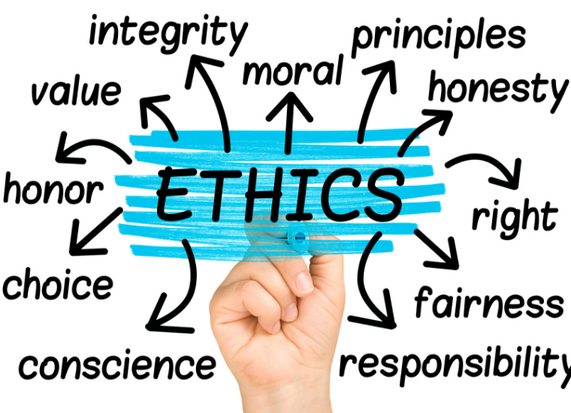
Ethics

Slide 13
Difference between Values and Ethics
While the 2 terms are usually applied synonymously, they are not quite identical;
Evans (2019), citing Surbhi indicates that:
Ethics are a set of principles that determine someone’s behaviour,
Whilst values are those beliefs “for which a person has an enduring preference.”
While ethics constrain a person from engaging in a behaviour, values motivate them to engage.

Slide 14
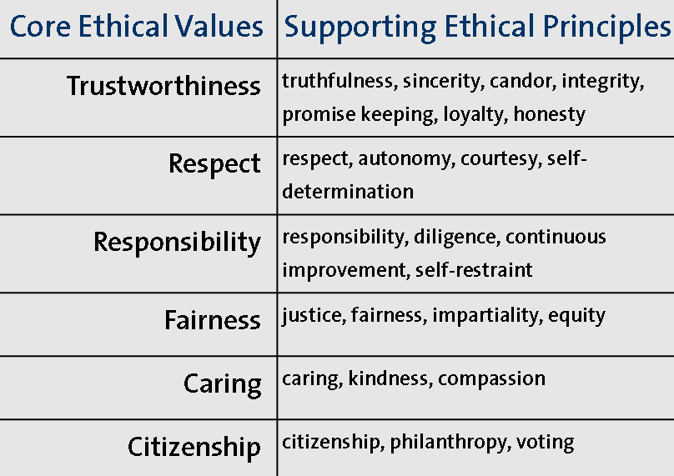

Slide 15
What is ethics in research?
Ethical principles, rules, norms, values and virtues that researchers should adhere to.
The ethical conduct of research is a cornerstone of modern scientific research.
Threefold foundation; 3 main rules
The responsible conduct of research
Clear and complete recording and reporting of research procedures, results, and analyses
Respect for those that may be affected by that research.

Slide 16
Research Ethics
Researchers need to foresee any ethical issues that may arise from their study because research involves collecting data from or about people.
The researcher should ensure the participants are protected and their trust built.
There are many associations that have published “codes of ethics”
Ethics in research is however more than adhering to a set of rules.

Slide 18
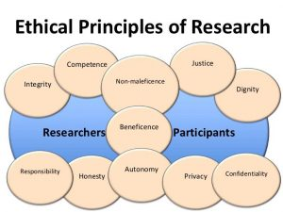

Slide 19
Ethical Principles in Research
Informed Consent
Confidentiality and Data Protection
Objectivity
Openness
Intellectual Property
Respect for Persons
Beneficence and Non-maleficence
Legality/Justice
Integrity
Conflict of Interest
Social Responsibility
Responsible Publication.

Slide 20
Informed Consent
Research studies may sometimes have undesirable consequences of participation;
This principle entails informing research participants of the aims of the study or research project, and any other information they may need to know before engaging in the project;
Participants should know the purpose, benefits, risks, and funding behind the study before they agree or decline to join.
Such information is essential for their consent or acceptance to participate in the study;
This protects the researcher(s) later in case the participants suffer any negative consequences of their participation.

Slide 21
Confidentiality and Data Protection
Research studies involve collection of data from respondents;
This data may be personal data or research results;
Exposing the identify of participants may sometimes affect their careers and relationships with other people;
Researchers must protect personally identifiable data so that it can not be linked to other data by anyone else;
Someone should not know who exactly provided which information in a particular study.

Slide 22
Objectivity
A good researcher must remain as objective and open-minded as possible;
Subjective attitudes and pre-conceived notions affect the quality of your study;
Researchers have a duty to avoid all forms of bias in experimental design, data analysis, data interpretation, peer review, personnel decisions, grant writing, expert testimony, and other aspects of research where objectivity is expected or required.

Slide 23
Openness
This is closely related to objectivity, but it relates to how research results are disseminated;
Researchers should freely share data, results, ideas, tools, resources;
Sometimes you may be required to share your dataset or data file in .xls or SPSS as part of your research report;
Researchers must be open to criticism and new ideas.

Slide 24
Intellectual Property
Researchers may need to use the works and creations of others in their projects;
Intellectual property encompasses copyrights, patents, symbols and other forms of scientific inventions;
The need for protection of intellectual property cannot be over-emphasized;
Researchers must respect any patents, copyrights, and other forms of intellectual property.
Do not use unpublished data, methods, or results without permission. Give proper acknowledgement or credit for all contributions to research. Never plagiarize.

Slide 25
Respect for Persons
Researcher must respect stakeholders of the study;
These may include participants/ respondents, and other users of the research results;
Respect encompasses compassion during experiments, careful consideration/ empathy of the consequences of experiments and research projects, courtesy in dealing with participants, and non-discrimination during data collection;
Respect may also encompass use of inclusive language in research proposals and reports, gender sensitivity, and respect of minorities and vulnerable groups.

Slide 26
Beneficence and Non-maleficence
Beneficence and Non-maleficence is a very important principle especially in research involving human and animal subjects;
Beneficence entails promoting the well-being of others; while non-maleficence is an intention to avoid harming or injuring others;
If you are conducting an experiment to test a new drug to treat Covid-19, are you sure it will not cause more deaths?
Science and research must aim at protecting the lives of humans and animals.

Slide 27
Legality/Justice
Whatever you do in your study must be legal and acceptable internationally;
Researchers must avoid the temptation of engaging in illegal or illicit ways of obtaining research findings or disseminating them;
Illegalities may encompass falsification of findings, plagiarizing other people’s works, infringing on copyrights, etc;
Illegalities in research have dire consequences, like cancellation of degrees or retraction of research papers.
Read: In December 2023, Harvard President Claudine Gay lost job due to plagiarism.

Slide 28
Integrity
As a researcher, keep your promises and agreements; act with sincerity; strive for consistency of thought and action.
If you collect data from a company and promise to share your findings with them, do so after your study;
Researchers must ensure the highest levels of integrity and virtue in their studies;

Slide 29
Conflict of Interest
Conflict of interest in research exists when individual co-authors have interests in the outcome of the research that may lead to a personal advantage and that might therefore, in actuality or appearance compromise the integrity of the research;
One may be undertaking a study on about employees of a department of which they are part;
Ethical researchers must declare whether or not there are conflicts of interests in the study they are undertaking.

Slide 30
Social Responsibility
Researchers have a responsibility to the society in which they live and operate;
We must strive to promote social good and prevent or mitigate social harms through research, public education, and advocacy.
In the era of sustainable development, researchers must have in mind the principles of environmental principles: “People, Planet, Profit”;
Researchers should not only aim at conducting and concluding their study. They must be empathetic of the impact of their study on the social wellbeing of people around them.

Slide 31
Responsible Publication
Research results are usually disseminated through publications;
Researchers must publish in order to advance research and scholarship, and not to simply advance just your own career;
Avoid wasteful and duplicative publication;
Researchers must publish in peer-reviewed scientific journals;
Care must be taken to avoid predatory journals.

Slide 32
Plagiarism as a form of Unethical Research Behaviour
Plagiarism is the use of another's work, words, or ideas without attribution;
The word “plagiarism” comes from the Latin word for “kidnapper” and is considered a form of theft, a breach of honesty in the academic community;
Plagiarism is not only unethical but also illegal in most universities and research communities;
Plagiarism impairs the writer’s ability to write their own, or think for themselves.

Slide 33
The issue with plagiarism
Academicians and researchers write for an academic audience that they ought to be respected in and freely engage with;
When a researcher plagiarizes, they join an academic conversation from a fraudulent angle and it is difficult for them to recover from the consequences of this;
Plagiarism has penalties that researchers must be aware of, like cancellation of academic qualification, loss of careers, and public embarrassment.

Slide 34
How do I avoid plagiarism?
Read widely before writing. Don’t start by writing. What are you writing?
Summarise with pen and paper before typing on the computer;
Add your voice (stance) in your write-up. Your voice has to be heard. Do not just cite and quote others;
Use your own language. Do not fall in love with other people’s work. A statement that appears perfect online is not yours. Write your own;
Don’t aim at perfection too early. Writing skills are like all other technical competences. They are developed over time.

Slide 35
How do I avoid plagiarism?
Avoid last-minute work. The pressure to submit an assignment increases the temptation to simply copy and submit;
Do not seek to use jargon or complex vocabulary. Communicate with clarity, tact, and conciseness;
Do not use generative AI tools like ChatGPT to write for you. They too can be detected by anti-plagiarism software;
Avoid direct copy-paste of research material. Read, comprehend/understand, internalize, and create your own ideas of what you have read. You can even draw a word graph or text map of your ideas before writing.

Slide 36
How do I avoid plagiarism?
Read more than you write; a paragraph of 6 lines may for example be a result of 3 research papers.
Always acknowledge the original author of the thought or idea you are writing about. This is through citation and referencing;
Paraphrase or quote from your sources. Do not copy directly from source;
Avoid self-plagiarism: plagiarizing your own earlier work. It is an act of using your earlier published research in a new paper without citing your earlier paper. This is also a form of academic misconduct that must be avoided.

Slide 37
Anti-plagiarism software
Use anti-plagiarism software to check the level of similarity and originality of your work before submission. Examples include:
TurnitIn
Grammarly.com
PlagScan
Plagiarism Checker
iThenticate
Contact your academic supervisor in case you need to use one of these. They usually have accounts on one of these tools.

Slide 38
Popular Cases of Unethical Research Behaviour
1: The Tuskegee Syphilis Experiment
One of the most famous pieces of unethical research undertaken in the United States was the Tuskegee Syphilis study, which gained attention for its unethical testing on African American patients in the rural South.
The U.S. Public Health Service (PHS) experiment, which ran from 1932 through 1972, looked at the untreated syphilis natural course among African American men. They were not informed that they had syphilis, were not informed that they were spreading it, they did not give informed consent to participate.
Notes:
More:
The study aimed to find out if the natural course of syphilis in black males differed considerably from that in whites and to see if cardiovascular damage was more common from syphilis than neurological impairment. The participants were not informed that they had syphilis or that sexual activity may spread the illness. Instead, they were informed that they had “bad blood,” a phrase used locally to describe a variety of ailments. Informed consent was not collected from the participants.
Some patients received arsenic, bismuth, and mercury as part of the study’s initial treatment phase. However, when the initial research could not yield any valuable information, it was decided to keep track of the participants until they passed away and stop all therapy.
After penicillin became available in the middle of the 1940s, the sick men were refused medication; this was still the case 25 years later, in clear contravention of government regulations that required the treatment of venereal disease. More than 100 of the subjects are thought to have passed away from tertiary syphilis.

Slide 39
Popular Cases of Unethical Research Behaviour
The Department of Health did not know if the drugs administered to them were effective. A decision was taken to study the patients until they either died or got cured.
Many of them ended up dying as guinea pigs in the experiment.
Watch YouTube video about the experiment here.
Notes:
More:
The study aimed to find out if the natural course of syphilis in black males differed considerably from that in whites and to see if cardiovascular damage was more common from syphilis than neurological impairment. The participants were not informed that they had syphilis or that sexual activity may spread the illness. Instead, they were informed that they had “bad blood,” a phrase used locally to describe a variety of ailments. Informed consent was not collected from the participants.
Some patients received arsenic, bismuth, and mercury as part of the study’s initial treatment phase. However, when the initial research could not yield any valuable information, it was decided to keep track of the participants until they passed away and stop all therapy.
After penicillin became available in the middle of the 1940s, the sick men were refused medication; this was still the case 25 years later, in clear contravention of government regulations that required the treatment of venereal disease. More than 100 of the subjects are thought to have passed away from tertiary syphilis.

Slide 40
Other incidents
2. Bharat Aggarwal, a former Distinguished Professor of Cancer Research at the University of Texas MD Anderson Cancer Center, US, resigned his position after fraud was discovered in 65 research papers published by him about cancer treatment for cancer.
3. Anna Ahimastos (Australia) resigned from her position at Melbourne's Baker IDI Heart & Diabetes Institute in 2015 after admitting to fabricating data in a trial of the blood pressure drug ramipril that analyzed if ramipril could reduce pain in people with peripheral artery disease.

Slide 41
Other incidents
4. Elias Alsabti (Iraq, US), was a medical practitioner who posed as a biomedical researcher. He plagiarized over 60 papers about cancer research, many with non-existent co-authors.
5. There are several other cases. Please follow the Retraction Watch Website for some of these.

