Slide 1
PROJECT COST MANAGEMENT
To cover
Importance of project cost management
PCM principles, concepts, and terms
Types of cost estimates and methods for preparing them
Cost budgeting for IT projects.
Benefits of earned value management and project portfolio management to assist in cost control
Project management software for project cost management

Slide 2
Cost and Project Cost Management
Cost is a resource sacrificed or foregone to achieve a specific objective, or something given up in exchange.
Costs are usually measured in monetary units, such as dollars/Pounds/Shillings.
Project cost management (PCM) includes the processes required to ensure that the project is completed within an approved budget.

Slide 3
PCM Processes
Cost estimating: Developing an approximation or estimate of the costs of the resources needed to complete a project.
Cost budgeting: Allocating the overall cost estimate to individual work items to establish a baseline for measuring performance.
Cost control: Controlling changes to the project budget.

Slide 4
Basic Principles of Cost Management
Executive board: Most members of an executive board have a better understanding and are more interested in financial terms than IS/IT terms, so IS/IT project managers must speak their language.
When justifying investments, it is important to focus on the impact on profits, not just revenues or expenses.
Life cycle costing: considers the total cost of ownership, or development plus support costs, for a project. Allows you to take a big picture view of the cost of a project over its entire life. This helps you to develop a more accurate projection of a project’s financial benefits.

Slide 5
Cost of Software Defects
It is important to spend money up-front on IS/IT projects to avoid spending a lot more later.
*Collard, Ross, Software Testing and Quality Assurance, working paper (1997).

Slide 6
Basic Principles of Cost Management….
Direct costs: are costs that can be directly related to producing the products and services of the project. E.g. salaries, hardware and software purchased etc.
Indirect costs: are costs that are not directly related to the products or services of the project, but are indirectly related to performing the project. They are hard to control. E.g other computers used in a project.
Tangible costs or benefits: are those costs or benefits that an organization can easily measure in dollars/shs.

Slide 7
Basic Principles of Cost Management….
Intangible costs or benefits: are costs or benefits that are difficult to measure in monetary terms.
Sunk cost: is money that has been spent in the past; when deciding what projects to invest in or continue, you should not include sunk costs. Consider it gone.
Learning curve theory: states that when many items are produced repetitively, the unit cost of those items decreases in a regular pattern as more units are produced.

Slide 8
Basic Principles of Cost Management….
Reserves: are finances included in a cost estimate to mitigate cost risk by allowing for future situations that are difficult to predict.
Contingency reserves allow for future situations that may be partially planned for (sometimes called known unknowns) and are included in the project cost baseline.
Management reserves allow for future situations that are unpredictable (sometimes called unknown unknowns).

Slide 9
Cost Management Plan
A document that describes how the organization will manage cost variances on the project.
A large percentage of total project costs are often labour costs, so project managers must develop and track estimates for labour.

Slide 10
Cost Estimating
Project managers must take cost estimates seriously if they want to complete projects within budget constraints.
It’s important to know the types of cost estimates, how to prepare cost estimates, and typical problems associated with IS/IT cost estimates.

Slide 11
Cost Estimate Input and Output
Inputs
Scope baseline, WBS,
Project schedule, Human resource plan, Risk register, organizational process assets (e.g. cost estimating policies & templates, historical info and lessons learnt.
Outputs
Activity/items/material cost estimates (e.g. Bill of Quantities [BOQ])
Basis of estimates (assumptions)

Slide 12
Types of Cost Estimates
Rough Order of Magnitude (ROM) Estimate: An estimation of a project’s cost to complete. Done during project selection and approval before initiation.
Budgetary: Done at the early stage of initiation. It shows the understanding of the scope and expenses.
Definitive: Done later during the project. It provides details for purchases, estimates and actual costs.

Slide 13
Cost Estimation Methods
Comparative or Analogous estimation: Use the actual cost of a previous, similar project as the basis for estimating the cost of the current project.
Top-down estimates: Use a high-level WBS and data from previous projects and add estimates for each item to get the full cost.
Bottom-up estimates: use a previous WBS and involve estimating work items or activities individually and summing them to get a project total.

Slide 14
Cost Estimation Methods…
Parametric model estimate: Uses project characteristics (parameters) in a mathematical model to estimate project costs. Details of previous related projects are used and adjustments made.
Expert judgment: by talking to people who have had hands-on experience in similar projects.

Slide 15
Constructive Cost Model (COCOMO)
Barry W. Boehm helped develop the COCOMO model for estimating software development costs.
Parameters include:
Function points: measures based on an estimate of the functionality of the delivered software e.g files, user input/output, user interactions, external interfaces.
Source Lines of Code (SLOC): A human-written line of code that is not a blank line or comment.
Boehm suggests that only parametric models do not suffer from the limits of human decision-making.
Notes:
It is an algorithmic software for cost estimation that uses a basic regression formula with parameters from previous projects data and current project characteristics

Slide 16
Sample Cost Estimate
Before creating an estimate, know what it will be used for, gather as much information about the project as possible, and clarify the ground rules and assumptions for the estimate.
If possible, estimate costs by major WBS categories.
Create a cost model to make it easy to change and document the estimate.

Slide 17
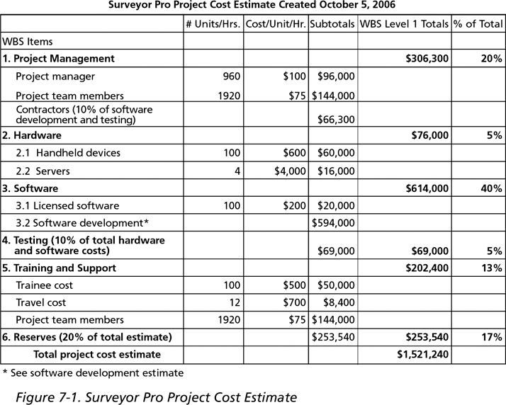
Surveyor Pro Project Cost Estimate
Surveyor Pro Project Cost Estimate Created on January 26, 2018

Slide 18
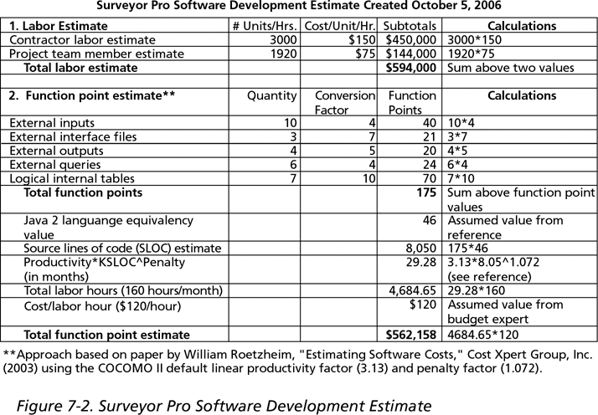
Surveyor Pro S/W Dev’t Estimate
Surveyor Pro Software Development Estimate Created on January 26, 2018
Notes:
KSLOC – Kilo Source Lines of Code = “1000(K)SLOC

Slide 19
Typical Problems with IT Cost Estimates
Developing an estimate for a large software project is a complex task that requires a significant amount of effort.
People who develop estimates often do not have much experience.
Human beings are biased toward underestimation.
Management might ask for an estimate, but really desire a bid to win a major contract or get internal funding.

Slide 20
Three –point estimates
Originated from PERT
Optimistic (O) – the activity cost based on best-case scenario.
Pessimistic (P) – the activity cost based on worst-case scenario.
Most Likely Time (M) – the activity cost based on realistic effort assessment for the required work and any predicted expenses.
Therefore estimated cost = (O+4M+P)/6
Vendor Bid Analysis: Analyze what a project shall cost based on responsive bids from qualified vendors.
Notes:
PERT (Program Evaluation and Review Technique) – A statistical tool used to analyse and represent the tasks involved in completing a given project.

Slide 21
Cost Budgeting
Cost budgeting involves allocating the project cost estimate to individual work items over time.
The WBS is a required input for the cost budgeting process because it defines the work items.
Important goal is to produce a cost baseline:
A time-phased budget that project managers use to measure and monitor cost performance.

Slide 22
Cost Budgeting
Objective
- To aggregate the estimated costs of individual activities to establish an authorized cost baseline.
Activities
- Involves determining the likely cost of project implementation.
- Specify when money is required (periodic funding requirements – quarterly, etc)
Inputs
- Activity cost estimates
- Basis of estimation
- Scope baseline
- Project schedule
- Resource calendar
- Contracts
- Organizational process assets
Outputs
- Cost performance baseline (Budget At Completion – BAC)
- Project funding requirements
- Project document updates (risk register, cost estimates, project schedule)
Techniques
- Cost aggregation
- Reserve analysis
- Historical relationship
- Funding limit reconciliation
Notes:
Organizational Process Assets - Cost control-related policies, Procedures & guidelines, Monitoring & reporting tools

Slide 23
Cost Budgeting techniques
Cost aggregation – summing up the costs for each work package to the project level.
Reserve analysis – project is analysed from a cost overruns view and buffers (contingency and management reserves) are placed.
Historical relationship – comparing the budget with historic or industry data that show costs relationships
Funding limit reconciliation – cost estimates are based on fund limits in the scope statement
Notes:
Contingency reserve – budget within the baseline allocated for identified risks
Management Reserve – is unplanned in-scope work, not included in the budget baseline

Slide 24
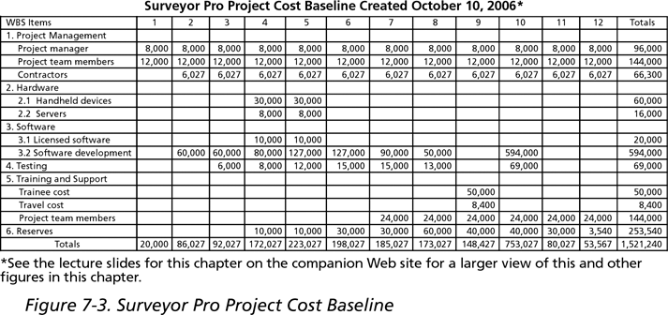
Surveyor Pro Project Cost Baseline
Surveyor Pro Project Cost Baseline Created on February 15, 2018
Surveyor Pro Project Cost Baseline Created on February 15, 2018

Slide 25
Cost Control
Project cost control includes:
Monitoring cost performance.
Ensuring that only appropriate project changes are included in a revised cost baseline.
Informing project stakeholders of authorized changes to the project that will affect costs.
Many organizations have problems with cost control.

Slide 26
Cost Control
Objective
To monitor the status of the project to update the project budget and manage changes to the cost baseline.
Activities
- Involves recording actual costs spent to date.
- Analyzing the relationship between the consumption of project funds to actual work accomplished.
- Seeks causes for positive/negative changes
Inputs
- Project Mgt Plan
- Cost performance baseline
- Cost Mgt plan
- Project Funding Requirements
- Project progress: started/ completed deliverables
- Organizational Process Assets
- Cost control-related policies
- Procedures & guidelines
- Monitoring & reporting tools
Techniques
- Earned Value Mgt (EVM)
- Forecasting

Slide 27
Cost Control Techniques
Earned Value Management (EVM) – A systematic PM process used to find variances in projects based on the comparison of the plan, actual work and work completed to check if the project is on track.
Cost Forecasting – process used to adapt cost planning to constantly changing circumstances. The remaining activities are valued based on plan, forecast and actual values.

Slide 28
Earned Value Management (EVM)‏
EVM is a project performance measurement technique that integrates scope, time, and cost data.
Given a baseline (original plan plus approved changes), you can determine how well the project is meeting its goals.
You must enter actual information periodically to use EVM.

Slide 29
EVM Terms
The Planned Value (PV)/ budgeted cost of work scheduled (BCWS)/ the budget: is that portion of the approved total cost estimate planned to be spent on an activity during a given period.
Formula = Multiply planned %age of completed work by the project budget. E.g;
Project Duration: 12 months
Project cost (BAC): $200,000
Time elapsed: 6 months
Percent Complete: 60% (as per schedule)
PV = 60% X 200,000
PV = $120,000
Notes:
Planned value shows how much value you expected to earn in a given time WHILE Earned Value shows how much value you have actually earned on the project

Slide 30
EVM Terms…
Actual Cost (AC)/ actual cost of work performed (ACWP): is the total of direct and indirect costs actually incurred in accomplishing work on an activity to date.
Formula: the amount that has actually been spent
Project Duration: 12 months
Project cost (BAC): $200,000
Time elapsed: 6 months
Percent Complete: 40%
Actual amount spent: $150,000
Actual cost = $150,000

Slide 31
EVM Terms…
The Earned Value (EV)/ budgeted cost of work performed (BCWP): is an estimate of the value of the work actually completed. It shows the value that the project has produced if it were to be ended today.
Formula: Multiply actual %age of the completed work by the project budget (BAC). E.g
Use previous Example
EV = 40% of BAC
EV = 40% X 200,000
EV = $80,000
Notes:
EV is based on the original planned costs for the project or activity and the rate at which the team is completing work on the project or activity to date.
Planned value shows how much value you expected to have earned in a given time WHILE Earned Value shows how much value you have actually earned on the project

Slide 32
Rate of Performance
Rate of performance (RP) is the ratio of actual work completed to the percentage of work planned to have been completed at any given time during the life of the project or activity.
For example, suppose the server installation was halfway completed by the end of week 1. The rate of performance would be 50 percent (50/100) because by the end of week 1, the planned schedule reflects that the task should be 100 percent complete and only 50 percent of that work has been completed.

Slide 33
Earned Value Analysis (EVA)
Schedule Variance
Is a useful metric used to measure schedule performance on a project.
SV = EV-PV.
Positive SV means ahead of schedule; negative means the project is behind schedule. Zero means that all planned value was earned.
SV = 32 – 48 = - 16 |Unfavorable|
SV % = SV/PV = -16/48 = - 33% |Unfavorable|
It is important to determine the cause of variance and deciding whether corrective or preventive action is required.
The larger percentage variances allowed at the start of the project can decrease as the project nears completion.

Slide 34
Earned Value Analysis (EVA)…
Cost Variance
Is a useful metric used to measure cost performance on a project.
CV = EV- AC
Positive CV means below budget; negative means the project is above budget. Zero means on budget.
CV = 32 – 40 = -8 |Unfavorable|
CV % = CV/AC = -8/40 = - 20% |Unfavorable| i.e. to date the project is 20% over budget for the work performed

Slide 35
Earned Value Analysis…
Schedule Performance Index (SPI)
Is the measure of progress achieved compared to progress planned on a project; used to forecast project completion estimates.
SPI = EV/PV
SPI < 1 indicates less work was completed than was planned.
SPI > 1 indicates more work was completed than was planned.
SPI = 1 indicates work was completed as was planned.
Activities on critical path must be analyzed to determine if the project will finish ahead/behind planned finish date.
SPI = 32/48 = 0.67; this indicates that on average, for each 8-hour day worked on the project , only 5 hrs 20 minutes worth of the planned work is being performed; i.e. work is accomplished at 67% efficiency.

Slide 36
Earned Value Analysis…
Cost Performance Index (CPI)
Is the measure of the value of work completed compared to the actual cost or progress made on the project. It is the most critical EVM metric.
CPI = EV/AC
CPI < 1 indicates a cost overrun for work completed.
CPI > 1 indicates a cost underrun of performance to date.
CPI = 32/40 = 0.80; this means that the project has a cost efficiency that provides US $ 0.80 worth of work for every project dollar spent to date.

Slide 37
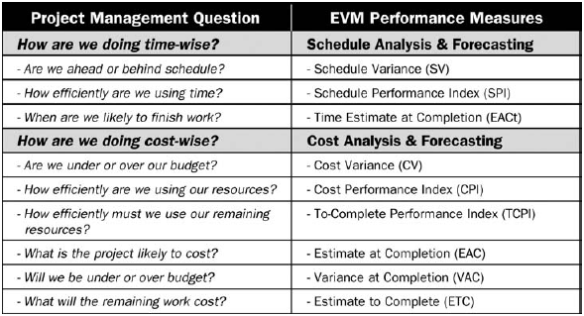
EVM role in relation to critical management questions

Slide 38
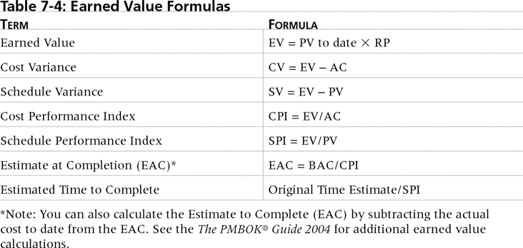
Earned Value Formulas

Slide 39
Rules of Thumb for Earned Value Numbers
Negative numbers for cost and schedule variance indicate problems in those areas.
A CPI or SPI that is less than 100 percent indicates problems.
Problems mean the project is costing more than planned (over budget) or taking longer than planned (behind schedule).

Slide 40
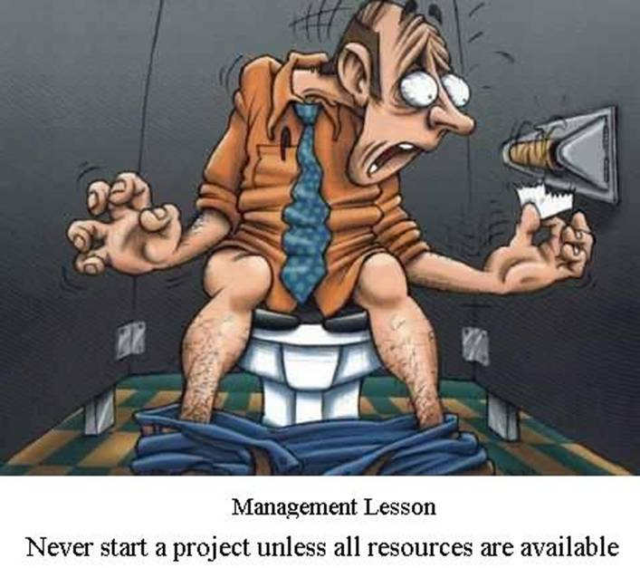

Slide 41
Using Software to Assist in Cost Management
Spreadsheets are a common tool for resource planning, cost estimating, cost budgeting, and cost control.
Many companies use more sophisticated and centralized financial applications software for cost information.
Project management software has many cost-related features, especially enterprise PM software.

Slide 42
Assignment 1 – Submission March 31st 2019
Given the following information for a one-year project, answer the following questions:
PV = $ 23,000
EV = $ 20,000
AC = $ 25,000
BAC = $ 120,000
What is the CV, SV, CPI and SPI for the project.
How is the project doing?
Based on given data calculate EAC
Based on given data estimate how long it will take to finish this project.

