Slide 1
Information Systems (IS) Auditing and Cybersecurity
Understanding IS/IT Auditing and Safeguarding Digital Assets
By: Ssendi Samuel
Bachelor of Business Computing Three

Slide 2
Information Systems Auditing
Information Systems (IS) Auditing refers to the process of evaluating and assessing the information systems of an organization to ensure the security, reliability, accuracy, and integrity of the data being processed. The goal of IS Auditing is to provide assurance that an organization's IT systems are functioning properly and effectively, while also safeguarding sensitive information and complying with legal and regulatory standards.
Notes:
As technology continues to evolve and play a critical role in organizational operations, IS Auditing has become a crucial component for managing risks, improving performance, and protecting valuable data assets from threats such as cyberattacks, data breaches, or unauthorized access.

Slide 3
Introduction to IS Auditing
Evaluating IT systems for security, reliability, and data integrity.
01
Ensures confidentiality, integrity, and availability of data.
02
Crucial for managing risks and complying with legal standards.
03

Slide 4
Objectives of IS Auditing
Confidentiality: Protect sensitive data from unauthorized access.
Integrity: Ensure accuracy and completeness of data.
Availability: Systems and data should be accessible when needed.

Slide 5
Types of IS Audits
Compliance Audits (e.g., GDPR, HIPAA)
Operational Audits (e.g., system efficiency)
Financial Audits (e.g., financial data integrity)
Security Audits (e.g., evaluating access controls)

Slide 6
IS Auditing Standards and Frameworks
COBIT: IT governance framework.
ISO/IEC 27001: Information security management.
NIST: Cybersecurity risk management framework.

Slide 7
Risk-Based Auditing Approach
Identifies risks in IT systems.
Focuses on mitigating internal and external risks.
Example: Auditing financial institutions for phishing risks and fraud prevention.

Slide 8
Cybersecurity in IS Auditing
Protect systems and networks from cyber threats.
Cybersecurity is critical in maintaining data confidentiality, integrity, and availability.
Evaluate effectiveness of security measures.

Slide 9
Common Cybersecurity Threats
Phishing: Deceptive emails trick users.
Malware: Malicious software disrupts systems.
DoS Attacks: Flooding systems to cause downtime.
Insider Threats: Misuse of access by employees.

Slide 10
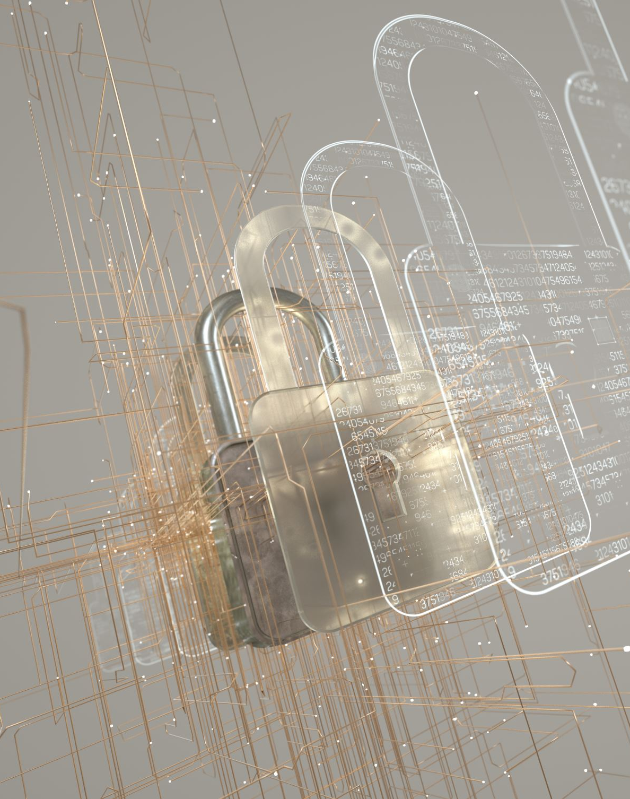
Key Cybersecurity Controls
Access Control: Limiting access to authorized users.
Encryption: Protecting data in transit and at rest.
Firewalls: Blocking unauthorized network access.
Incident Response Plans: Procedures to follow in case of a breach.

Slide 11
The IS Audit Process
Planning: Define scope and objectives.
Gathering Information: Review logs, policies, and documents.
Evaluating Controls: Assess effectiveness of current security measures.
Reporting Findings: Present recommendations for improvement.
Notes:
The IS Audit Process
The IS audit process typically follows a structured approach to ensure that all relevant aspects of information systems are reviewed thoroughly. Below is an overview of the key stages involved:
Planning the Audit:
Define the audit’s scope, objectives, and timeframe.
Identify the systems and processes to be reviewed (e.g., network security, data backup systems).
Understand the organization’s IT environment, including hardware, software, and business processes.
Gathering Information and Evidence:
Review documents such as system logs, security policies, access control lists, and network architecture diagrams.
Conduct interviews with IT staff and key personnel to understand system operations.
Perform testing of IT systems to ensure they function as intended.
Evaluating Controls:
Assess whether the organization has implemented adequate controls to mitigate risks.
Identify any gaps or weaknesses in controls and make recommendations for improvement.
Reporting Findings:
Provide a detailed audit report that outlines the findings, areas of concern, and recommendations.
The report should also include a risk rating for each issue to help prioritize remediation efforts.
Follow-Up:
After the audit, the auditor should follow up with the organization to ensure that corrective actions have been implemented.

Slide 12
Examples of IS Audits
Healthcare: HIPAA compliance audit.
Banking: Cybersecurity audit for fraud prevention.
E-Commerce: PCI DSS audit for protecting payment data.
Notes:
Examples of IS Auditing in Action
Healthcare Industry (HIPAA Compliance): A hospital undergoes an IS audit to ensure that its IT systems comply with the Health Insurance Portability and Accountability Act (HIPAA). The audit assesses whether patient data is stored securely, whether data access is limited to authorized personnel, and whether the hospital has implemented procedures for detecting and reporting data breaches.
Banking Sector (Cybersecurity Audit): A bank’s cybersecurity controls are evaluated in an IS audit to assess its preparedness for cyberattacks. The audit reviews firewalls, encryption protocols, user access controls, and incident response procedures. The auditor identifies gaps in password policies and recommends the implementation of multi-factor authentication to enhance security.
E-Commerce (PCI DSS Compliance): An online retailer undergoes an IS audit to ensure compliance with the Payment Card Industry Data Security Standard (PCI DSS). The audit focuses on the security of payment systems, ensuring that cardholder data is encrypted, access controls are in place, and network security measures are robust.

Slide 13
Conclusion and Key Takeaways
IS Auditing ensures the reliability and security of IT systems.
Cybersecurity is essential in protecting systems from internal and external threats.
Auditors identify risks, assess controls, and recommend improvements.

Slide 14
Questions?

