Slide 1
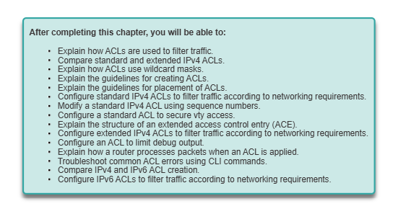

Slide 2
Access Control Lists (ACLs)
A set of IOS commands that control whether a router forwards or drops packets based on the packet header.
An ACL (Access Control List) is a list of statements that are meant to either permit or deny the movement of data from the network layer and above.
They are used to filter traffic in our networks as required by the security policy.

Slide 3
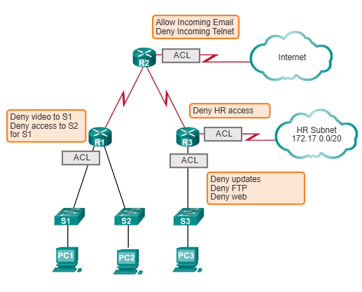
Key Functions of ACLs:
✔ Limit Network Traffic ✔ Control Traffic Flow
✔ Enhance Security
✔ Filter Traffic by Type ✔ Screen Network Access
By Default:
A router does not filter traffic unless an ACL is explicitly configured.
ACLs evaluate every packet before forwarding, ensuring priority-based traffic control.

Slide 4
ACL configuration guidelines
ACLs should be ideally configured on the routers that act as firewalls in your network.
ACLs should be configured on the routers in your network to control access to sensitive information in a particular subnet
ACLs should be configured on the edge of your network, for example, to separate traffic from the Headquarters to other branches.
ACLs should be configured to control traffic from the various protocols that you may have configured in your network.

Slide 5
The three rules of configuring ACLs
These rules determine how traffic on a network will flow and therefore they should not be ignored.
1 ACL per protocol – this is to control each of the protocols that you may have configured on your router.
1 ACL per direction – there are two directions in this case; inbound traffic is the traffic that is coming into the router whilst outbound traffic is traffic that is leaving the router.
1 ACL per interface – this is meant to control traffic from leaving the router through a specified interface.

Slide 6
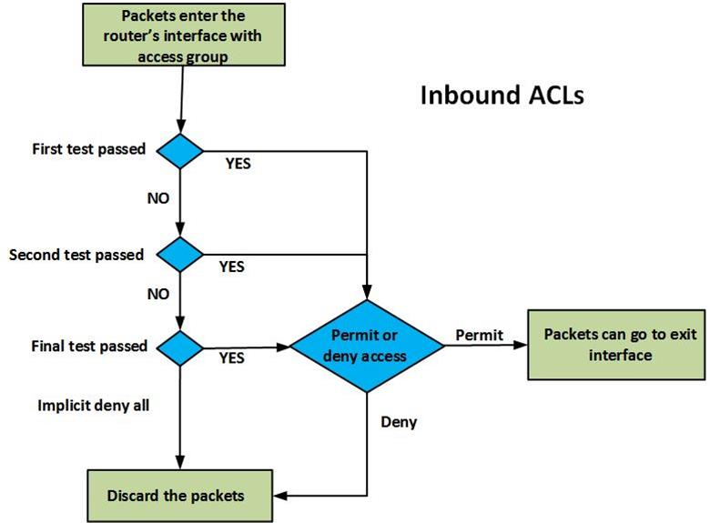
Directions in which ACLs can be configured.
Inbound ACLs-
the router checks the traffic that it receives from an interface against the configured ACLs before it can determine whether to route the traffic or not.
This type of ACL is important since the router does not waste CPU cycles by processing packets that would eventually be dropped.
Filters packets before routing lookups (saves processing time).

Slide 7
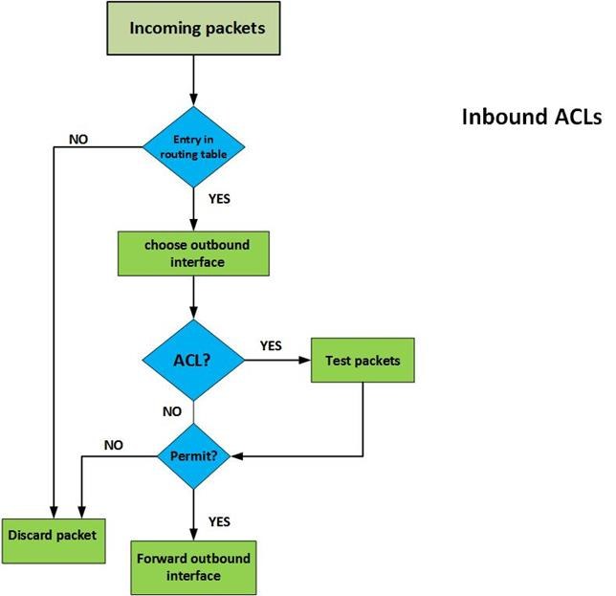
Directions in which ACLs can be configured.
2. Outbound ACLs
the packets are usually processed and forwarded to the outward ACL for filtering.
In this ACL, the router first checks in its routing table to see if the packet has a destination, if the destination is not in the routing table the packet is dropped.
The second thing the router inspects is whether the outbound interface has an ACL, if the interface does not have an ACL for the packet, it is forwarded.
Finally, for packets that have an ACL that is bound to the outbound interface, they are inspected by the ACL group statements to see if they match any criteria.
If they match any criteria, the router decides whether to forward or drop the packet. If they do not match any criteria and the ACL does not permit them, they are dropped.

Slide 8
Guidelines for ACL Placement-Where to Apply ACLs?
Inbound ACLs: Applied close to the source to filter traffic before it consumes bandwidth.
Outbound ACLs: Applied close to the destination to control traffic leaving the network.

Slide 9
The implicit deny all statement
If no permit rule exists, all traffic is blocked.
Implicit deny is always the last rule, even if not written.

Slide 10
Types of ACLs
Standard ACLs
an administrator can permit or deny packets based on their source IP address ONLY.
These ACLs do not check the packets for any other criteria and therefore the destination is not usually checked.
2. Extended ACLs
Extended Access Control Lists check the traffic against several criteria that has been set by the administrator.
Some of the criteria include;

Slide 11
Types of Cisco IPv4 ACLs
Standard IPv4 ACLs
Filters traffic based on the source IPv4 address only.
Does NOT evaluate destination addresses or ports.
Implicit deny blocks all other traffic.
Standard ACLs control access broadly
Characteristics
Uses only source IP addresses for filtering.
Numbered between 1-99 or 1300-1999.
Example:
access-list 10 permit 192.168.1.0 0.0.0.255
This rule allows traffic from 192.168.1.0/24.

Slide 12
Extended ACLs
Filters traffic using multiple attributes:
Protocol type (e.g., TCP, UDP, ICMP).
Source & Destination IPv4 addresses.
Source & Destination TCP/UDP ports (e.g., HTTP - Port 80).
Extended ACLs offer precise traffic filtering!

Slide 14
How ACLs Control Network Traffic:
ACLs permit or deny traffic based on network addresses or TCP ports.
They filter data based on the TCP communication process.
Understanding TCP Communication: 1. Connection-Oriented & Reliable: TCP ensures data is segmented, transmitted, and reassembled correctly. 2. Full-Duplex Communication: Data flows in both directions simultaneously. 3.Flow & Congestion Control: Prevents network overload by regulating data transmission speed.
TCP Communication Flags:
SYN – Starts session (synchronization).
ACK – Acknowledges received data.
FIN – Ends session.
SYN/ACK – Confirms synchronization.
Port-Based Filtering:
HTTP (Port 80) – Web browsing.
SMTP (Port 25) – Email.
FTP (Ports 20, 21) – File transfer.

Slide 15
Common TCP and UDP ports
Read about the common TCP and UDP ports

Slide 16
How ACLs Use TCP/IP Conversations to Filter Traffic
ACLs analyze packet headers to permit or deny network traffic.
A packet-filtering router extracts key information from the TCP/IP packet to make filtering decisions.
What ACLs Use for Filtering:
Layer 3 (Network Layer):
Source IP Address – Where the packet originates.
Destination IP Address – Where the packet is headed.
ICMP Message Type – Determines control messages.
Layer 4 (Transport Layer):
TCP/UDP Source Port – Identifies the sender’s application.
TCP/UDP Destination Port – Matches the requested service (e.g., HTTP - 80, FTP - 21).

Slide 17
How ACLs Process Packets:
Sequential Evaluation: Each packet is checked against ACL rules (ACEs) in order.
Match Found? ✅ Permit or Deny traffic based on the rule.
No Match? ❌ The packet is dropped (implicit deny rule).

Slide 18
Guidelines for ACL Creation
Deny statements should be specific to avoid unintended access restrictions.
Always include a final "deny all" statement (implicit deny exists but can be explicitly defined).
Use sequence numbers for better organization and easier modification.
Regularly review and update ACLs as network policies change.

Slide 19
Verifying ACLs
Show configured ACLs:
show access-lists
Show interfaces with ACLs applied:
show ip interface
Check ACL logs:
debug ip packet

Slide 20
Securing VTY Ports with a Standard IPv4 ACL
Restricting Remote Access
ACLs can restrict Telnet/SSH access to trusted IP addresses.
Example:
access-list 15 permit 192.168.1.10 0.0.0.0
line vty 0 4 access-class 15 in
Only 192.168.1.10 is allowed remote access.

