Slide 1
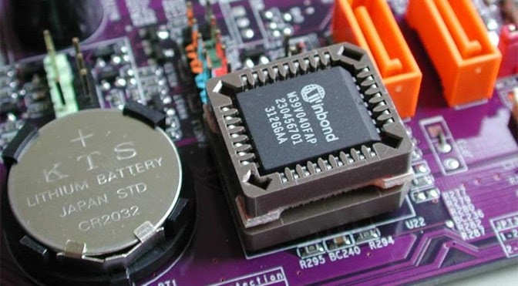
BIOS and CMOS
Topic 5
Notes:
NOTE:
To change the image on this slide, select the picture and delete it. Then click the Pictures icon in the placeholder to insert your own image.

Slide 2
BIOS (Basic Input/Output System
BIOS: Firmware that initializes and tests hardware components during the booting process and provides runtime services for operating systems and programs.
• Role: Acts as an intermediary between the computer's hardware and the operating system.
Functions
Power-On Self-Test (POST): Diagnostic testing sequence to ensure the computer hardware is functioning correctly before loading the operating system.
Boot Loader: Identifies and loads the operating system from the storage device into the computer's memory.
Hardware Abstraction: Provides a set of low-level routines that the operating system uses to interact with hardware components, such as the keyboard, display screen, and storage devices.

Slide 3
Components
ROM Chip: The BIOS firmware is stored on a non-volatile ROM chip on the motherboard.
BIOS Routines: Includes routines for device initialization, interrupt handling, and hardware configuration.
BIOS Settings: User-configurable settings stored in the CMOS (Complementary Metal-Oxide Semiconductor).

Slide 4
Types of BIOS
Legacy BIOS:
Older type of BIOS.
Limited to 16-bit code execution and 1 MB of addressable memory.
UEFI (Unified Extensible Firmware Interface):
Modern BIOS replacement.
Supports 32-bit and 64-bit code execution.
Enhanced security features, faster boot times, and larger drive support.

Slide 5
CMOS (Complementary Metal-Oxide Semiconductor)
CMOS: A type of non-volatile memory that stores BIOS settings and system configuration.
Functions
Store Configuration Settings: Stores system configuration settings, such as date and time, boot sequence, and hardware settings.
Battery Backup: Powered by a small CMOS battery to retain settings when the computer is powered off.
Real-Time Clock (RTC): Maintains system time and date.

Slide 6
BIOS/CMOS Setup Programs
Accessing BIOS/CMOS Setup
Common Access Keys
Keys to Enter BIOS Setup: Del, F2, F10, Esc, F12 (varies by manufacturer).
Steps to Access Setup
Restart the Computer: During the initial boot sequence, press the designated key to enter the BIOS setup.
Navigate BIOS Menu: Use keyboard keys (arrow keys, Enter, Esc) to navigate through the BIOS setup menu.

Slide 7
BIOS/CMOS Setup Configuration
System Time and Date: Set the system's clock and calendar.
Boot Sequence: Configure the order of devices to boot from (e.g., hard drive, CD/DVD, USB).
Hardware Configuration: Enable or disable hardware components, such as integrated peripherals (e.g., USB ports, audio).
Power Management: Configure power-saving settings and behavior.
Security Settings: Set passwords for system access and BIOS setup.
Advanced Settings: Configure CPU settings, memory timings, and other performance-related options.

Slide 8
Saving and Exiting
Save Changes: Save any changes made to the BIOS settings before exiting.
Options include "Save & Exit", "Exit Without Saving", "Load Default Settings".
2. Reboot: The system will reboot with the new configuration settings.

Slide 9
System Resources
System Resources: Components and interfaces used by the operating system and hardware to manage tasks and operations. Includes CPU, memory, I/O ports, and interrupts.
Types of System Resources
1. Interrupt Requests (IRQs): Signals sent to the CPU to get its attention for processing tasks. Each device must have a unique IRQ to function correctly.
Common IRQs:
IRQ0: System Timer; IRQ1: Keyboard; IRQ6: Floppy Disk; IRQ12: Mouse

Slide 10
Direct Memory Access (DMA) Channels
DMA: Allows devices to transfer data directly to/from memory without involving the CPU, improving performance.
Common DMA Channels:
DMA0: Reserved; DMA1: Available; DMA2: Floppy Disk Controller

Slide 11
Input/Output (I/O) Ports
I/O Ports: Interfaces used by peripheral devices to communicate with the CPU.
Common I/O Ports:
COM1: 3F8h (Serial Port); COM2: 2F8h (Serial Port); LPT1: 378h (Parallel Port)

Slide 12
Configuring System Resources
Automatic Configuration: Plug and Play (PnP): Automatically assigns system resources to devices to avoid conflicts.
Manual Configuration
BIOS/CMOS Setup: Manually assign IRQs, DMA channels, and I/O ports if automatic configuration fails or specific settings are required.
Device Manager (Windows): Use Device Manager to view and configure system resources for hardware devices.

Slide 13
Troubleshooting System Resource Conflicts
Common Issues
1. IRQ Conflicts: Two devices attempting to use the same IRQ.
2. DMA Conflicts: Devices trying to use the same DMA channel.
3. I/O Port Conflicts: Devices trying to use the same I/O port address.

Slide 14
Resolution Steps
1. Identify Conflicts: Use BIOS setup or Device Manager to identify conflicting resources.
2. Reassign Resources: Manually reassign IRQs, DMA channels, or I/O ports in BIOS or Device Manager.
3. Update Drivers: Ensure that the latest drivers are installed for all hardware devices.

Slide 15
Practical Example: Configuring BIOS/CMOS Settings
Accessing BIOS: Restart the computer and press the designated key (e.g., F2, Del, Esc) to enter BIOS setup.
Setting System Time and Date:
Navigate to the "System Time" and "System Date" fields.
Adjust the values using the arrow keys and Enter.
Configuring Boot Order:
Navigate to the "Boot" menu
4. Use Device Manager: Open Device Manager in Windows, expand the device categories, and view the resource settings for each device.

Slide 16
END

