Slide 1
COMPUTER NETWORK ADDRESSING
BY
ABDALLAH IBRAHIM NYERO
(MBA, BIM, CCNA, CCNP)
Lecturer: Business Computing Department
MUBS

Slide 2
Learning objectives
The Objectives of this lecture are to;
Define What Computer Network address is
Learn Why Addresses are Important in Computer Networks
Differentiate between MAC Address and IP address
State the versions of IP address
Analyse different classes of IP address
Differentiate between a Public and Private Address
Binary and decimal conversions

Slide 3
introduction
Each node on a network has to be addressed;
Physically i.e. MAC address and
Logically i.e. IP address: Ipv4 and IPv6

Slide 4
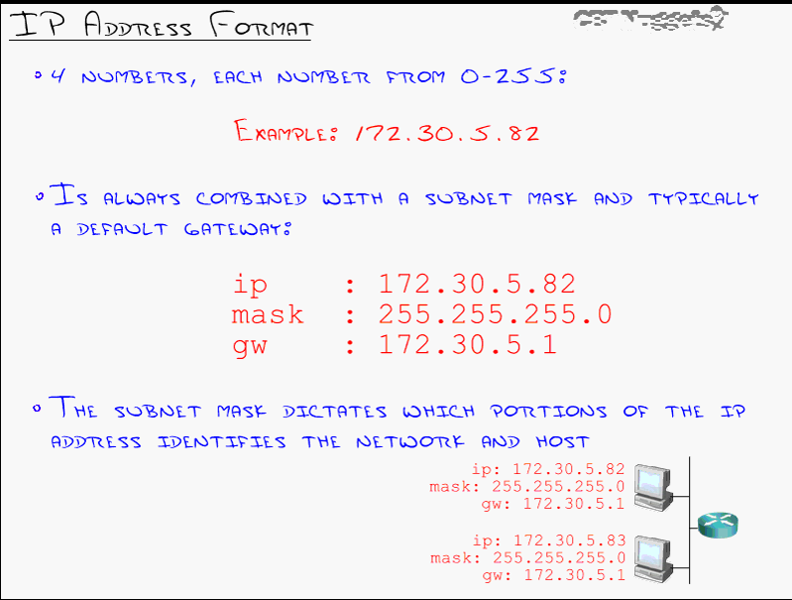
IP address Version 4 0703175630

Slide 5
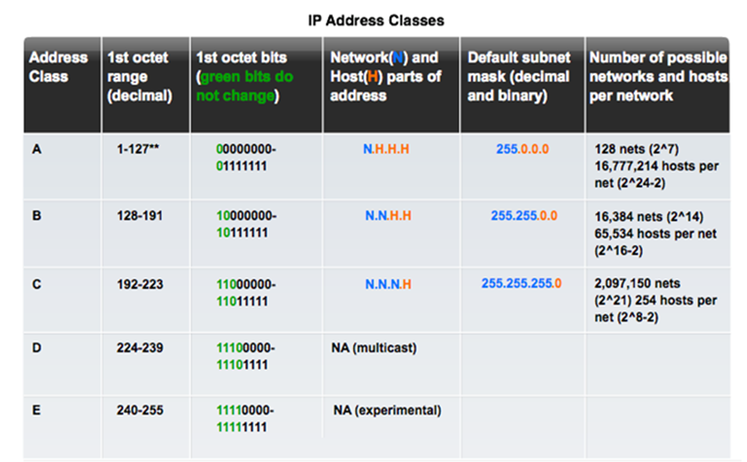
Legacy Classful Addressing

Slide 6
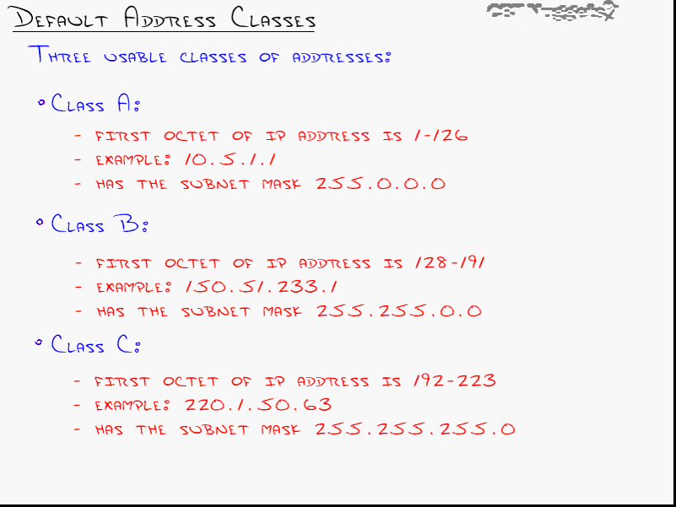
Default Address Classes

Slide 7
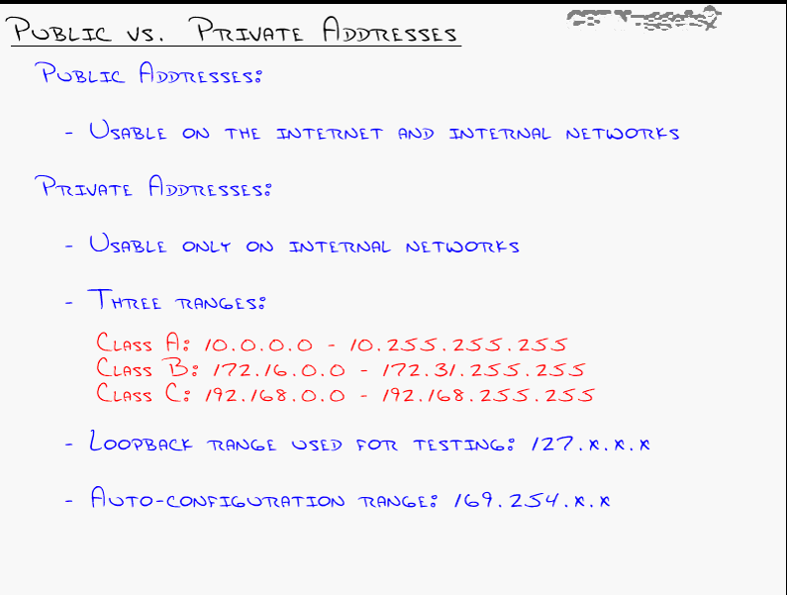
Public Vs Private

Slide 8
quiz
Open Command prompt and determine the following;
The IP address of your computer
The Class of the Address
Is it Private or Public , give reason for your answer?
MAC address of your Computer
Your Internet Service Provider (ISP)
https://whatismyipaddress.com/

Slide 9
Finding your ip on mac, window or linux
Windows: Open command prompt and type ipconfig /all
Mac: Open terminal and type ifconfig
http://www.wikihow.com/Find-Your-IP-Address-on-a-Mac
Linux: Open terminal and type ifconfig
http://www.wikihow.com/Check-the-IP-Address-in-Linux

Slide 10
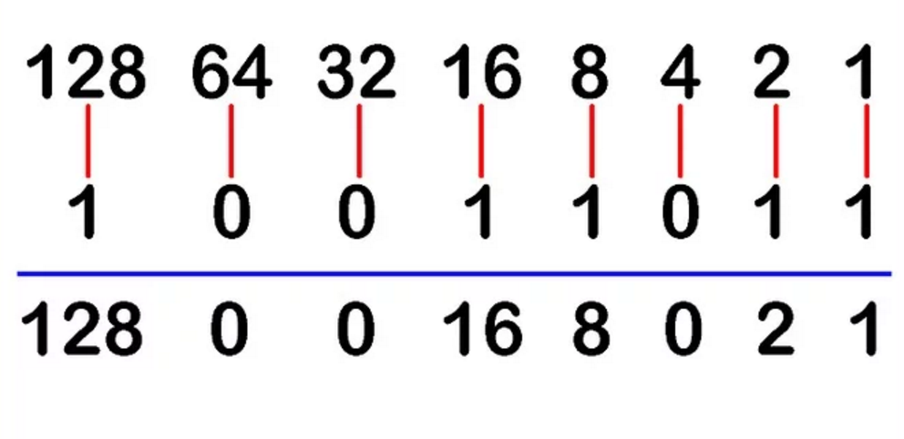
Binary to Decimal conversion

Slide 11
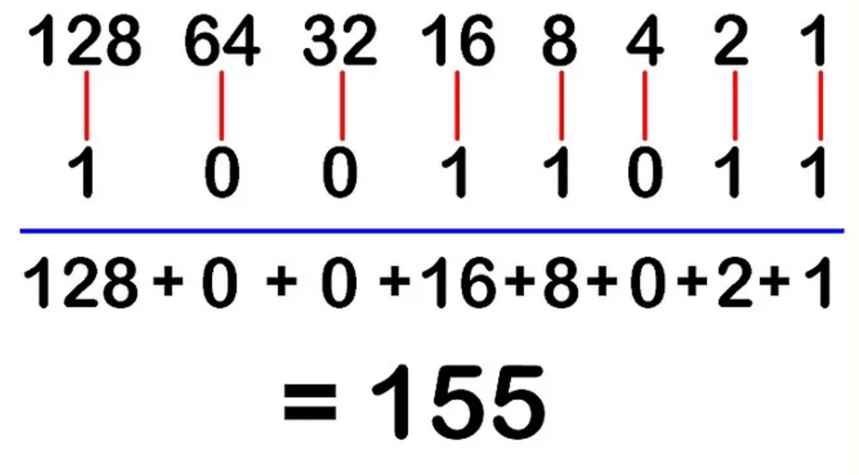
Binary to Decimal conversion

Slide 12
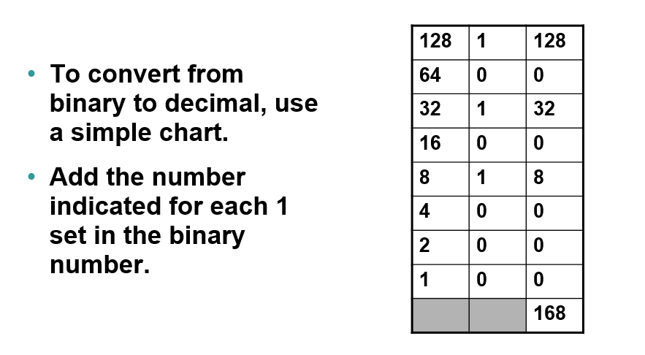
Binary to Decimal conversion

Slide 13
Decimal to Binary conversion

Slide 14
Problems with Classful IP Addresses
The original classful address scheme had a number of problems
Problem 1. Too few network addresses for large networks
Class A and Class B addresses are gone

Slide 15
Problems with Classful IP Addresses
Problem 2. Inflexible. Assume a company requires 2,000 addresses
Class A and B addresses are overkill
Class C address is insufficient (requires 8 Class C addresses)
Fix #2: Classless Interdomain Routing (CIDR)
Problem 3: Exploding Routing Tables: Routing on the backbone Internet needs to have an entry for each network address. In 1993, the size of the routing tables started to outgrow the capacity of routers.
Fix #2: Classless Interdomain Routing (CIDR)

Slide 16
Problems with Classful IP Addresses
Problem 4. The Internet is going to outgrow the 32-bit addresses
2 ^32=
128
Fix #3: IP Version 6

Slide 17
subnetting
Subnetting—break a larger network into smaller networks by borrowing bits. Network bits are represented by 1 while host bits are represented by 0
Why subnet?
Easy management of the network
Efficient utilization of IP address space.
To separate network segments by function
Assist in resolving network congestion problems
Subnets are created to limit the scope of broadcast traffic
Security measures

Slide 18
How to create subnets
Determine the number of required network IDs:
One for each subnet
One for each wide area network connection
Determine the number of required host IDs per subnet:
One for each TCP/IP host
One for each router interface
Based on the above requirements, create the following:
One subnet mask for your entire network
A unique subnet ID for each physical segment
A range of host IDs for each subnet

Slide 19
Subnetting a Class A/B/C Address
How many subnets does the chosen subnet mask produce?
How many valid hosts per subnet are available?
What are the valid subnets?
What’s the broadcast address of each subnet?
What are the valid hosts in each subnet?

Slide 20
Practice Example: 255.255.255.224 (/27) Network 192.168.10.0
How many subnets? 224 is 11100000, so our equation would be 2^3 = 8.
How many hosts? 2^5– 2 = 30.
What are the valid subnets? 256 – 224 = 32. We just start at zero and count to the subnet mask value in blocks (increments) of 32: 0, 32, 64, 96, 128, 160, 192, and 224.
What’s the broadcast address for each subnet (always the number right before the next subnet)?
What are the valid hosts (the numbers between the subnet number and the broadcast address)?

Slide 21
Practice Example: 255.255.255.224 (/27) Network 192.168.10.0
Subnets | First Valid Address | Last Valid Address | Broadcast Address
192.168.10.0 | 192.168.10.1 | 192.168.10.30 | 192.168.10.31
192.168.10.32 | 192.168.10.33 | 192.168.10.62 | 192.168.10.63
192.168.10.64 | 192.168.10.65 | 192.168.10.94 | 192.168.10.95
192.168.10.96 | 192.168.10.97 | 192.168.10.126 | 192.168.10.127
192.168.10.128 | 192.168.10.129 | 192.168.10.158 | 192.168.10.159
192.168.10.160 | 192.168.10.161 | 192.168.10.190 | 192.168.10.191
192.168.10.192 | 192.168.10.193 | 192.168.10.222 | 192.168.10.223
192.168.10.224 | 192.168.10.225 | 192.168.10.254 | 192.168.10.255

Slide 22
QUESTION AND ANSWER SESSION
Q & A

Slide 23
Reference materials
Jim Kurose, Keith Ross. Computer Networking: A Top Down Approach. 6th edition, March 2012.
CBT Nuggets—Jeremy Ciora

Slide 24
THANK YOU
Wednesday, 26 October 2022

