Slide 1
Animation Techniques

Slide 2
Animation techniques refer to the various methods and approaches used to create the illusion of motion and bring still images or objects to life. These techniques involve manipulating and sequencing visual elements to produce the perception of movement, resulting in animated sequences that can be displayed in films, videos, games, or other multimedia presentations.

Slide 3
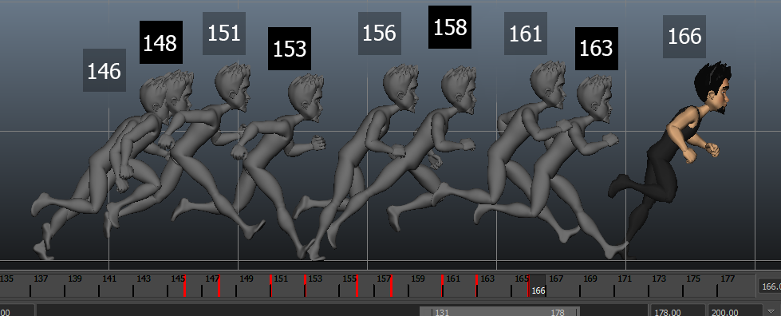
Animation Techniques

Slide 4
Animation techniques can be broadly categorized into two main types:
1. Traditional Animation Techniques: These techniques involve creating animation manually by hand-drawing or physically manipulating objects. Examples include:
Cel Animation (2D Animation): The classic technique of hand-drawing individual frames on transparent celluloid sheets (cels) and photographing them sequentially to create motion.
Stop Motion Animation: Animating physical objects or models by capturing successive frames of movement, often using techniques like claymation, puppet animation, or object animation.
Flip Book Animation: A simple form of animation where a series of images are drawn on paper and viewed rapidly to create the illusion of motion.

Slide 5
Animation techniques can be broadly categorized into two main types:
2. Computer-Generated Animation Techniques: These techniques rely on computer software and algorithms to create animation. Examples include:
3D Animation: Using computer graphics to generate three-dimensional objects and characters, animating them in a virtual 3D environment.
Keyframe Animation: Defining key positions or poses at specific time intervals, with the computer interpolating the intermediate frames to create smooth motion.
Motion Capture (MoCap): Recording real-world movements using sensors or cameras and then applying them to 3D models to replicate lifelike motion.
Particle Animation: Simulating and animating particles or particles systems, such as smoke, fire, or water, using mathematical algorithms.

Slide 6
Applications
Entertainment: Animation is widely used in the entertainment industry, including films, TV shows, and web series, to create captivating storytelling and visual experiences.
Advertising and Marketing: Animation is employed in advertisements and marketing campaigns to deliver messages effectively and creatively.
Education: Animation is used in educational videos and interactive learning materials to explain complex concepts in an engaging and easy-to-understand manner.

Slide 7
Applications…continu
Gaming: Animation plays a crucial role in video games, bringing characters and environments to life and enhancing the gaming experience.
Simulation and Training: Animation is utilized in simulations and training programs to mimic real-world scenarios and provide hands-on training without real-world risks.

Slide 8
Types of Animation
2D Animation: Traditional hand-drawn or computer-assisted animation that occurs in a 2D space.
3D Animation: Computer-generated animation that takes place in a 3D environment, allowing for realistic movement and depth.
Stop Motion Animation: Animation created by photographing physical objects or models in small increments and then playing them in sequence.
Motion Graphics: Animation that combines graphic design and visual effects to convey information or messages.
Cut-out Animation: Animation technique using 2D characters and objects cut out from paper or other materials and animated frame by frame.

Slide 9
Importance
Storytelling: Animation allows for creative storytelling, enabling the portrayal of fantastical worlds and characters that may be difficult to achieve with live-action.
Visual Appeal: Animation captures the imagination and attention of viewers through vibrant visuals, colorful characters, and dynamic movements.
Versatility: Animation can convey a wide range of emotions and concepts, making it a versatile medium for various applications.

Slide 10
Educational Value: Animation simplifies complex topics and makes them engaging and accessible, making it an effective educational tool.
Branding and Marketing: Animation helps create memorable brand characters and visuals that leave a lasting impression on audiences.

Slide 11
Challenges
Time-Consuming: Animation can be a time-consuming process, especially for complex and detailed scenes.
Skill and Expertise: Achieving high-quality animation requires skilled animators and specialized knowledge of animation techniques and software.
Rendering Complexity: 3D animation, in particular, may require significant computing power and rendering time to achieve realistic results.

Slide 12
Challenges…continu
Fluidity and Realism: Achieving smooth and realistic movements in animation, especially with character animation, can be challenging.
Innovation and Originality: With the abundance of animated content, creating unique and original animations becomes a challenge.

