Slide 1
The Internet & Social Media

Slide 2
Internet definition (Wikipedia)
The Internet is the global system of interconnected computer networks that use the Internet protocol suite (TCP/IP) to link billions of devices worldwide.
It is a network of networks that consists of millions of private, public, academic, business, and government networks of local to global scope, linked by a broad array of electronic, wireless, and optical networking technologies.

Slide 3
Internet definition con’t
Internet is defined as an Information super Highway, to access information over the web.
Internet is a world-wide global system of interconnected computer networks.

Slide 4
Internet definition con’t
The Internet carries an extensive range of information resources and services, such as;
Inter-linked hypertext documents
applications
World Wide Web (WWW),
electronic mail,
telephony,
peer-to-peer networks for file sharing

Slide 5
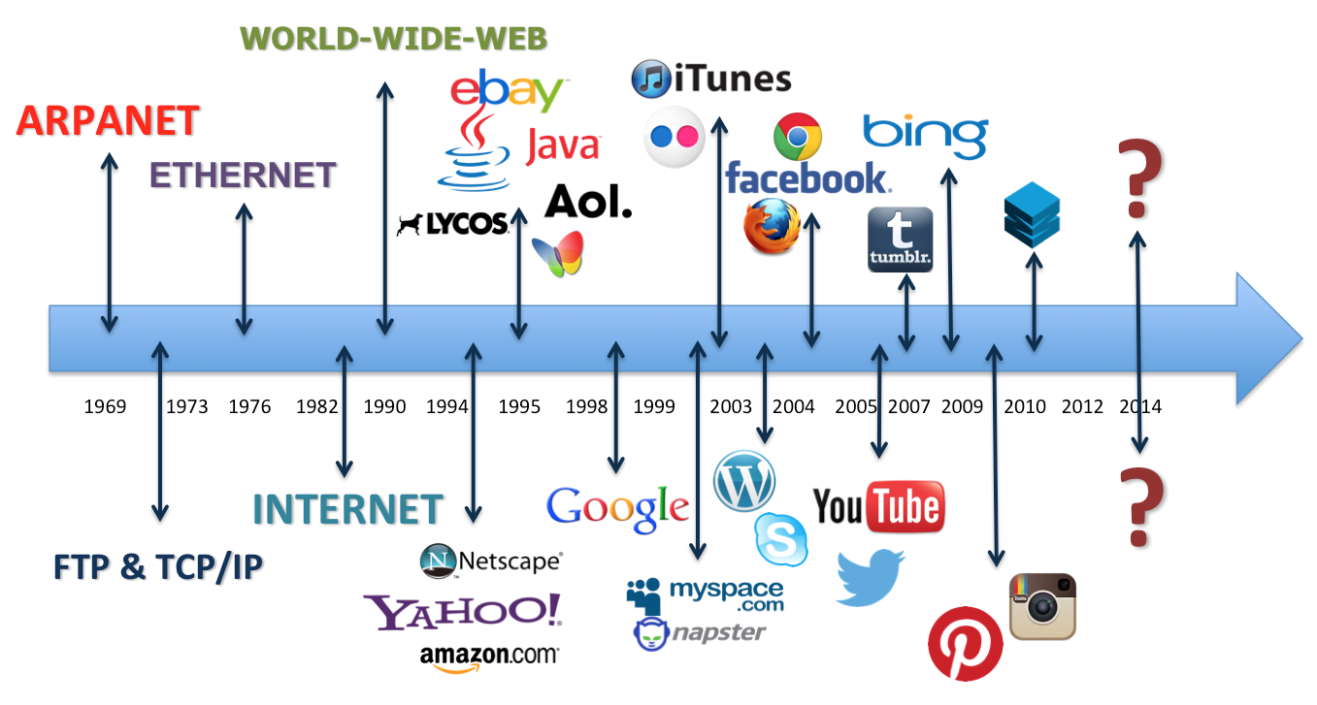
Internet Timelines/History

Slide 6
Internet Technologies
TCP/IP, or the Transmission Control Protocol/Internet Protocol, is a suite of communication protocols used to interconnect network devices on the internet.
TCP/IP can also be used as a communications protocol in a private network (an intranet or an extranet).

Slide 7
DNS: The Domain Name
System (DNS) is a hierarchical decentralized naming system for computers, services, or other resources connected to the Internet or a private network.
It associates various information with domain names assigned to each of the participating entities

Slide 8
WWW or World Wide Web
An information system on the Internet which allows documents to be connected to other documents by hypertext links, enabling the user to search for information by moving from one document to another.

Slide 9
Browser,
A browser is an application program that provides a way to look at and interact with all the information on the World Wide Web

Slide 10
Scripting languages etc.
A scripting language is a programming language designed for integrating and communicating with other programming languages. Some of the most widely used scripting languages are JavaScript, VBScript, PHP, Perl, Python, Ruby, ASP and Tcl

Slide 11
Internet Technologies con’t
Every computer in internet is identified by a unique IP address.
IP Address is a unique set of numbers (such as 192.145.236.94) which identifies a computer location.
A special computer DNS (Domain Name Server) is used to give name to the IP Address so that user can locate a computer by a name

Slide 12
Internet Technologies con’t
For example, a DNS server will resolve aname http://www.mubs.ac.ug to a particular IP address (192.145.236.94) to uniquely identify the computer on which this website is hosted.
Internet is accessible to every user all over the world.

Slide 13
Forms of Internet - Intranet
Intranet is defined as private network of computers within an organization with its own server and firewall. Moreover we can define Intranet as:
Intranet is system in which multiple PCs are networked to be connected to each other. PCs in intranet are not available to the world outside of the intranet.

Slide 14
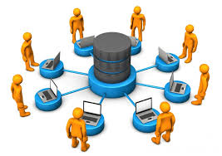
Intranet con’t
An intranet is an internal internet, available to individuals within a specific organization.
The intranet also refers to a closed community of users, often within an organization. Intranets are designed to be used for internal business purposes only.

Slide 15
Intranet con’t
Usually each company or organization has their own Intranet network and members/employees of that company can access the computers in their intranet.
Every computer in internet is identified by a unique IP address.
Each computer in Intranet is also identified by a IP Address, which is unique among the computers in that Intranet

Slide 16
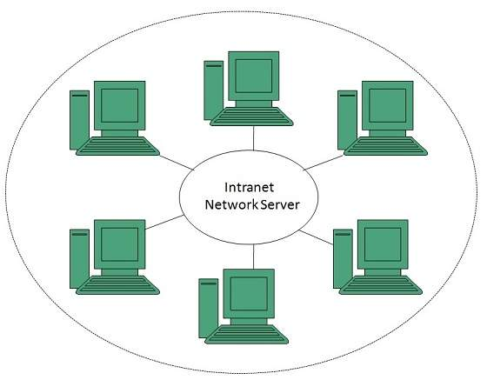

Slide 17
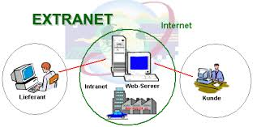
Forms of Internet - Extranet
Extranet refers to network within an organization, using internet to connect to the outsiders in controlled manner. It helps to connect businesses with their customers and suppliers and therefore allows working in a collaborative manner.

Slide 18
Extranet Con’t
An extranet is an extension of an organization’s Intranet. The difference is that an extranet is accessible to selected people or groups outside the organization e.g. organization’s suppliers, distributors and corporate customers.
An individual can obtain a password authorization and then be routed to the organizations extranet to conduct transactions & obtain information not available to the public.

Slide 19
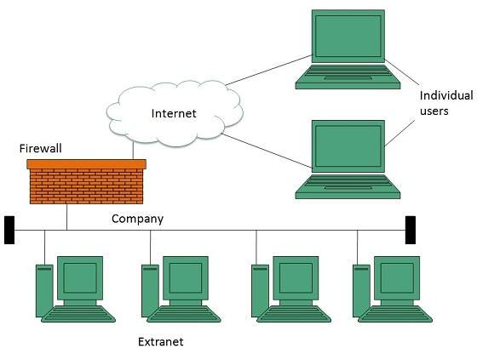

Slide 20
Vital Internet Technologies
A reasonably powerful PC (preferably Pentium or similar) that has sufficient hard disk space on which to store files (at least 10GB storage capacity).
A modem that works at a high transmission rate.
Computer software/telecommunication program
Telephone lines or points
Internet Service Provider (ISP)

Slide 21
Internet Applications
Electronic mail or e-mail.
Electronic conferencing.
Electronic education / learning/ research.
Electronic chart services.
Electronic collaboration.
Electronic medicine.
Electronic shopping.
Electronic entertainment.
Electronic marketing/selling products or services.
Electronic funds transfer/purchase products.
Electronic banking.
Electronic commerce
E.t.c.

Slide 22
Internet Business Opportunities

Slide 23
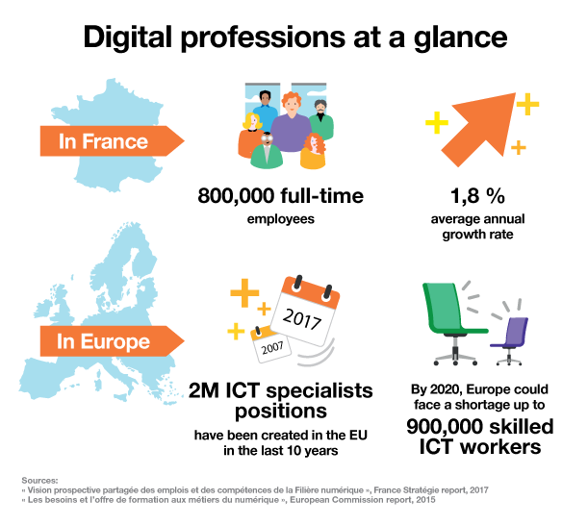

Slide 24
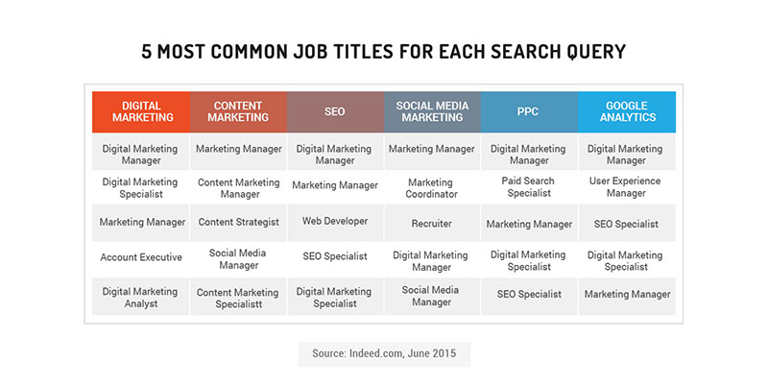
New Professions in the digital world
Customer Acquisition and Retention
SEO Manager
SEM Manager
Project Manager
E-commerce Manager
Social Network
Manager
Webmaster
Quality Assurance and Tester
Graphics and Media Developer
Online Content Writer or Curator
User Experience Specialist

Slide 26
Internet Business Opportunities
Credit authorization at the point of sale using online POS networks.
Credit inquiries can be made and answered in seconds.
Desktop videoconferencing between a company and its business partners reduces expensive business trips, allows customers, suppliers, and employees to collaborate, thus improving the quality of decisions reached.
Business-to-business e- Commerce website for transactions with suppliers and customers leads to fast, convenient services lock-in customers and suppliers.

Slide 27
Internet Business Opportunities Cont’
Use of the Internet and extranets to transmit customer orders from has led to the provision of better customer service by reducing delay in filling orders.
Transmission of customer orders also improves cash flow by speeding up the billing of customers.
Generating new revenue from online sales or electronic commerce applications is a growing source of business value.

Slide 28
Internet Business Opportunities Cont’
Attract new customers via Web marketing and advertising and online sales with innovative products.
Increase the loyalty of existing customers via improved Web customer service and support.
It fosters communication interactively with customized information and services to individual customers.

Slide 29
Internet Business Opportunities Cont’
Reduced costs and cost savings through online sales and customer support.
Develop new Web-based markets and distribution channels for existing products.
Develop new information-based products accessible on the Web.

Slide 30
Assignment
Students should review the online business opportunities on the link below;
https://smallbiztrends.com/2016/11/online-business-ideas.html

Slide 31
What is Social media?

Slide 32
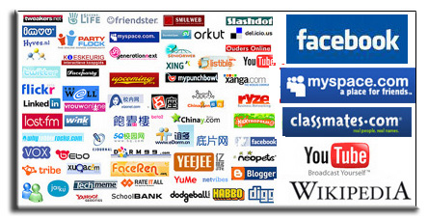

Slide 33
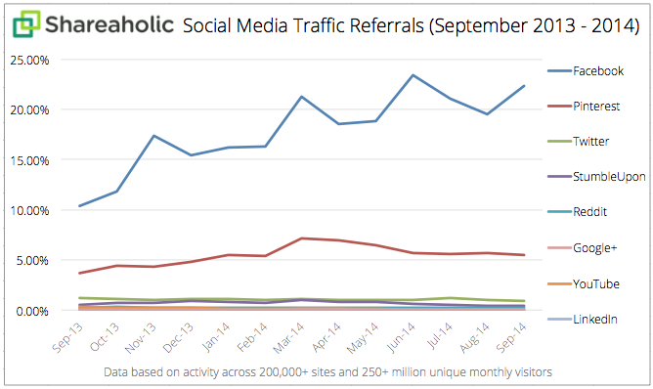

Slide 34
Social Media is
Consumer generated media It is media that is designed to be shared, sharing means that it is easy to comment on, that it is easy to send, there are no costs associated with viewing the media and last but not least it is always available.
Social media enables people to share information with friends and colleges using the Internet

Slide 35
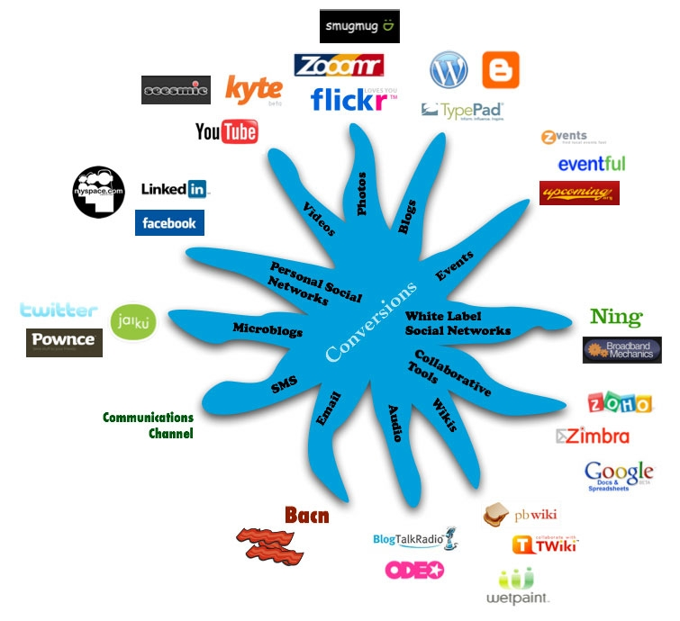
photo credit: dbarefoot

Slide 36
What else….which ones do u use
Skype
Google Talk
Windows messenger

Slide 37
Social Networking
Social Networking is the use of communities to engage with others: Facebook, Google Plus, MySpace, LinkedIn, Twitter, WatsApp, etc...... Social Networking sites often include social media tools to facilitate the interaction and conversation

Slide 38
Social Networking
Friendship
Keeping in Touch
Developing new relationships
Sharing
Photos
Community
Causes
Beliefs
Advocacy
Links
Interests
Teaching

Slide 39
Why is Social Media important?
Everybody is online – using a smart phone, computer, TV or other electronic device according to a new study from the Kaiser Family Foundation.
Growing up online has shaped how teens and young adults receive, process and act on information. They expect information to be brief, instant and always on (there are no office hours

Slide 40
How popular are Social Networks?
According to the analysts at Hitwise, social networks in general are more popular than search engines in some parts of the world
Facebook’s overall web traffic pulled ahead of Google’s
Facebook dominated the crop of social networks, accounting for the majority (55%) of all social site visits. When compared to the wider web, Google gets around 9.3% of all web traffic, while Facebook captures just over 7%

Slide 41
Quiz 1……!
Why do business invest in Social Media?

Slide 42
Quiz 1……!
How can Organizations use Social Media to their benefit?

Slide 43
Types Of Social Media (Kakkar, 2018)
Social networking (Facebook, LinkedIn, Google+).
Media Sharing Networks (Instagram, Snapchat, YouTube)
Discussion Forums (Reddit, Quora, Digg)
Bookmarking and Content Curation Networks (Pinterest, Flipboard)
Consumer Review Networks (Yelp, Zomato, TripAdvisor)
Blogging and Publishing Networks (WordPress, Tumblr, Medium)

Slide 44
Types Of Social Media
Social Shopping Networks (Polyvore, Etsy, Fancy)
Interest-based Networks (Goodreads, Houzz, Last.fm)
Microblogging (Twitter, Tumblr).
Photo sharing (Instagram, Snapchat, Pinterest).
Video sharing (YouTube, Facebook Live, Periscope, Vimeo).

Slide 45
Question
Identify any five organizations in Uganda and discuss how they are utilizing social media in their business today.

