Slide 1
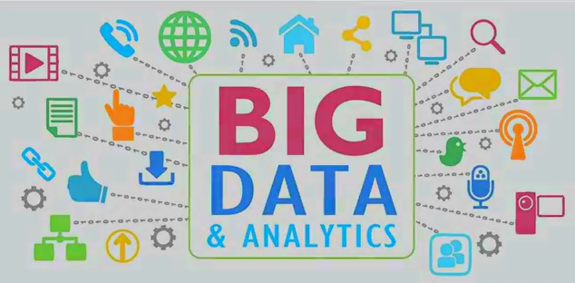
Chapter -1 Introduction to Big Data and Big Data Analytics

Slide 2
contents
Evolution of Big data
sources of Big Data
What is Big Data?
Characteristic of Big Data( 5 Vs)
Tools used in Big Data
Introduction to Big Data analytics
Big Data analytics goals
Applications/use cases of Big Data analytics
Challenges of Big Data
How Hadoop solves the Big Data problem

Slide 3
Evolution of Big Data
The Model of Generating/Consuming Data has Changed
Old Model: Few companies are generating data, all others are consuming data
New Model: all of us are generating data, and all of us are consuming data

Slide 4
Unit of Data size | Exact size | Approximate Size | Examples
KB (kilobyte ) | 2 ¹⁰ or 1024 bytes | (10³ or one thousand) bytes | A typical joke =1KB
MB(megabyte ) | 2 ²⁰ bytes | (10⁶ or one million) bytes | Complete work of Shakespeare =5MB
GB (gigabyte ) | 2 ³⁰ bytes | (10⁹ or one billion) bytes | Ten yards of books on a shelf = 1GB
TB (terabyte) | 2 ⁴⁰ bytes | (10¹² or one trillion) bytes | All the X-rays for a large hospital =1TB Tweets; created daily =121TB;
PB (peta byte) | 2 ⁵⁰ bytes | (10¹⁵ or one quadrillion) bytes | All U.S. academic research libraries = 2PB Data processed in a day by Google =24PB | B I G D A T A
EB (exa byte) | 2 ⁶⁰ bytes | (10¹⁸ or one Quintillion) bytes | Total global data created in 2006 = 161EB
ZB (zetta byte) | 2 ⁷⁰ bytes | (10²¹ or one Sextillion) bytes | Total amount of global data created in 2012 = 2.7 ZB and expected 44 ZB by 2020
YB (yotta byte) | 2 ⁸⁰ bytes | (10²⁴ or one Septillion) bytes

Slide 5
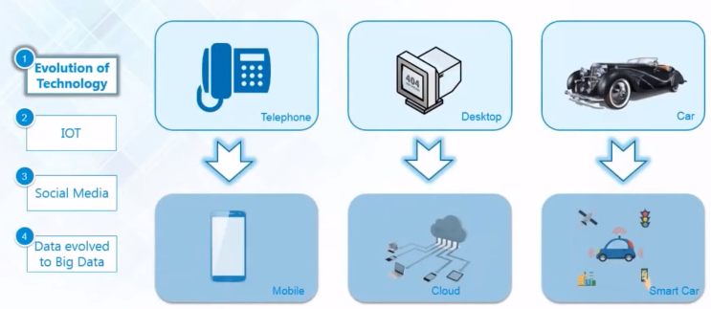
Evolution of Big Data by technology

Slide 6
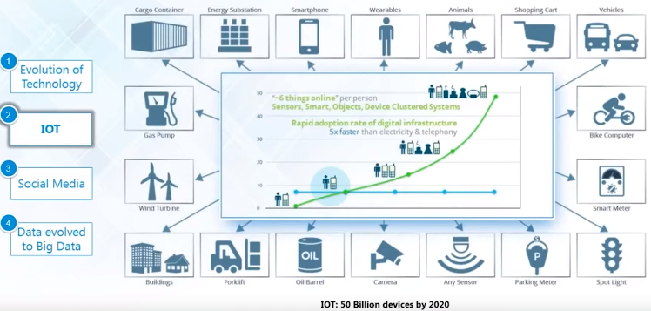
Evolution of Big Data by Internet Of Things

Slide 7
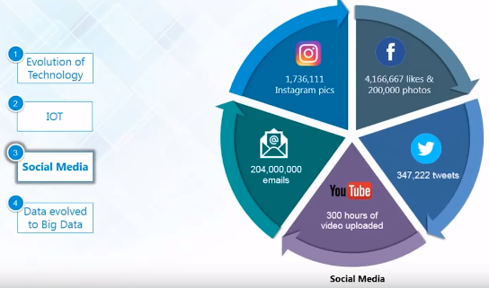
Evolution of Big Data by Social Media

Slide 8
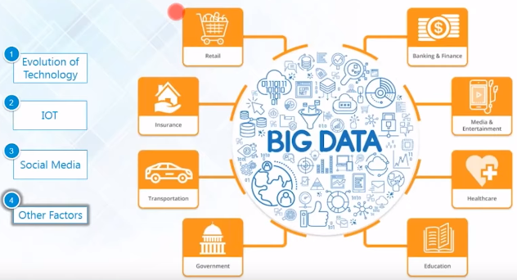
Evolution of Big Data by other factors

Slide 9
Big Data sources
Human Generated Data
is emails, documents, photos and tweets. We are generating this data faster than ever. Just imagine the number of videos uploaded to You Tube and tweets swirling around. This data can be Big Data too.
Machine Generated Data
is a new breed of data. This category consists of sensor data, and logs generated by 'machines'
such as email logs, click stream logs, etc. Machine generated data is orders of magnitude larger than Human Generated Data.

Slide 10
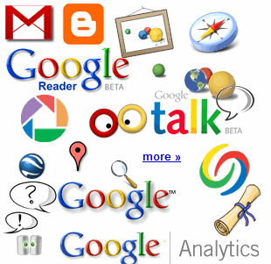
Big Data sources
Web Data
Social media data : Sites like Facebook, Twitter, LinkedIn generate a large amount of data
Click stream data : when users navigate a website, the clicks are logged for further analysis (like navigation patterns). Click stream data is important in on line advertising and E-Commerce
12+ TBs of tweet data every day
25+ TBs of log data every day
? TBs ofdata every day

Slide 11
Big Data sources
sensor data : sensors embedded in roads to monitor traffic and misc.
4.6 billion camera phones world wide
30 billion RFID tags today (1.3B in 2005)
100s of millions of GPS enabled devices sold annually
2+ billion people on the Web by end 2011
76 million smart meters in 2009… 200M by 2014

Slide 12
What is Big Data?
Big data
is the term for a collection of data sets so large and complex that it becomes difficult to process using traditional data processing applications.
Real world examples of Big Data
Facebook : has 40 PB of data and captures 100 TB / day
Yahoo : 60 PB of data
Twitter : 8 TB / day
EBay : 40 PB of data, captures 50TB/ day

Slide 13
Characteristics of Big Data( 5 Vs of Big data )

Slide 14
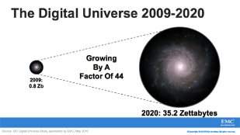
Characteristics of Big Data( 5 Vs of Big data )
1st V-volume
Data Volume
44x increase from 2009 to 2020 From 0.8 zettabytes to 35zb
Data volume is increasing exponentially

Slide 15
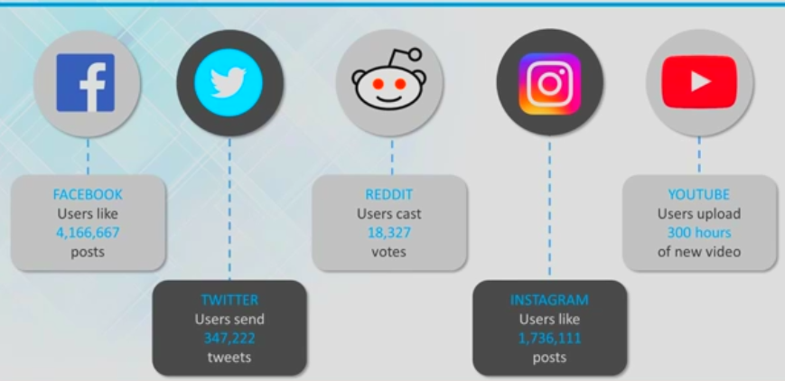
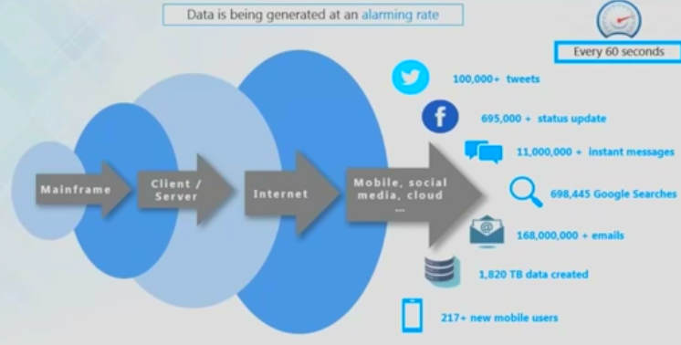
Characteristics of Big Data( 5 Vs of Big data )
2nd V-velocity: Data is being generated at every minute

Slide 16
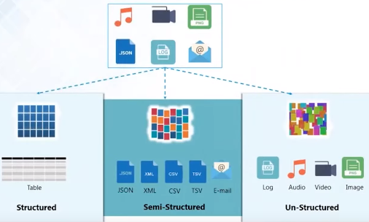
Characteristics of Big Data( 5 Vs of Big data )
3rd V-Variety: different kinds of data generated from various sources

Slide 17
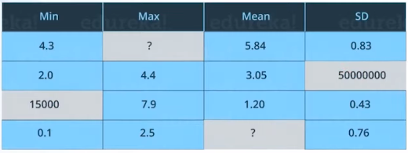
Characteristics of Big Data( 5 Vs of Big data )
4th V - Veracity: uncertainties and inconsistencies in big data

Slide 18
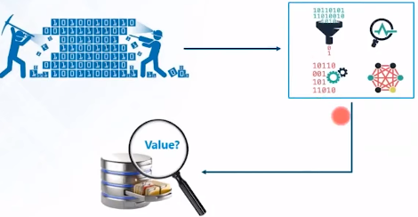
Characteristics of Big Data( 5 Vs of Big data )
5th V - Value: Mechanism to bring correct meaning out of the data

Slide 19
Characteristics of Big Data( 5 Vs of Big data )

Slide 20
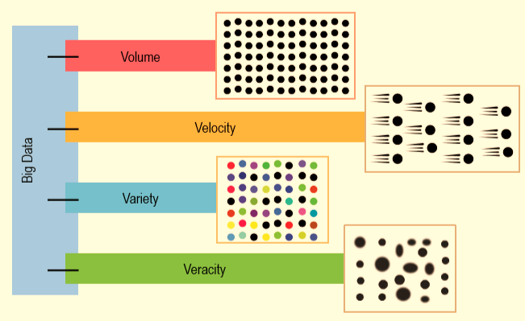
Characteristics of Big Data( 5 Vs of Big data )

Slide 21
Traditional DB vs Big Data
Traditional data base/
data warehouse
Big Data
Data
TB to PB
Only structured
Hardware
big central servers
Expensive
Hardware reliability
Limited scalability
Software
Centralized
Schema based
Oracle/mysql/sql server
Data
PB to ZB
structured and unstructured
Hardware
computer clusters
Cost effective
Unreliable HW
Scales further
Software
Distributed
Not schema based
Hadoop

Slide 22
Big data tools

Slide 23
What is Big data analytics

Slide 24
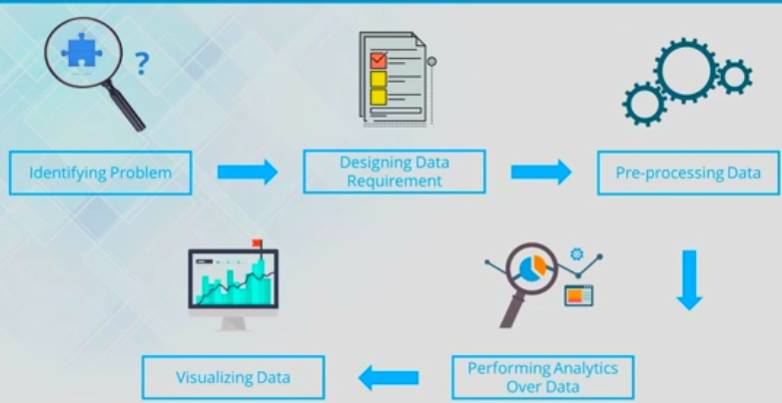
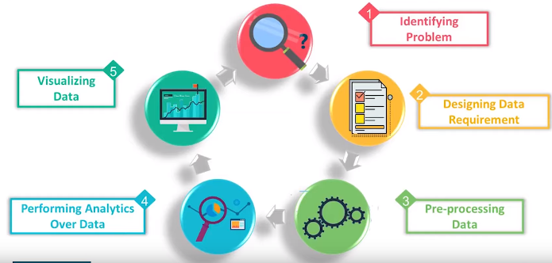
Stages in Big data analytics

Slide 25
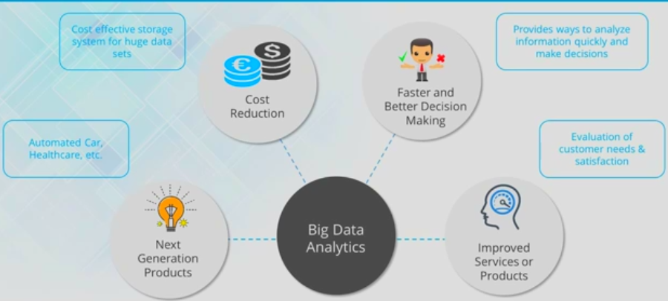
Big data analytics goals

Slide 26
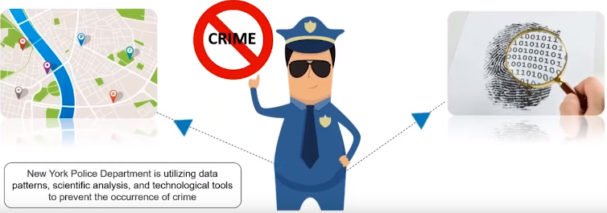
Big data analytics goals
1.Making organizations more smarter and efficient

Slide 27
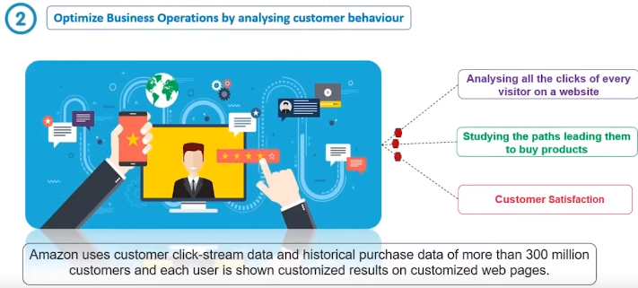
Big data analytics goals
1.Making organizations more smarter and efficient

Slide 28
Big data analytics goals

Slide 29
Big data analytics goals

Slide 30
Big data analytics application domains

Slide 31
Big data analytics use cases

Slide 32
Big data analytics use cases

Slide 33
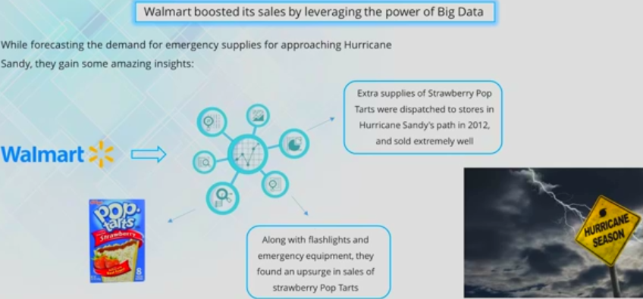
Big data analytics use cases

Slide 34
Big data analytics use cases

Slide 35
Big data analytics use cases

Slide 36
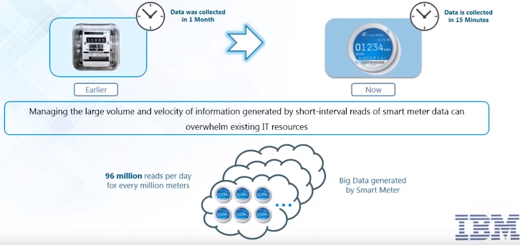
Big data analytics use cases
IBM Big data analytics – Big data collected by smart meters

Slide 37
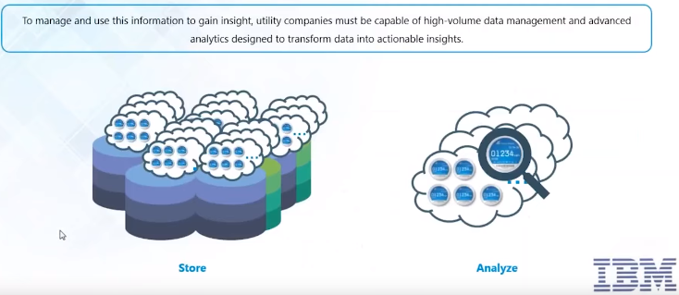
Big data analytics use cases
IBM Big data analytics – problem with smart meter big data

Slide 38
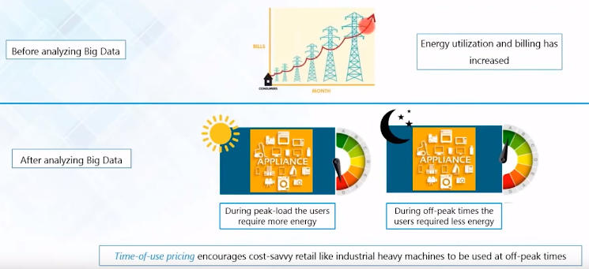
Big data analytics use cases
IBM Big data analytics – how smart meter big data analysed

Slide 39
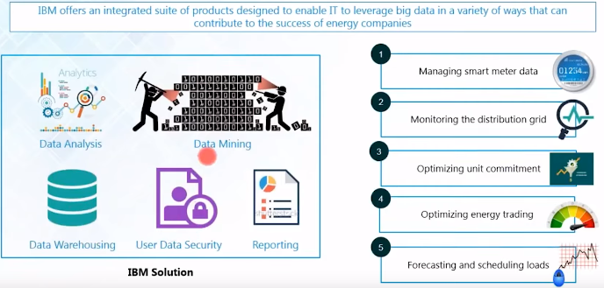
Big data analytics use cases
IBM Big data analytics – IBM smart meter solution

Slide 40
Types of Big data analytics

Slide 41
Types of Big data analytics

Slide 42
Types of Big data analytics

Slide 43
Types of Big data analytics

Slide 44
Challenges/problems with Big data

Slide 45
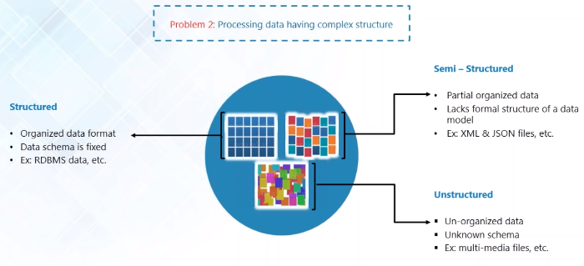
Challenges/problems with Big data

Slide 46
Challenges/problems with Big data

Slide 47
HADOOP is solution to Big data problems

Slide 48
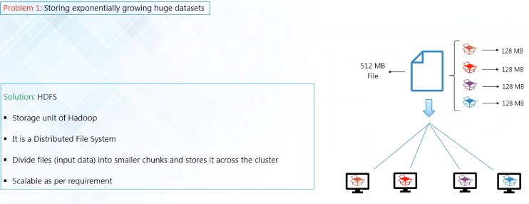
HADOOP is solution to Big data problems

Slide 49
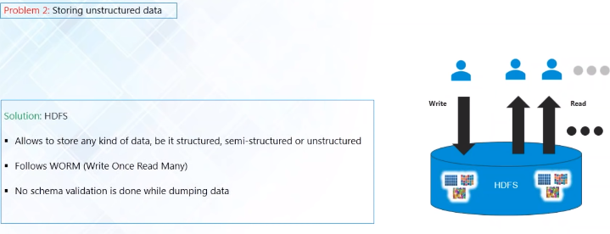
HADOOP is solution to Big data problems

Slide 50
HADOOP is solution to Big data problems

Slide 51
Introduction to Big data and Analytics
ANY QUESTIONS / DOUBTS
???

