Slide 1
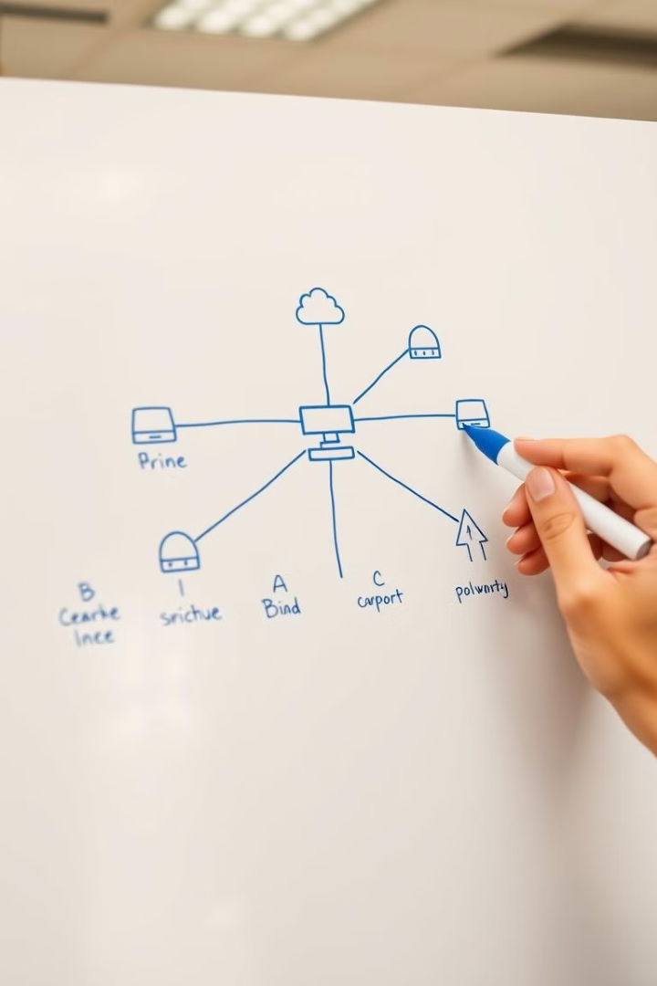
Network Topologies

Slide 2
Network Topologies
Network topology refers to the arrangement of network components, including computers, servers, and network devices.
Network topology can be viewed in two ways:
physical topology, which describes how the network's physical components are connected
logical topology, which illustrates how data flows within the network.

Slide 3
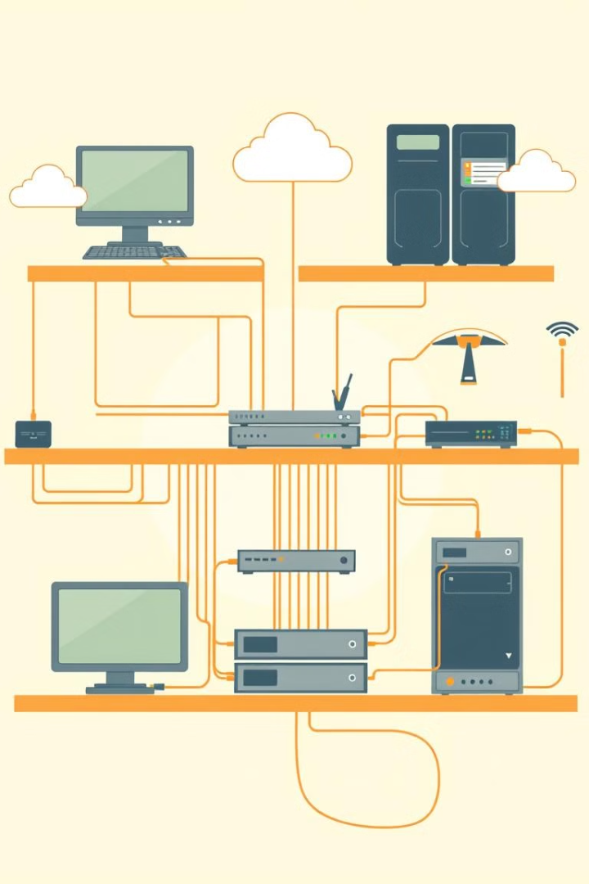
What does network topology include?
Understanding both types is crucial for efficient network management, troubleshooting, and performance optimization.
Physical topology depicts the actual arrangement of devices, cables, and connections,
logical topology illustrates the communication flow and relationships between devices.

Slide 4
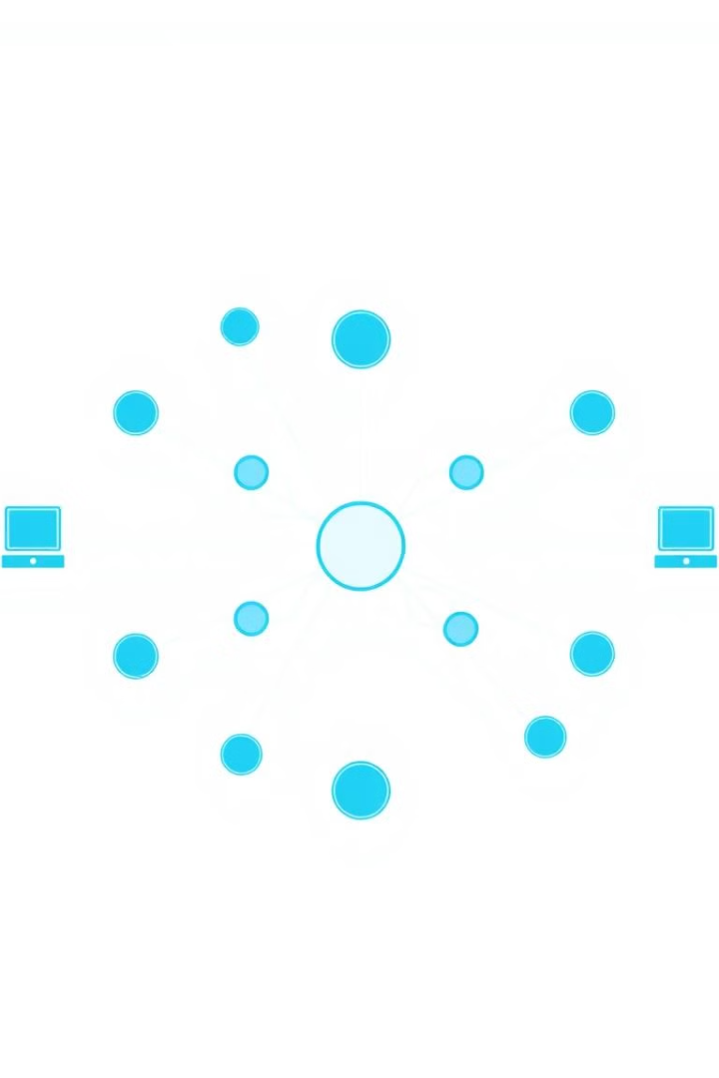
Bus Topology
In a bus topology, all devices share a single communication channel, like a highway, with data packets traveling in both directions.
Physical Topology: all devices are connected to a single central cable, known as the bus or backbone.
The cable is terminated at both ends, and all data sent by a device travels along this cable.
Logical Topology: Logically, bus topology operates in a shared communication medium. When a device sends data, it is broadcasted to all other devices on the network. However, only the intended recipient accepts and processes the data
Advantages
Simple to implement, cost-effective, easy to expand.
Disadvantages
Performance can be affected by heavy traffic, single point of failure.

Slide 5
Star Topology
A star topology connects all devices to a central hub or switch, providing a dedicated connection to each device.
Physical Topology: all devices are connected to a central hub or switch.
Each device has its own dedicated cable connecting it to the hub.
Logical Topology: Logically, star topology is managed by the hub.
Data sent from a device is received by the hub, which then forwards it to the destination device
Advantages
Disadvantages
Easier troubleshooting, increased security, scalability.
Higher cost, single point of failure at the central hub.

Slide 6
Ring Topology
In a ring topology, devices are connected in a closed loop, with data circulating in one direction.
Physical Topology: each device is connected to exactly two other devices, forming a circular
or ring-like structure.
Data travels in one direction or both directions around the ring.
Logical Topology: Logically, ring topology involves the data traveling in a circular manner, where
each device receives and then passes the data to the next device until it reaches its destination.
1
Advantages
2
Disadvantages
High data transfer rates, better fault tolerance compared to bus topology.
Difficult to install and troubleshoot, single point of failure.

Slide 7
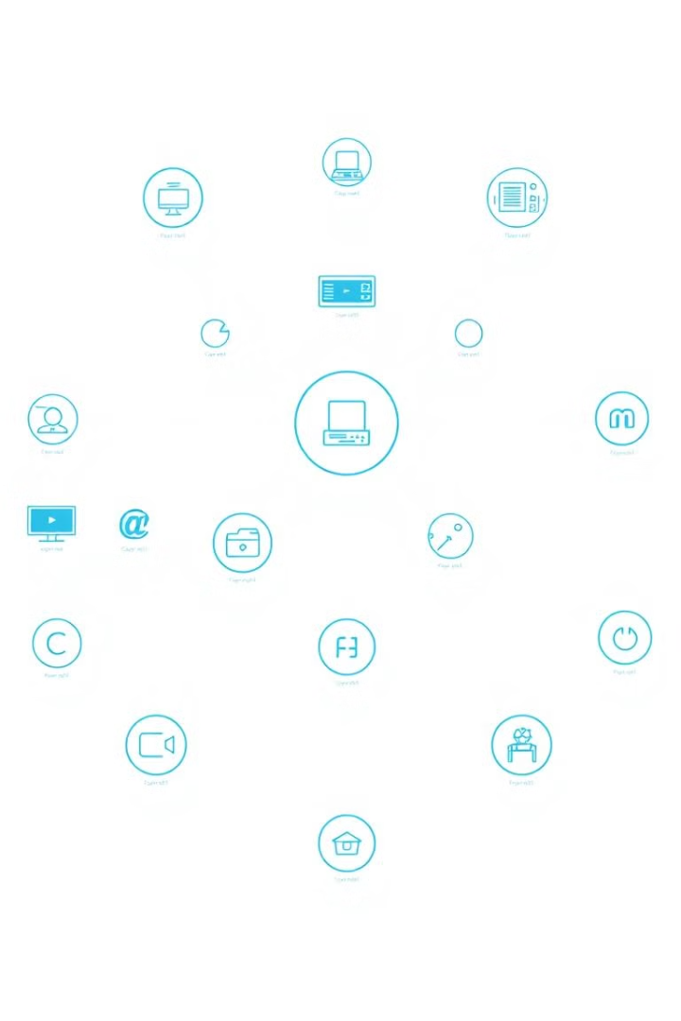
Mesh Topology
A mesh topology provides multiple paths for data transmission, connecting each device to several others.
Physical Topology: In a physical mesh topology, each device is connected directly to every other device in the network. This creates a web-like structure with multiple paths for data to travel.
Logical Topology: Logically, mesh topology allows data to take any available path to reach its destination, which increases redundancy and fault tolerance
1
Fully Connected
Every device is connected directly to every other device. Provides maximum redundancy.
2
Partially Connected
Devices have multiple connections, but not all devices are connected to each other.

Slide 8
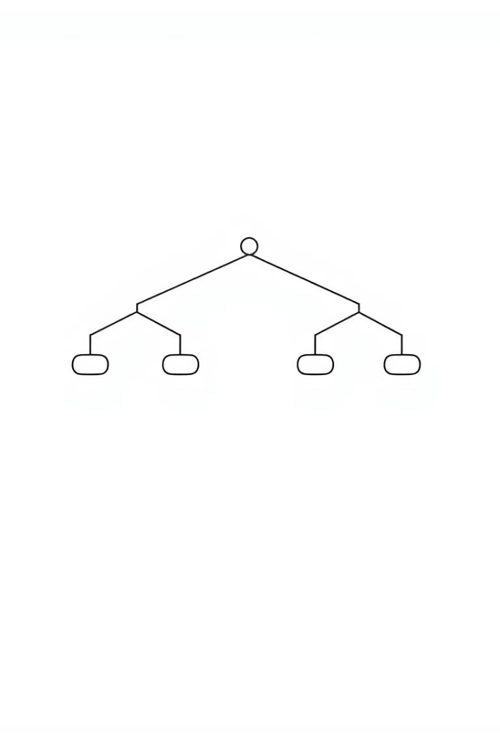
Tree Topology
Tree topology is hierarchical, with a central root node and multiple branches, resembling a tree structure.
Physical Topology: Tree topology combines characteristics of both star and bus topologies. Devices are arranged in a hierarchical structure, with groups of star-configured networks connected to a central bus.
Advantages
Easy to manage, scalable, reliable.
Logical Topology: Logically, tree topology can function like a series of interconnected star networks, where data flows through the hierarchy of the network.
Disadvantages
Requires more cabling, single point of failure at the root node.

Slide 9
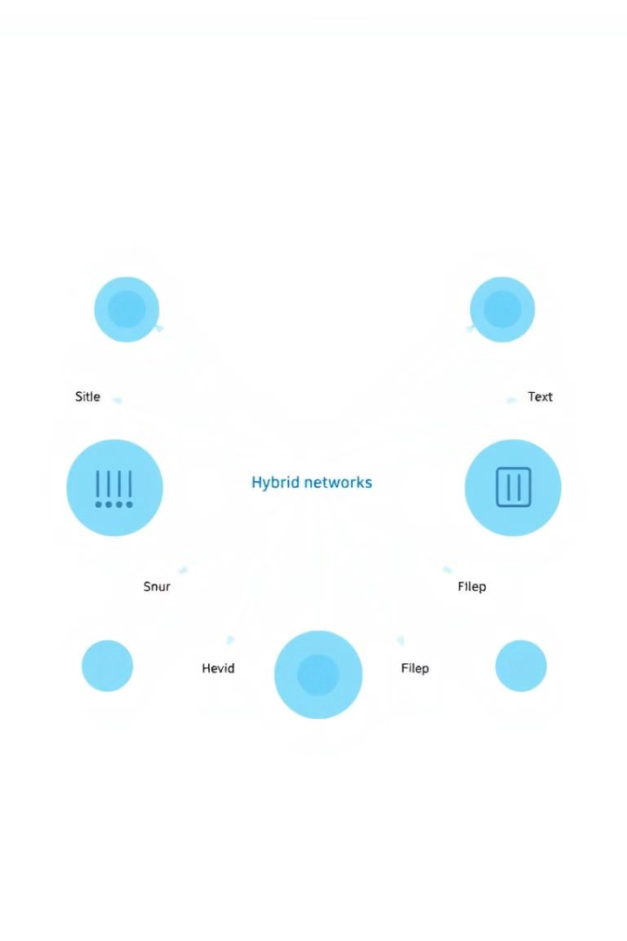
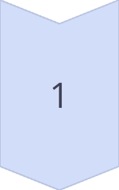
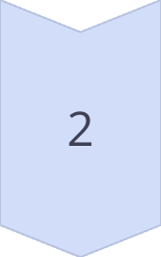
Hybrid Topology
Hybrid topologies combine elements from multiple topologies, creating a more complex and customized network.
Example 1
Star topology connected to a bus backbone. Combines the benefits of both.
Example 2
Ring topology connected to a star topology. Offers redundancy and centralized management.

Slide 10
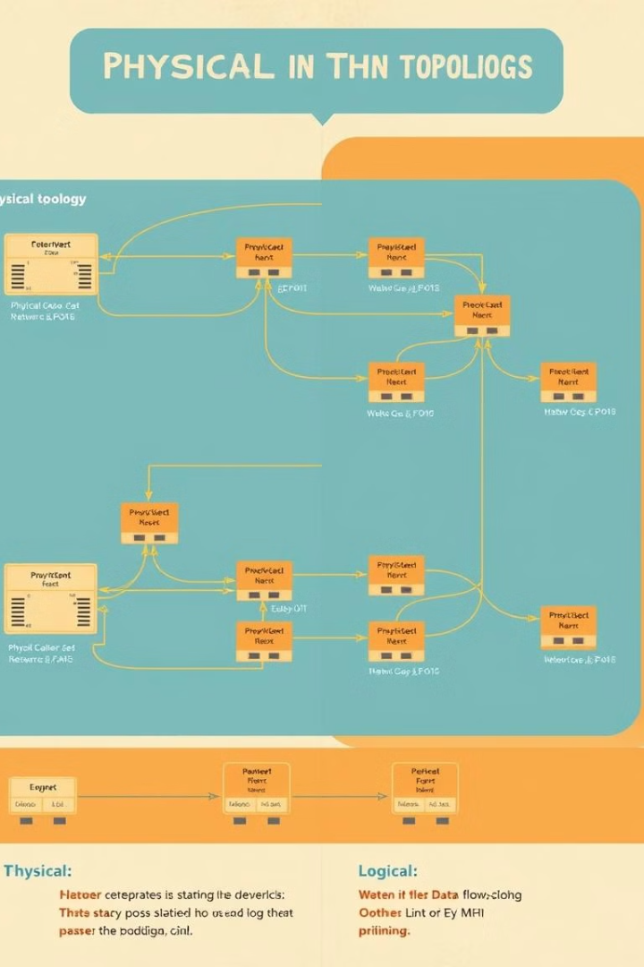
Understanding the Differences: Physical vs. Logical
Feature
Physical Topology
Logical Topology
Focus
Physical connections and cable arrangement
Data flow and communication paths
Representation
Diagram showing devices, cables, and connections
Diagram showing data flow and logical relationships between devices
Example
A diagram showing a star topology with network cables and devices
A diagram showing data flowing from a client computer to a server through a switch

Slide 11
BRAIN TEASER
Ethernet networks often have a star physical topology but operate logically as a bus topology when using a hub, as all data is broadcast to all devices.. TRUE/FALSE
A large corporate network might use a star topology for its main office, a mesh topology for data centers, and a ring topology for branch offices. All of these are interconnected in a hybrid arrangement. TRUE/FALSE
What is the most common network topology?
Star
Mesh
Bus
None of the above
What is the most reliable network topology?
Star
Mesh
Bus
None of the above

Slide 12
Benefits of Understanding Topology
1
Performance Optimization
2
Security Enhancement
Understanding topology helps identify bottlenecks and optimize network performance by choosing the right configuration and protocols for data flow.
Topology awareness enables security measures to be implemented strategically, isolating vulnerable devices and segmenting the network for enhanced security.
3
Troubleshooting Efficiency
4
Network Expansion and Scalability
Understanding the network structure facilitates efficient troubleshooting by pinpointing the source of problems and isolating affected areas.
Knowing the topology allows for efficient planning and expansion of the network, ensuring smooth integration of new devices and services.

Slide 13
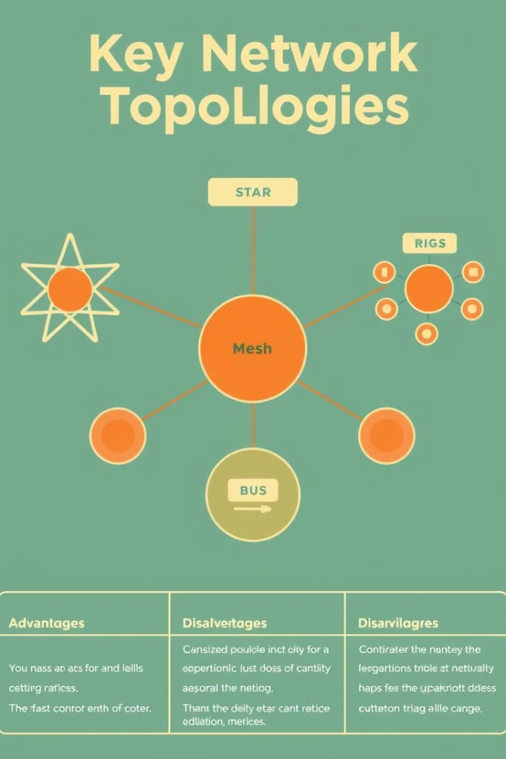
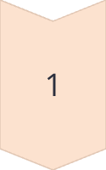
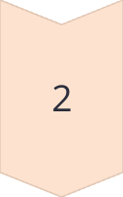
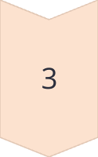
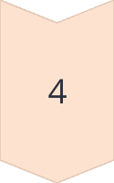
Factors Influencing Topology Choice
Network Size and Complexity
Large and complex networks may require specialized topologies like mesh or tree to accommodate scalability and manage traffic efficiently.
Performance Requirements
High-performance networks demand efficient data flow, often achieved with dedicated connections or optimized routing strategies.
Security Needs
Security concerns influence topology choices, with segmented networks and controlled access to sensitive devices being crucial.
Budget and Resource Availability
Cost-effective solutions are often prioritized, balancing performance and security requirements with budget constraints.

Slide 14
How do you implement network topologies in your organization?
Assess requirements and constraints
Choose the right network topology
Design the logical network
Plan physical layout
Select networking equipment
Implement network devices
Test the network
Document the network
Training and transition
Monitor and maintain
Review and optimize

Slide 15
How to make a network topology map
Creating a network topology map begins with:
Develop a general network layout and list all the key components, including computers, servers, connections, ports, hubs, and routers.
Once you have created the layout, you can go ahead and draw the network. While this may work for a small network with a few devices, it is not applicable for large networks with a complex design.
for large networks, you can use a network diagramming solution ie network glue that automatically discovers your IT environment and generates detailed maps.
Robust network mapping solutions even keep the network up to date by automatically detecting the changes made to it.

Slide 16
Software used to map networks
Virima
SolarWinds Network Topology Mapper
Microsoft Visio
Nagios XI
Paessler PRTG Network Monitor
Network Glue

Slide 17
Map and document network topologies with Network Glue
Network Glue stands out as a powerful solution specifically designed to automate and simplify the process of network documentation and management.
Some of the robust features of Network Glue include:
Automated device discovery
Dynamic topology mapping
Real-time updates
Detailed device information
Visit Network Glue for a deeper insight into how it can transform a network topology mapping and documentation processes.

Slide 18
Challenges in implementing network topologies:
Complexity of hybrid topologies
Cost and infrastructure requirements
Scalability and expansion
Security and data protection
Management and maintenance

Slide 19
Network Topology: An Essential Foundation
Network Management
Understanding topology is essential for effective network management, allowing administrators to monitor, configure, and troubleshoot network performance.
Security Measures
Topology knowledge enables the implementation of effective security measures, like segmentation, access control, and intrusion detection.
Network Expansion
Understanding topology facilitates efficient planning and expansion of the network, ensuring seamless integration of new devices and services.
Troubleshooting Efficiency
A strong understanding of topology allows IT professionals to quickly identify the root cause of network issues and efficiently resolve them.

Slide 20
Evolving Network Topologies
Network topology is constantly evolving with technological advancements. Cloud computing, virtualization, and Software-Defined Networking (SDN) have introduced new concepts and architectures. Modern networks are becoming more dynamic, adaptable, and software-driven, requiring a deeper understanding of topology principles to manage and optimize them.
Read about the Evolution of Network Topologies

Slide 21
Choosing the Right Topology
The best network topology depends on the specific needs and requirements of the network.
Network Size
Small networks might use simpler topologies, while large networks require more complex ones.
Cost
Different topologies have varying costs, affecting the overall budget.
Performance
Data transfer rates and latency are key factors influencing performance.
Security
Some topologies offer greater security features than others.

Slide 22
Emerging Trends
Cloud computing and software-defined networking are influencing network topology design.
Cloud-Based Networking
Software-Defined Networking (SDN)
Virtualized networks are becoming increasingly common.
SDN allows for more flexible and automated network management.

