Slide 1
Virtual Reality

Slide 2
Virtual Reality (VR) is a computer-generated simulation of a three-dimensional, interactive environment that can be explored and experienced by users in a seemingly real or physical way. VR typically involves the use of specialized hardware, such as head-mounted displays (HMDs) and motion tracking devices, to immerse users in the virtual world and enable interaction with the digital environment.

Slide 3
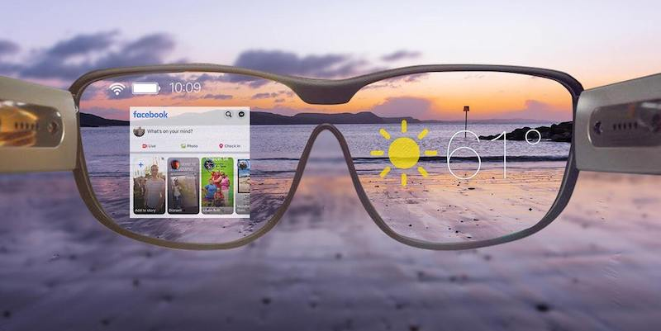

Slide 4
Applications of Virtual Reality
Gaming and Entertainment: VR is extensively used in gaming, offering immersive and interactive experiences that transport players into virtual worlds.
Training and Simulation: VR is employed in various industries, such as aviation, military, and medical fields, for training purposes, allowing users to practice in realistic but safe virtual environments.
Architectural Visualization: VR enables architects and clients to walk through virtual building designs, providing a more immersive and realistic understanding of the proposed structures.

Slide 5
Applications of Virtual Reality..continu
Education and Learning: VR is used in educational settings to create engaging and interactive learning experiences, allowing students to explore historical events, scientific concepts, or other subjects.
Virtual Tourism: VR is utilized to offer virtual travel experiences, allowing users to visit distant locations and landmarks without physically traveling.

Slide 6
Importance of Virtual Reality
Immersive Experience: VR offers a level of immersion and presence that other media cannot match, making it a powerful tool for creating impactful experiences.
Enhanced Learning: VR enables experiential learning, allowing users to engage with complex concepts and scenarios in a more interactive and memorable manner.
Training Efficiency: VR training simulations can reduce costs and risks associated with real-world training while providing a safe and controlled environment for practice.

Slide 7
Importance of Virtual Reality…continu
Therapeutic Applications: VR is being explored for therapeutic purposes, such as pain distraction during medical procedures or anxiety treatment through exposure therapy.
Empathy and Understanding: VR experiences can promote empathy and understanding by allowing users to step into the shoes of others and experience different perspectives.

Slide 8
Challenges of Virtual Reality
Hardware Limitations: High-quality VR experiences require powerful and expensive hardware, which may limit accessibility for some users.
Motion Sickness: Some users may experience motion sickness or discomfort due to discrepancies between virtual and real-world movement.
Content Creation: Creating high-quality and compelling VR content can be resource-intensive and challenging for developers and content creators.

Slide 9
Challenges of Virtual Reality…continu
Social Isolation: Prolonged use of VR may lead to social isolation as users become immersed in virtual worlds at the expense of real-world interactions.
Ethical Considerations: VR raises ethical concerns related to privacy, data collection, and potential negative effects on mental health and well-being.

