Slide 1
MAKERERE UNIVERSITY MAKERERE UNIVERSITY BUSINESS SCHOOL FACULTY OF COMPUTING AND INFORMATICS DEPARTMENT OF APPLIED COMPUTING AND IT
INFORMATION COMMUNICATION TECHNOLOGY I *PR
Lecturers: Ms. Nakalema S, Mr. Olupot C, Ms. Nakawooya F, Ms. Nansamba C.

Slide 2
Computer Software
Learning Objectives & Outcome
Define computer software
Types of software
Categories of software
Commercial verses open source software
Factors to consider when choosing a software for implementation

Slide 3
Computer Software Defined
Refers to all of the programs and data the computer uses to perform and accomplish a task the end user desires. Software is kept on some hardware device such as a hard disk or floppy disk, but it itself is intangible.
Computers cannot function without software since it is the software that controls and monitors the activities of any information system.

Slide 4
Why Study Computer Software?
ICT, and computer software in particular, is part of a key investment for many business organizations.
Software is an important part of any business assets, and requires proper choice so that it matches an organization’s business needs.
Organizations also require software to fulfill routine business needs as it constitutes a large budget of any business organization.

Slide 5
Why Study Computer Software? Cont’
Handles the input, processing, output, storage, and control activities of IS.
Software can be used to support a new corporate initiative to create new products and services based on IT.
IS depend on software resources to help end users use computer hardware to transform data into information products.

Slide 6
Categories of Computer Software
Computer
Software
Application
Software
System
Software
General-
Purpose
Programs
Application-
Specific
Programs
System
Management
Programs
System
Development
Programs

Slide 7
SYSTEM SOFTWARE

Slide 8
1. System Software
Systems software is a program that control and support the operations of a computer system as it performs various information processing tasks.
There are two major functional categories of system software; namely: systems management programs and system development programs.

Slide 9
1. System Management Programs
It controls and coordinates the operation of the various components and peripheral devices of a computer system.
E.g. Operating Systems, database management systems, network management programs, systems utilities, application servers, and performance and security monitors.

Slide 10
2. System Development programs
It is a program used to help users to develop and build new application programs or specific information systems applications.
Major examples include programming language and translators, programming editors and tools and CASE (Computer-Aided Software Engineering) packages.

Slide 11
System Management Programs
Operating systems
Database management systems
Network management programs
Systems utilities
Application servers
Performance monitors
Security monitors.

Slide 12
Operating Systems
The operating system is a system of programs that manages the operations of the CPU, controls the input/output and storage resources and activities of the computer system, and provides various support services such as scheduling, system accounting, debugging etc, as the computer executes the application programs of end users.
That is, a program that manages the computer hardware.

Slide 13
Basic Functions of Operating Systems
User
Interface
Resource
Management
Task
Management
File
Management
Utilities
and Other
Functions

Slide 14
Functions of OS
The user interface:
This is the part of the operating system that allows users to communicate with the computer. Through the interface, the end user has access to the resources such as resource management; file management; task management and utilities.

Slide 15
Functions of OS Cont’
Efficient resource management. It manages the computer memory for example memory allocation and loading of programs on the hard disk.
File management: For example maintenance of file for proper storage, opening and closing of files, checking on the file levels, etc.
Task management: It checks whether the hardware (including peripheral devices such as printers) is functioning properly.

Slide 16
Functions of OS Cont’
Utilities and support services: Such as error detection and reporting for example display of a message on screen if a fault is detected within the hardware component.
Security: Controlling system security for example monitoring the use of passwords.
Initial start-up of the computer: When it’s switched on. This is achieved by the boot program which is in-built in the ROM.
Managing multitasking

Slide 18
1. Windows Family OS
The most common type is the Microsoft suite of operating systems.
They include from most recent to the oldest as follows: Windows 7, Windows Vista, Windows XP Professional Edition, Windows XP Home Edition, Windows 2000, Windows ME, Windows 98, Windows NT, Windows 95 and Microsoft DOS.

Slide 19
2. UNIX Family of Operating Systems.
UNIX family has been developed by a whole history of individuals, corporations and collaborators.
It is a multitasking and multiuser system, network-managed operating system whose portability allows it to run on mainframes, midrange computers, and microcomputers.
It can be difficult to learn. UNIX must normally run a computer made by the same company that produces the software. An example is Linux.

Slide 20
3. Macintosh Operating Systems
This is the latest operating system from Apple for the iMac and other Macintosh microcomputers, based on UNIX has advanced multitasking and multimedia capabilities, along with a new suite of Internet services called iTools.
The greatest problem with these operating systems lies in the fact that, not as many application programs are written for them. Another drawback is that the system can only be run on Apple produced hardware.

Slide 21
Multiprogramming & Multitasking
1. Multiprogramming
Multiprogramming is the ability to execute multiuser programs concurrently through a sharing of the computer’s resources.
A multiprogramming operating system takes advantage of this fact by allowing another program to use the CPU when it would otherwise be idle.

Slide 22
Multiprogramming & Multitasking
2. Multitasking
Multitasking is a task management approach that allows the user to run two or more programs at the same time. Thus a user may be updating a spreadsheet while spell checking a document using a word processor.

Slide 23
Utilities or Service Programs
This is a program which performs a function that may be required by a number of other programs and provide a range of tools that support the operation and management of a computer system, e.g. monitor systems performance, data sorting, etc.
E.g. text editors; sort utilities; file copy utilities; file maintenance utility; tracing and debugging; rename utilities. Others include utilities like delete, send, compare linker, loader, merge, etc.

Slide 24
System Development Programs
Major examples of development programs include
Programming languages and translators
Programming editors and tools
CASE (Computer-Aided Software Engineering) packages.

Slide 25
Programming Languages
Refer to the languages in which computer programs are written and programming language has its own unique vocabulary, grammar, and uses.
A programming language allows a programmer or end user to develop the set of instructions that constitute a computer program.

Slide 26
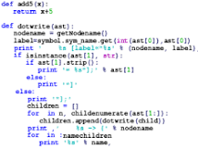
Programming Languages
Is a formal computer language or constructed language designed to communicate instructions to a machine, particularly a computer.
Programming languages can be used to create programs to control the behavior of a machine or to express algorithms.

Slide 27
Categories of Programming Languages
The machine languages
The assembly languages
High-level languages
Fourth generation languages and
Object-oriented languages

Slide 28
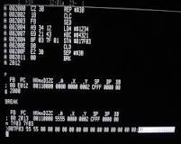
The machine languages
Machine code or machine language is a set of instructions executed directly by a computer's central processing unit (CPU).
Each instruction performs a very specific task, such as a load, a jump, or an ALU operation on a unit of data in a CPU register or memory.

Slide 29
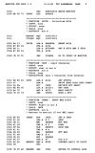
The assembly languages
An assembly (or assembler) language, often abbreviated asm, is a low-level programming language for a computer, or other programmable device, in which there is a very strong (generally one-to-one) correspondence between the language and the architecture's machine code instructions.

Slide 30
Language Translator Programs
In order for the source code to be executed by a computer, it must be translated into fundamental machine instructions.
Programming language translators are actually programs that translate other programs into machine language instruction codes that computers can execute.
Major types of language translator programs include: assemblers, compilers and interpreters.

Slide 31
High-level languages
high-level language. A machine-independent programming language, such as C, C++, Java, Perl and COBOL.
It lets the programmer concentrate on the logic of the problem to be solved rather than the intricacies of the machine architecture such as is required with low-level assembly languages.

Slide 32
Fourth generation languages
A fourth-generation programming language (4GL) is a computer programminglanguage envisioned as a refinement of the style of languages classified as third-generation programming language (3GL).

Slide 33
Object-oriented programming languages
Object-oriented programming (OOP) is a programming language model organized around objects rather than "actions" and data rather than logic. Historically, a program has been viewed as a logical procedure that takes input data, processes it, and produces output data.

Slide 34
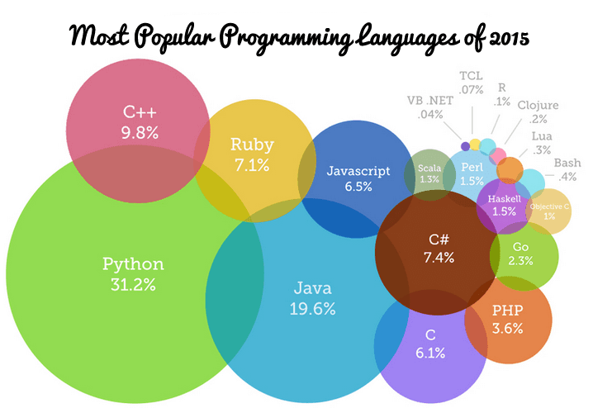
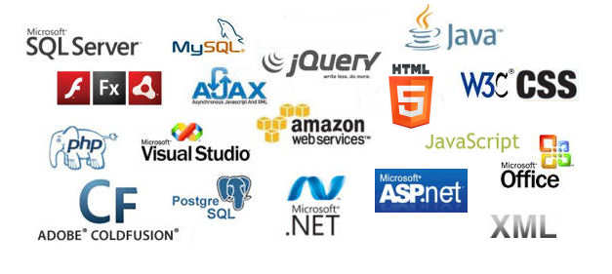

Slide 35
COMPUTER SOFTWARE
APPLICATION SOFTWARE

Slide 36
2. Application Software
Application software is a program designed to meet a generic set of business requirements that will suit a very large number of business customers.
Application software includes a variety of programs that consists of general-purpose and application-specific software.

Slide 37
Categories of Computer Software
Computer
Software
Application
Software
System
Software
General-
Purpose
Programs
Application-
Specific
Programs
System
Management
Programs
System
Development
Programs

Slide 38
Application Software
Divided into:
General purpose
Application specific Software

Slide 39
General Purpose
This is software that involves programs that support end users in any area of the organization in performing common information processing activities, from all application areas.
E.g. Word processing programs & desktop publishing, electronic spreadsheet & database management programs, graphics programs, Web browsers, electronic mail & Instant messaging, groupware e.t.c
Also commonly referred to as software package or commercial off-the-shelf.

Slide 40
Application - Specific Software
These are programs dedicated to very specific functions within a knowledge area that meets specific business needs of specific users.
Examples include: both business enterprise application software such as ERP, CRM, SCM etc and other specific transaction processing systems in the categories of; accounting, inventory management, sales management, generating marketing plans, and electronic commerce and so forth.
Also commonly referred to as Bespoke or Tailor-made or Custom software.

Slide 41
Bespoke Software
These are programs constructed by programmers to meet the specific needs of the particular organization or of a single customer as defined in a specification. They are developed within an organization. In this way the customer can obtain exactly the system that they need.
Small businesses rarely commission bespoke software applications.

Slide 42
Advantages of Bespoke Applications
They precisely fit the organization’s information needs or specific requirements.
The organization has complete discretion over data structures and ownership of the program.
The system can be integrated with other applications within the organization.
The system can be modified to fit changing needs.
It’s a source of competitive advantage as competitors may not easily adapt to that particular software.

Slide 43
Disadvantages of Bespoke Applications
Development takes a long time which delays the delivery and implementation of the system.
They are costly to develop and test.
Support of a bespoke system is expensive as the organization has to bear all the cost.

Slide 44
Commercial Off - the – Shelf (COTS)
COTS is a generalized solution to an application area offered for sale by a software vendor.
The software is developed with the intention of selling the software in multiple copies and can be marketed and licensed throughout the world.
They are designed basically to suit extremely a large customer base.

Slide 45
Advantages of COTS
Quality. The software package is a proven product that has undergone testing
Time. It can be purchased and implemented almost immediately. There is no requirement for design, programming, unit and systems testing.
High quality documentation & training available for inspection.
Maintenance and enhancement provided at a fixed price under an agreement.
They are generally cheaper to buy than bespoke packages are to develop.

Slide 46
Advantages of COTS cont’
They are likely to be available almost immediately for use.
Any system bugs should have been discovered by other users and eliminated.
New updated versions of the software are likely to be available on a regular basis, with built in user friendliness.
The experience of a great number of users with similar needs to those in the organization are incorporated into the design of the package.

Slide 47
Disadvantages of COTS
Failure to completely fit requirements as they are generalized.
Most software packages do not fulfill all the user requirements defined for a particular application.
There is a risk that they may go out of business, or experience financial problems that affect the quality of their support and development services.
Inability to generate a competitive edge because the package is also available to competitors
Ownership is retained by the supplier.

Slide 48
Disadvantages of COTS cont’
Legal redress is virtually impossible because of the licence agreement.
The organization is dependent upon an outside supplier for the maintenance of the software,
Many software suppliers are larger than most of their customers, and are therefore difficult to influence.
Different packages used by the organization may have incompatible data structure.

Slide 49
Open Source & Proprietary Software
Open Source Software
This is made available under a licence that allows customers to make several copies and pass them on to anyone. A good example is the KiLinux.
The software comes with its source code and one can modify it to meet his/her needs.

Slide 50
Open Source & Proprietary Software
Proprietary Software
This is software developed by a supplier and made available for customers to use under a licence. This defines how the software can be used and usually forbids customers from doing certain things such as: making multiple copies of the software and passing them on; and selling your licence to someone else.
Most proprietary software comes without the source code.

Slide 53
Factors to consider when Selecting a software package
User requirement
Cost
Interface design/easy to use
Controls
Updates
Compatibility with existing software and hardware
Support and maintenance
User manuals / extend documentation
Market confidence
Technical requirements e.t.c

Slide 54
Qualities of software products
Several software products quality includes correctness, reliability, robustness, performance, user friendliness, verifiability, maintainability, reusability,portability, understandability, interoperability, productivity, and timeliness.
Etc

Slide 55
References
For detailed materials, students are advised to read: ICT in Business Text 2012 Edition By Musa Moya & Sonny Nyeko and ICT Revision Kit
THANK YOU
THANK YOU

