Slide 1
NETWORK DESIGN
BY:
EELU SAMUEL
Computer science and engineering

Slide 2
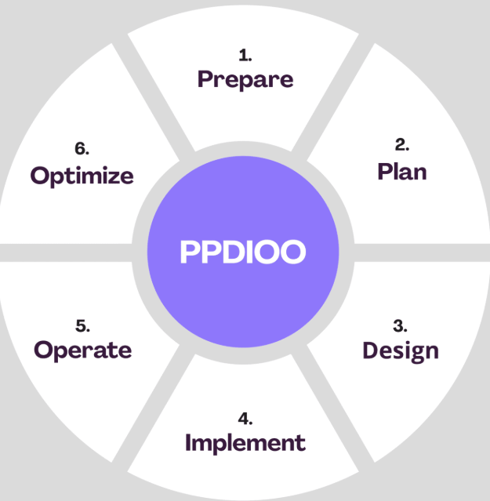
Network life cycle
A process of planning and designing a communication network

Slide 3
Network life cycle cont…
Prepare: Identify the requirements
Plan: Based on the specified requirements
Design: Create a detailed network design (Topology)
Implement: Configuration (IP),Security measures
Operate: Monitoring and validating the network
Optimizing: Testing and optimization for proper functionality

Slide 4
Network design steps…
Identify the requirements (new office, costs, improvement etc)
Assess the current state of the network
Design your network topology
Choose the hardware and the software
Plan for implementation and beyond

Slide 5
Top 5 network design best practices
Integrate security early on
Know when to use top-down vs bottom-up
Standardize everything
Plan for growth
Create and maintain network documentation

