Slide 1
COMMUNICATION MEDIA/CHANNEL
BY:
EELU SAMUEL
Computer science and engineering

Slide 2
Communication media/channel
This can be guided or unguided
Guided
Twisted pair
Coaxial cables
Fiber optic cables
Unguided
Microwave
Radio wave
Infrared
Satellite
Cellular

Slide 3
Communication media/channel cont..
Can transmit from 10mbps to 10gbps
Attributes
Used in LAN and local telephone network
Copper wires are insulated using plastic
Most popular media
Can carry voice and data signals
Wires are twisted to reduce noise
UTP and STP
Read Disadvantages of twisted pair
Twisted pair

Slide 4
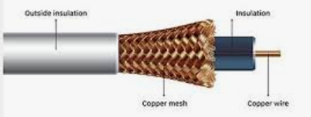
Communication media/channel cont..
Can transmit from 10Mbps to 100Mbps
Attributes
Video transmission in TVs
Single solid copper wire insulated
Copper mesh protects electromagnetic waves
Used for both analog and digital
High frequency range signals
Made up of thicknet and thinnet
Read Disadvantages of coaxial cable
Coaxial cable

Slide 5
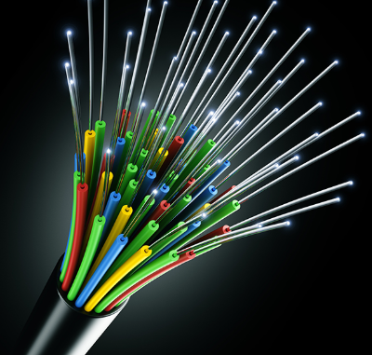
Communication media/channel cont..
Can transmit up to 100Gbps or more
Attributes
Long distance communication
Uses light pulses
Has glass cladding
Single strand can trans thousands
Secure with low signal loss
Read Disadvantages of fiber optics
Fiber optic

Slide 6
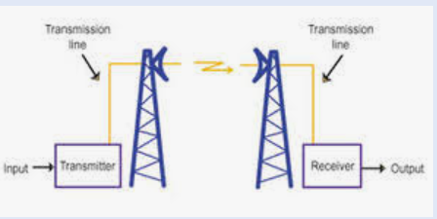
Communication media/channel cont..
Can transmit 1 Mbps to 10Gbps
Attributes
High speed transmission
Transmitter to receiver
All media first converted to microwave
Repeater placed after every 50KM
Read Disadvantages of microwaves
Microwave

Slide 7
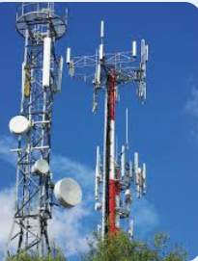
Communication media/channel cont..
Can transmit 1 Mbps to 10Mbps
Attributes
AM and FM
Long distance and penetrating through buildings
Requires trans and receiver
Receiver uses an antenna
Read Disadvantages of radio
Broadcast radio

Slide 8
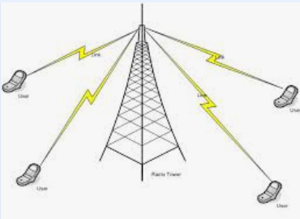
Communication media/channel cont..
Can transmit 10 Mbps to 1Gbps
Attributes
Uses wireless telephone and modem
Uses high frequency radio waves
Connects phones to access network
Read Disadvantages of cellular radio
Cellular radio

Slide 9
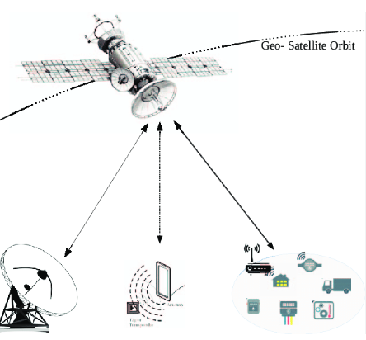
Communication media/channel cont..
Can transmit 1 Mbps to 10Gbps
Attributes
Global communication
Orbit the earth
Receives microwave signals
Magnify signals and retransmit
data speed very high
Avoids cables and repeaters
Uplink and downlink
Read Disadvantages of satellite communication
Satellite communication

Slide 10
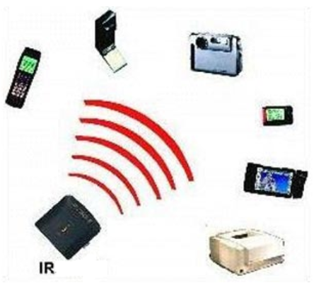
Communication media/channel cont..
Can transmit up to 1Gbps
Attributes
Remote control
Uses infrared
moderate band width (115kbps) for few meter
Bluetooth- short distance
Requires line of site
Read Disadvantages of infrared
Infra Red (IR)

Slide 11
THANK YOU
END

