Slide 1
PROJECT TIME MANAGEMENT
TOPIC 5

Slide 2
Learning Objectives...
Use a Gantt chart for planning and tracking schedule information, find the critical path for a project, and describe how critical chain scheduling and the Program Evaluation and Review Technique (PERT) affect schedule development.
Discuss how reality checks and people issues are involved in controlling and managing changes to the project schedule.
Describe how project management software can assist in project time management and review words of caution before using this software.

Slide 3
Importance of Project Schedules
Managers often cite delivering projects on time as one of their biggest challenges.
Schedule issues are the main reason for conflicts on projects, especially during the second half of projects.
Time has the least amount of flexibility; it passes no matter what happens on a project.

Slide 4
Schedule Conflicts
Individual Work Styles and Cultural Differences Cause Schedule Conflicts
Studies have been done about people’s attitudes toward structure and deadline.
Some people prefer to follow schedules and meet deadlines while others do not.
Different cultures and even entire countries have different attitudes about schedules.

Slide 5
Project Time Management Processes
Activity definition: Identifying the specific activities that the project team members and stakeholders must perform to produce the project deliverables.
Activity sequencing: Identifying and documenting the relationships between project activities.
Activity resource estimating: Estimating how many resources a project team should use to perform project activities.

Slide 6
PTM Processes…
Activity duration estimating: Estimating the number of work periods that are needed to complete individual activities.
Schedule development: Analyzing activity sequences, activity resource estimates, and activity duration estimates to create the project schedule.
Schedule control: Controlling and managing changes to the project schedule.

Slide 7
Activity Definition
An activity or task is an element of work normally found on the WBS that has an expected duration, a cost, and resource requirements.
Project schedules grow out of the basic documents that initiate a project.
The project charter includes start and end dates and budget information.
The scope statement and WBS help define what will be done.

Slide 8
Activity Definition…
Activity definition involves developing a more detailed WBS and supporting explanations to understand all the work to be done, so you can develop realistic cost and duration estimates.

Slide 9
Activity Lists and Attributes
An activity list is a tabulation of activities to be included on a project schedule. The list should include:
The activity name
An activity identifier or number
A brief description of the activity
Activity attributes provide more information about each activity, such as predecessors, successors, logical relationships, leads and lags, resource requirements, constraints, imposed dates, and assumptions related to the activity.

Slide 10
Milestones
A milestone is a significant event that normally has no duration.
It often takes several activities and a lot of work to complete a milestone.
Milestones are useful tools for setting schedule goals and monitoring progress.
Examples include completion and customer sign-off on key documents and completion of specific products.

Slide 11
Activity Sequencing
Involves reviewing activities and determining dependencies.
A dependency or relationship relates to the sequencing of project activities or tasks.
You must determine dependencies in order to use critical path analysis.

Slide 12
Activity Sequencing
Typical questions when scheduling activities in a logical way are:
Which activity immediately precedes this activity?
Does a certain activity has to be finished before another starts?
Can several activities be done in parallel? Can some overlap?
Which activities run concurrently?
Which activity immediately follow this activity?
Which activities control the start and finish?

Slide 13
Three Types of Dependencies
Mandatory dependencies: Inherent in the nature of the work being performed on a project; sometimes referred to as hard logic. E.g. a system can’t be tested before development.
Discretionary dependencies: Defined by the project team; sometimes referred to as soft logic and should be used with care because they may limit later scheduling options. E.g. Wiring a house can be done before fixing doors.

Slide 14
Three Types of Dependencies
External dependencies: Involve relationships between project and non-project activities. ; usually outside the control of project team. E.g. Building a house may depend on approval of architectural plans, NEEMA approvals.

Slide 15
Types of Relationships Between Activities:
Task Dependence Example Description
A
Finish-to-Start (FS)
Task A must finish before task B can start
B
A
Start-to-Start (SS)
Task A & B must start at the same time, irrespective of when they finish
B
Finish-to-Finish (FF)
A
Task A & B must finish at the same time, irrespective of when they start
B
Start-to-Finish (SF)
A
B
Task B can’t finish until A starts.

Slide 16
Relationships….
Task Dependence
Description
Finish: Start-x days
Finish: Start + x Days
the task will start x days before its predecessor (ID6) is complete. e.g.. (6FS -2days)
the task will start x days after its predecessor (ID6) is complete. e.g. (6FS+2days)
The same apply to Start: Start-+X days.

Slide 17
Network Diagrams
Network diagrams are the preferred technique for showing activity sequencing.
A network diagram is a schematic display of the logical relationships among, or sequencing of, project activities.
Two main formats are the arrow and precedence diagramming methods.

Slide 18
Arrow Diagramming Method (ADM)
Also called activity-on-arrow (AOA) network diagram – most commonly used.
Activities are represented by arrows.
Nodes or circles are the starting and ending points of activities.
Can only show finish-to-start dependencies.

Slide 19
Process for Creating AOA Diagrams
Find all of the activities that start at node 1. Draw their finish nodes and draw arrows between node 1 and those finish nodes. Put the activity letter or name and duration estimate on the associated arrow.
Continue drawing the network diagram, working from left to right. Look for bursts and merges. A burst occurs when a single node is followed by two or more activities. A merge occurs when two or more nodes precede a single node.

Slide 20
Process for Creating AOA Diagrams
Continue drawing the project network diagram until all activities that have dependencies are included in the diagram.
As a rule of thumb, all arrowheads should face toward the right, and no arrows should cross in an AOA network diagram.

Slide 21
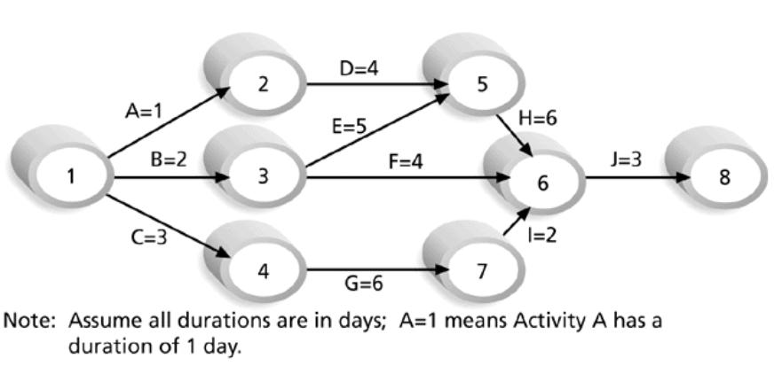
Sample Activity-on-Arrow (AOA) Network Diagram for Project X

Slide 22
Precedence Diagramming Method (PDM)
Activities are represented by boxes.
Arrows show relationships between activities.
More popular than ADM method and used by project management software.
Better at showing different types of dependencies.

Slide 23
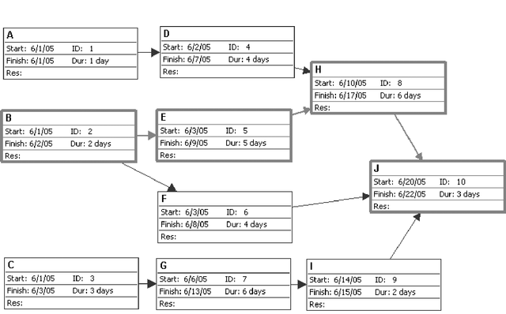
Sample PDM Network Diagram

Slide 24
Activity Resource Estimating
Before estimating activity durations, you must have a good idea of the quantity and type of resources that will be assigned to each activity.
Consider important issues in estimating resources:
How difficult will it be to complete specific activities on this project?
What is the organization’s history in doing similar activities?
Are the required resources available?

Slide 25
Activity Duration Estimating
Duration includes the actual amount of time worked on an activity plus the elapsed time.
Effort is the number of workdays or work hours required to complete a task.
Effort does not normally equal duration.
People doing the work should help create estimates, and an expert should review them.

Slide 26
Three-Point Estimates
Instead of providing activity estimates as a discrete number, such as four weeks, it’s often helpful to create a three-point estimate:
An estimate that includes an optimistic, most likely, and pessimistic estimate, such as three weeks for the optimistic, four weeks for the most likely, and five weeks for the pessimistic estimate.
Three-point estimates are needed for PERT estimates and Monte Carlo simulations.

Slide 27
Schedule Development
Uses results of the other time management processes to determine the start and end dates of the project.
Ultimate goal is to create a realistic project schedule that provides a basis for monitoring project progress for the time dimension of the project.
Important tools and techniques include Gantt charts, critical path analysis, critical chain scheduling, and PERT analysis.

Slide 28
Gantt Charts
Gantt charts provide a standard format for displaying project schedule information by listing project activities and their corresponding start and finish dates in a calendar format.
Symbols include:
Black diamonds: Milestones
Thick black bars: Summary tasks
Lighter horizontal bars: Durations of tasks
Arrows: Dependencies between tasks

Slide 29
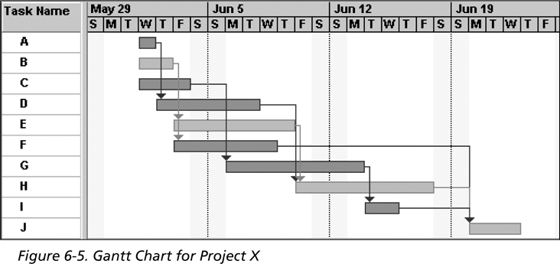
Gantt Chart for Project X
Note: In MS Project 2003 darker bars are red to represent critical tasks.

Slide 30
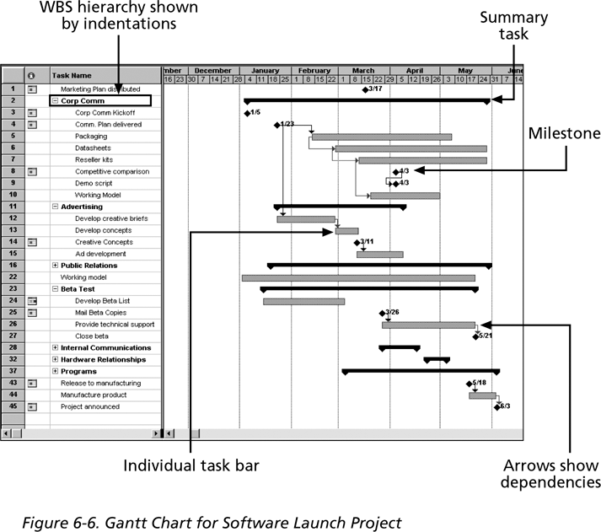
Gantt Chart for Software Launch Project

Slide 31
Adding Milestones to Gantt Charts
Many people like to focus on meeting milestones, especially for large projects.
Milestones emphasize important events or accomplishments in projects.
You typically create milestone by entering tasks that have a zero duration, or you can mark any task as a milestone.

Slide 32
SMART Criteria
Milestones should be:
Specific
Measurable
Assignable
Realistic
Time-framed

Slide 33
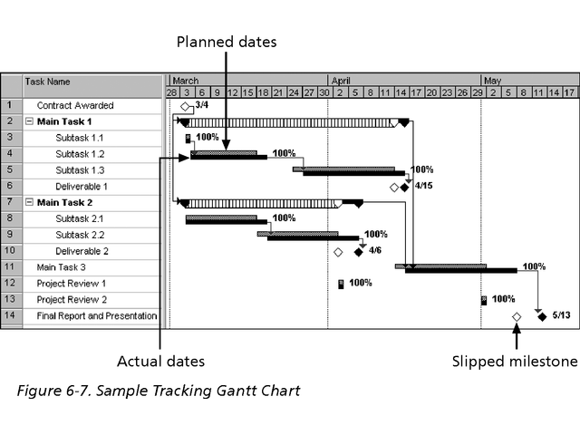
Sample Tracking Gantt Chart

Slide 34
Critical Path Method (CPM)
CPM is a network diagramming technique used to predict total project duration.
A critical path for a project is the series of activities that determines the earliest time by which the project can be completed.
The critical path is the longest path through the network diagram and has the least amount of slack or float.
Slack or float is the amount of time an activity can be delayed without delaying a succeeding activity or the project finish date.

Slide 35
Calculating the Critical Path
Develop a good network diagram.
Add the duration estimates for all activities on each path through the network diagram.
The longest path is the critical path.
If one or more of the activities on the critical path takes longer than planned, the whole project schedule will slip unless the project manager takes corrective action.

Slide 36
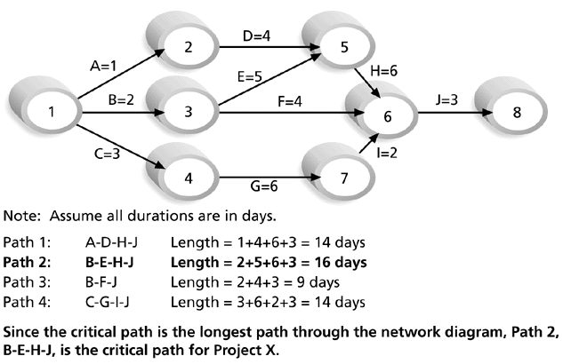
Determining the Critical Path for Project X

Slide 37
More on the Critical Path
The critical path does not necessarily contain all the critical activities; it only accounts for time.
There can be more than one critical path if the lengths of two or more paths are the same.
The critical path can change as the project progresses.

Slide 38
Using Critical Path Analysis to Make Schedule Trade-offs
Free slack or free float is the amount of time an activity can be delayed without delaying the early start of any immediately following activities.
Total slack or total float is the amount of time an activity can be delayed from its early start without delaying the planned project finish date.
A forward pass through the network diagram determines the early start and finish dates.
A backward pass determines the late start and finish dates.

Slide 39
Using the Critical Path to Shorten a Project Schedule
Three main techniques for shortening schedules:
Shortening the duration of critical activities or tasks by adding more resources or changing their scope.
Crashing activities by obtaining the greatest amount of schedule compression for the least incremental cost.
Fast tracking activities by doing them in parallel or overlapping them.

Slide 40
Many Horror Stories Related to Project Schedules
Creating realistic schedules and sticking to them is a key challenge of project management.
Crashing and fast tracking often cause more problems, resulting in longer schedules.
Organizational issues often cause schedule problems.

Slide 41
Importance of Updating Critical Path Data
It is important to update project schedule information to meet time goals for a project.
The critical path may change as you enter actual start and finish dates.
If you know the project completion date will slip, negotiate with the project sponsor.

Slide 42
Critical Chain Scheduling
Critical chain scheduling is a method of scheduling that considers limited resources when creating a project schedule and includes buffers to protect the project completion date.
It attempts to minimize multitasking, which occurs when a resource works on more than one task at a time.

Slide 43
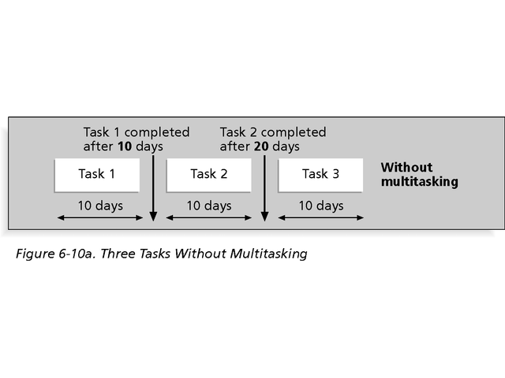
Multitasking Example

Slide 44
Buffers and Critical Chain
A buffer is additional time to complete a task.
Murphy’s Law states that if something can go wrong, it will.
Parkinson’s Law states that work expands to fill the time allowed.
In traditional estimates, people often add a buffer to each task and use the additional time whether it’s needed or not.
Critical chain scheduling removes buffers from individual tasks and instead creates:
A project buffer or additional time added before the project’s due date.
Feeding buffers or additional time added before tasks on the critical path.

Slide 45
Program Evaluation and Review Technique (PERT)
PERT is a network analysis technique used to estimate project duration when there is a high degree of uncertainty about the individual activity duration estimates.
PERT uses probabilistic time estimates:
Duration estimates based on using optimistic, most likely, and pessimistic estimates of activity durations, or a three-point estimate.

Slide 46
PERT Formula and Example
PERT weighted average =
optimistic time + 4 X most likely time + pessimistic time
6
Example:
PERT weighted average =
8 workdays + 4 X 10 workdays + 24 workdays
6 = 12 days
where:
optimistic time= 8 days
most likely time = 10 days
pessimistic time = 24 days
Therefore, you’d use 12 days on the network diagram instead of 10 when using PERT for the above example.

Slide 47
Schedule Control
Perform reality checks on schedules.
Allow for contingencies.
Don’t plan for everyone to work at 100 percent capacity all the time.
Hold progress meetings with stakeholders and be clear and honest in communicating schedule issues.

Slide 48
Schedule Control...
The goal is to know the status of the schedule, influence factors that cause schedule changes, determine that the schedule has changed, and manage changes when they occur.
Tools and techniques include:
Progress reports.
A schedule change control system.
Project management software, including schedule comparison charts, such as the tracking Gantt chart.
Variance analysis, such as analyzing float or slack.
Performance management, such as earned value.

Slide 49
Reality Checks on Scheduling
Review the draft schedule or estimated completion date in the project charter.
Prepare a more detailed schedule with the project team.
Make sure the schedule is realistic and followed.
Alert top management well in advance if there are schedule problems.

Slide 50
Working with People Issues
Strong leadership helps projects succeed more than good PERT charts do.
Project managers should use:
Empowerment
Incentives
Discipline
Negotiation

Slide 51
Using Software to Assist in Time Management
Software for facilitating communication helps people exchange schedule-related information.
Decision support models help analyze trade-offs that can be made.
Project management software can help in various time management areas.

Slide 52
Caution
Many people misuse project management software because they don’t understand important concepts and have not had training.
You must enter dependencies to have dates adjust automatically and to determine the critical path.
You must enter actual schedule information to compare planned and actual progress.

Slide 53
Assignment 2: Hand in on April 7
Activity | Predecessor | Optimistic Duration (Days) | Likely Duration (days) | Pessimistic Duration (days)
A | - | 5 | 6 | 10
B | - | 4 | 7 | 9
C | B | 2 | 3 | 5
D | B | 1 | 3 | 11
E | D | 3 | 9 | 12
F | D&E | 7 | 10 | 14
Using PERT determine the probabilistic time estimate (duration) for the project
Draw a network diagram to denote the above information
Determine the critical path for the project

