Slide 1
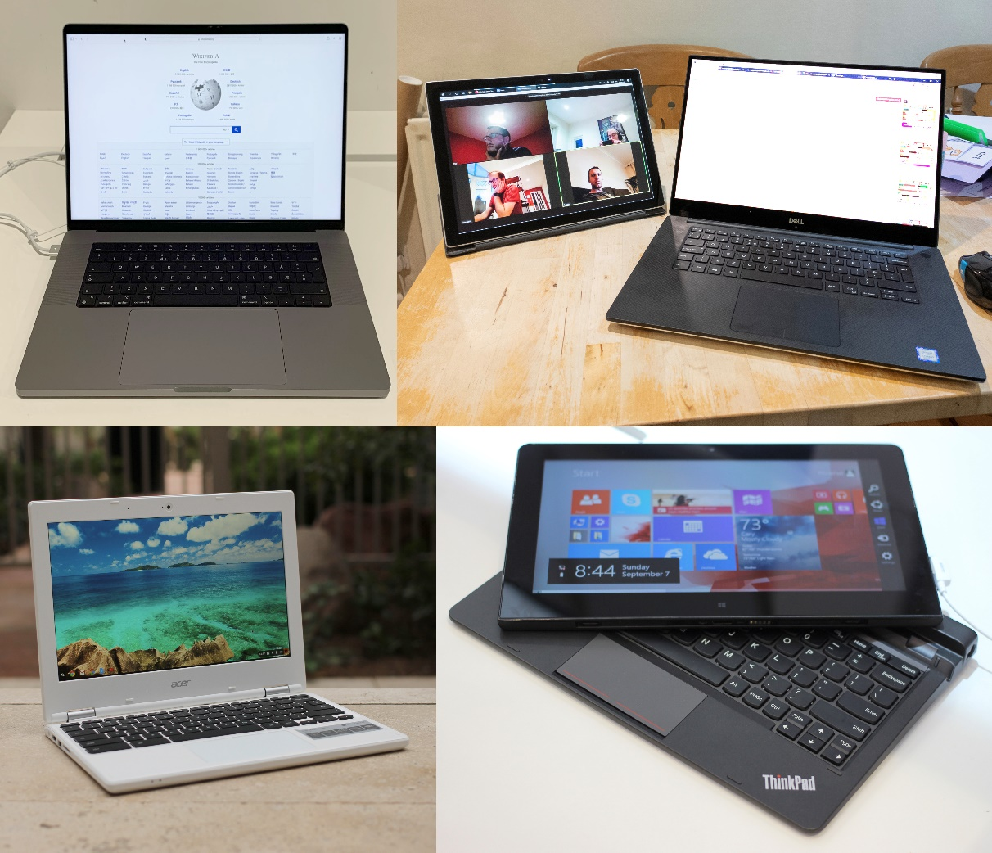
Portable Computers
Topic 10
Notes:
NOTE:
To change the image on this slide, select the picture and delete it. Then click the Pictures icon in the placeholder to insert your own image.

Slide 2
Types of Portable Computers
Laptops
Definition: Portable computers with integrated screens, keyboards, and trackpads.
Characteristics: Versatile, suitable for a wide range of tasks from casual use to professional applications.
Examples: Dell XPS, MacBook Pro, Lenovo ThinkPad.

Slide 3
Types of Portable Computers Cont’d
Ultrabooks
Definition: A category of thin and lightweight laptops with high-end processors and long battery life.
Characteristics: Emphasize portability and performance.
Examples: MacBook Air, HP Spectre, ASUS ZenBook.

Slide 4
Types of Portable Computers Cont’d
Netbooks
Definition: Small, lightweight, and inexpensive laptops designed primarily for web browsing and basic tasks.
Characteristics: Limited processing power and storage, often with smaller screens.
Examples: ASUS Eee PC, HP Mini.

Slide 5
Types of Portable Computers Cont’d
Tablets
Definition: Handheld devices with touch screens, designed for portability and ease of use.
Characteristics: Touch interface, optional keyboard attachments, ideal for media consumption and light productivity tasks.
Examples: iPad, Samsung Galaxy Tab, Microsoft Surface.

Slide 6
Types of Portable Computers Cont’d
Convertible/2-in-1 Devices
Definition: Devices that can function as both a laptop and a tablet, typically with a detachable or foldable keyboard.
Characteristics: Versatile, combining features of laptops and tablets.
Examples: Microsoft Surface Book, Lenovo Yoga, HP Pavilion x360.

Slide 7
System Components
Central Processing Unit (CPU)
Function: Executes instructions and performs calculations.
Types: Intel Core i-series, AMD Ryzen.
Memory (RAM)
Function: Stores data temporarily for quick access by the CPU.
Types: DDR4, DDR5.

Slide 8
System Components Cont’d
Storage
Function: Stores data permanently.
Types: Hard Disk Drives (HDD), Solid State Drives (SSD).
Display
Function: Visual output device for interacting with the computer.
Types: LCD, LED, OLED, touchscreen.

Slide 9
System Components Cont’d
Battery
Function: Provides portable power.
Types: Lithium-ion, Lithium-polymer.
Input Devices
Keyboard: For text input.
Touchpad/Trackpad: For cursor control.
Touchscreen: For direct interaction with the display.

Slide 10
System Components cont’d
Network Interfaces
Wi-Fi: Wireless connectivity.
Ethernet Port: Wired network connectivity.
Bluetooth: Short-range wireless communication.
Ports and Connectors
USB: For connecting peripherals.
HDMI: For external display connections.
Audio Jacks: For headphones and microphones.

Slide 11
Maintenance and Troubleshooting

Slide 12
Regular Maintenance
1. Cleaning: Regularly clean the keyboard, screen, and ports to prevent dust and debris buildup.
2. Software Updates: Keep the operating system and software up to date for security and performance improvements.
3. Battery Care: Follow best practices for charging and discharging to extend battery life.

Slide 13
Troubleshooting Common Issues
1. Overheating: Ensure proper ventilation, clean dust from vents and fans, and consider using a cooling pad.
2. Slow Performance: Close unnecessary programs, check for malware, and consider upgrading RAM or storage.
3. Connectivity Issues: Check Wi-Fi settings, reset the router, and ensure drivers are up to date.
4. Battery Problems: Calibrate the battery, check for software issues, and replace if necessary.

Slide 14
Diagnostic Tools
Built-in Utilities: Use operating system tools like Task Manager, Device Manager, and Disk Utility.
Third-Party Software: Utilize diagnostic tools like HWMonitor, CrystalDiskInfo, and MemTest86.

Slide 15
Maintenance of laptops

Slide 16
Physical Maintenance
1. Cleaning: Use a microfiber cloth for screens, compressed air for keyboards, and isopropyl alcohol for surfaces.
2. Storage: Keep the laptop in a cool, dry place. Avoid extreme temperatures and direct sunlight.
3. Transport: Use a padded laptop bag or case to protect against physical damage.

Slide 17
Software Maintenance
1. Operating System Updates: Regularly update the OS to ensure security and performance.
2. Antivirus Software: Install and maintain antivirus software to protect against malware.
3. Disk Cleanup: Regularly delete unnecessary files and use disk cleanup tools to free up space.
4. Backup: Regularly back up important data to an external drive or cloud storage.

Slide 18
Battery Maintenance
1. Charging Practices: Avoid letting the battery drain completely and avoid keeping it plugged in at 100% for extended periods.
2. Calibration: Occasionally let the battery drain completely and then fully charge it to recalibrate the battery meter.
3. Storage: If not using the laptop for an extended period, store it with a 50% charge.

Slide 19
Hardware Upgrades
1. RAM: Adding more RAM can improve multitasking and overall performance.
2. Storage: Upgrading from an HDD to an SSD can significantly boost speed and responsiveness.
3. Battery: Replacing an old battery can extend the laptop's usable life.

Slide 20
Thank you

