Slide 1
Shading Models

Slide 2
Shading Models
A shading model, also known as a lighting model, is a mathematical representation that determines how light interacts with a surface in computer graphics. It calculates the color and brightness of a surface point based on various lighting conditions and material properties. Shading models are essential for creating realistic and visually appealing 3D graphics.

Slide 3
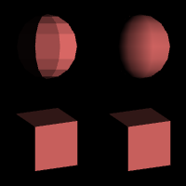
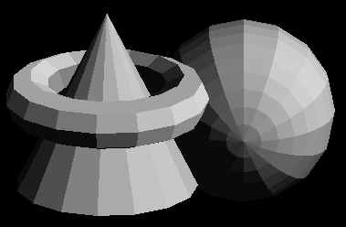
Shading Models

Slide 4
Parameters of Shading Models
Lighting Parameters: These parameters define the properties of the light sources in the scene, such as the position, intensity, color, and direction.
Surface Normals: Surface normals are vectors perpendicular to the surface at each point and are crucial for calculating lighting interactions accurately.
Material Properties: These parameters describe the characteristics of the surface material, including its diffuse color, specular color, shininess, transparency, and reflectivity.
Viewing Parameters: The viewer's position and direction affect how the surface interacts with light and the viewer's perspective.

Slide 5
Types of Common Shading Models
Lambertian (Diffuse) Shading: The Lambertian shading model is based on the law of Lambert's cosine, which calculates the diffuse reflection of light on a surface. It assumes that light is reflected equally in all directions, making surfaces appear uniformly lit.
Phong Shading: The Phong shading model includes both diffuse and specular reflections. It produces smoother highlights on surfaces and provides a more realistic representation of materials with different shininess.
Blinn-Phong Shading: This is a modification of the Phong shading model that offers improved computational efficiency while maintaining a similar visual quality.

Slide 6
Types of Common Shading Models..continu
Gouraud Shading: Gouraud shading calculates the color at each vertex of a 3D model and then interpolates the colors across the surface. It is computationally less expensive than Phong shading but can produce visible color banding on smooth surfaces.
Flat Shading: Flat shading assigns a single color to each face or polygon, resulting in a faceted appearance. It is computationally efficient but lacks visual smoothness.
Cook-Torrance Shading: The Cook-Torrance model is a more advanced shading model suitable for realistic rendering of materials with microfacet surfaces, such as metals.

Slide 7
Advantages of Shading Models
Realism: Shading models contribute to the realism of computer-generated images by simulating how light interacts with surfaces in the real world.
Visual Appeal: Properly implemented shading models enhance the visual appeal of 3D graphics, making them more engaging and believable to viewers.
Diverse Effects: Different shading models can simulate a wide range of materials, from matte surfaces to shiny metals, allowing for diverse visual effects.

Slide 8
Advantages of Shading Models..continu
Dynamic Lighting: Shading models enable dynamic lighting in real-time applications like video games, where lighting conditions can change dynamically.
Artistic Control: Artists and designers can use shading models to achieve specific visual styles and artistic effects in their creations.

Slide 9
Challenges of Shading Models
Computational Complexity: Advanced shading models with realistic effects can be computationally expensive, leading to reduced performance in real-time applications.
Artifacts: Some shading models may produce visual artifacts, such as aliasing or shading discontinuities, which can degrade image quality.
Parameter Tuning: Properly setting the parameters of shading models for specific materials and lighting conditions requires expertise and artistic judgment.

Slide 10
Challenges of Shading Models..continu
Compatibility: Shading models may not be universally supported across different rendering platforms or hardware, leading to variations in visual output.
Global Illumination: Simulating global illumination effects accurately in real-time applications can be challenging and may require specialized techniques.

