Slide 1
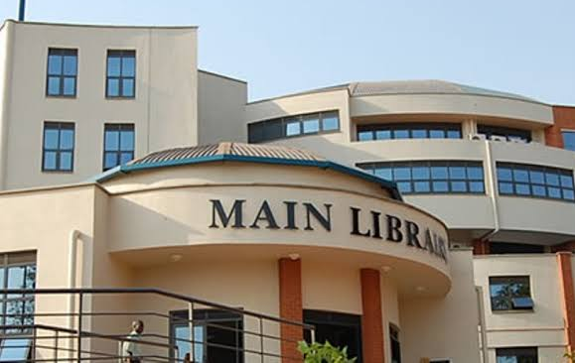
MAKERERE UNIVERSITY BUSINESS SCHOOL
FACULTY OF BUSINESS ADMINISTRATION
Business Communication Skills
FOR BACHELORS
©2024 - DEPARTMENT OF COMMUNICATION

Slide 2
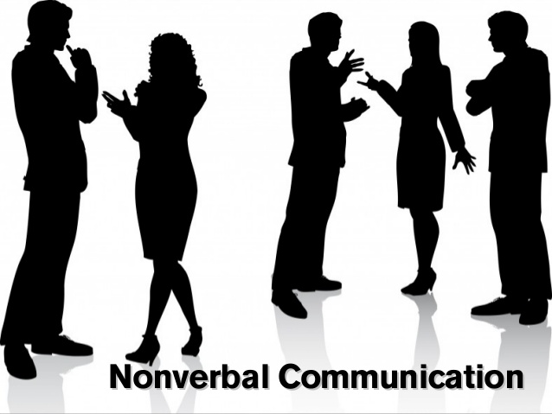
NON VERBAL COMMUNICATION

Slide 3
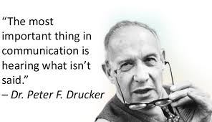

Slide 4
Topic Outline
Introduction
Topic Learning Outcomes
Importance of NVC
Key Features of NVC
Divisions of nonverbal communication
Technological Advancements in NVC
Application of nonverbal communication
Limitations of nonverbal communication
Conclusion
Case study

Slide 5
Introduction
This implies the need to pay attention to the nonverbal cues we use in our communication.
Non-verbal communication helps communicate the feelings and emotions behind the words spoken.
People can deceive with the use of words that they can control but the nonverbal cues naturally arise and honestly reflect the speaker’s mood, attitude, feelings etc
If there is a contradiction between spoken words and expressions, people settle for the message in the expression.
Non-verbal communication can also demonstrate self-belief, eagerness and professionalism through one’s personality.

Slide 6
Topic Learning Outcomes
6
At the end of this topic, learners should be able to:
Define the concept of Nonverbal communication.
Explain the various divisions & forms of Nonverbal communication.
Differentiate Non Verbal Communication from other types of Communication.
Evaluate or justify the need for Nonverbal communication in business and professional settings.
Plan for & apply Nonverbal cues in various professional settings, managing conflicts and interpersonal relations.

Slide 7
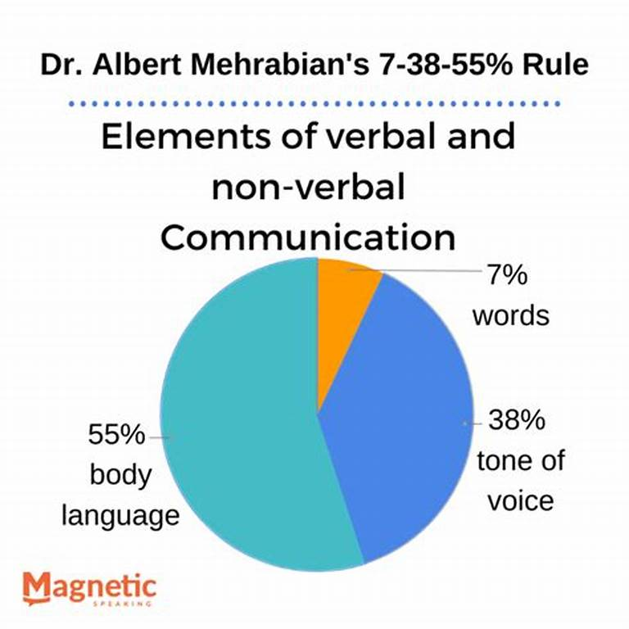
Non-verbal Communication (NVC)
7
Approximately 55% to 93% of all communication can be attributed to nonverbal sources.
It conveys a message from or about the person giving them.
It involves a complete mix of behaviours, psychological responses, and environmental interactions through which we consciously or unconsciously relate to another person.
Nonverbal cues carry approximately two-thirds of a message’s communicative value.

Slide 8
Importance of Non-verbal Communication
8
Aids in displaying emotions.
Emphasize or underscore words.
Nonverbal cues can substitute for or take the place of spoken words.
Nonverbal cues can contradict or negate verbal messages.
Creating a particular impression – smile, firm handshake, punctuality, smart dress.
Reinforcing and complement verbal message indicating seriousness, interest and engagement – e.g. an emphatic gesture, sparkling eyes, disapproving frown.
Providing feedback – applause, fidgeting, yawn.
Establishing desired atmosphere – informal dress, respectful distance, friendly smile.
NB: Students should research more about the importance of NVC.
Filter what

Slide 9
Key Features of Non-verbal Messages
9
These are messages with no use of words.
Non-verbal communication takes place at every level and in all age groups.
Verbal communication has restrictions in terms of reach whereas non-verbal communication has no such boundaries.
One’s culture determines the meanings attached to such messages.
Its interpretation depends heavily upon the power of observation

Slide 10
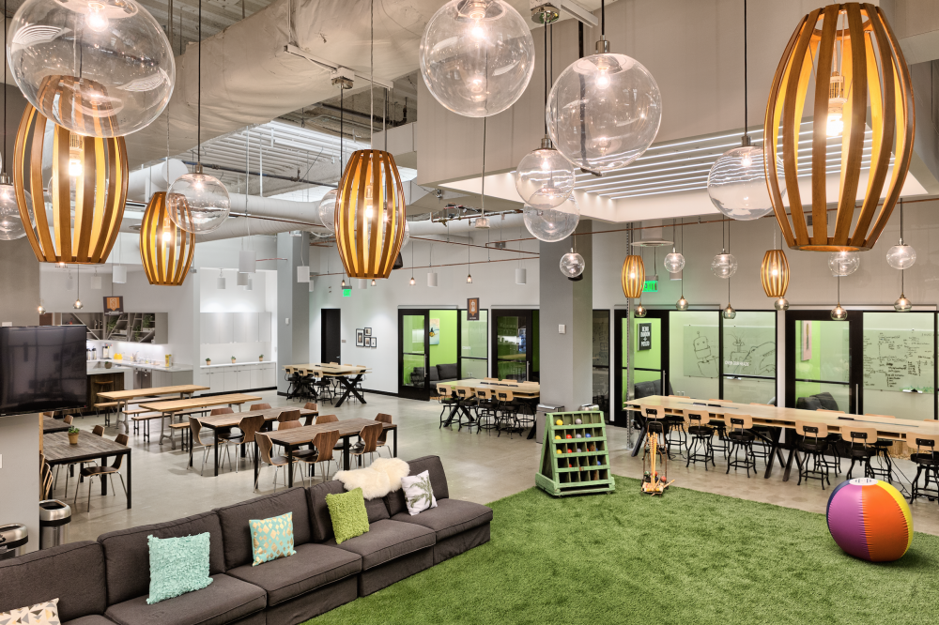
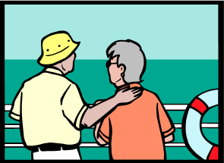
Divisions of Non Verbal Communication
NVC is broadly categorized into three divisions
Environmental Non-Verbal: this relates to the messages we convey based on our surroundings.
Social Non Verbal: that focuses on messages relayed by how we interact with others.
Physical Non Verbal: that focuses on the messages relayed by how we use our different body parts.

Slide 11
Types Of Nonverbal Communication There are three broad divisions of NVC which include the following:
11
1. Environmental Non-Verbal
Time
Territory
Smell / Scent, Design and Arrangement.
2. Social Non-Verbal
Space
Status
Symbols
3.Physical Non-Verbal
Body Language
Physical Appearance
Facial expressions
Gestures
Voice
Body Odor
Eye movements
Touch
Clothing and accessories

Slide 12
1. Environmental Non-verbal
12
Communication based on one’s surroundings
The workplace environment as well as the way we make use of space, time and territory can influence the outcome of communication.
Hence organizations give careful consideration to office space, factory layout, sales area and conference venues.
The environment should put people at ease and match their expectations
In the workplace, attention to punctuality or a disregard for it can make a strong nonverbal impact.
Certain instincts, such as the desire for privacy, familiarity and security, need to be satisfied.
Careful design of the workplace can meet these needs and in doing so improve communication, productivity and morale.
Natural and artificial light, colour, temperature, tables, chairs, desks, lounges, plants, sound, artwork, magazines, floor and wall coverings all have an impact on people’s perception of an organization

Slide 13
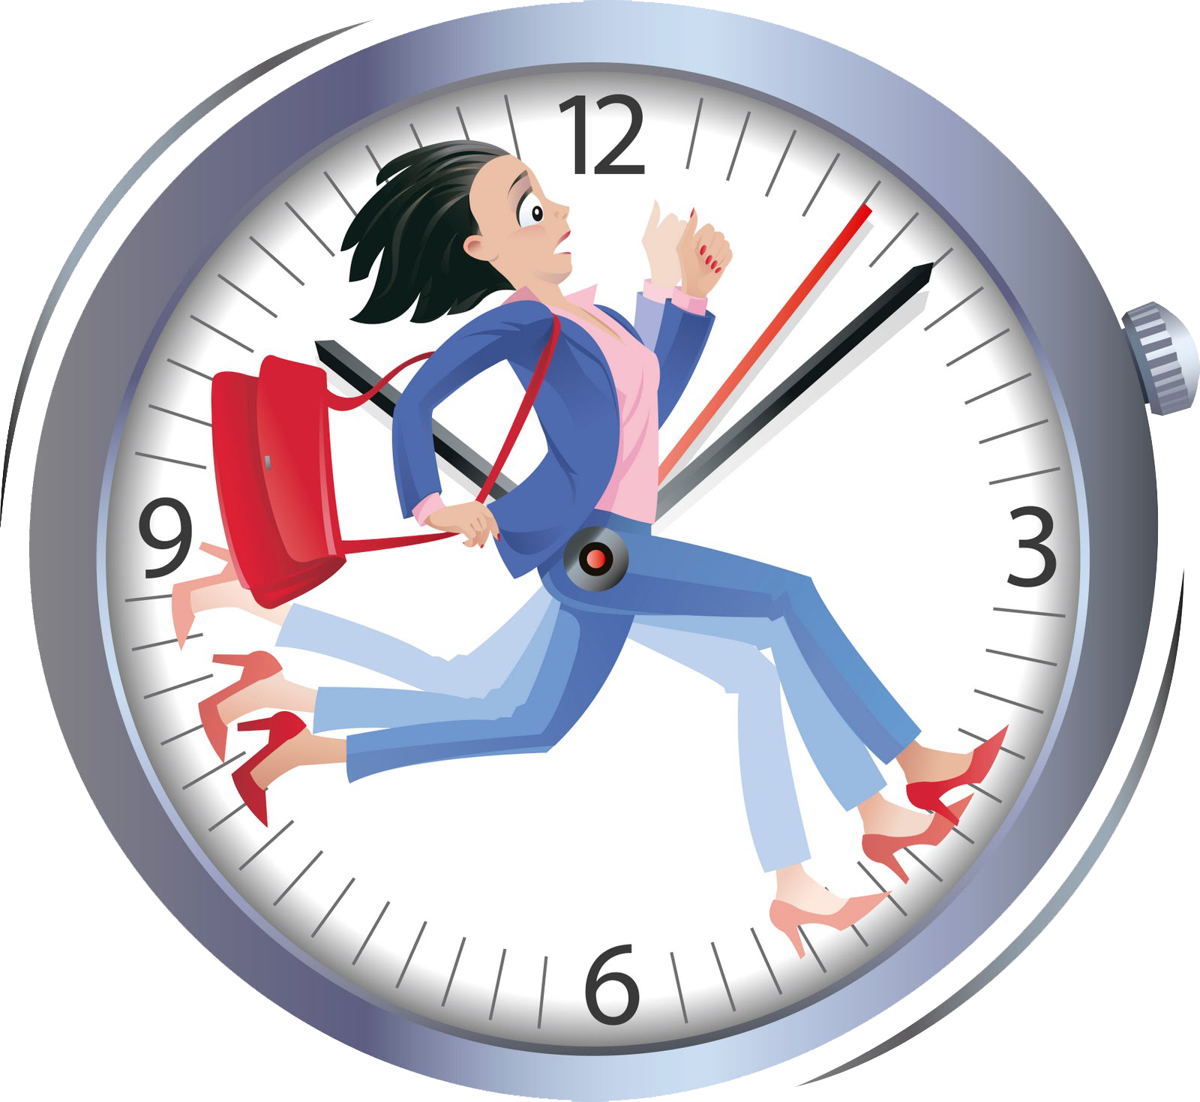
a) Time as Environmental NVC
13
This relates to messages conveyed by the way we value and use time.
Time language - meaning we give to time, i.e. how we communicate to others what time means to us.
In business time is limited and highly valued (power and money) hence structure and use it effectively.
E.g. workers must arrive on time; work in shifts and meet specified production quotas.
The time we give to listen or to speak to people creates a sense of recognition & self-esteem.
A person who uses one’s own and other people’s time wastefully, creates an impression of being inefficient and disorganised.
A sense of timing in conducting meetings, in conveying good or bad news, in making a presentation, generates respect and goodwill
i)Monochromic cultures i.e. believe in doing one activity at a time e.g. reading a newspaper in a meeting may imply impoliteness.
ii)Polychromic cultures i.e. People do several things at the same time e.g. having a meeting while at the same time
reading documents or surfing the internet to research
for solutions.

Slide 14
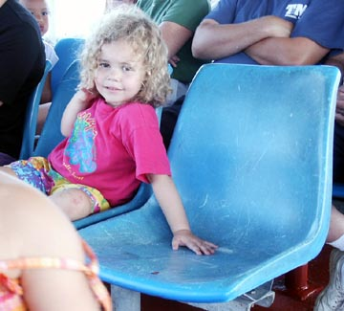
b) Territory as Environmental NVC
14
desk at work, a seat in a classroom, or a preferred spot in a public space. as their territory that others can’t enter without permission.
Territorial markers, can be placing a bag on a chair to establish boundaries.
This refers to the comfortable space we maintain between ourselves and the people we are communicating with.
It communicates ownership or occupancy of areas and possessions
We all have a need for physical space, however that need changes depending on the culture, the condition, and the closeness of the relationship.
Many people consider their workspace, a table, a chair, piece of machinery, an office they have run for several years, a personal

Slide 15
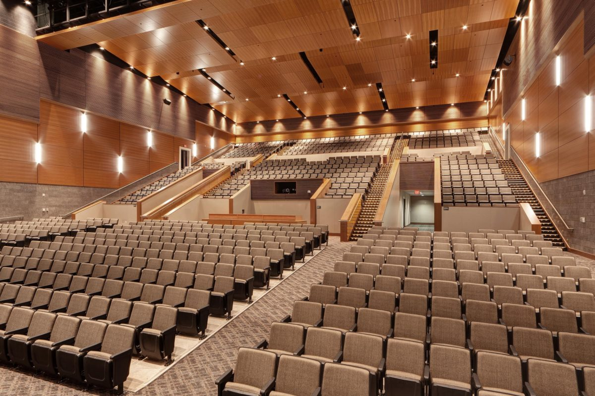
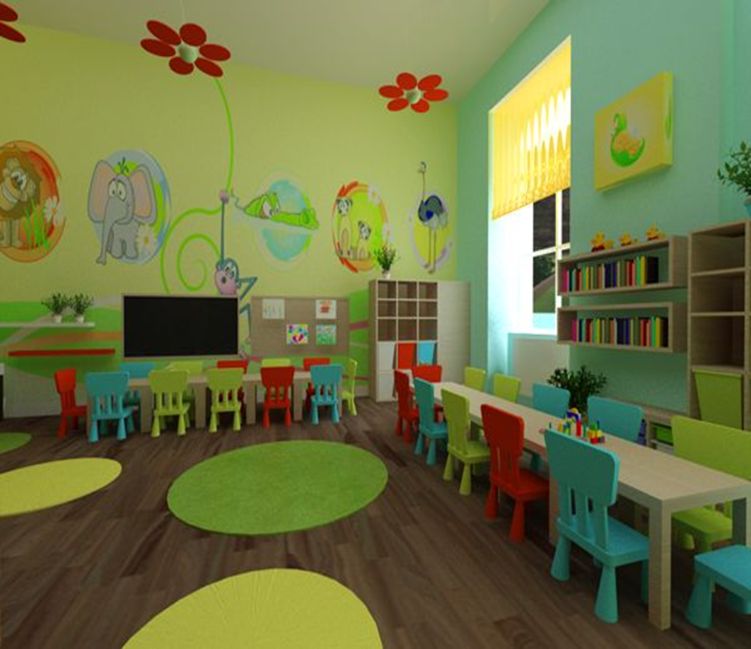
c) Design and Arrangement as Environmental NVC
15
The layout and design of our surroundings communicates something about us.
Includes structure of a building, space, arrangements of an office, furnishing, the layout of the desk and chairs, office size and colour
They convey status of the occupant, personality, perhaps our need for formality, quality of service etc.
To test the reality of this component of context, try to rearrange parts of the environment without telling another person and look for the negative reaction you will likely get.

Slide 16
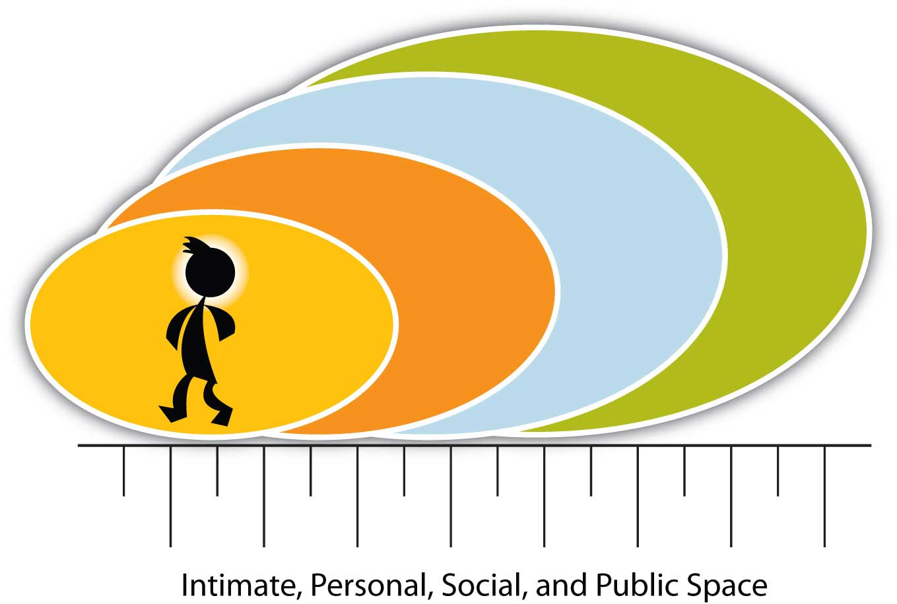
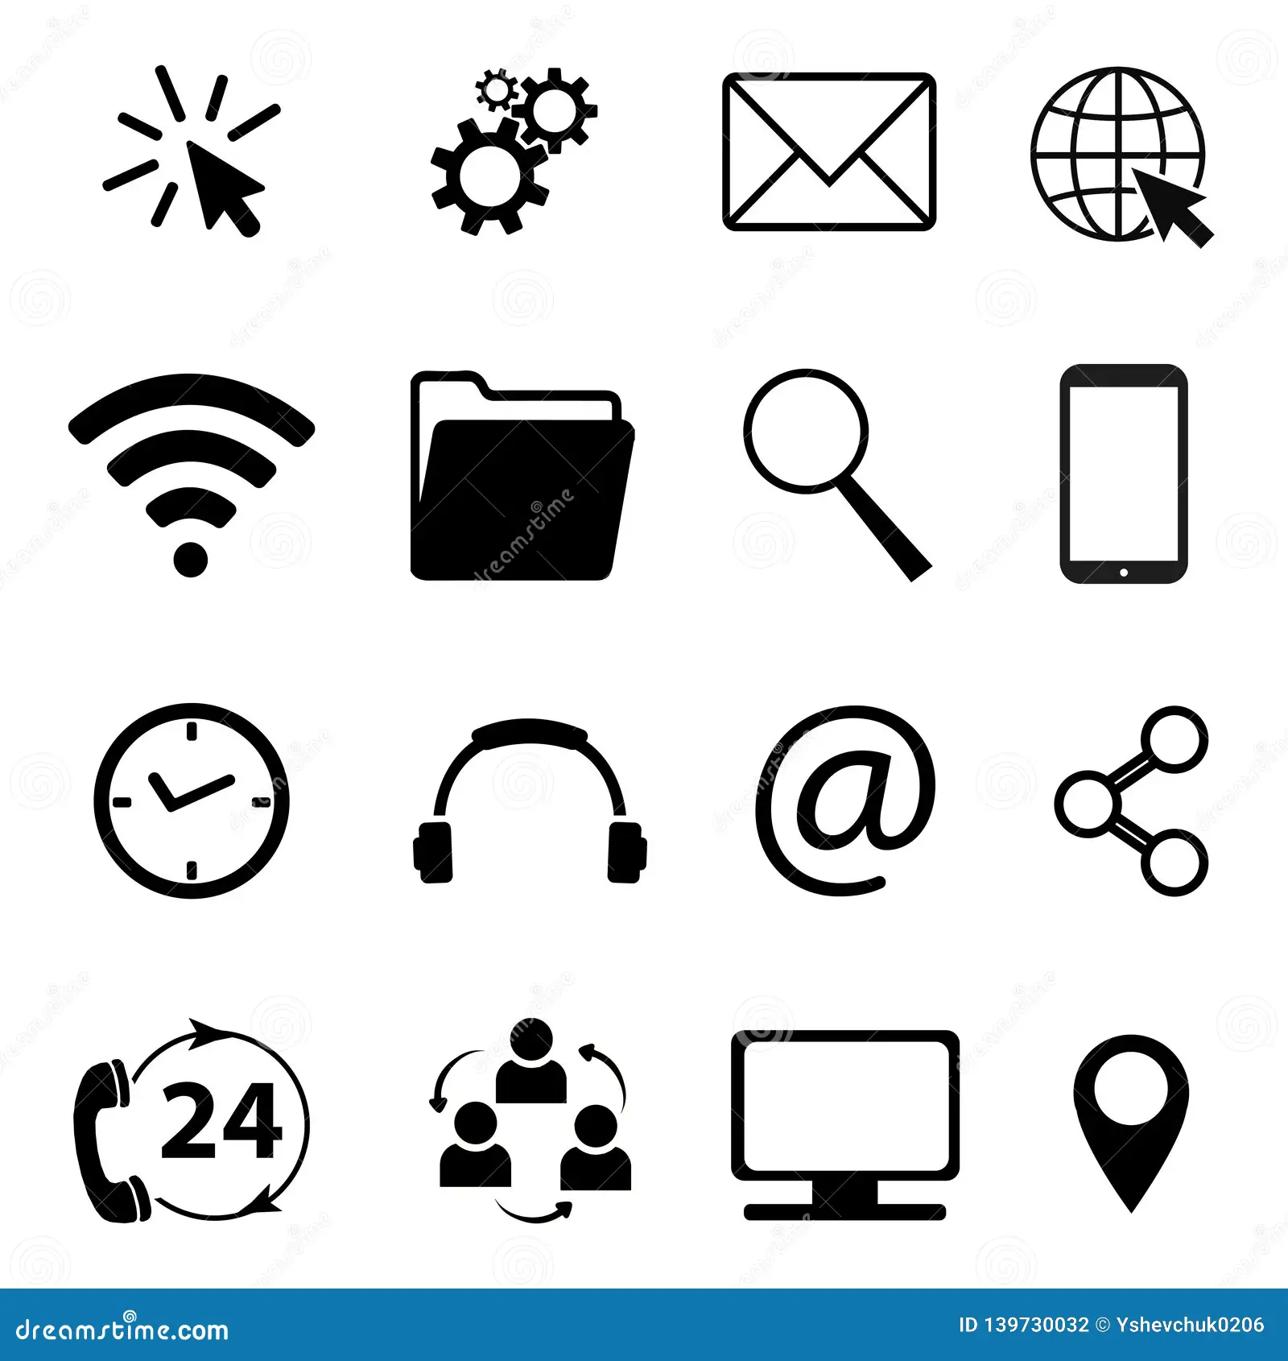
Social Non Verbal Communication
Communication arising from the relationships one has with others.
16
a)Space:
b) Status:
c)Symbols:

Slide 17
Space as Social Non Verbal Communication
Space also known as proxemics, refers to the study of how we communicate with the space around us— how we arrange it and what we arrange in it.
In the workplace, we have both formal and informal space we give to the person(s) we are communicating with. Any infringement would cause discomfort.
For example, Have you ever been speaking to someone and became uncomfortable because they were too close? In an empty theatre, will you sit very next to a stranger or leave a few seats empty?

Slide 18
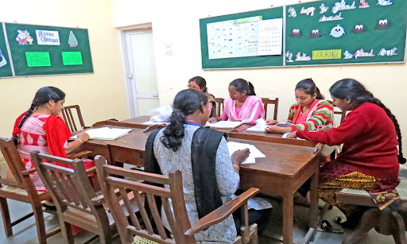
Status as Social NVC
18
Titles or positions nonverbally communicate status.
The more fancy, spacious or difficult it is to access a manager, the higher the position.
For e.g. Time that elapses between knocking at someone‘s door and entry communicates status.
Office Layouts; Executives and high-status individuals typically have larger, more private offices with high-end furniture, while lower-status employees may have smaller, shared workspaces.
Restaurants and Cafes; High-end dining establishments often have more spacious seating arrangements, private dining rooms, and exclusive areas for VIPs.
Hotels and Resorts; Luxury hotels and resorts offer larger, more private accommodations, exclusive lounges, and high-end amenities, indicating higher social status.
Event Venues; Exclusive events held in prestigious locations with well-planned layouts can signal the high social status of attendees.

Slide 19
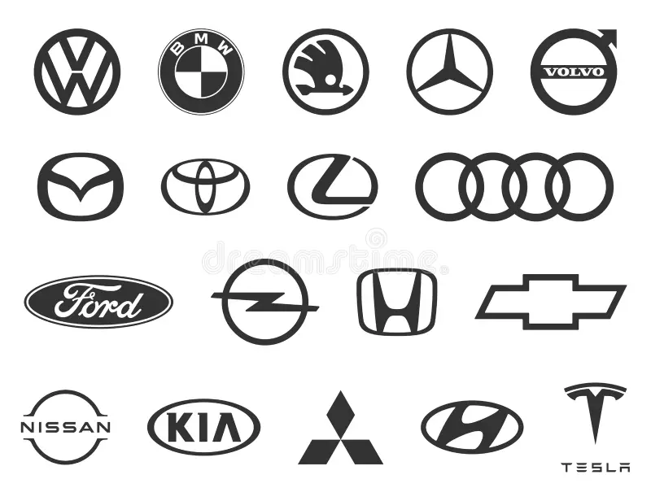
Symbols as Social NVC
19
Refers to any unique identifier (object or image) that conveys specific meaning without the use of words. E.g. a logo or a trademark. They can also include road signs and symbols
They create a company’s unique identity and recognition of the organization and its products. by the public.
This aids in identifying thus boosting sales and maintaining usable public image.
These symbols can vary widely depending on cultural, social, and contextual factors.

Slide 20
3. Physical Non Verbal Communication
20
Also known as kinesics refers to the study of the way we use our different body parts to communicate.
In understanding body language, we look at the meaning the body is communicating.
For example, body gestures, postures, facial expressions, eye movements, voice, touch, clothing, physical appearance etc.
We can tell attitude, perceived status, relationships, moods, deception, warmth, need for interaction, and the like from body gestures and activities as people express themselves

Slide 21
Body Posture as Physical NVC
21
An upright posture can convey confidence, attentiveness, and positivity, whereas slouching can indicate lack of confidence, disinterest, or fatigue.
Body posture affects how we think about ourselves, how we relate to others, and how others relate to us.
This varies from culture to culture and mostly hereditary and natural.
The way we stand, sit, maintain our upper body, hold our heads high, or move during communication convey a lot of information about our emotional state, intentions, and reactions.
For example,
Crossed arms might indicate defensiveness, while open arms can suggest openness and friendliness.

Slide 22
Gestures as Physical NVC
Refers to the way the physical movements of our limbs (arms, legs, hands, and head convey meaning while communicating.
For example shrugging of shoulders could mean indifference, jerk of the head to indicate direction, tapping fingers could mean impatience, handshakes can mean friendliness etc. Their meaning varies from culture to culture.
Purpose
As the sender, you use body gestures to accent and reinforce our oral messages.
As receivers, we observe gestures to get a picture of the internal emotional state of the sender.

Slide 23
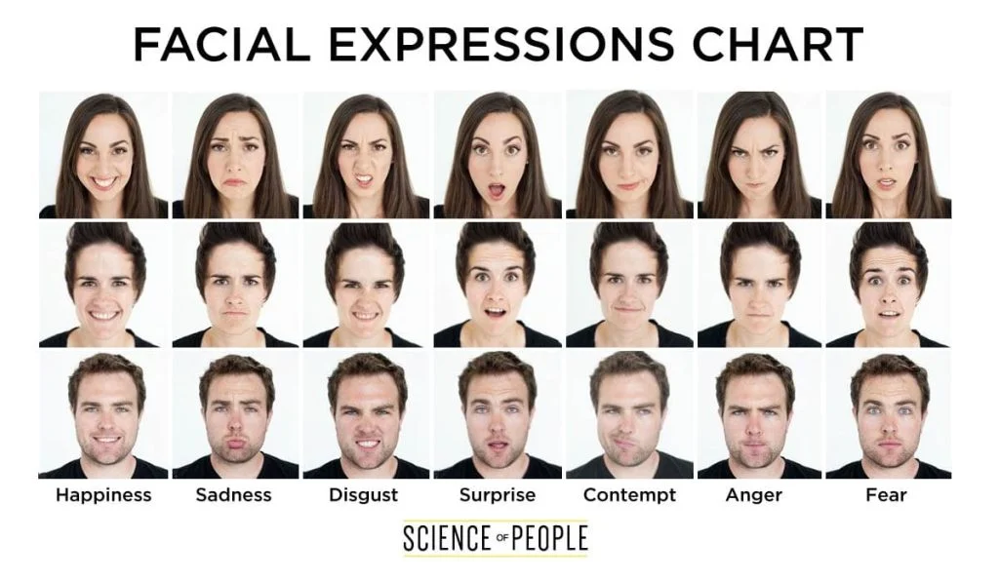
Facial Expression as a Physical NVC
23
Refers to the messages conveyed by the use of our faces while communicating.
The face being our primary source of emotions conveys our emotions, intentions, and reactions feelings, objectives.
We look at the mouth, jaw, eyes, nose, cheeks, and forehead to make an informed understanding of the Non verbal message.
For Example: a smile, frown, raised eyebrow or yawn can depict fear, friendship, surprise, anger, excitement, confusion. etc.

Slide 24
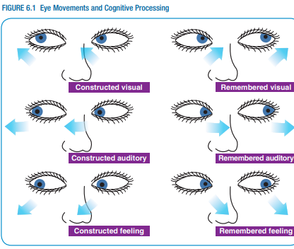
Eye Movement as Physical NVC
24
Non verbal messages that are observed from the way we position/use our eyes while communicating.
The eye being the windows to our soul, often predicts a speaker’s true feelings or emotions. It can portray fears, lies and untruthfulness.
Also, How and how much we look at a person can convey different meanings.
For example;
The speaker should use the eye contact to judge whether the receiver is paying attention, showing respect, responding favourably, or feeling distress.
The speaker should have sustained eye contact to show interest, attention, respect, honesty, sincerity, confidence, and in some context intimacy. Otherwise a gaze aversion can depict shyness, discomfort, nervousness or cultural norms.

Slide 25
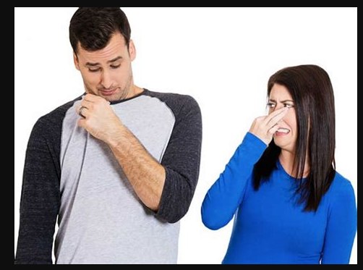
Body Scent /Ordor as Physical NVC
, scented candles, and air fresheners attracts therefore can trigger romance, or friendship
A bad smell can repel or cause discomfort, loss of morale and productivity.
NB: Students to discuss how smell influences business operations.
Also known as olfactics refers to the various messages we convey about an individual’s hygiene and grooming, emotional state, health & wellness, diet and nutrition, hormonal changes, social status & cultural background based on the way we smell.
Different smells trigger corresponding emotional reactions E.g. a good scent from perfumes, colognes, mouthwashes, household disinfectants, scented candles

Slide 26
Touch as Physical NVC
Touch also known as haptics conveys a wide range of emotions and messages.
E.g. power, empathy, understanding, warmth, reassurance, support, encouragement, comfort affection, friendship etc.
Affectionate Touch: Hugs, kisses, and cuddles convey love and care.
Friendly Touch: Handshakes, pats on the back, and high-fives indicate friendliness and camaraderie, comfort and reassurance.
Professional Touch: Formal handshakes convey professionalism and respect.
Comforting Touch: Holding someone's hand or giving a gentle pat can provide

Slide 27
Illustration of Touch

Slide 28
Dress Code as Physical NVC
This refers to the messages that our dressing communicates e.g. occasion, status, personality, attitude, emotions, behaviour etc.
It includes a person’s clothing and accessories e.g. tie, perfume, footwear, jewellery, bags.
The colour, design, cut and fitting, combine to make up the clothing.
We need to take extra care in choosing bearing in mind the comfort, combination and appropriateness.
Appropriateness for the occasion in terms of; formality of the occasion, the time of the day, the season, the cultural background of the people who will be present and the conventions of your organization is essential.
Comfort relates to how free you feel when you put on such attire.
Combination relates to how well you have matched your dressing with accessories if any.

Slide 29
Pictures Depicting Dress Code

Slide 30
Physical Appearance as Physical NVC
Relates to the general outward appearance of a person’s body makeup (face, body, overall look) in terms of height, weight, size, shape and looks in terms of neatness, grooming etc.
It can create a positive/negative effect on the receiver and can influence perceptions of attractiveness, health, strength, and personality traits.
For example, tall men, slender people, and attractive women are awarded a premium for their height, thinness, and beauty in some professions. Also, taller individuals might be perceived as more authoritative, while those with a more muscular build might be seen as strong and capable.
One should also take of the appearance of business documents in terms of their neatness.
We therefore need to take standard care of our skin, nails, feet, hair and documents to be able to create a good first impression

Slide 32
Paralanguage as Physical NVC
The non-verbal aspects of the spoken words are known as paralanguage.
This includes voice quality and usage, sound utterance, pitch, voice control rate, pauses, volume, tone, silences, laughs, screams, sighs, etc.
We need to use our paralanguage effectively by being aware and controlling how it is used.

Slide 33
Silence as Physical NVC
Silence is often used to communicate feelings such as disapproval; indifference or anger.
It is expressive as depicted by idioms in the English language. “ a stony silence” and “ a loaded silence”.
Orators often pause before and/or after making an important point to emphasize it. Such a pause before the point is made to convey a sense of anticipation. A pause, later on, gives the audience time to reflect and think over what has just been said.
Thus silence itself can be used as an instrument in communication.
However one drawback is that silence can be easily misinterpreted.

Slide 34
Techonological Advancements in Non Verbal Communication
34
Emojis on Keyboard interfaces.
Biometric Sensors(Finger prints in banks, in security, unlocking phones).
Facial Recognition tools(unlocking phones, accessing restricted rooms).
Motion Sensors/Detectors(Alarms, Security Lighting)
Virtual and Augmented Reality(VAR).

Slide 35
Application of Nonverbal Communication
Customer Service delivery; Friendly Body Language i.e. Smiling, making eye contact, gestures, nodding creates a welcoming atmosphere which enhances customer satisfaction.
Educators apply gestures, facial expressions, space and territoriality to engage learners & manage classroom dynamics.
Tour guides use gestures, and facial expressions to convey enthusiasm & improve the tourist experience.
Health professionals use facial expressions, and gestures to show empathy and detect patient signals i.e. body temperature to check fever.
Interviewers use facial expressions, gestures, and posture to determine interviewee confidence.
Discuss the applications used by your profession

Slide 36
Limitations Associated with NVC
Differences in interpretation. Each person may interpret it according to background, knowledge and experience.
Can’t be stored.
No consistency in meaning i.e. unique from society to society. E.g. nodding means yes to a Ugandan but no to Japanese.
May not be complete for effectiveness.
May contradict the verbal communication e.g. I’m happy to receive, yet the attitude or body language is not friendly.
It’s applicable when there is along distance between the communicators.
Highly influenced by the personality of the communicator and receiver in question.

Slide 37
Conclusion
Whilst we all have experience of these actions (or indeed non-actions) such as putting our head in our hands, turning our back or keeping an office door open or closed, care must be taken that similar actions can mean different things around the world.
A person who is aware of another person’s non verbal cues will understand that person better.
If you want to establish strong and lasting connections then you need to improve your nonverbal communication skills.
The quality of relationships improves when you can skilfully read people and understand the feelings behind their words.

Slide 38
Exercise: Study the case below and answer questions there in
38

Slide 39
39
"The human body is the best picture of the human soul."– Ludwig Wittgenstein

Slide 40
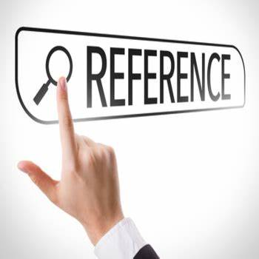
References
https://youtu.be/HVCrsbeTW0?si=Itu7V1vvtrvL7HCB
https://youtu.be/HxDqYEl20hI?si=OOvusZz_c0oIZCPG
https://youtu.be/fJB3mZiEbnU?si=IedOh1PmDp3I7tsu
Burgoon, J. K., Manusov, V., & Guerrero, L. K. (2021). Nonverbal communication. (2nd ed.). Routledge. https://doi.org/10.4324/9781003095552.
Gamble, T. K., & Gamble, M. (2016). Nonverbal messages tell more: A practical guide to nonverbal communication. Routledge. Chapter 6.

Slide 41
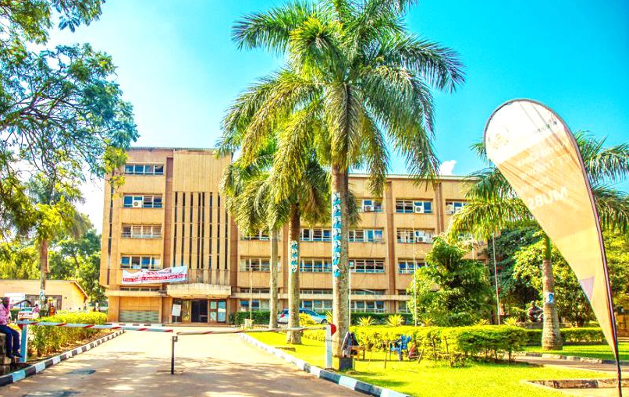
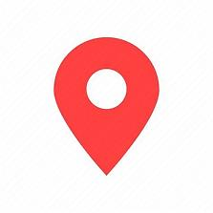
Thank you for being a great audience
Address
Main building , first floor Room 1.0
Contacts
Facilitator:
Team Leader: +256-772-156-003
Email
hodbad@mubs.ac.ug / / jodiya@mubs.ac.ug
©2024 - FACULTY OF BUSINESS ADMINISTRATION, Department of Communication

