Slide 1
Introduction to Web Servers & Hosting
This presentation explores web servers and hosting. We'll cover server components and types. Discover popular software like Apache and Nginx. Learn about essential features and protocols. Finally, we'll cover hosting basics to get your website online.

Slide 2
What are Computer Servers and Their Role?
A computer server is a system that provides data, resources, or services to other computers over a network.
Servers are centralized computers. They manage resources. They provide services to other devices.

Slide 3
Functions/roles of computer servers
Hosting websites
managing databases
processing requests
Data Storage
Network Management
Centralized Resource

Slide 4
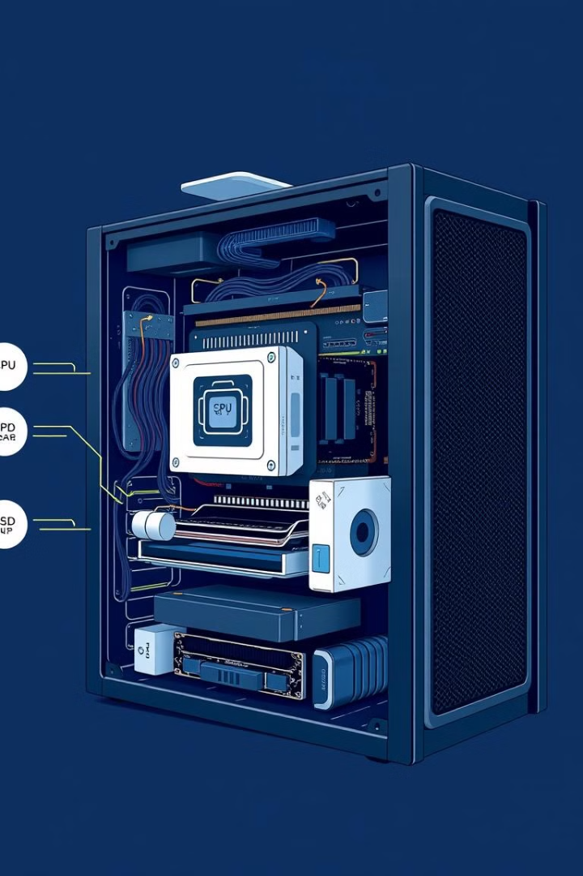
Server Components
1
CPU
2
RAM
The central processing unit executes instructions. It is the server's brain.
Random access memory provides fast data access. It is for active processes.
3
Storage
Hard drives or SSDs store data persistently. Storage includes the OS and applications.

Slide 5
Server Components
Hardware Components:
Software Components:
CPU: Handles processing tasks.
RAM: Stores temporary data for fast access.
Storage (HDD/SSD): Holds website files and databases.
Network Interface Card (NIC): Connects to the internet.
Power Supply Unit (PSU): Provides electricity.
Operating System (Linux, Windows Server).
Web Server Software (Apache, Nginx, IIS).
Database Server (MySQL, PostgreSQL).
Security & Firewall Systems.

Slide 6
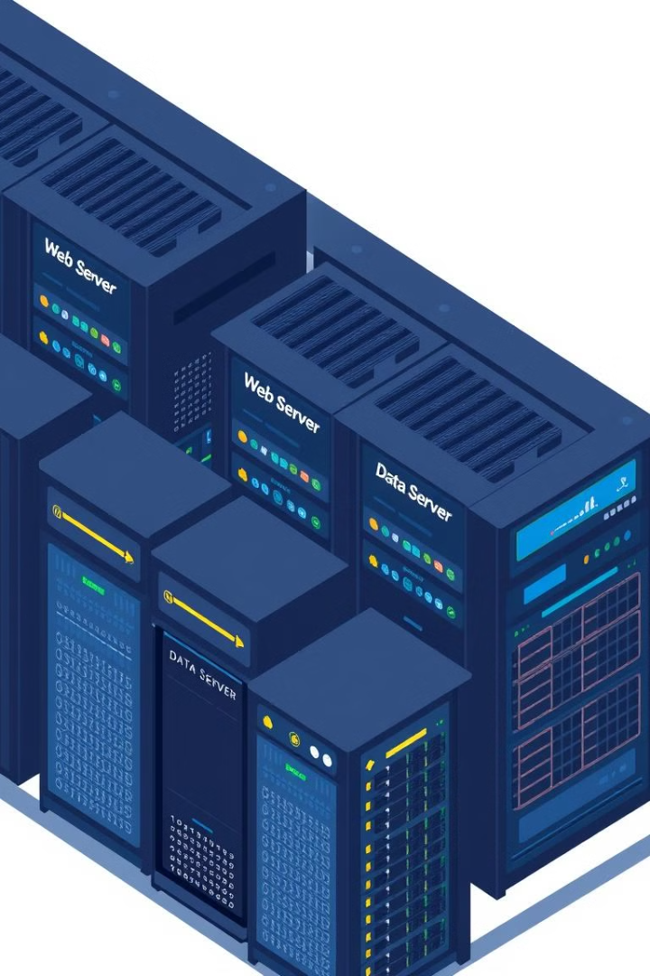
Different Types of Servers: A Comprehensive Overview
Web Servers
Database Servers
Deliver web content to clients. They handle HTTP requests.
Store and manage structured data. They are used by applications.
File Servers
Provide centralized file storage and sharing. Access control is a key feature.

Slide 7
Types of Servers
Web Server: Hosts websites and serves web pages Eg Apache,NGINX,IIS.
Database Server: Stores and manages structured data eg oracle,MySQL.
Application Server: Runs applications and services eg Jboss,IBM web sphere.
Mail Server: Handles email communication eg Sendmail, postfix,Microsoft exchange.

Slide 8
Types of Servers
File Server: Stores and shares files across a network eg windows file server, network attached storage(NAS).
Proxy Server: Acts as an intermediary for requests from clients eg Squid Proxy, HAproxy.

Slide 9
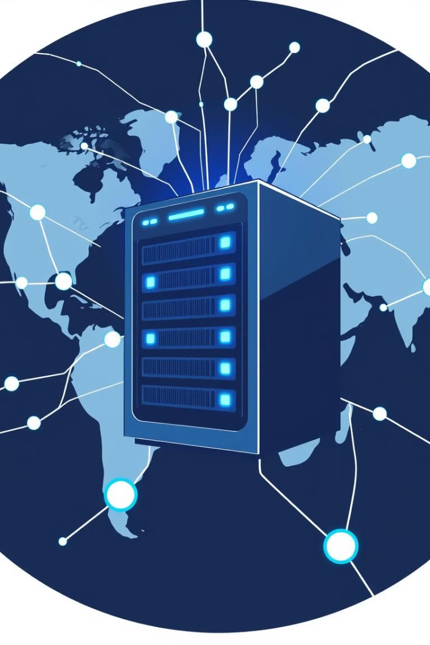
Web Servers: How They Power the Internet
Content Delivery
Request Handling
Security
Web servers deliver web pages. They also deliver images and videos.
Web servers implement security measures. They protect against threats.
They receive and process HTTP requests. Servers respond with content.

Slide 10
Overview of Web Servers
A web server processes and delivers web content using HTTP/HTTPS.
It serves static files (HTML, CSS, JavaScript) and dynamic content (PHP, Python, Node.js).
It ensures security, load balancing, and content caching.

Slide 11
Dynamic vs. static web servers
A web server can be used to serve either static or dynamic content.
Static refers to the content being shown as is, while dynamic content can be updated and changed.
A static web server consists of a computer and HTTP software. It is considered static because the server sends prewritten hosted files as is to a browser.

Slide 12
Dynamic vs. static web servers
A dynamic web browser consists of a web server and other software, such as an application server and database.
It is considered dynamic because the application server can be used to update any hosted files before they are sent to a browser.
The web server can generate content by requesting it in real time from the underlying database.
Also, this content is delivered based on a user's specific input or other variables.

Slide 13
How to choose a web server
What the website is used for and whether the web server can support those needs.
How well it works with the OS and other servers.
Its hosting environment.
Its ability to handle server-side programming.
Whether it can handle sudden spikes in workloads without impacting performance (scalability).
Security characteristics.
Publishing, search engine and site-building tools that come with

Slide 14
Top Web Server Software: Apache, Nginx, IIS, LiteSpeed
Apache
1
Popular open-source server. It is known for its flexibility.
2
Nginx
High-performance server. It's used as a reverse proxy.
IIS
3
Microsoft's web server. It integrates with Windows.
4
LiteSpeed
Commercial server. Known for its speed and performance.

Slide 15
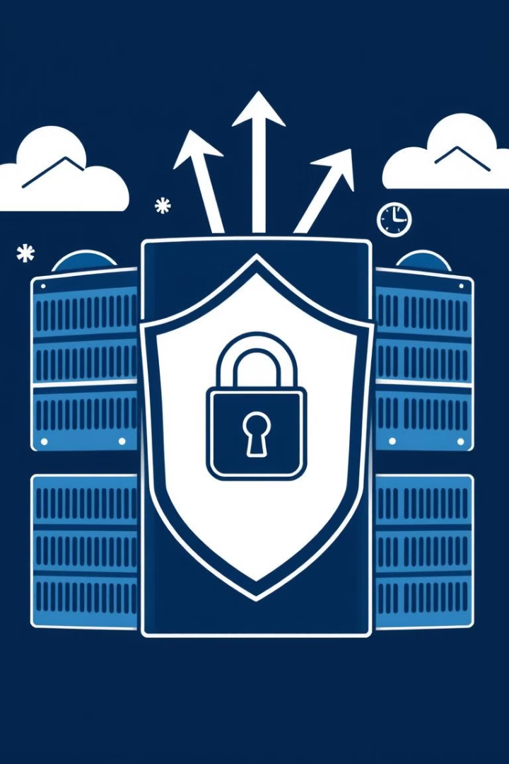
Essential Features That Define a Great Web Server
Security
Protection against attacks. Includes SSL/TLS support.
Performance
Fast response times. Efficient resource utilization.
Scalability
Ability to handle traffic spikes. Support for load balancing.
Virtual Hosting:.
Host multiple websites on one server
Logging & Monitoring:
Track server activities and performance.

Slide 16
Understanding HTTP/HTTPS and SSH Protocols
SSH
1
Secure remote access to the server. Uses encryption for security.
HTTPS
2
Secure HTTP. Uses SSL/TLS for encrypted communication.
HTTP
3
The foundation of web data communication. Unencrypted.

Slide 17
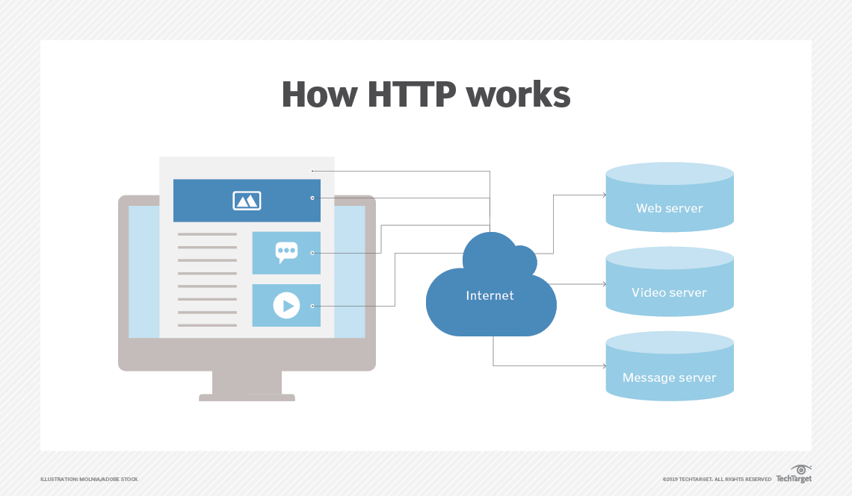

Slide 18
Hosting Fundamentals
Hosting means placing resources—such as software applications, files, or entire operating systems—on a machine (often called a host) that’s connected to a network.
What is a Host? A host is any computer or device that’s assigned an IP address and connected to a network. It can be a dedicated physical machine, a virtual machine (VM), or even a containerized environment. The host’s role is to run services and manage requests from clients.

Slide 19
Hosting Fundamentals
What Services and Resources can be hosted? These can range from running a business application, storing files, managing emails, or even processing data for complex tasks.
Hosting refers to the process of providing storage space, computing resources, and network connectivity for websites, applications, or services to be accessible on the internet

Slide 20
Types of Hosting Environments
Shared Hosting: Multiple websites on one server (cost-effective, limited resources).
VPS Hosting: Virtual server with dedicated resources.
Dedicated Hosting: Entire server for one client (high performance, high cost).
Cloud Hosting: Distributed resources for scalability.
Container-Based Hosting:Containers (using technologies like Docker) allow applications to run in isolated environments on the same operating system.
Managed Hosting

Slide 21
Domain Names and DNS
Domain Names like www.example.comis a human-friendly address that points to your website’s server.
Domain Name System : The DNS is like the internet’s phonebook. When you enter a domain name into your browser, the DNS translates it into the corresponding IP address of the server where your website is hosted.

Slide 22
Server Hardware and Data Centers
The physical infrastructure behind hosting is critical:
Server Hardware:
High-performance servers are designed to run continuously and handle multiple requests simultaneously.
They are built with redundancy in mind—using RAID configurations, backup power supplies, and high-quality cooling systems
Data Centers:
Data centers house these servers and provide a controlled environment with stable power, high-speed internet connectivity, and robust security measures.
The location of a data center can affect website performance due to latency, so many providers offer options to host servers closer to your target audience.

Slide 23
Key Hosting Components:
Domain Name System (DNS): The DNS translates human-readable domain names (e.g., example.com) into IP addresses that computers use to locate and connect to websites.
SSL Certificates: Secure Socket Layer (SSL) certificates encrypt data exchanged between users and a website, ensuring secure communication and boosting trust.
Bandwidth & Storage: Determines how much data can be transferred and stored on the hosting server.
Control Panels (cPanel, Plesk): Provide a user-friendly interface for managing server resources, emails, databases, and security settings.

Slide 24
Control Panels and Management Tools
To simplify the administration of hosting environments, many providers offer control panels such as:
cPanel
Plesk
custom dashboards.
These interfaces allow users to manage domains, email accounts, databases, and server settings without interacting directly with the command line.
They provide a user-friendly way to perform essential tasks like:
Setting up new websites or subdomains.
Configuring email accounts and spam filters.
Managing databases and application settings.
Monitoring resource usage and traffic.

Slide 25
Hosting Fundamentals: Getting Your Website Online
Hosting
2
Select a hosting provider. Choose a suitable plan.
Domain
1
Choose and register a unique domain name.
Deployment
Upload website files to the server. Configure settings.
3

Slide 26
ASSIGNMENT-Setting Up a Web Server
Instructions: Follow the steps below to set up a web server on your local machine or a cloud environment.
S
Step 1: Install a Web Server
Choose and install Apache on your system (Linux, Windows, or macOS).
Verify the installation by starting the web server and checking its status.

Slide 27
Learners who spend one hour learning on day 1 have an 80% higher success rate for course completion...

