Slide 1
Regulation of Passenger Transportation

Slide 2
Uganda Railways Corporation ACT
The Inland Water Transport ACT,2021.
The Traffic and Road Safety ACT, 1998 (AMENDMENT) ACT, 2020
The Civil Aviation (Commercial Air Transport By Foreign Air Operators Within Uganda) Regulations, 2022 Arrangement of Regulations
The Local Governments (Kampala City) (Taxi Parks) Byelaws.

Slide 3
The Traffic and Road Safety ACT, 1998 (AMENDMENT) ACT, 2020

Slide 4
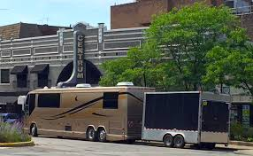
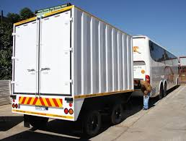
Categorisation of passenger vehicles based on number of passengers carried
Light omnibus” means a vehicle having seating accommodation for more than eight people in addition to the driver’s seat but not exceeding sixteen people in addition to the driver’s seat and may be coupled to a trailer, the permissible maximum mass of which does not exceed seven hundred fifty kilograms.

Slide 5
Medium omnibus :this is a motor vehicle used for the carriage of passengers and having seating accommodation of more than eight people in addition to the driver’s seat but not exceeding thirty people in addition to the driver’s seat and may be coupled to a trailer the permissible maximum mass of which does not exceed seven hundred kilograms
Private omnibus: this is a motor vehicle used for the carriage of persons, not being a public service vehicle, having seating accommodation for more than eight persons in addition to the driver’s seat.

Slide 6
Public omnibus: this is a public service vehicle that carries passengers at separate fares on a previously determined route e.g taxi vehicles, buses.
Tourist vehicle: is a motor vehicle that is specially designed and built for transportation of tourists.
Town taxicab: is a motorcar used as a passenger vehicle which stands on a rank or plies for hire on a road or a fixed place of business and is licensed to carry passengers for hire or reward under a contract express or implied for the use of the vehicle as a whole at an authorised fee and rate displayed on the vehicle and the sum indicated on the meter.

Slide 7
Passenger vehicles and licensing
For purposes of issuing driving licences, motor vehicles shall be divided into the following groups
Group D: includes motor vehicles used for the carriage of passengers and having more than eight seats in addition to the driver’s seat but not exceeding 30 seats in addition to the driver’s seat or motor vehicles of category D coupled to a trailer the permissible maximum mass of which does not exceed 750 kg.

Slide 8
Group D1: motor vehicles used for the carriage of passengers and having more than 8 seats in addition to the driver’s seat but not more than 16 seats in addition to the driver’s seat or motor vehicles of subcategory D1 coupled to a trailer, the permissible maximum mass of which does not exceed 750 kg.
Group DE: motor vehicles used for the carriage of passengers with a seating accommodation exceeding 30 seats in addition to the driver’s seat and motor vehicles of this subcategory may be coupled to a trailer whose permissible maximum mass exceeds 750 kg .

Slide 9
tricycles e.g tukutuku.These require a B1 license.
Motorcycles:- operators require a license if the motorcycle has an engine capacity of 125cc

Slide 10
Transport Operator Penalties(Causing bodily injury or death through reckless driving)
Causing death:-A person who causes the death of any person by reckless driving of a motor vehicle, trailer or engineering plant commits an offence and is liable, on conviction, to imprisonment not exceeding ten years.
(2)Causing injury:- A person who causes bodily injury to any person by reckless driving of a motor vehicle, trailer or engineering plant commits an offence and is liable, on conviction, to a fine not exceeding one hundred currency points or imprisonment not exceeding three years or both.

Slide 11
3)Causing an accident:-A person who causes an accident by reckless driving commits an offence and is liable, on conviction, to a fine not exceeding one hundred currency points or imprisonment not exceeding one year or both.
(4) Being arrested by a police officer:-A police officer in uniform may arrest without warrant the driver of any motor vehicle, trailer or engineering plant who commits an offence within his or her view—
(a) if the driver refuses to give his or her name and address;
(b) if the police officer has reason to believe that the name or address so given is false;
(c) if the motor vehicle, trailer or engineering plant does not bear an identification plate; or
(d) for any other reason as the Minister may prescribe by regulations.

Slide 12
What is reckless driving?
a) driving over the prescribed speed limit;
(b) failing to use signals;
(c) disobeying traffic signs and signals;
(d) drifting into another lane;
(e) distracted driving;
(f) using a hand held mobile phone while driving;
(g) driving a vehicle on a public road without due care and attention or reasonable consideration for other persons using the public road;
(h) driving while under the influence of drink or drugs contrary to this Act; or
(i) failing to stop for a pedestrian at a designated pedestrian crossing.”

Slide 13
Taxi operators’ conduct while in the taxi park
Entry fee:-Every taxi shall enter a park through a controlled gate on payment of a fee on every entry which payment shall be evidenced by the issue of a receipt by an officer of the council.
Compulsory inspection:-The receipt shall be produced at any time by the driver or conductor of the taxi for inspection by an officer of the council.
Traffic control:-The driver or conductor of the taxi shall at all times obey the orders, directions or instructions of an officer of the council.

Slide 14
Touting for passengers prohibited:-While any taxi is within the park, it shall not be lawful for the driver or conductor of the taxi or any other person employed in connection with the taxi to tout for passengers.
Taxis to operate within the park:-It shall be unlawful for any driver or conductor of a taxi to carry passengers from outside the park; except that passengers beyond a distance of one hundred metres from the outer limit of any park may be carried.
Passengers to stand in queues or lines:-Persons within any park intending to use taxis shall stand in queues or lines.

Slide 15
Care to be exercised while using parks:-No taxi shall be driven or used within the park in such manner as to be a danger or nuisance to other persons, taxis or any other property.
Protection from liability:-The council shall not be liable for loss, injury or damage to any person, taxi or any other property.
Offences and penalties:-Any person who contravenes any provision of these Byelaws commits an offence and is liable on conviction to a fine not exceeding one thousand shillings or to imprisonment for a term not exceeding three months or to both

Slide 16
Uganda Railways Corporation ACT

Slide 17
Carriage of Passengers
(Role of the Rail way
corporation)
The corporation may, subject to the Act:
Determine the conditions upon which passengers may be carried.
Determine the rates, fares and charges for the carriage of passengers.
Determine the different classes of accommodation available to passengers in trains, vessels or vehicles.
Make provisions for the carriage of a specified amount of luggage by a passenger free of charge, and different amounts may be determined for passengers travelling by different classes.

Slide 18
Overcharge and undercharge.
Where the amount paid for the carriage of any passenger by the corporation, is found to be incorrect, if the amount is—
(a) an overcharge, the passenger or the person who paid the charge shall be entitled to a refund of the amount of the overcharge.
(b) an undercharge, the corporation shall be entitled to collect the amount of the undercharge from the passenger or the person who paid the charge.

Slide 19
NB: An overcharge or undercharge shall not be refunded or collected under subsection (1) unless a notice in writing containing such particulars as may reasonably be necessary is given—
by the person claiming the overcharge to the managing director within three months after the commencement of the passenger’s journey.
Or
(b) by the managing director, to the person against whom the amount of the undercharge is claimed. Where the undercharge is caused by any information or description subsequently found to be incorrect, the period of three months shall commence from the discovery by the corporation of the correct information or description

Slide 20
NB 2: Refund of money for a ticket not used:- Where a ticket issued under this Act has not been used, a refund of the amount paid for the ticket shall be given if within three months after the date of the expiry of the validity of the ticket a notice in writing containing such particulars as may reasonably be necessary is given to the managing director by the person claiming the refund.
NB 3: Failure to claim a refund within the stipulated time:- Where the person claiming a refund proves, to the satisfaction of the managing director, that it was impracticable for him or her to notify the managing director of his or her claim within the times specified and that the notification was made or given in reasonable time, nothing shall prejudice the right of that person to obtain the refund.

Slide 21
Liability for loss of life, etc. of passengers
(1) The corporation is not liable for the loss of life of, or personal injury to, any passenger except where the loss of life or personal injury is due to proven negligence of responsibility on the part of the corporation or of an employee.

Slide 22
(2).The corporation is not liable for the loss of life of, or personal injury to, any passenger—
who is travelling, whether with or without permission, in any part of a train, vessel or vehicle other than a part normally provided for the use of passengers during travelling.
(b) who is travelling without a pass or valid ticket.
(c) who is travelling over a railway which is under construction, whether with or without permission.
(d) who, at the time the loss of life or injury occurred, was being carried by any transport service other than one provided by the corporation or under the control of the corporation,

Slide 23
(3).The corporation is not liable for the loss of life of or injury to any passenger who is carried by the corporation when the loss of life or injury occurs during the carriage by vessel and arose from—
(a) act of God;
(b) act of war; or
(c) civil commotion.

Slide 24
Offences relating to passengers.
Entering any part of the train not intended for the carriage of passengers or reserved for the use of another person, or already containing the maximum number of persons authorised for that part, and refusing to leave that part after being required to do so by an authorized employee.
Resisting or obstructing the lawful entry of any person into any part of the train not already containing the maximum number of persons authorised for that part.
Refusing or failing to obey the requirement of an authorized employee.

Slide 25
Knowingly entering or refusing to leave any part of the train not intended for the use of passengers.
Without reasonable cause using or interfering with any means of communication provided on the train for communication between passengers and any employee in it.
Knowingly entering, or refusing to leave after being required to do so, any part of the train provided for the exclusive use of persons of a different class or sex.

Slide 26
Offences relating to tickets.
Selling or parting with any ticket or free pass for another person.
Purchasing or obtaining any ticket or free pass, or any portion of it, from any person other than an authorised employee or agent of the corporation;
(c) Obtaining by false pretence or other fraudulent means any ticket or free pass issued by the corporation;
e.t.c

Slide 27
Punishment on conviction: A fine not exceeding fifty thousand shillings or imprisonment not exceeding one year or both.
In addition, the passenger on conviction is liable to a penalty equal to the fare due in respect of any journey travelled by means of any such ticket or free pass together with the excess charge which on demand he or she is liable to pay.

Slide 28
Other offenses
Penalty
Traveling on a train, vessel or vehicle of the corporation without a valid ticket or free pass without valid reasons;
Having a valid ticket or free pass for a certain distance different from the ticket required for the actual distance being travelled.
Travelling on a train, vessel or vehicle of the corporation by a higher class than the valid ticket or free pass which he or she holds entitles him or her to travel without a valid reason;
Being removed from the train/requested to leave the train.
Being requested to pay on demand by an authorised employee, the fare and such penalty charges as the corporation may determine.

Slide 29
Offenses discussion continued
Offenses
Penalty
Wilingfully refusing to pay the fare and excess charge which, on demand, he or she is liable to pay.
Travelling on a train, vessel or vehicle of the corporation with a ticket or free pass, or any portion of it, purchased or obtained by him or her from any other person other than an authorized employee.
A fine not exceeding ten thousand shillings or to imprisonment not exceeding one month may be given.

Slide 30
INLAND WATERWAYS(PASSENGER WATER TRANSPORT)

Slide 31
Passengers to embark and disembark, etc. only at inland waterway port.
No vessel shall, without lawful excuse, embark or disembark any passenger at any place other than an inland waterway port, except when—
(a) the port administrator has authorised the master of any vessel to embark passengers at any place other than an inland waterway port.
NB: These do not apply to small boats carrying passengers from any place to any other place.

Slide 32
The Master of the ship has to supply information regarding:
the register of the vessel and its papers.
(b) a list of the members of the crew.
(c) a list of the passengers, if any, showing particulars of their sex(gender) and occupation.
(d) a list showing the births, deaths or marriages, if any, which have occurred during the voyage.
(e) a list showing stowaways, if any, on the vessel.
(f) any other information in relation to the vessel, passengers and their cargo, as the authorised employee may require.

Slide 33
THE CIVIL AVIATION (COMMERCIAL AIR TRANSPORT BY FOREIGN AIR OPERATORS WITHIN UGANDA) REGULATIONS

Slide 34
Control of special categories of passengers
Where passengers are obliged to travel because they have been the subject of judicial or administrative proceedings, law enforcement officers shall inform the aircraft operator and the Pilot In Command in order that appropriate security controls can be applied.
(2) The aircraft operator shall inform the Pilot In Command of the number of armed or unarmed escort persons, the individuals whom they are escorting and their seat locations in the aircraft.
Source: The Civil Aviation (Security) Regulations, 2022

Slide 35
Power to stop passengers travelling
Where a police officer or an aviation security officer has reasonable cause to suspect that a person—
(a) is about to embark on an aircraft in Uganda; or
(b) is on board an aircraft in Uganda,
or
c)That a person intends to commit an offence that amounts to an act of unlawful interference.
The police officer may, with the approval of the police officer in charge at the airport or in case of an aviation security officer, with the approval of the officer in charge of the airport, prohibit that person from travelling on board the aircraft.
Source: The Civil Aviation (Security) Regulations, 2022

Slide 36
The police officer may:
(i) Prevent the suspected passenger from embarking on the aircraft,
(ii) Remove the suspected passenger from the aircraft;
or
(iii) The suspected passenger may be arrested without a warrant and immediately handed to the police for appropriate action.
Source: The Civil Aviation (Security) Regulations, 2022

Slide 37
Stowaways
A person shall not hide himself or herself in an aircraft for the purpose of being carried in the aircraft without the consent of the operator or of any other person entitled to give consent to his or her being carried in the aircraft.

Slide 38
Stowage of baggage and cargo
Only hand baggage has to be taken into the passenger cabin given that it can be adequately and securely stowed.
All baggage and cargo on board, which might cause injury or damage, or obstruct aisles and exits when displaced has to be placed in storages designed to prevent its movement.
Each item carried in the cabin has to be stowed only in a location that is capable of restraining it.

Slide 39
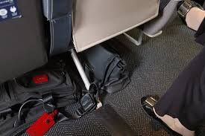
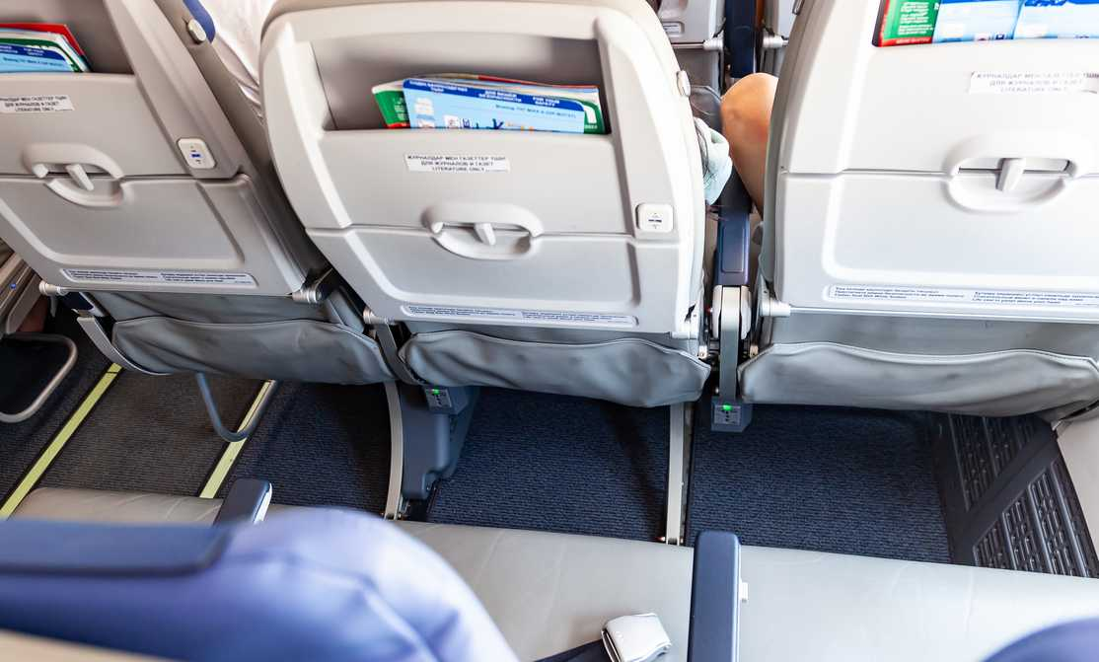
(b) Mass/weight limitations placarded on or adjacent to stowages do not have to be exceeded.
(c) Under a seat, stowages shall not be used unless the seat is equipped with a restraint bar and the baggage is of such size that it may adequately be restrained by this equipment.
(d) Items shall not be stowed in toilets or against bulkheads that are incapable of restraining articles against movement forwards, sideways or upwards and unless the bulkheads carry a placard specifying the greatest mass/weight that may be placed there.

Slide 40
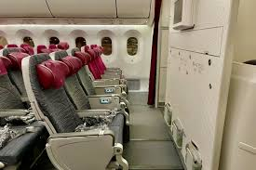
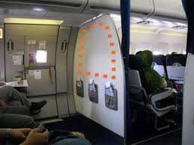
A bulkhead is a physical partition that divides a plane into different classes or sections. Typically, a bulkhead is a wall but can also be a curtain or screen. Bulkheads can be found throughout the plane, separating the seats from the galley(kitchen) and lavatory areas e.g toilet.

Slide 41
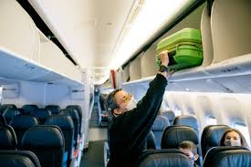
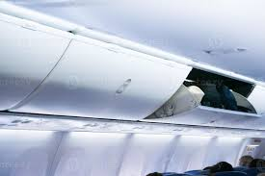
Baggage and cargo placed in lockers shall not be of such size that they prevent latched doors from being closed securely.
Baggage and cargo shall not be placed where it can impede access to emergency equipment.
Checks have to be made before take-off, before landing and whenever the fasten seat belts signs are illuminated or it is otherwise so ordered to ensure that baggage is stowed where it cannot impede evacuation from the aircraft or cause injury by falling or other movement, as may be appropriate to the phase of flight.

Slide 42
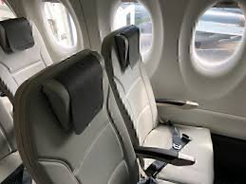
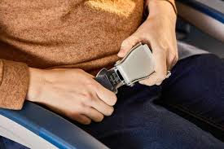
Passengers: Passenger seat belts
(1) A passenger occupying a seat or berth shall fasten his or her safety belt and keep it fastened while the sign is lighted or, in an aircraft not equipped with such a sign, whenever instructed.
(2) A passenger safety belt shall not be used by more than one occupant during take- off and landing.
(3) At each unoccupied seat, the safety belt and shoulder harness, where installed, shall be secured not to interfere with a crew member in the performance of his or her duties or with the rapid egress of occupants in an emergency.

Slide 43
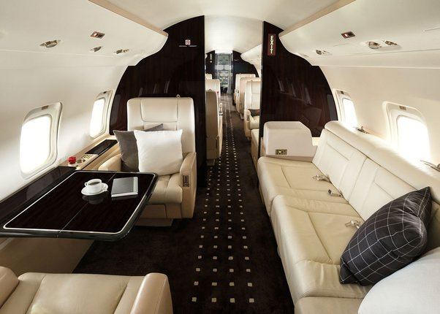
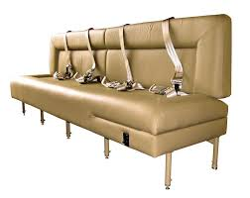
Passenger seat belt discussion continuation
(4) A person who is below two years of age may be held by an adult who is occupying a seat or berth.
(5) A berth, such as a multiple lounge or divan seat, may be occupied by two persons provided it is equipped with an approved safety belt for each person and is used during en route flight only.

Slide 44
Unacceptable conduct
a) Interfering with a crew member in the performance of his or her duties
(b) A passenger refusing to fasten his or her seat belt and keeping it fastened while the seat belt sign is lighted.
(c) Willfully, recklessly or negligently acting in a way that:
(i) endangers an aircraft or persons and property therein
(ii) causes or permits an aeroplane to endanger any person or property
(d) A passenger secreting himself or herself nor secreting cargo on board an aircraft.

Slide 45
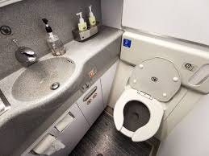
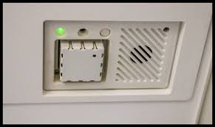
(e) Smoking while the no-smoking sign is lighted
(f) Smoking in any aircraft lavatory
(g) Tampering with, disabling or destroying any smoke detector installed in any aircraft lavatory
(h) Willingfully, recklessly or negligently imperil the safety of an aircraft or any person on board, whether by interference with any crew member, or by tampering with the aircraft or its equipment, or by disorderly conduct by any other means.

Slide 46
Alcohol or drugs
(1) An officer in charge shall not permit any person who appears to be intoxicated or who demonstrates, by manner or physical indications, that that he or she is intoxicated to—
(a) board an aircraft; or
(b) while on board the aircraft be served alcohol.
(2) A person(Passenger) shall not—
(a) board an aircraft while under the influence of drugs; or
(b) while on board the aircraft, be intoxicated or under the influence of drugs.

Slide 47
Carriage of munitions of war
A person shall not take on board an aircraft any goods that are munitions of war.
NB: Where the weapons or ammunition may, under the law of the State in which the aircraft is registered, be lawfully taken or carried on board for the purpose of ensuring the safety of the aircraft or of the persons on board, then the weapons may be carried.

Slide 48
Offences and penalties

Slide 49
Offences on board the aircraft
Assaults, harassments, intimidations or threats to a crew member or passenger whether physically or verbally, if the act interferes with the performance of or lessens the ability of the crew member to perform his or her duties.
Disobeying a lawful instruction given by the aircraft Pilot-in-command or on behalf of the aircraft Plot-in-command by a crew member, for the purpose of ensuring the safety of the aircraft or of any person or property on board or for the purpose of maintaining good order and discipline on board

Slide 50
Offences on board the aircraft discussion continued
Unlawfully seizing an aircraft in flight or on the ground
Using an aircraft for the purpose of causing death, serious bodily injury, or serious damage to property or the environment.
Commiting an act of violence e.g fighting against a person on board an aircraft in flight, if that act is likely to endanger the safety of that aircraft
NB: Penalty is a fine not exceeding one hundred seventy five currency points or a term of imprisonment not exceeding six years on conviction.

Slide 51
Offences jeopardising good order and discipline on board aircraft
Engaging in an act of physical violence against a person, sexual assault or child molestation.
Assaulting, intimidating or threatening another person, whether physically or verbally.
Intentionally causing damage to or destroying property.
Consuming alcoholic beverages or drugs resulting in intoxication
Engaging in a disorderly conduct including but not limited to, becoming a public nuisance or exhibiting unruly behaviour.
Operating a portable electronic device when such act is prohibited

Slide 52
Jurisdiction of the offences
Uganda shall have jurisdiction over any act constituting an offence if the act took place on board
a) the aircraft registered in Uganda;
(b) an aircraft leased, with or without crew, to a lessee whose principal place of business is in Uganda or, if the lessee does not have a principal place of business, whose permanent residence is in Uganda;
(c) the aircraft on or over the territory of Uganda

Slide 53
(d) any other aircraft in flight outside Uganda, if the next landing of the aircraft is in Uganda, and the Pilot-In-Command has —
(i) delivered the suspected offender to the competent authorities in accordance with regulation 80 (3);
(ii) requested Uganda to prosecute the suspected offender; and
(iii) affirmed that no similar request has been or will be made by the Pilot-In-Command or the aircraft operator to any other contracting State.

Slide 54
TAKE HOME ASSIGNMENT
In groups of four(4), please visit the Civil Aviation (Security) Regulations, 2022 and discuss the regulations on:
Part VI—Facilitation
57. Entry and departure procedures and responsibilities
61. Inadmissible persons
62. Deportees
Part VII—Offences and Penalties
66. Offences committed at airports

Slide 55
THE END

