Slide 1
Network Protocols and communications
By Namuwaya Hajarah

Slide 2
What is a network protocol?
Network protocols are fundamental rules that govern data exchange between devices on a network.
They define how information is formatted, transmitted, and received, ensuring seamless communication.
Network protocols are standardized rules that govern how data is transmitted and received across a network. These protocols ensure proper communication between devices on a network
To successfully send and receive information, devices on both sides of a communication exchange must accept and follow protocol conventions

Slide 3
Importance of network protocols..
They provide a common language for different devices and systems to communicate
ensuree data is transmitted accurately and efficiently.

Slide 4
Types of Network Protocols
Network communication protocols. The formats and regulations that govern how data is exchanged between networks are formally described by these protocols. This applies to both hardware and software and is a requirement for communicating between computing systems and telecommunication systems. In addition to handling syntax, synchronization and semantic requirements that both analog and digital communications must meet to work, communication protocols also handle authentication and error detection. HTTP, UDP, TCP and Internet Relay Chat are network communication protocols.
Network management protocols. To ensure steady communication and optimal performance throughout the network, network management protocols help specify the policies and processes needed to monitor, administer and maintain a computer network. They also assist in communicating these demands across the network. Simple Network Management Protocol (SNMP) and ICMP are network management protocols.
Network security protocols. The primary responsibility of network security protocols is to ensure that the data in transit over the network connections are kept safe and secure. These protocols also specify how the network protects data from any unauthorized efforts to inspect or extract it. This ensures that unauthorized users, services or devices don't have access to the network. Protocols such as Secure Sockets Layer (SSL), Secure FTP and HTTP Secure (HTTPS) operate at this level.
https://youtu.be/znIjk-7ZuqI

Slide 5
Examples of Network Protocols
Transmission Control Protocol (TCP):
Function: Ensures reliable transmission of data by establishing a connection and verifying that all packets reach their destination.
Use Case: Commonly used in web browsing, email, and file transfers.
Internet Protocol (IP):
Function: Routes data packets to their destination based on IP addresses.
Use Case: Forms the backbone of the internet, directing traffic to the correct network.
User Datagram Protocol (UDP):
Function: Allows fast, connectionless data transfer without ensuring all packets are received.
Use Case: Suitable for applications like video streaming or online gaming, where speed is critical.

Slide 6
Examples of Network Protocols cont”
HyperText Transfer Protocol (HTTP/HTTPS):
Function: Governs the transfer of web pages on the internet.
Use Case: Used by web browsers to request and display web pages.
File Transfer Protocol (FTP):
Function: Facilitates the transfer of files between a client and a server.
Use Case: Used for uploading or downloading files to/from a server.
Dynamic Host Configuration Protocol (DHCP):
Function: Automatically assigns IP addresses to devices on a network.
Use Case: Used in networks to ensure each device has a unique IP address without manual configuration.
Domain Name System (DNS):
Function: Translates human-readable domain names into IP addresses.
Use Case: Enables users to access websites using domain names instead of numerical IP addresses.

Slide 7
Examples of Network Security Protocols
Secure Sockets Layer (SSL)/Transport Layer Security (TLS):
Function: Encrypts data transmitted over the internet to ensure secure communication.
Use Case: Commonly used in HTTPS for secure web browsing.
IPSec (Internet Protocol Security):
Function: Secures IP communications by authenticating and encrypting each IP packet.
Use Case: Used in VPNs to secure communications over public networks.
SSH (Secure Shell):
Function: Provides a secure channel over an unsecured network for command-line operations and file transfers.
Use Case: Used for secure remote login to a computer.

Slide 8
Examples of network protocol uses
Some specific examples of network protocols and their uses are the following:
Post Office Protocol 3, or POP3, is the most recent version of a standard protocol that is used for receiving incoming emails.
SMTP is used to send and distribute outgoing emails.
FTP is used to transfer files from one machine to another. The files can be multimedia files, program files, text files and documents.
Telnet is a collection of rules used to connect one system to another via a remote login. The local computer sends the request for connection, and the remote computer accepts the connection.
HTTPS is a common protocol used to protect communication between two computers, one of which is using a browser and the other of which is downloading data from a web server.
Gopher is a set of rules used to search for, get hold of and display documents from remote sites. Gopher operates according to the client-server model.

Slide 9
Common Network Protocol Issues
Latency: Delay in data transmission, which can affect real-time communications.
Packet Loss: Occurs when data packets are lost during transmission, leading to incomplete data.
Congestion: Overloading of network resources, causing slow data transmission and packet loss.
Security Vulnerabilities: Risks such as data interception, unauthorized access, and protocol exploitation.

Slide 10
communication protocol
A communication protocol is a set of rules and conventions that define how data is transmitted and received between devices over a network.
These rules ensure that devices with different hardware and software configurations can communicate with each other in a standardized way.
Communication protocols specify how data is packaged, transmitted, error-checked, and interpreted at the receiving end, enabling reliable and accurate data exchange.
Communication protocols allow different network devices to communicate with each other.
They are used in both analog and digital communications and can be used for important processes, ranging from transferring files between devices to accessing the internet.

Slide 11
Common types of communication protocols include the following:
Automation: These protocols are used to automate different processes in both commercial and personal settings, such as in smart buildings, cloud technology or self-driving vehicles.
Instant messaging: Instantaneous, text-based communications on smartphones and computers occur because of a number of different instant messaging network protocols.
Routing: Routing protocols permit communication between routers and other network devices. There are also routing protocols specifically for ad hoc networks.
Bluetooth: Ever-popular Bluetooth devices — including headsets, smartphones and computers — work due to a variety of different Bluetooth protocols.
File transfer: If you have ever moved files from one device to another, either via a physical or digital medium, you’ve used file transfer protocols (FTP).
Internet Protocol: Internet Protocol (IP) allows data to be sent between devices via the internet. The internet could not operate as it currently does without IP.

Slide 12
Network Protocols in Action
Network protocols work together seamlessly to enable the smooth flow of data across the network.
Request
Transmission
Delivery
When a user sends a request, such as browsing a webpage, the Application layer prepares the request data.
The data is passed through each layer of the OSI model, being encapsulated and formatted at each stage.
The data reaches the destination server, where it is processed and a response is sent back to the user.

Slide 13
Benefits of Network Protocols
Network protocols provide a standardized framework for communication, ensuring interoperability and seamless data exchange.
Interoperability
Reliability
Efficiency
Security
Different devices can communicate with each other, regardless of their hardware or software.
Data is delivered accurately and without errors, ensuring the integrity of information.
Data is transmitted effectively, minimizing delays and optimizing network performance.
Protocols can incorporate security measures to protect data from unauthorized access or tampering.

Slide 14
The Reference Model
The OSI (Open Systems Interconnection) model is a conceptual framework used to understand and standardize the functions of a telecommunication or computing system.
It divides the process of communication between two networked systems into seven distinct layers
Physical Layer
Data Link Layer
Network Layer
Deals with the physical transmission and reception of raw data streams over a physical medium , such as the electrical signals used over cables or the radio waves used in wireless networks.
It defines the hardware elements, such as cables, switches, and network interface cards (NICs).
Protocols/Standards: Ethernet (IEEE 802.3), USB, Bluetooth, DSL
Provides error detection and correction mechanisms, as well as data framing, allowing for reliable data transmission between adjacent network nodes. from the physical layer
It structures the data into frames and handles the physical addressing (MAC addresses).
Sub-layers:
MAC (Media Access Control)
LLC (Logical Link Control):
Protocols/Standards: Ethernet, Wi-Fi (IEEE 802.11), PPP , ARP
Responsible for addressing and routing data packets across the network, ensuring that data reaches its intended destination.
Manages the routing of data from the source to the destination through the most efficient path. It handles logical addressing (IP addresses) and path determination
Protocols/Standards:
IP (Internet Protocol), ICMP (Internet Control Message Protocol), IPsec (Internet Protocol Security

Slide 15
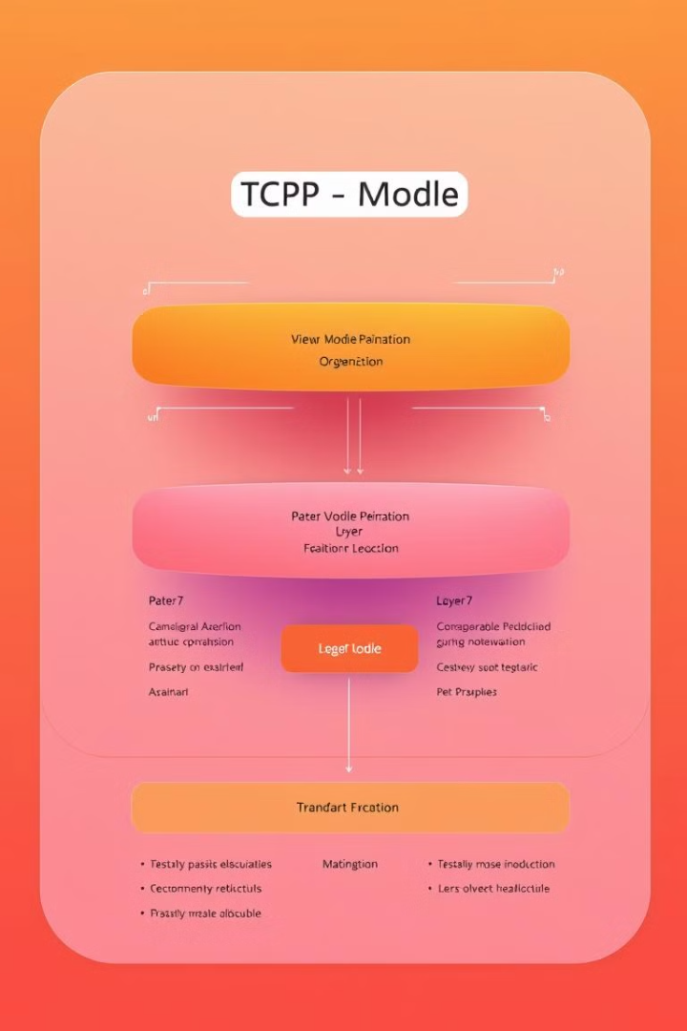
Transport Layer
The Transport layer is responsible for providing a reliable and ordered delivery of data between applications on different hosts.
Ensures complete data transfer with reliability, flow control, and error checking. It segments and reassembles data and ensures that it is delivered error-free, in sequence, and without losses or duplications
1
TCP
Transmission Control Protocol (TCP) is a connection-oriented protocol that provides reliable data delivery, ensuring that all data is received in the correct order and without errors.
2
UDP
User Datagram Protocol (UDP) is a connectionless protocol that prioritizes speed over reliability. It is often used for real-time applications where data loss is acceptable, such as streaming video or audio.
Protocols/Standards: TCP (Transmission Control Protocol), UDP (User Datagram Protocol), SCTP (Stream Control Transmission Protocol)

Slide 16
TCP and UDP
TCP and UDP are two widely used transport layer protocols, each offering different characteristics for data transmission.
1
TCP
2
UDP
A connection-oriented protocol, providing reliable data delivery with error checking and flow control.
A connectionless protocol, offering faster data transmission but with no guarantees of delivery or order.

Slide 17
Session Layer
The Session layer establishes, coordinates, and terminates conversations between applications on different hosts.
1
Session Establishment
The Session layer sets up the communication channel between two applications.
2
Data Exchange
Data is transmitted between the applications, with the Session layer managing the communication flow.
3
Session Termination
The Session layer gracefully closes the communication channel, releasing resources.
Protocols/Standards: NetBIOS, RPC (Remote Procedure Call), PPTP (Point-to-Point Tunneling Protocol)

Slide 18
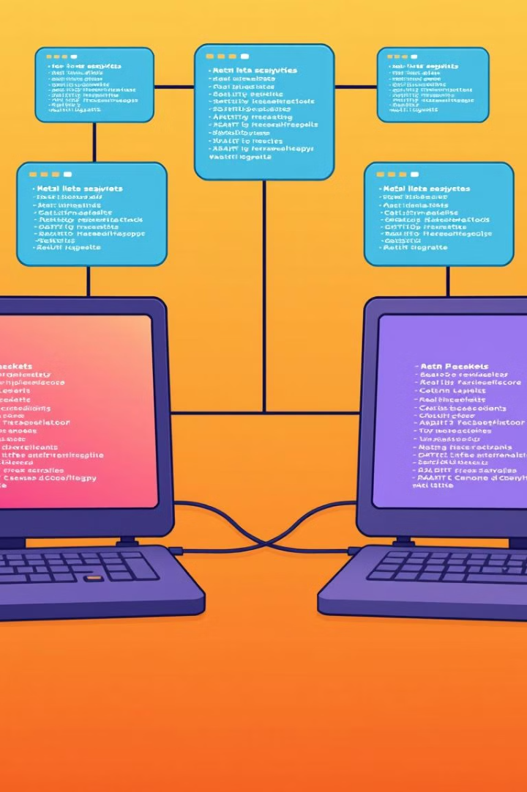
Presentation Layer
The Presentation layer ensures that data is presented in a format that both the sender and receiver can understand.
Translates data between the application layer and the network. It ensures that the data is in a usable format and handles data encryption, compression, and translation.
Function
Example
Data Encryption
Securely transmitting sensitive information.
Data Compression
Reducing the size of data packets to improve transmission efficiency.
Data Conversion
Converting data from one format to another, such as from ASCII to Unicode.
Protocols/Standards: SSL/TLS (Secure Sockets Layer/Transport Layer Security), JPEG, GIF, MPEG

Slide 19
Application Layer
The Application layer provides services to end users, such as email, web browsing, and file sharing. It is the layer that users directly interact with.
HTTP
Hypertext Transfer Protocol (HTTP) is used for transferring web pages and other web-related data.
SMTP
Simple Mail Transfer Protocol (SMTP) is used for sending and receiving email messages.
FTP
File Transfer Protocol (FTP) is used for transferring files
between computers.

Slide 20
The OSI Model
1
Physical Layer
Handles the transmission of raw data signals over the physical medium, including cables and wireless signals.
2
Data Link Layer
Ensures error-free data transfer between nodes on a network segment, managing frame formatting and error detection.
3
Network Layer
Provides logical addressing and routing of data packets across networks, enabling communication between devices on different segments.
Transport Layer
The Open Systems Interconnection (OSI) model is a conceptual framework that divides network communication into seven layers.
4
Manages end-to-end data delivery, ensuring reliable and ordered data flow between applications, including error control and flow control.
5
Session Layer
Establishes, coordinates, and terminates communication sessions between applications, managing dialogue control and synchronization.
6
Presentation Layer
Formats and translates data for presentation to applications, ensuring compatibility between different systems and formats.
7
Application Layer
Provides services for network applications, such as email, file transfer, and web browsing, interacting directly with user applications.

Slide 21
Let's go through a scenario where all layers of the OSI model work together to send an email from one computer to another over the internet:
Action A: You compose an email in your email client (e.g., Gmail, Outlook).
Action D: The email message, which may include text, attachments, or images, is formatted for transmission.
Action F: The session between your computer and the email server is established.
Action H: The email data is broken into smaller chunks (segments) to be sent over the network.
Action B: Each data packet is addressed and routed across the internet.
Action C: Data is prepared for transmission over the physical network.
Action G: The data is transmitted as electrical, light, or radio signals over the network medium.

Slide 22
TCP/IP Model
The Transmission Control Protocol/Internet Protocol (TCP/IP) model is a simplified version of the OSI model, commonly used in modern networks.
Application Layer
Transport Layer
Internet Layer
Network Access Layer
Provides network services for applications, such as web browsing, email, and file transfer.
Manages end-to-end data delivery, providing reliable and ordered data flow between applications, including TCP and UDP.
Handles logical addressing and routing of data packets across networks, using IP addresses and routing protocols.
Provides access to the physical network, including the physical and data link layers of the OSI model.

Slide 23
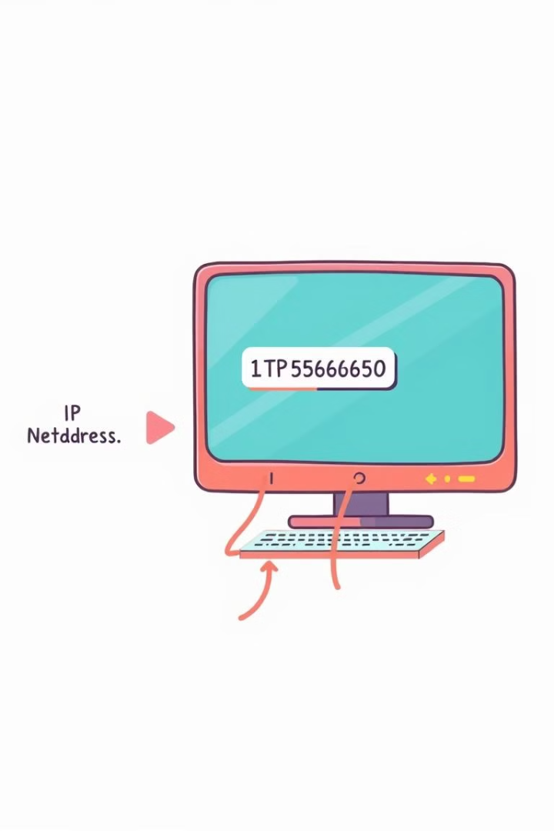
IP Addressing
IP addresses are unique identifiers assigned to devices on a network, allowing communication between them.
IPv4
A 32-bit addressing system, using four decimal numbers separated by dots, e.g., 192.168.1.1.
IPv6
A 128-bit addressing system, using hexadecimal numbers separated by colons, e.g., 2001:0db8:85a3:0000:0000:8a2e:0370:7334.
Subnet Mask
A mask used to differentiate network and host portions of an IP address, determining the network to which a device belongs.

Slide 24
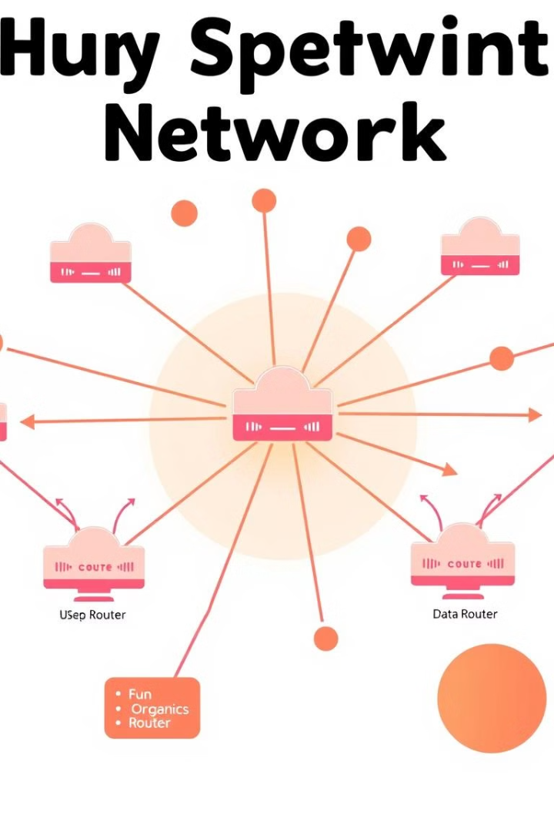
Routing Protocols
Routing protocols are algorithms used by routers to determine the best path for data packets to reach their destination.
RIP
Routing Information Protocol, a distance-vector protocol that broadcasts routing updates periodically.
OSPF
Open Shortest Path First, a link-state protocol that builds a map of the network and calculates shortest paths based on link costs.
BGP
Border Gateway Protocol, used for inter-domain routing, exchanging routing information between autonomous systems.

Slide 25
Network Security
Network security measures are implemented to protect networks and data from unauthorized access, threats, and vulnerabilities.
Firewalls
Act as barriers between a network and external threats, blocking unauthorized traffic based on predefined rules.
Encryption
Transforms data into an unreadable format, protecting sensitive information during transmission and storage.
Antivirus Software
Detects and removes malicious software, such as viruses, worms, and Trojans, protecting devices from attacks.
Intrusion Detection Systems
Monitor network traffic for suspicious activities and alert administrators of potential security breaches.

Slide 26
Network Monitoring
Network monitoring tools provide insights into network health, performance, and security, enabling proactive troubleshooting and optimization.
Metric
Description
Bandwidth Utilization
Amount of network bandwidth being used by traffic.
Latency
Time delay in data transmission between devices.
Packet Loss
Percentage of data packets that fail to reach their destination.
Security Events
Detection of suspicious activity or potential security breaches.

Slide 27
Conclusion
Network protocols are essential for modern communication, enabling seamless data exchange between devices and facilitating the interconnected world we live in.

