Slide 1
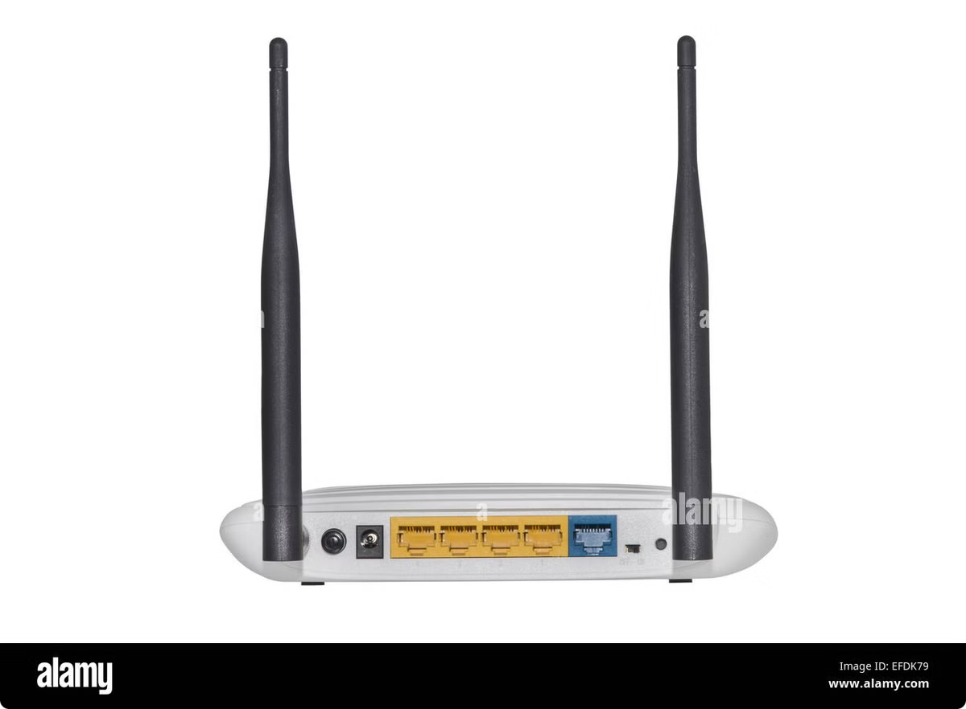
Router Configuration
This presentation provides a comprehensive guide to router configuration, outlining the essential steps for network administrators and IT professionals.
by Namuwaya Ali Hajarah

Slide 2
Router
A router is a networking device that forwards data packets between computer networks.
It directs traffic between devices on different networks based on their IP addresses.
Purpose of Routers:
Connects multiple networks (e.g., your home network and the internet).
Determines the best path for data to travel.
Translates between different network protocols (e.g., LAN to WAN).

Slide 3
Functions of a Router
Traffic Forwarding: Routes data from one network to another.
Security: Routers can filter traffic and offer basic security (via access control lists).
Network Address Translation (NAT): Allows multiple devices on a local network to share a single public IP address.
DHCP Server: Can assign IP addresses to devices on the network automatically.

Slide 4
Basic Router Components
Interfaces (Ports): Physical connections to other devices (e.g., Ethernet ports).
CPU and Memory: To process routing information and handle network protocols.
Operating System: Router runs on a specific OS (e.g., Cisco IOS) that allows you to configure it.
Note: Routers are like small computers designed for networking tasks.

Slide 5
Basic Router Configuration Overview
Step 1: Connect to the router (Console, SSH, or Telnet).
Step 2: Enter privileged EXEC mode (enable).
Step 3: Enter global configuration mode (configure terminal).
Step 4: Set basic parameters (hostname, passwords, banners, etc.).
Step 5: Configure interfaces (assign IP addresses, enable interfaces).
Step 6: Configure the default gateway (static routes).

Slide 6
Configure Initial Settings
The initial configuration process sets the foundation for the router's operation, including hostname, password, and time settings.
Hostname
A unique identifier for the router, facilitating network management.
Password
A strong password protects the router's configuration and access.
Time Settings
Ensures accurate time synchronization for network events and logs.

Slide 7
Configure Interfaces
Configuring router interfaces involves defining the physical and logical properties of each network connection, including IP addresses and subnet masks.
Physical Interfaces
Logical Interfaces
IP Addressing
Ethernet ports, wireless interfaces, or other connections that allow the router to connect to the network.
Virtual interfaces that represent specific network segments or services.
Assigning unique IP addresses to interfaces for communication and network segmentation.

Slide 8
Configure VLANs
Virtual Local Area Networks (VLANs) segregate network traffic based on user groups or network segments, enhancing security and efficiency.
1
VLAN Segmentation
Creating logical groups of devices within a network.
2
Traffic Isolation
Restricting communication between VLANs for security and network control.
3
Improved Performance
Optimizing network performance by reducing broadcast traffic.
4
Simplified Management
Managing network resources efficiently with a modular structure.

Slide 9
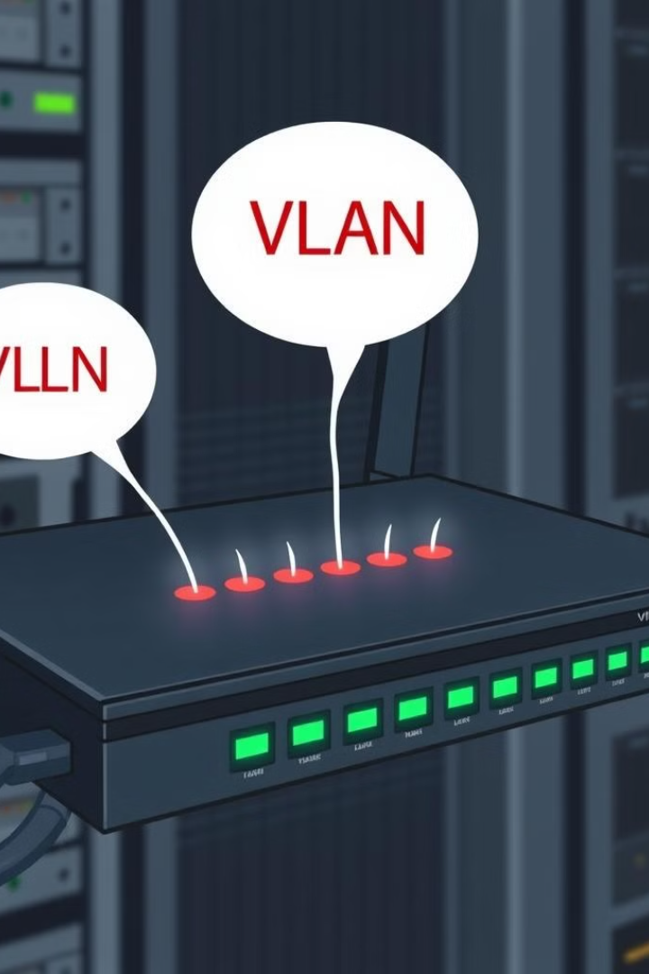
Configure Inter-VLAN Routing
Enabling inter-VLAN routing allows communication between different VLANs, facilitating network connectivity and resource sharing.
VLAN Routing
Setting up routes between VLANs to enable communication.
VLAN Trunking
Bundling multiple VLANs over a single physical link for efficiency.
Inter-VLAN Security
Implementing security policies to control traffic flow between VLANs.

Slide 10
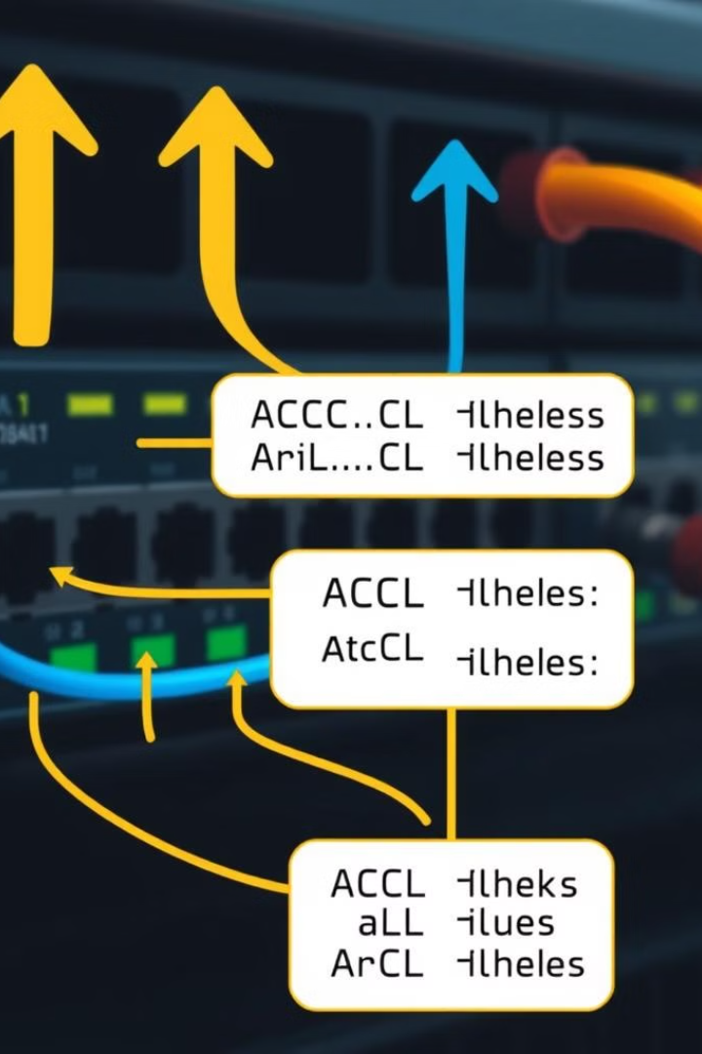
Configure Access Control Lists (ACLs)
Access Control Lists (ACLs) are security measures that filter network traffic based on defined rules, enhancing network security and limiting unauthorized access.
Type
Description
Standard ACLs
Filter traffic based on source IP address.
Extended ACLs
Filter traffic based on source and destination IP addresses, ports, and protocols.

Slide 11
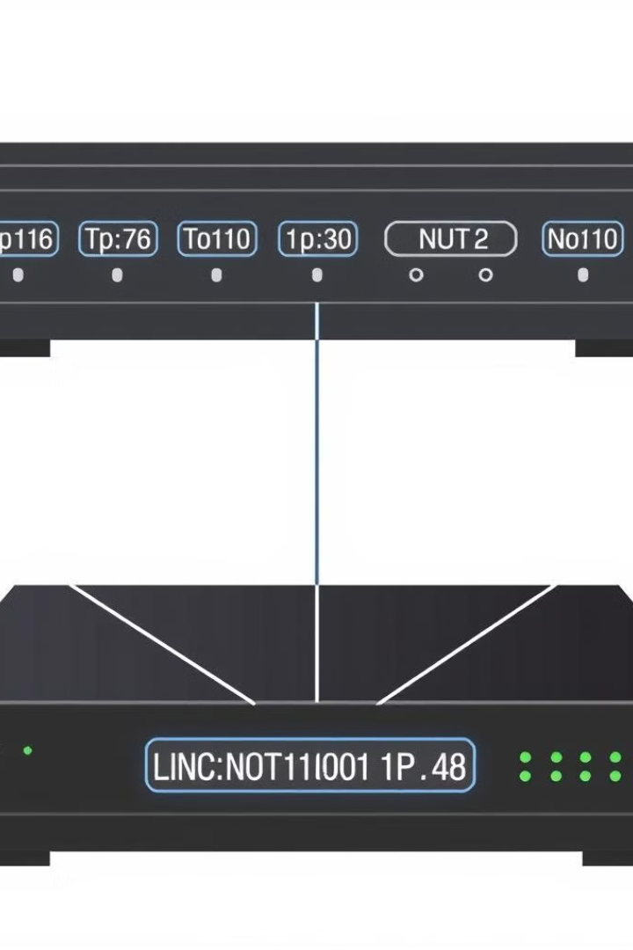
Configure NAT (Network Address Translation)
Network Address Translation (NAT) allows private networks to use a limited number of public IP addresses, conserving address space and improving network security.
Security Enhancement
NAT hides private network addresses from external threats.
Address Conservation
NAT enables multiple devices to share a single public IP address.
Internet Access
NAT allows private networks to access the internet.

Slide 12
Configure Routing Protocols
Routing protocols automate network routing, allowing routers to exchange network information and discover optimal paths for data transmission.
1
2
3
RIP (Routing Information Protocol)
OSPF (Open Shortest Path First)
BGP (Border Gateway Protocol)
A link-state routing protocol designed for large, complex networks.
A path-vector routing protocol commonly used for internet routing.
A distance-vector routing protocol suitable for small networks.

Slide 13
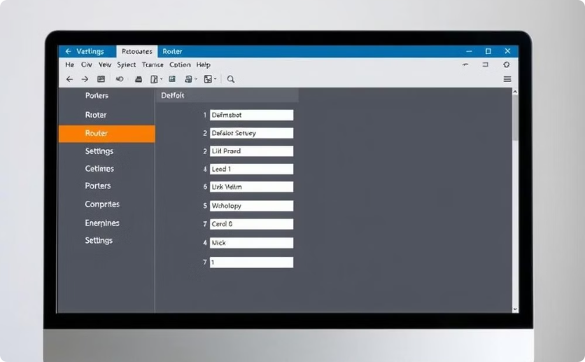
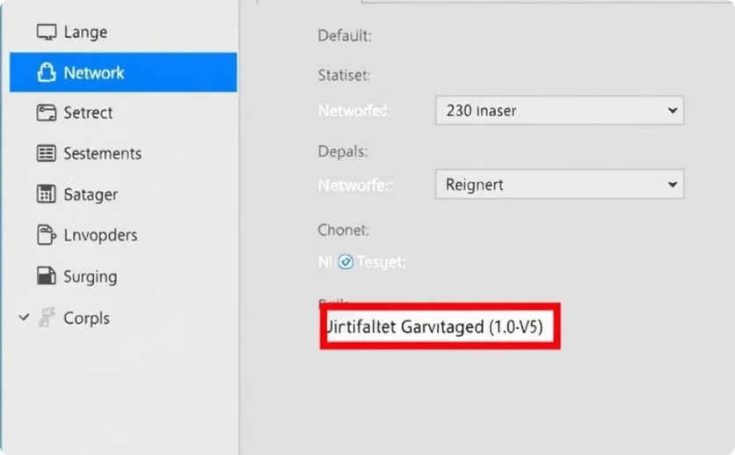
Configure the Default Gateway
The default gateway acts as a bridge between a local network and external networks, directing traffic that is not locally addressed.
Router Configuration
Device Settings
Configuring the default gateway address on the router interface.
Configuring the default gateway address on the connected devices.

Slide 14
Configuring Router Interfaces
Properly configuring router interfaces is a critical step in network setup. This process ensures reliable connectivity and efficient data flow across your network infrastructure.

Slide 15
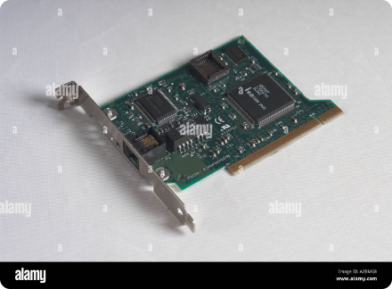
Assigning IP Addresses
1
IPv4 or IPv6
2
Static vs. Dynamic
3
Subnet Mask
Determine the appropriate IP protocol version for each interface based on network requirements.
Choose between manually assigning static IP addresses or using dynamic allocation protocols like DHCP.
Correctly configure the subnet mask to define the network and host portions of the IP address.

Slide 16
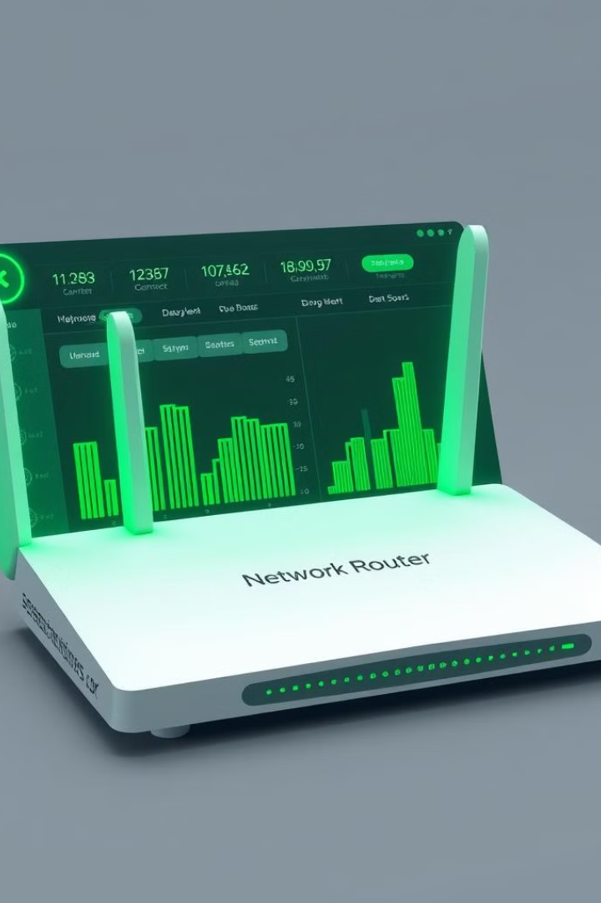
Enabling Interfaces
1
Physical Connection
Ensure the physical network cables are properly plugged into the router ports.
2
Administrative Status
Administratively enable the interface by setting its status to "up" in the configuration.
3
Operational Status
Verify the interface is in an operational "up" state and ready to pass network traffic.

Slide 17
Configuring Interface Parameters
Speed and Duplex
MTU
Description
Set the appropriate speed and duplex mode (half or full) to match the connected network equipment.
Adjust the Maximum Transmission Unit (MTU) size if required by the network topology.
Add a descriptive name or note to easily identify the purpose of each interface.

Slide 18
Configuring Interface Security
Access Control Lists
Port Security
Implement ACLs to control inbound and outbound traffic on the interface.
Enable port security to restrict the number of MAC addresses allowed on the interface.
DHCP Snooping
Storm Control
Configure DHCP snooping to prevent rogue DHCP servers from assigning unauthorized IP addresses.
Implement storm control to mitigate the impact of broadcast, multicast, or unknown unicast traffic storms.

Slide 19
Configuring Interface QoS
1
Priority Queuing
Configure priority queuing to ensure critical traffic is processed ahead of best-effort data.
2
Bandwidth Allocation
Assign bandwidth limits or minimum guarantees to control traffic flow on the interface.
3
Traffic Shaping
Implement traffic shaping to smooth out bursts and prevent interface congestion.

Slide 20
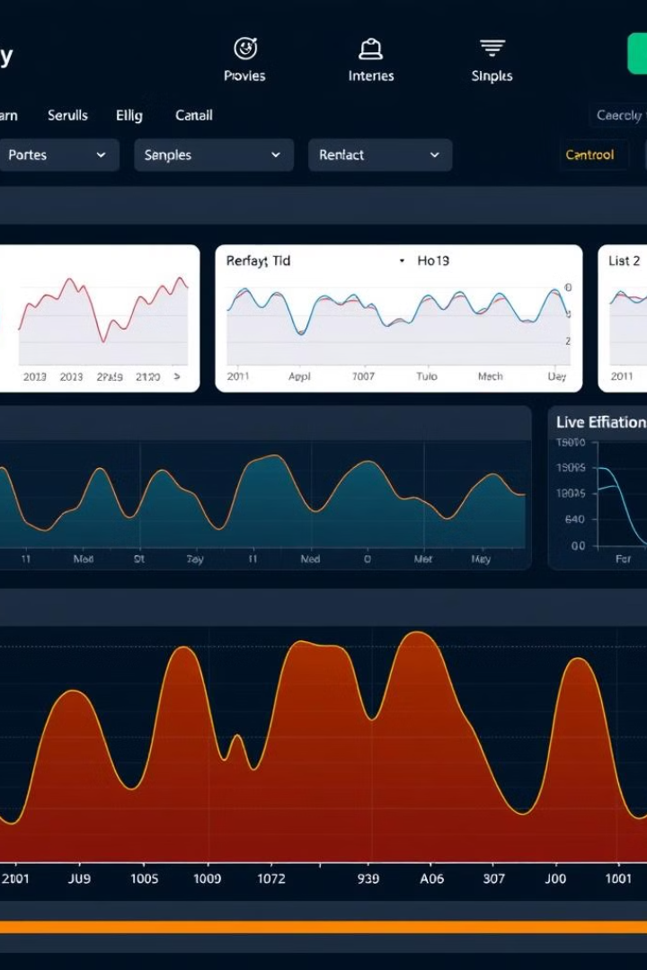
Monitoring Interface Status
Link Status
Monitor the physical link state to ensure the interface is up and connected.
Traffic Utilization
Track input and output traffic rates to identify high-usage interfaces.
Error Counters
Observe error and discarded packet counters to detect potential issues.
Availability
Monitor interface uptime and reliability to ensure consistent network connectivity.

Slide 21
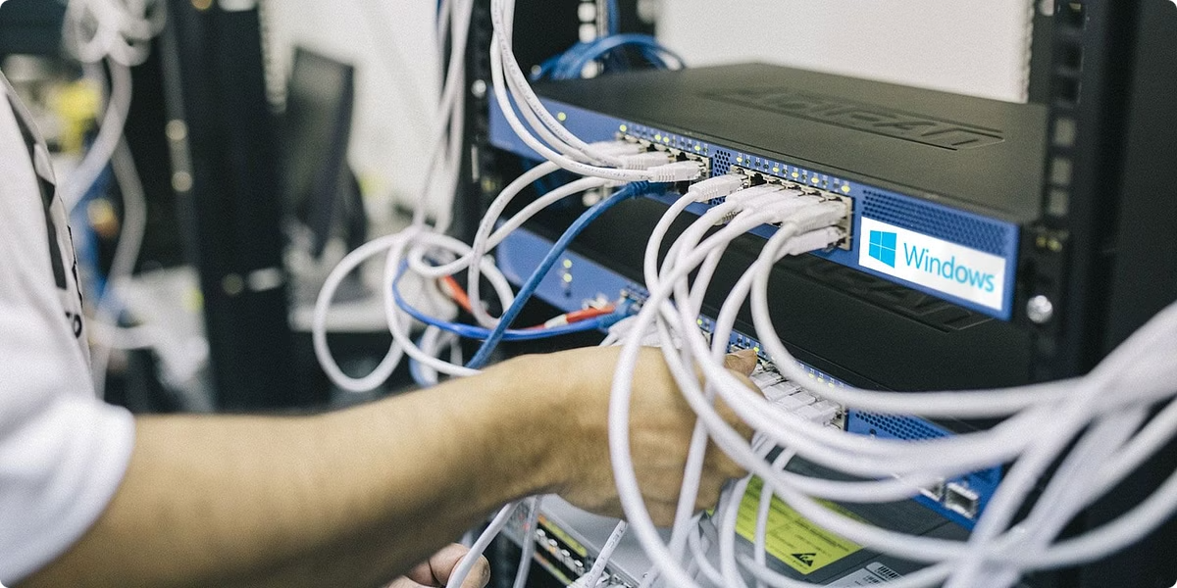
Interface Troubleshooting
Ping Tests
Perform ping tests to verify end-to-end IP connectivity through the interface.
Packet Captures
Capture and analyze interface traffic to identify issues like frame errors or drops.
Interface Resets
Reset the interface to recover from certain types of configuration or hardware faults.

Slide 22
Best Practices
Document Configuration
Maintain detailed records of all interface settings for future reference.
Automate Processes
Use scripts and templates to streamline interface configuration and changes.
Implement Redundancy
Leverage features like VRRP or HSRP to provide failover for critical interfaces.
Regularly Review
Periodically review interface configurations to ensure they remain optimal.

Slide 23
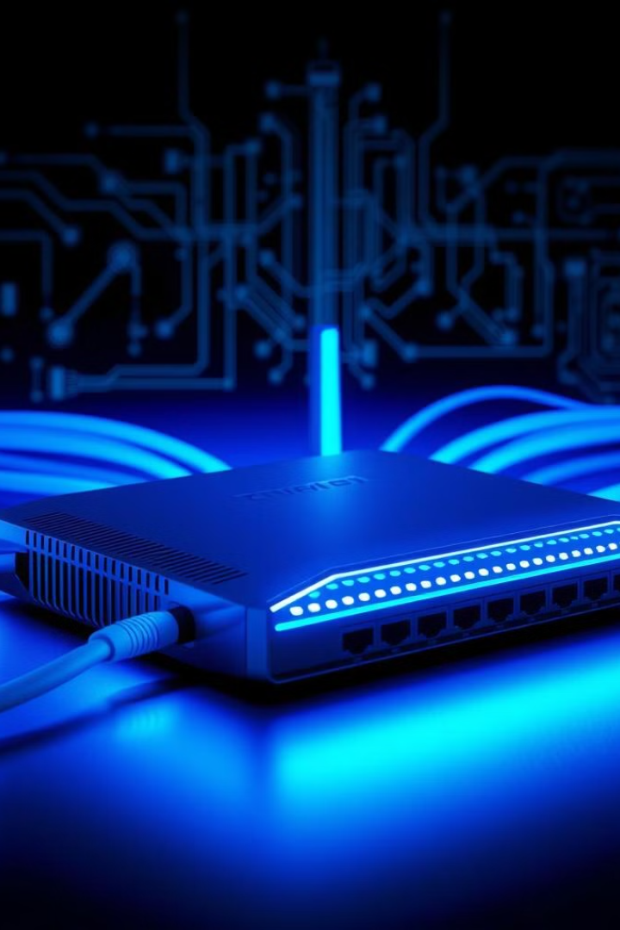
Configuring the Default Gateway
Properly setting the default gateway is crucial for network connectivity and internet access.

Slide 24
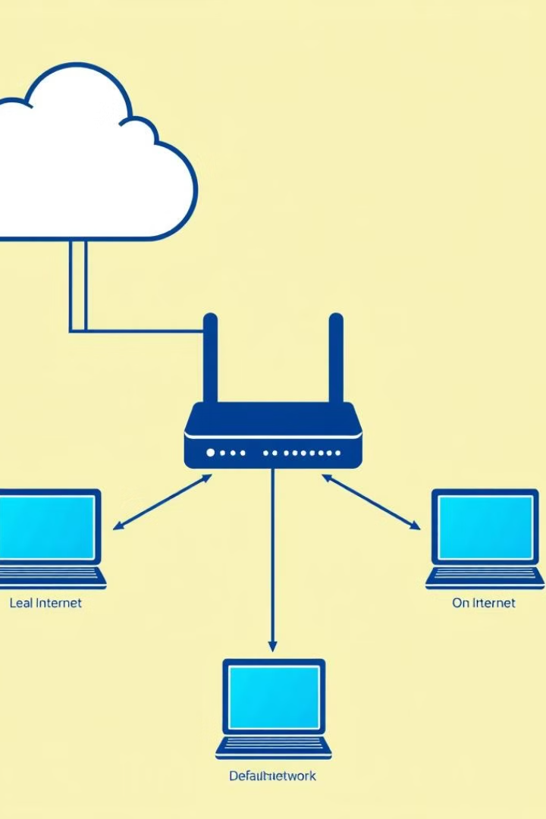
Understand the Default Gateway
1
Definition
The router that connects a local network to the internet.
2
Purpose
Provides the path for network traffic to reach external networks.
3
Importance
Ensures devices can communicate beyond the local network.

Slide 25
Locate Default Gateway Address
Windows
macOS/Linux
Routers
Use ipconfig command to find the gateway address.
Use the route or ip route show commands.
Check the router admin interface for the gateway.

Slide 26
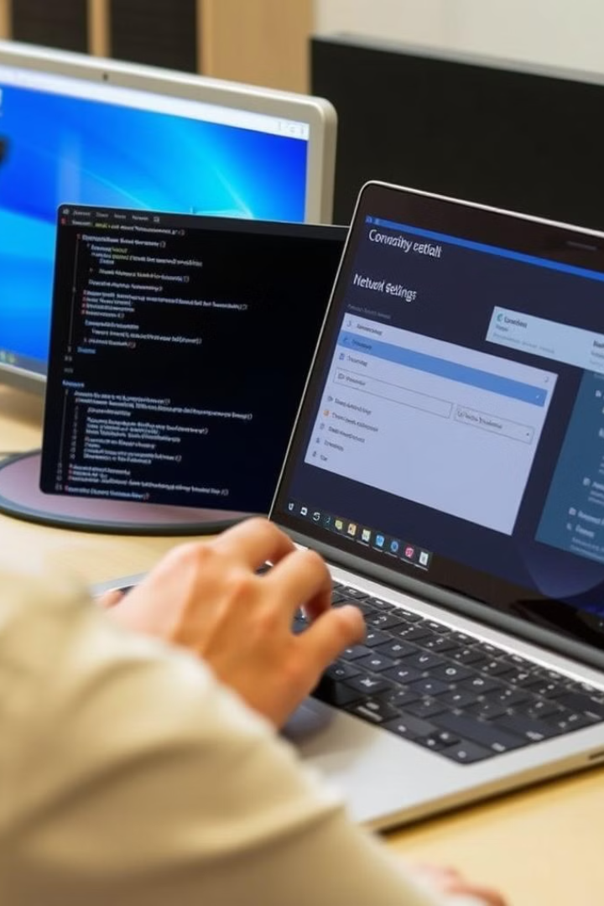
Set Default Gateway in OS
1
Windows
Use the netsh interface ip set route command.
2
macOS
Use the route add default command.
3
Linux
Edit the /etc/network/interfaces file.

Slide 27
Verify Gateway Configuration
Test Connectivity
Ping the gateway address to verify reachability.
Check Routes
Inspect the routing table for the default route.
Monitor Traffic
Use network diagnostic tools to observe traffic.

Slide 28
Update Gateway Settings
Change Gateway
Modify the default gateway address as needed.
Restart Network
Restart the network interface or reboot the system.
Retest Connectivity
Verify the new gateway is working correctly.

Slide 29
Troubleshoot Gateway Issues
Incorrect Address
Ensure the gateway IP is configured properly.
Connectivity Problems
Check physical network connections and settings.
Router Misconfiguration
Review the router's configuration for errors.

Slide 30
Best Practices for
configuring default gateways
Use a static gateway address
Avoids issues with DHCP lease expiration
Ensure redundant gateways
Provide failover for high availability
Update gateway regularly
Maintain compatibility with network changes

Slide 31
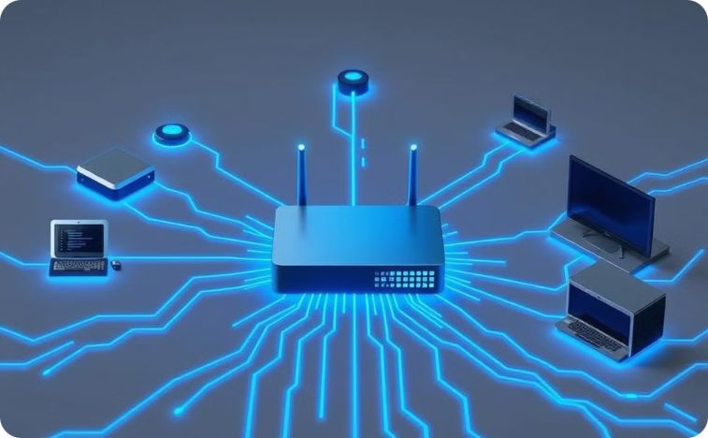
Conclusion
Reliable Connectivity
Proper default gateway setup ensures smooth network operations.
Configuring the default gateway is a fundamental network administration task that enables seamless internet access and communication beyond the local network.

