Slide 1
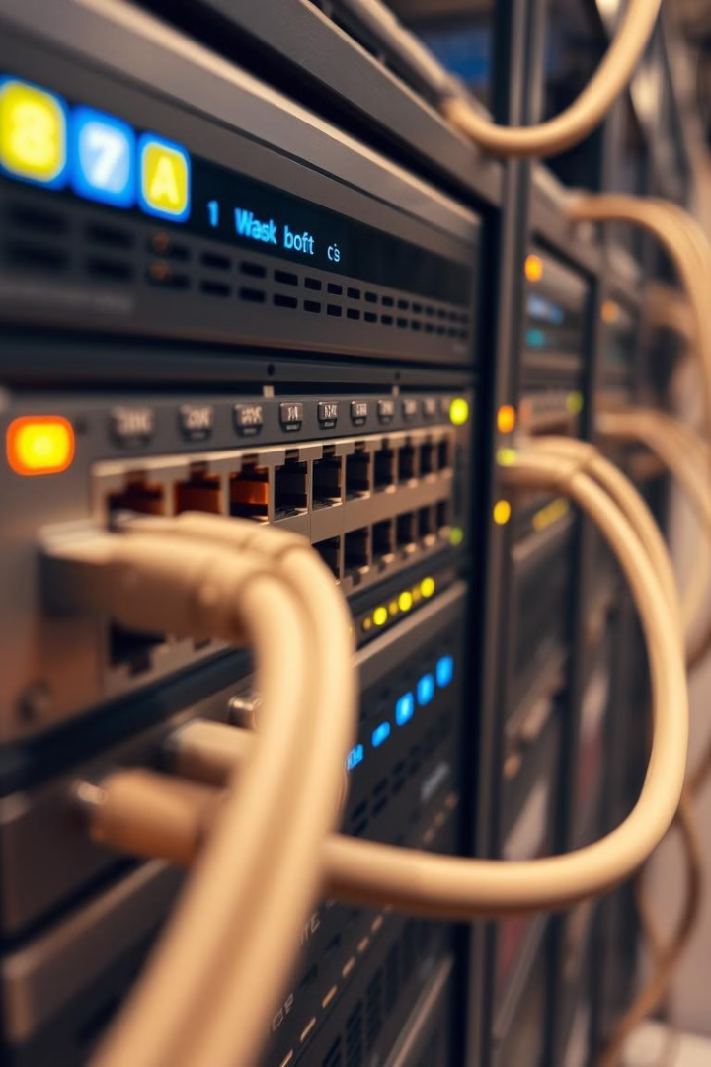
Ethernet and Switching: A Comprehensive Overview
Ethernet and switching are fundamental technologies in modern computer networks. They enable devices to communicate seamlessly within a local area network (LAN) and extend connectivity across larger networks. This presentation explores the intricacies of Ethernet and switching, delving into their history, key concepts, components, and practical applications. Understanding these technologies is essential for network engineers and IT professionals to design, troubleshoot, and optimize network performance.
by Namuwaya Hajarah

Slide 2
Introduction to Ethernet and Switching
Ethernet is the most widely used LAN technology.
Switching is a method used to direct data within a network.
Together, Ethernet and switching enable fast and efficient data communication.

Slide 3
What is Ethernet?
Ethernet is a networking technology that includes protocal, port, cable and computer chip needed to plug a desktop into a LAN for speedy data transmission via coaxial or fibre optic cablesEthernet is a networking technology for connecting devices in a LAN.
Operates at Layer 1 (Physical) and Layer 2 (Data Link) of the OSI Model.
Uses MAC addresses for device identification.
Common Ethernet speeds: 10 Mbps, 100 Mbps, 1 Gbps, 10 Gbps.
Ethernet Standards
10Base-T: 10 Mbps over twisted-pair cables.
100Base-T: Fast Ethernet, 100 Mbps.
1000Base-T: Gigabit Ethernet, 1 Gbps.
10GBase-SR: 10 Gbps over fiber optic cables.

Slide 4
How does Ethernet work?
It employs a star and linear bus topology on both the physical and data link layer,
Divides the data connection in two distinct layers;
Logical link control(LLC)
Medium access control(MAC)
Ethernet employs a mechanism called Carrier Sense Multiple Access/CD
It transmits data using two components;
Frames and packets
Frames contain sent pay load, both MAC and physical address f both the sender and recipient
Error correction data and information on VLAN
Each frame is encapsulated in packets that comprise of many bytes of data to set up connection and determine the path

Slide 5
Why is Ethernet?
The reason behind its wide usability is that Ethernet is:
Easy to understand, implement, and maintain.
Allows low-cost network implementation.
Ethernet offers flexibility in terms of the topologies that are allowed.
Ethernet generally uses a bus topology

Slide 6
Key Features of Ethernet
Speed & Flexibility
Reliability
Cost-effectiveness
Interoperability
Security
Manageability & Compatibility
Availability & Simplicity
Standardization
Scalability
Broad compatibility
Ease of integration
Ease of troubleshooting

Slide 8
What are the advantages of Ethernet?
high data transfer speeds
low latency
scalability
widespread compatibility.
It provides a stable and reliable network connection
etc

Slide 9
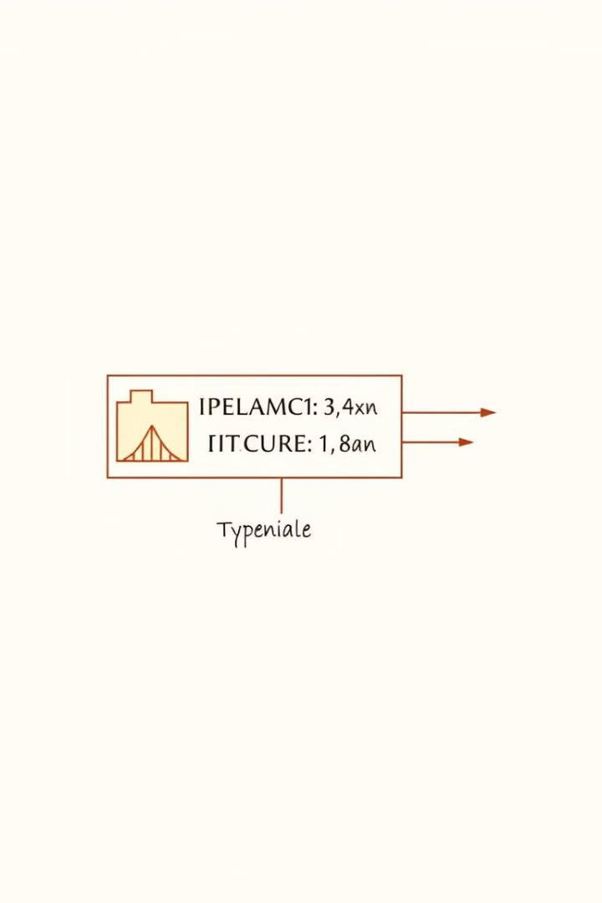
Ethernet Data Frames Structure
Field
Description
Preamble
Synchronization sequence for the receiver
Destination MAC Address
Unique identifier of the receiving device
Source MAC Address
Unique identifier of the sending device
Type Field
Indicates the protocol encapsulated in the payload
Payload
Actual data being transmitted
CRC
Error detection code to ensure data integrity

Slide 10
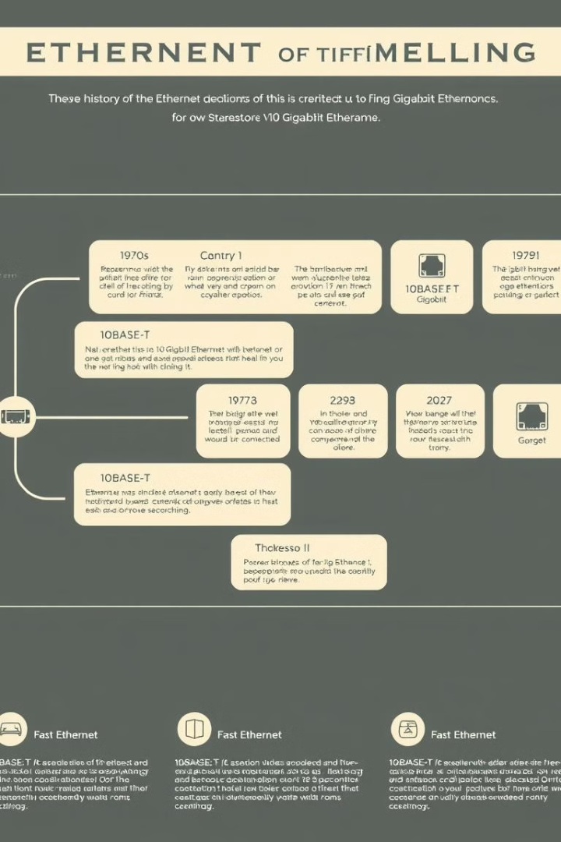
The Evolution of Ethernet
1
Early Ethernet (1970s)
The original Ethernet standard, developed at Xerox PARC, used coaxial cable and operated at 2.94 Mbps. It laid the foundation for modern Ethernet technology.
2
10BASE-T (1980s)
The introduction of twisted-pair cabling and the 10BASE-T standard enabled more affordable and flexible Ethernet deployments, marking a significant shift in network infrastructure.
3
Fast Ethernet and Gigabit Ethernet (1990s-2000s)
The evolution continued with Fast Ethernet (100 Mbps) and Gigabit Ethernet (1 Gbps), meeting the growing demand for higher bandwidth and data transfer rates.
4
10 Gigabit Ethernet and Beyond (2000s-Present)
Ethernet technology has continued to evolve, with the advent of 10 Gigabit Ethernet (10 Gbps), 40 Gigabit Ethernet (40 Gbps), and even higher speeds, catering to the ever-increasing bandwidth requirements of modern networks.

Slide 11
Ethernet Physical Layer
Cable Types
Connectors
Standards
Ethernet networks utilize various cable types, including twisted-pair (UTP), shielded twisted-pair (STP), and fiber optic cables. Each type offers different performance characteristics and cost considerations.
Ethernet cables typically employ RJ-45 connectors, which are standardized and ensure interoperability between different devices and network components.
Ethernet standards, such as 10BASE-T, 100BASE-TX, and 1000BASE-T, define the physical layer specifications, including cable types, connector types, and data transmission rates.

Slide 13
Introduction to Switching
Switching is the process of transferring data packets from one device to another in a network, or from one network to another, using specific devices called switches.
A switch is a networking device that connects devices within a LAN. A switch is a hardware device in a network that connects other devices, like computers and servers.
Operates at Layer 2 (Data Link) of the OSI Model.
Directs data packets based on MAC addresses.
Improves network efficiency by sending data only to the intended device.

Slide 14
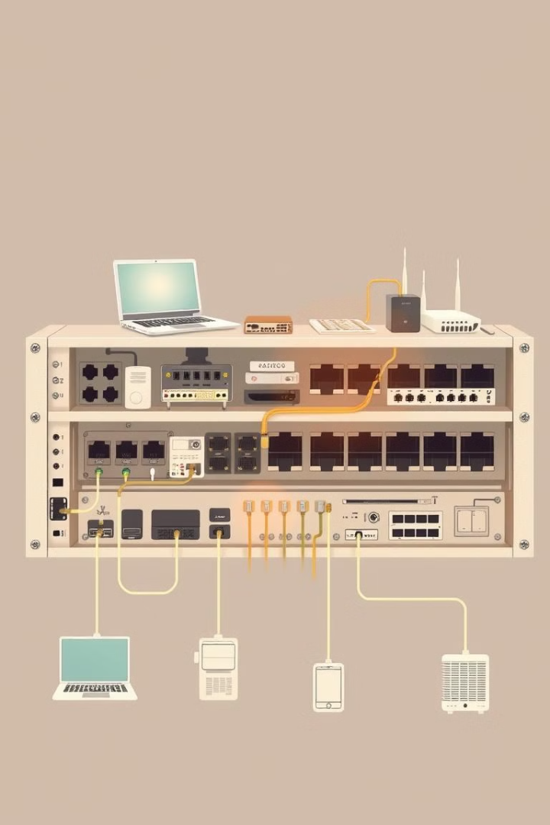
Network Switches
1
Centralized Hub
Network switches act as centralized hubs within a network, connecting multiple devices and facilitating communication between them.
2
MAC Address Table
Switches maintain a MAC address table, which maps MAC addresses to connected ports, enabling efficient data forwarding.
3
Collision Avoidance
Switches eliminate collisions by preventing multiple devices from transmitting data simultaneously on the same shared medium, enhancing network performance.
4
VLAN Support
Switches often support VLANs (Virtual Local Area Networks), allowing for network segmentation and isolation, enhancing security and network management.

Slide 15
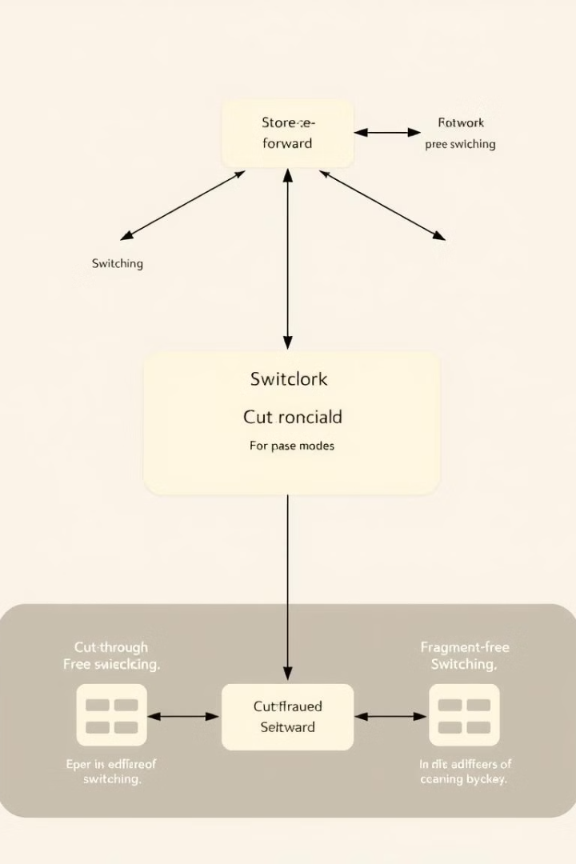
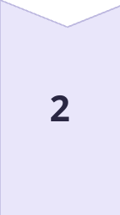
Switching Modes/Types of Switching
Store-and-Forward
In store-and-forward switching, the entire frame is received and checked for errors before forwarding, ensuring data integrity but potentially increasing latency. Stores the entire packet, checks for errors, then forwards it.
Cut-Through
Cut-through switching forwards frames as soon as the destination MAC address is received, minimizing latency but potentially forwarding corrupted frames. Forwards packets as soon as the destination MAC address is read.
Fragment-Free
Fragment-free switching balances performance and error detection by forwarding frames after receiving the first few bytes, ensuring the frame is complete before forwarding. Stores the first 64 bytes, then forwards to avoid collisions.

Slide 16
Process of Switching
Frame Reception: The switch receives a data frame or packet from a computer connected to its ports.
MAC Address Extraction: The switch reads the header of the data frame and collects the destination MAC Address from it.
MAC Address Table Lookup: Once the switch has retrieved the MAC Address, it performs a lookup in its Switching table to find a port that leads to the MAC Address of the data frame.
Forwarding Decision and Switching Table Update: If the switch matches the destination MAC Address of the frame to the MAC address in its switching table, it forwards the data frame to the respective port. However, if the destination MAC Address does not exist in its forwarding table, it follows the flooding process, in which it sends the data frame to all its ports except the one it came from and records all the MAC Addresses to which the frame was delivered. This way, the switch finds the new MAC Address and updates its forwarding table.
Frame Transition: Once the destination port is found, the switch sends the data frame to that port and forwards it to its target computer/network

Slide 17
MAC Address Table
Switches use a MAC address table to track the location of devices.
The table maps MAC addresses to specific switch ports.
This allows the switch to forward data only to the correct destination.

Slide 18
Layer 2 Networking
MAC Addressing
Switching
Physical Layer Interface
Inter-Network Communication
Layer 2 operates at the data link layer, responsible for MAC addressing, framing, and error detection, providing reliable data transmission between devices on a local network.
Switches operate at Layer 2, making forwarding decisions based on MAC addresses, facilitating efficient data transfer between connected devices.
Layer 2 interacts with the physical layer, handling the transmission of data frames over physical media like cables or wireless connections.
Layer 2 provides a foundation for inter-network communication, where routers operate at Layer 3 to connect different networks and route traffic between them.

Slide 19
VLAN (Virtual Local Area Network) & VLAN Configuration
Introduction to VLANs
VLANs allow network segmentation on a switch.
A VLAN creates multiple logical networks on a single physical network.
Improves security and reduces broadcast traffic.
VLANs are identified by a VLAN ID (e.g., VLAN 10 for Marketing).
Ports are assigned to VLANs based on their function or location.
Trunk ports carry traffic for multiple VLANs between switches.

Slide 20
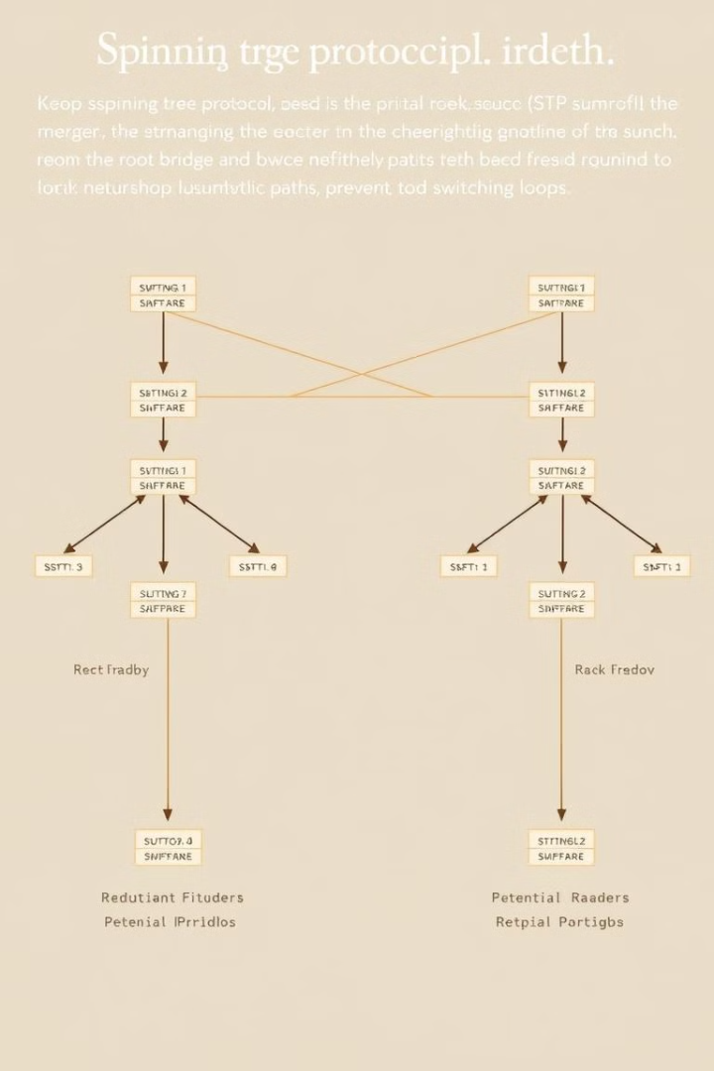
Spanning Tree Protocol (STP)
Loop Prevention
STP prevents network loops by blocking redundant paths, ensuring that data follows a single, consistent path, eliminating broadcast storms and network instability.
Root Bridge Election
STP elects a root bridge, which becomes the central point for network traffic forwarding, ensuring consistent path selection across the network.
Path Blocking
STP designates certain ports as blocked, preventing traffic from traversing those paths, preventing loops and ensuring proper data flow.

Slide 21
Collision Domains and Broadcast Domains
Collision Domain: A network segment where data collisions can occur.
Broadcast Domain: A network segment where all devices receive broadcast messages.
Switches reduce collision domains but not broadcast domains (without VLANs).

