Slide 1
GREEN SUPPLY CHAIN MANAGEMENT

Slide 2
What is Supply Chain management?
Supply chain management (SCM) is the oversight of materials, information, and finances as they move in a process from supplier to manufacturer to wholesaler to retailer to consumer.

Slide 3
What Is Green Supply Chain Management?
"Integrating environment thinking into supply chain management, including product design, material sourcing and selection, manufacturing processes, delivery of the final product to the consumers, and end-of-life management of the product after its useful life"

Slide 4
Areas to Green the Supply Chain
Designing Of Products
Production
Material Purchase
Packaging
Warehousing
Logistics & Reverse Logistics

Slide 5
Designing Of Products:-An eco friendly design approach leads less material usage e.g less energy consumption, emits less noise, less heat e.t.c
Production:-involves achieving Economies of scale in production, Lean manufacturing approach, Fuel efficient tools and machines, Selecting less carbon intensive energy sources

Slide 6
Packaging:- involves using reusable, recyclable, biodegradable, re-furbishable packaging, energy efficient and mercury free packaging.

Slide 7
Logistics:-Optimized Truck loads(consolidation of loads, use of full truckloads), Direct shipment to the customer(Dellmodel), Routing of distribution(choosing the most cost effective routes and routes that minimize fuel consumption), Reverse Logistics.

Slide 8
Green purchasing:-involves implementing Green purchasing policies, providing technical support to vendors to reduce the emissions(buyer-supplier involvement), developing Guidelines for usage of less hazardous materials.

Slide 9
Green supply chain management challenges
Lack of knowledge:- people to implement the green supply chain activities lack the knowledge on what should be done to green the various activities in the supply chain.
Lack of standardized metrics for measuring sustainability across the supply chain.
Complicated process:- it is difficult to monitor sustainability measures. Any little modification in any green supply chain element hampers the entire process.
Lack of reliability:-There are possibilities of sharing innacurate information and total dependency on the information shared.

Slide 10
Challenges discussion continued
Poor alignment of responsibilities:-requires alignment of the supplier and manufacturers responsibilities with other supply chain partners.
Increased costs:-greening the supply chain requires more investment. The cost of revamping the infrastructure is higher; therefore, green supply chain development may seem costly initially.
Organisational culture:-Green practices throughout the supply chain become seamless when the company and its culture support these initiatives. When company culture does not support green initiatives, it adversely impacts success.

Slide 11
Technology challenges:-any software applications and advanced technology can support GSCM at different process steps. These could be warehouse management systems (WMS) that boost warehouse efficiency. It could also refer to the latest manufacturing tech that makes products using less energy.
Leadership Commitment:-When decision-makers are onboard, developing a unified approach to creating a green supply chain strategy is simple. But, when decision-makers disagree, there can be contradictions throughout the supply chain.

Slide 12
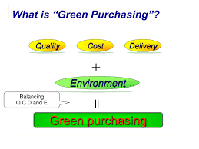
Green purchasing
Environmentally Preferable Purchasing (EPP)

Slide 13
Basic Principles of Green purchasing
Consider whether a product is needed before purchasing it or not.
Purchase a product considering the various environmental impacts over its life cycle from extraction of raw material to disposal.
select suppliers who make conscious efforts to take care of the environment.
Collect environmental information on products and services
Support greening of your supply chain

Slide 14
Environmental issues to consider
Energy saving
Waste minimization(e.g Longer life, Recycled contents, Packaging)
Water saving
Pollution Prevention

Slide 15
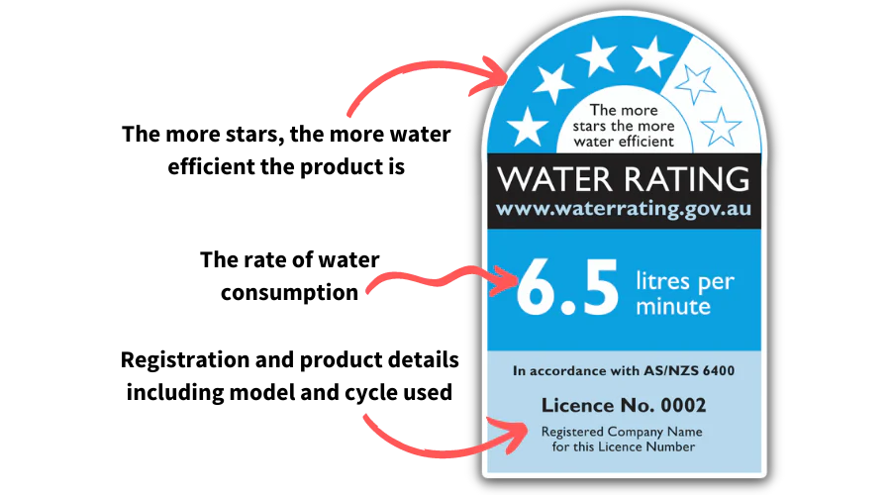
Water saving
Choose products that are water efficient, with a high water efficiency rating if available.
If possible, choose products that are produced through water efficient processes.
Harvest and reuse rainwater and stormwater where possible.

Slide 16
Energy saving
Choose products that are energy efficient, with a high energy star rating if available and appropriately sized to suit the task
If possible, choose products that are produced through energy efficient processes
Purchase green power from an accredited supplier
Services can also be selected on the basis of minimising energy consumption

Slide 17
NB:Ratings are different for each type of heating and cooling equipment, simply because of the energy source used to power it. In other words, you can’t use the same rating to compare a gas furnace to an electric heat pump, because they don’t use the same type of fuel. However, when you understand the numbers behind the ratings, you can get a good idea of how much money you’ll spend to run your equipment, whether it uses gas, electricity, or both
This energy rating applies to equipments like Air conditioning equipments

Slide 18
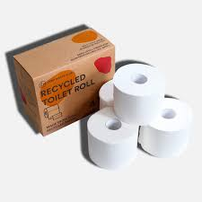
Waste minimisation
Follow the waste hierarchy – avoid, reduce, reuse, recycle
Choose products that are made from re-used e.g paper bags or recycled products e.g recycled toilet rolls from office paper
Choose products that can be easily re-used or recycled.
Choose products and services that are durable, long-lasting and produce minimal waste

Slide 19
Pollution and human health
Use products that have minimal toxicity – eg, pesticides, sun screen, skin ligteners, shampoo, conditioners, hair color(dye),color cosmetics e.g lip stick e.t.c are graded as toxic
Avoid products that create pollution e.g vehicles that have high level of fuel consumption, vehicles that use non-clean fuels e.t.c. Also, buyers may purchase from firms with emission controls or cleaner production techniques,
Reduce hazadeous waste e.g. paint, refrigerant gases,laboratory chemicals and reagents, cleaning and disinfecting(sterilants) agents e.t.c, latex and laboratory chemicals and reagents.

Slide 20
Minimise materials use
Minimise the amount of material consumed wherever possible.
Maintain & repair equipment to extend its life(ie choosing products that are repairable rather than disposable).

Slide 21
THE END

