Slide 1
Project Quality Management
Topic 6

Slide 2
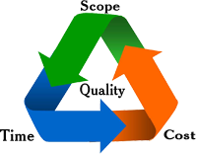
Relevance of Quality in PJ Mgt

Slide 3
What Is Quality?
The International Organization for Standardization (ISO) defines quality as “the degree to which a set of inherent characteristics fulfils requirements” (ISO9000:2000).
Other experts define quality based on:
Conformance to requirements: The project’s processes and products meet written specifications.
Fitness for use: A product can be used as it was intended.

Slide 4
What Is Project Quality Management?
Project quality management ensures that the project will satisfy the needs for which it was undertaken.
Processes include:
Quality planning: This is where quality objectives, standards, and procedures are defined. The goal is to determine how quality will be managed throughout the project.
Quality assurance: Focuses on preventing defects and ensuring that project activities align with quality standards.
Quality control: Monitoring specific project results to ensure that they comply with the relevant quality standards.

Slide 5
Project Quality Management?

Slide 6
Quality Planning
Important to prevent defects by:
Selecting proper materials.
Training and indoctrinating people in quality.
Identifying quality standards relevant to the project (e.g., ISO 9001, industry best practices).
Developing quality management plans that specify quality requirements, roles, and responsibilities and how success will be measured.
Establishing quality assurance and control measures to be followed throughout the project.

Slide 7
Design of Experiments
Design of experiments is a quality planning technique that involves documenting important factors that directly contribute to meeting customer requirements.
In the context of project management, an experiment is not in a secret lab with bubbling liquid in beakers; instead, the testing is done in a controlled manufacturing setting.
Also applies to project management issues, such as cost and schedule trade-offs.

Slide 8
Quality Assurance
Quality assurance includes all the activities related to satisfying the relevant quality standards for a project.
Another goal of quality assurance is continuous quality improvement through bench marking and audit.
Benchmarking generates ideas for quality improvements by comparing specific project practices or product characteristics to those of other projects or products within or outside the performing organization.
Quality audit is done by following the audit checklist and procedures that were prepared in the planning stage and use various methods such as interviews, observations, surveys, tests, and inspections.

Slide 9
Quality Control
The main outputs of quality control are:
Acceptance decisions
Rework
Process adjustments
Some tools and techniques include:
Pareto analysis – identify causes, frequency and consequences of defects.
Fish-bone analysis
Six Sigma
Root cause analysis
Quality control charts
Notes:
Quality control ensures that products, services, or processes meet specified standards by identifying and correcting defects.
Pareto analysis helps project managers prioritize problems, risks, or defects based on their frequency and impact. It is based on the 80/20 principle which states that 80% of problems come from 20% of causes. (a few causes can lead to very many problems) can use ms excel
identifying all Key Issues.
Prioritizing Problem Resolution: instead of fixing everything, teams can solve the most impactful issues first. This ensures better use of time, resources, and budget.
Improving Quality Control: by correcting the defects.
Monitoring Progress: After implementing corrective actions, a Pareto chart can track improvement trends over time.
Root Cause Analysis (RCA)
Helps to find the root cause of a problem.
The goal is to eliminate the root causes rather than just treating the symptoms, ensuring long-term quality improvement.
How to use root cause
Identify the Problem: define the issue, defect, or failure clearly.
Collect Data: gather evidence such as inspection reports, customer complaints, or process logs. Identify when, where, and how often the problem occurs.
Identify Possible Causes: use brainstorming sessions, expert opinions, or past data to list potential causes.
Determine the Root Cause: pinpoint the true source of the issue.
Implement Corrective Actions: develop long-term solutions to prevent recurrence.
Monitor & Verify: track improvements and ensure the issue does not return.
Quality Control Chart
is a statistical tool used in quality control and process monitoring to track variations in a process over time.

Slide 10
Fish-bone Diagram: Analysing frequent System Breakdowns
Low System Memory
Old/ Outdated Hardware
Lack of Usage Skills
Insufficient RAM
Lack of Funds to buy
Lack of training
Problem:
System Downtime
User negligence
Weak security systems
Competitor attacks
Malicious- ware
Denial of Service Attacks
Hackers
Notes:
Causes of causes to the problem are identified

Slide 11
6 Sigma
Notes:
Six sigma
It is a method for improving processes and eliminating defects to ensure high-quality products or services.
It is called six sigma because the name originates from statistical process control, not the number of steps in its methodology.
It uses DMAIC (Define, Measure, Analyze, Improve, Control) – For Existing Systems- If the project is a system Improvement Project. E.g. You want to improve the E-learning system in Mubs
Define – Identify the problem and quality objectives- E.g. Non usage by students, small upload space for users, low internet connectivity for students, et.c.
Measure – Collect data to understand current performance- From lecturers and students. How are the uploads slow?
Analyze – Find root causes of defects using statistical tools– Brainstorm about the root causes of these problems or system errors or issues
Improve – Implement solutions to fix defects- Suggest solutions as a team and implement them.
Control – Maintain improvements using monitoring systems.- Keep on improving system

Slide 12
Testing
Many IS/IT professionals think of testing as a stage that comes near the end of IS/IT product development.
Testing should be done during almost every phase of the IS/IT product development life cycle.
Notes:
Testing is the process of evaluating a software system or application to ensure it meets specified requirements and functions correctly.
The main goal is to identify defects, ensure quality, and validate that the system performs as expected before deployment.

Slide 13
Types of Tests
Unit testing tests each individual component to ensure it is as defect-free as possible.
Integration testing occurs between unit and system testing to test functionally grouped components.
System testing tests the entire system as one entity.
User acceptance testing is an independent test performed by end users prior to accepting the delivered system.
Notes:
User acceptance testing is where the end users (clients, business users, or stakeholders) validate that the system meets their requirements and is ready for deployment. Whether the system meets their needs
Key Objectives of UAT
✅ Ensure the system works as expected in real-world scenarios ✅ Verify that all business requirements are met ✅ Identify any gaps between system functionality and user needs ✅ Gain final approval before going live

Slide 14
Tools for quality
Flow charts/Diagrams
Cause – effect diagrams /Fish bone diagrams
Tally sheets/ Lists – contain quality parameters for evaluation
Pareto diagrams -exist as a special form of vertical bar chart and are used to identify the vital few sources that are responsible for causing most of a problem’s effects. Typically, it will be organized into categories that measure either frequencies or consequences.
Notes:
Flow chart is a visual (charts graphs) representation of a process using symbols and arrows to show the sequence of steps.
Purpose in Quality Management:
Helps in process standardization and identifying inefficiencies (maps out roles and responsibilities, how information is communicated throughout the orgn)
Used in root cause analysis by tracing problem sources
Helps in designing workflow improvement
Tally sheets are simple data collection tools used to record the frequency of occurrences of defects, errors, or events.
Data collection is an important activity in the problem solving process as it provides a basic for further action. A data may be numerical, observations
📌 Purpose in Quality Management:
Used for defect analysis in manufacturing or service delivery
Provides a basis for further statistical analysis

Slide 15
Flow chart Example

Slide 16
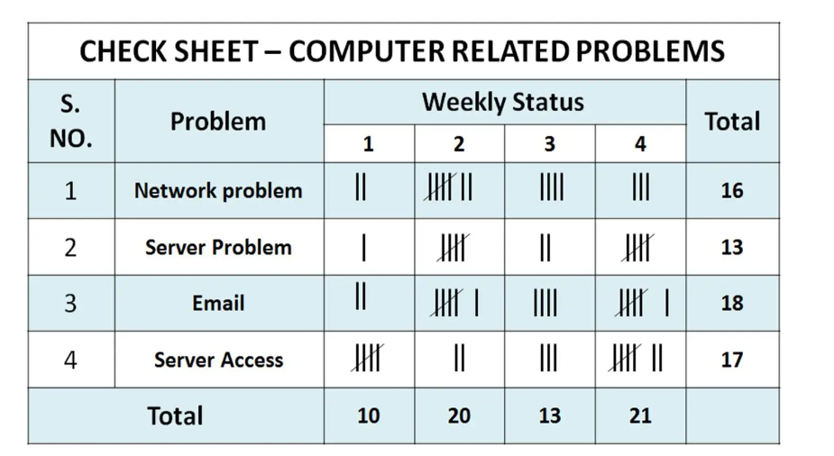
Example of Tally sheets
Tally sheets are simple data collection tools used to record the frequency of occurrences of defects, errors, or events.

Slide 17
Tools for quality
Histogram - are a special form of bar chart and are used to describe the central tendency, dispersion, and shape of a statistical distribution.
Control charts – Based on upper and lower limits that give a picture (research)
Scatter diagrams – Considers a correlation between a dep vs an independent variable (research)
Others include – Brainstorming,
Notes:
A histogram is a bar graph representing the distribution of data based on frequency. 📌 Purpose in Quality Management:
Helps in identifying patterns and variations in process performance
Useful in decision-making for quality improvements
💡 Example: A software company might use a histogram to analyze the frequency of different types of bugs reported by users.

Slide 18
Who’s Responsible for the Quality of Projects?
Project managers are ultimately responsible for quality management on their projects. Some PJs, have a QA manager/dept
Several organizations and references can help project managers and their teams understand quality.
International Organization for Standardization (www.iso.org)‏
IEEE (www.ieee.org)‏
Notes:
Institute of Electrical and Electronics Engineers (IEEE)
It provides a wealth of resources that help project managers understand and implement quality standards in their projects.
IEEE Standards for Quality Management like Standard for Software Quality Assurance Plans, Standard for Software Test Documentation
IEEE offers training on quality management, software engineering principles, and testing methodologies where it even awards certificates.
International Organization for Standardization
It provides methods of Improving product and service quality, Enhancing customer satisfaction, Managing risks and compliance.
Guidelines, handbooks, and training programs for understanding quality management

Slide 19
ISO Standards
ISO 9000 is a quality system standard that:
Is a three-part, continuous cycle of planning, controlling, and documenting quality in an organization.
Provides minimum requirements needed for an organization to meet its quality certification standards.
Helps organizations around the world reduce costs and improve customer satisfaction.
ISO 15504, sometimes known as SPICE (Software Process Improvement and Capability determination), is a framework for the assessment of software processes.
Notes:
ISO (International Organization for Standardization) develops global standards to ensure quality, safety and efficiency across different industries. These standards help businesses improve processes, meet regulatory requirements, and build customer trust.
It sets standards for quality mgt, info security and IT

Slide 20
Improving IS/IT Project Quality
Several suggestions for improving quality for IS/IT projects include:
Clear Project Planning & Requirements; define project goals, scope, and success criteria clearly.
Implement Quality Standards: follow industry best practices like ISO 9001 (Quality Management)
Robust Testing & Quality Assurance (QA): implement automated testing to detect bugs early.
Effective Communication & Collaboration: encourage cross-functional teamwork between developers, testers, and business teams.
Understand the cost of quality.

Slide 21
The Cost of Quality
The cost of quality is the cost of conformance plus the cost of nonconformance.
Conformance means delivering products that meet requirements and fitness for use.
Cost of nonconformance means taking responsibility for failures or not meeting quality expectations.
A 2002 study reported that software bugs cost the U.S. economy $59.6 billion each year and that one third of the bugs could be eliminated by an improved testing infrastructure.*
*RTI International, “Software Bugs Cost U.S. Economy $59.6 Billion Annually, RTI Study Finds,” July 1, 2002.

Slide 22
Five Cost Categories Related to Quality
Prevention cost: Cost of planning and executing a project so it is error-free or within an acceptable error range.
Appraisal cost: Cost of evaluating processes and their outputs to ensure quality.
Internal failure cost: Cost incurred to correct an identified defect before the customer receives the product.
External failure cost: Cost that relates to all errors not detected and corrected before delivery to the customer.
Measurement and test equipment costs: Capital cost of equipment used to perform prevention and appraisal activities.

Slide 23
More factors that influence quality of work
Organizational Influences: Resource Allocation through adequate funding, good leadership and staffing improve project execution.
Workplace Factors: A well-structured, stress-free workplace improves productivity. Training employees produces high quality work
Expectations and cultural differences: Project managers must understand and manage stakeholder expectations.

Slide 24
Maturity Models
Maturity models are frameworks for helping organizations improve their processes and systems.
The Software Quality Function Deployment Model focuses on defining user requirements and planning software projects.
The Software Engineering Institute’s Capability Maturity Model is a five-level model laying out a generic path to process improvement for software development in organizations.

Slide 25
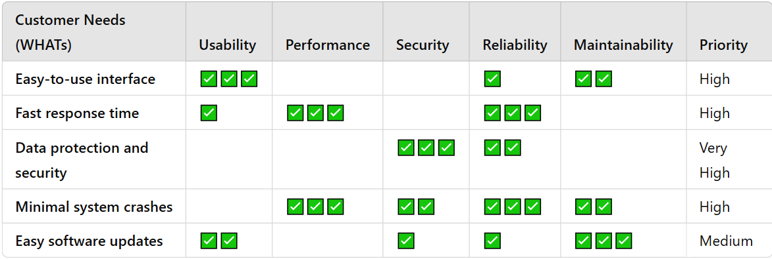
Example of Quality Matrix for Software Development
Notes:
Focuses on customer needs while relating them to the quality principles of usability, performance etc… customer is given an empty sheet and they tick what is priority to them then the analyst can base on that to know which requirements to focus on most.

Slide 26
CMM Levels and CMMI
CMM levels, from lowest to highest, are:
Initial
Repeatable
Defined
Managed
Optimizing
The Capability Maturity Model Integration (CMMI) is replacing the older CMM ratings and addresses software engineering, system engineering, and program management.
Companies may not get to bid on government projects unless they have a CMMI Level 3.
Notes:
CMM is a framework developed by the Software Engineering Institute (SEI) to assess and improve software development processes.
It helps organizations manage and enhance the quality of software projects by defining five maturity levels.
It is a five-level model laying out a generic path to process improvement for software development in organizations.
Orgns move from chaos to stable processes to reduce risks and enhance project perfomance

Slide 27
Five Maturity Levels
Initial
The software process is usually ad hoc, and may be even poorly defined. Few processes are defined, and success depends on individual effort, there is a high risk of project failure, delays, and defects.
Repeatable
Basic project management processes are established to track cost, schedule, and functionality. The necessary process discipline is in place to repeat earlier successes on projects with similar applications.
Defined
The software process is documented, standardized, and integrated. All projects use an approved, tailored version of the organization's standard software process for developing and maintaining software.

Slide 28
Five Maturity Levels...
Managed
Detailed measures of the software process and product quality are collected. Both the software process and products are quantitatively understood and controlled.
Optimizing
Continuous process improvement is enabled by quantitative feedback from the process and from piloting innovative ideas and technologies.

Slide 29
CMM Levels

Slide 30
CMMI
CMM only focused on software development but CMMI does beyond that. It looks at system security, supply chain management etc
Five levels:
Initial
Managed
Defined
Quantitatively managed
Optimizing

Slide 31
PMI’s Maturity Model
PMI released the Organizational Project Management Maturity Model (OPM3) in December 2003.
Addresses standards for excellence in project, program, and portfolio management best practices and explains the capabilities necessary to achieve those best practices.
Notes:
Organizational Project Management Maturity Model (OPM3) is a framework developed by the Project Management Institute (PMI) to help organizations assess and improve their project, program, and portfolio management capabilities.
Project Management Maturity
How well an organization executes individual projects
Ensures projects are delivered on time, within budget, and with expected quality
Example: A university IT project implementing structured timelines, budgets, and risk assessments
2️⃣ Program Management Maturity
How effectively the organization coordinates related projects to achieve strategic objectives.
Ensures resource optimization and alignment with strategic goals
Example: A solar energy ICT initiative coordinating different software solutions for energy monitoring and billing
3️⃣ Portfolio Management Maturity
How efficiently the organization selects and prioritizes projects aligned with business goals.
Helps prioritize investments in projects with the highest impact
Example: A government ICT project aligning digital transformation projects with national development goals

Slide 32
Using Software to Assist in Project Quality Management
Spreadsheet and charting software helps create Pareto diagrams, fishbone diagrams, and so on.
Statistical software packages help perform statistical analysis.
Project management software helps create Gantt charts and other tools to help plan and track work related to quality management.

Slide 33
Exercise
Assume you are the Quality Assurance manager of MTP enterprises, an organization that handles multitudes of projects worth millions of dollars. Using your experience in the field of Project management, explain the following;
Describe how you would communicate quality planning aspects to your team to avoid quality problems.
Describe how you would implement a quality assurance process to boost confidence in the quality of your products.
Describe how you would report on the overall level of quality acheived using specific techniques and tools

