Slide 1
ENVIRONMENTAL INFLUENCE ON THE STRATEGIC MANAGEMENT PROCESS

Slide 2
An organisation doesn’t operate in a vacuum
Neither do its people operate in a vacuum
We should critically ask yourself the following questions during Environmental Analysis
What are the developments (trends) in the environment?
How do these developments impact (their relevance/significance) on our operations and competitiveness?

Slide 3
Why Environmental Analysis?
Environment is dynamic
Environmental factors influence strategic change
A prime factor in competitive management is decision making which should be adjusted to those relevant environmental changes
Helps in anticipating opportunities, and devising means of exploiting them
Helps us to anticipate threats, proactively develop strategies which will enable us to turn the threat (s) to our competitive advantage
Enables managers to prepare / plan for the future

Slide 4
External Environment
Operating Environment
Organizational Envir’t
Customers
Notes:
Organizational environment-departments, staff and management competencies.
Operating environment-potential customers, agents, dealers, suppliers, consultants, advertising agents, competitors, shareholders etc

Slide 5
Customers
Customers are the Kings
We are the servants in their Kingdom
They are not an interruption to our work but are the purpose for it

Slide 6
What customers want?
Reliability
Attractiveness
Credibility
Empathy
Responsiveness
Honesty

Slide 7
Good attitude (friendly, helpful)
Quick service and quick decisions
Feel good factor
Good mannerism (polite, alert)
Knowledge (services, procedures)

Slide 8
Good appearance (smart, fresh, clean and appropriate for the working environment)
Good presentation (clear, concise, well-prepared, well-spoken)
Time awareness (punctuality, keeping appointments)
Sensitivity to their needs

Slide 9
Organisational Environment
The people you interact with (workmates/internal stakeholders)
Ambience
The functional areas / departments

Slide 10
Operating Environment
Mainly made up of stakeholders
Competitors
Shareholders
Suppliers
Marketing intermediaries

Slide 11
Financial intermediaries
Advertising agencies
Media agencies
Consultants
Activists
How many are they?
How strong are they?
How can they positively or negatively influence our business?
Where/when can they influence (affect) our business operations and competitiveness?

Slide 12
External Environment
Political - Legal
Economic forces
Social – Cultural
Technology

Slide 13
Political – legal environment
Political conditions
Government’s foreign policies
Government fiscal, monetary and other policies

Slide 14
Government legislations, laws, regulations and restrictions on trade
Political ideologies of a country

Slide 15
Economic policies
The nature of the economy (how big is it?, is it growing or declining?)
Structure of the economy( agro based or industrialized or in-btwn?)
Organisation of financial markets
Government’s spending policy
Development of financial institutions

Slide 16
Exchange rates( dollar rate)
Interest rates especially on business loans
Income per capita
Levels of competition in the market
Stages in the country’s business cycle( is it a boom or depression?)
Government policy on citizenship( easy acquiring of citizenship by serious investors or allowing dual citizenship to people on kyeyo)

Slide 17
Social-cultural factors
Cultural beliefs, customs and practices and their effect on consumption
Income distribution( social classes, royals, ruling families)
Life style changes (e.g. working mothers)
Fashion trends, and hypes
General standard of living

Slide 18
Education levels and level of entrepreneurship development( can we access highly trained local labour which is cheaper?)
Language( one familiar or several unfamiliar)
Religion / superstitions
How beauty is judged in this area?

Slide 19
Technological factors
Level of technology and the rate at which its changing
How those changes in technology affects our business operations
Government spending on research and development

Slide 20
Better production innovations and developments like pay for production or just in time by our rivals-threat to us, them using out dated systems-opportunity
High degree of technology adoption / the industry’s focus on technology-threat, low- may be an opportunity
Increasing internet access and mobile technology-opportunity
Cost of the technology( acquiring it, maintaining it, and adjusting it)

Slide 21
Industry Analysis

Slide 22
Before joining an industry, a firm should consider;
Industry size, structure, profitability, long term attractiveness, life cycle
Competitive situation analysis

Slide 23
Level of technology in the industry
Competitive position of the firm
Ease of entry in the industry

Slide 24
Michael Porter’s model
Michael E. Porter of the Harvard Business School
Suggested five competitive forces model;
Rivalry within the industry
Threat of new entrants
Threat of substitute products
Power of buyers
Power of suppliers

Slide 25
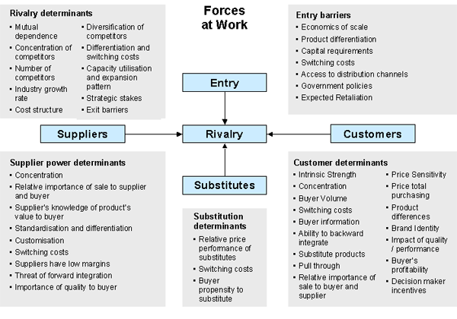

Slide 26
Rivalry determinants
Mutual dependence
Concentration of competitors
Number of competitors
Industry growth rate
Cost structure
Diversification by competitors
Differentiation and switching costs
Exit barriers
Capacity utilisation

Slide 27
Entry barriers
Economies of scale
Product differentiation
Capital requirements
Switching costs
Distribution channels access
Government policies
Expected retaliation

Slide 28
Substitution determinants
Price relativity
Switching costs
Buyer propensity to substitute

Slide 29
Customer power determinants
Intrinsic strength
Buyer volume
Switching costs
Buyer information
Backward integration ability
Substitute products
Price sensitivity
Impact on quality
Brand identity

Slide 30
Supplier power
Importance to supplier
Knowledge of product value to buyer
Brand
Quality
Standardisation and differentiation
Switching costs
Threat of forward integration

Slide 31
Model Basics
Helps managers to identify the opportunities and threats confronting their company (ies).
The stronger the 5 competitive forces, the more serious the threat and vise versa.
Through strategic change you can alter the strengths of such forces

Slide 32
Porter’s Model – Cont.
Need to understand the forces in the industry, their impact/seriousness, how and when they benefit or be against you, and their sources.
Confirm which forces favour your business success (opportunities) or scare your business success (threats)

Slide 33
Limitations
Limited availability of the required information i.e high level of secrecy in government bodies and some business associations
The available information may not be up-to-date, or be irrelevant or even inaccurate
The model ignores other trends like changes in demand, technology used in production, and the market growth/attractiveness

