Slide 1
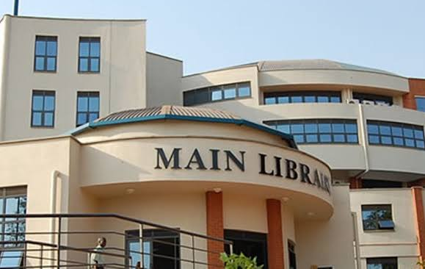
MAKERERE UNIVERSITY BUSINESS SCHOOL
FACULTY OF BUSINESS ADMINISTRATION
Business Communication Skills
FOR DIPLOMA STUDENTS
©2024 - DEPARTMENT OF COMMUNICATION

Slide 2
ORGANISATIONAL

Slide 3
Topic Outline
Introduction to organizational communication
Purpose of organizational communication
Classification of organizational communication
Formal Vs Informal
External Vs Internal
Flow of information in an organization
Vertical
Diagonal
Horizontal
Grapevine

Slide 4
Introduction
Communication is the heart or lifeblood of any organisation.
Therefore, organisations can hardly survive without communication.
The role of communication is crucial In any organization, whether big or small.
No organizational activity can occur without it, making it paramount for all organizations to embrace effective communication.

Slide 5
Topic Learning Outcomes
By the end of this topic, the learners will be able to:
Explain organizational communication
Explain the purpose of communication in the organization
Classify communication
Establish and evaluate how information flows through the organization

Slide 6
Definition
It is the exchange of information with organizational stakeholders.
It includes both communication within the organization and communication with external target groups.

Slide 7
Co-ordinating activities
Making decisions (planning)
Organizing resources
Motivational tool (staffing)
Teamwork effectiveness (leadership)
Conflict resolution
Controlling (Measure of performance through financial statements).

Slide 8
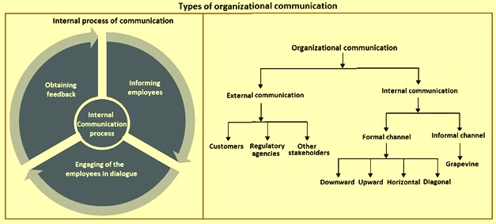
Classification of Communication
1. Formal vs. informal communication
2. Internal vs. external
communication

Slide 9
Formal vs Informal Communication
Formal communication is communication that follows strict rules regarding who communicates, why, how and when to communicate E.g. Board meetings.
Informal communication is information which does not follow strict rules E.g. Chatting with colleagues at the office.

Slide 10
Formal Communication (Organization Chart)
MIRJAM NILSSON President
VICTORIA LINDQVIST Executive Assistant
AUGUST BERGQVIST VP Finance
ALEXANDER MARTENSSON VP Technology
ANGELICA ASTROM VP Operations
ALLAN MATTSSON VP Marketing
FLORA BERGGREN VP Production
IAN HANSSON VP Transportation
MIRA KARLSSON Accounting
APRIL HANSSON
Help Desk
JENS MARTENSSON Facilities
KALLE PERSSON Project Manager
VICTORIA LINDQVIST Production Manager
ANGELICA ASTROM Dispatch
KALLE PERSSON Project Manager
APRIL HANSSON Help Desk
JENS MARTENSSON Facilities
MIRA KARLSSON Accounting

Slide 11
Internal Communication
Communication between members of the same company.
Entails all formal and informal communication that takes place internally at all levels of the organization.
Internal communication forms include notices, telephone, memos, e-mails, face-to-face conversations etc.
Importance:
To Instruct
To inform
To motivate staff
To provide confirmations, responses
Idea generation

Slide 12
External Communication
It is communication that occurs between the organization and external entities like customers, suppliers, government and the general public.
External communication forms include Letters, reports, Meetings, Telephone Communication etc.
Importance:
Provide information about products and services
Promote the organization
Handle enquiries about the organization and its products and services.
Advertise the organization

Slide 13
The Flow of Information in Organizations/Communication Systems
Formal Lines/communication systems
Depends on the kind of information to be communicated and the level of the person sending or receiving the information
Vertical communication
Horizontal communication
Diagonal communication
Informal communication Lines/ systems
Grape vine

Slide 14
Vertical Flow of Communication
Encompasses both upward and downward flow of information.
Information moves between individuals at different levels in an organization.
It follows a chain of command (reporting lines) displayed on the organizational chart.
It is divided into Upward and Downward flow of Information

Slide 15
Upward and Downward Vertical Flow of Communication
For each category explain:
Definition
Examples
Forms used
How effective is each
How can the effectiveness be improved

Slide 16
Horizontal Communication
Occurs between people at the same level or status. E.g. a meeting of only departmental heads.
The senders and the receivers can be members in the same department or different units. but at the same level

Slide 17
Diagonal Communication
There is no obvious line of authority since it takes place between people who work in different departments and at different levels within the organization.
It involves committees, teams or task forces created to solve problems or complete special projects.
Its success depends largely on cooperation, goodwill and respect between the parties concerned.

Slide 18
Grapevine Communication
70% of organizational communication emanates through grapevine. ( American Management Association)
This is an informal communication system, which results from failure to use the proper lines of communication.

Slide 19
Grapevine Cont’d…
It is a vehicle that distorts the truth
Commonly called rumors and gossip.
An active grapevine can cause much damage to an organization by spreading incomplete, false or exaggerated information.

Slide 20
Advantages of Grapevine Communication
Quick dissemination of information
Quick feedback
Group cohesiveness
It is flexible.

Slide 21
Disadvantages of Grapevine Communication
Spreads untrue information
Spreads only partial information spreads i.e. rumors
Hinders the good will of the organization

Slide 22
Managing Grapevine
Provide information through formal systems on important issues to employees
Provide clear, accurate and timely information
Provide full facts
Keep communication lines open and the process as short as possible

Slide 23
Conclusion
Grapevine cannot be eliminated, rubbed out, hidden under a basket, chopped, tied up or shopped because of its quick dissemination of information, quick feedback, flexibility and creating bonds. However, it can be managed to benefit the organization.

Slide 24
Exercise
Using clear examples, explain the different ways information flows from in an organization of your choice,
While grapevine is commonly perceived to negatively impact on organizational processes, it has also contributed positively to organisations. Discuss using clear organizational scenarios, the above statement.

Slide 25
References
Introducing Organizational Communication.mp4
https://www.humix.com/video/81c5bc39d5f14fa55824a0abd144102e30947b8e2ef8ecbe3ceafdfb77dce8c5
https://getuplearn.com/humix/video/LT0XkG5OrBf

Slide 26
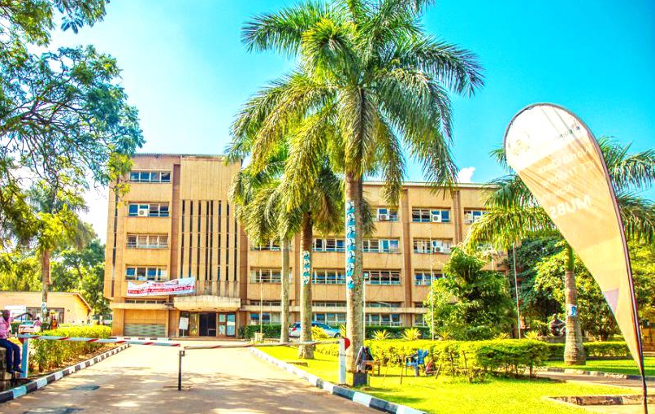
Thank you for being a great audience
Address
Main building , first floor Room 1.0
Contacts
Facilitator:
Team Leader: +256-777-899-582
Email
hodcommunication@mubs.ac.ug/ snakyeyune@mubs.ac.ug
©2024 - FACULTY OF BUSINESS ADMINISTRATION, Department of Communication

