Slide 1
PC COMPONENTS

Slide 2
Motherboard
Function: The main circuit board that holds the CPU, memory, and other essential components and allows them to communicate.

Slide 3
Motherboards
1. AT (Advanced Technology):
Older form factor, now obsolete, Large size, limited connectivity.
2. ATX (Advanced Technology Extended):
The most common form factor, Standardized size: 305 x 244 mm, Good expandability and cooling.

Slide 4
3. BTX (Balanced Technology Extended):
Improved airflow and cooling, Less common than ATX.
4. Micro ATX:
Smaller than ATX: 244 x 244 mm, Fewer expansion slots but compatible with ATX cases.
5. NLX (New Low Profile Extended):
Designed for slimline cases, Not widely used today.

Slide 5
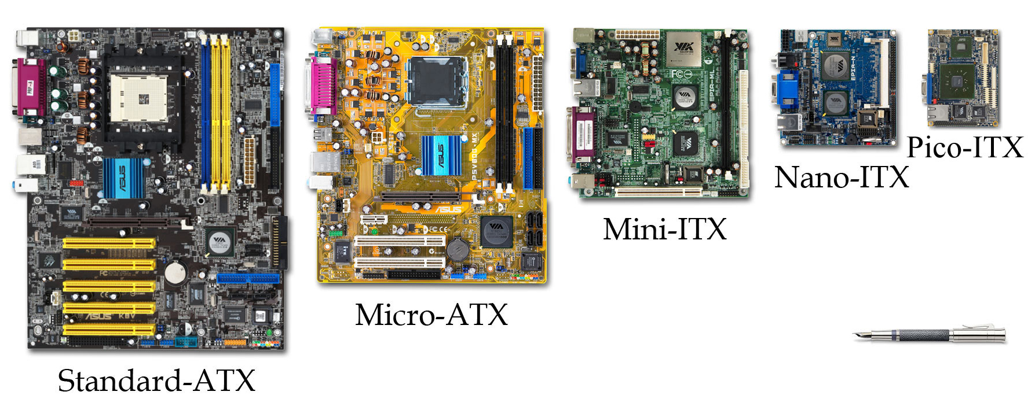
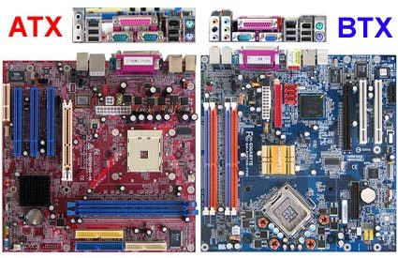

Slide 6
Input Devices
Mouse
Types: Optical, laser, mechanical.
Functions: Pointing, clicking, scrolling.
Keyboard
Types: Membrane, mechanical.
Layout: QWERTY, AZERTY.
Features: Function keys, multimedia keys, ergonomic designs.

Slide 7
Multimedia Input Devices
Game Controllers: Joysticks, gamepads.
Audio Input: Microphones, MIDI devices.

Slide 8
Ports:
Function: Allow the connection of peripheral devices to the computer.
Types:
USB (Universal Serial Bus): Used for connecting a wide range of devices like keyboards, mice, printers, and external storage.
HDMI (High-Definition Multimedia Interface): Transmits video and audio from the computer to an external display or TV.
Ethernet Port: For wired network connections using an Ethernet cable.

Slide 9
Ports and Cables
1. USB (Universal Serial Bus)
Versions: USB 1.0/1.1, 2.0, 3.0, 3.1, 3.2, 4.0.
Connectors: Type-A, Type-B, Micro-USB, USB-C.
Uses: Data transfer, power supply.

Slide 10
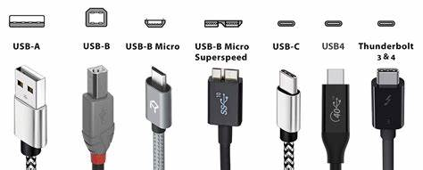

Slide 11
2. Parallel Ports
Characteristics: Used for printers, older technology.
Connectors: 25-pin D-sub connector.
3. Serial Ports
Characteristics: Used for modems, mice, older technology.
Connectors: 9-pin D-sub connector.
4. IEEE 1394 (FireWire)
Versions: 400, 800.
Uses: High-speed data transfer, multimedia devices.

Slide 12
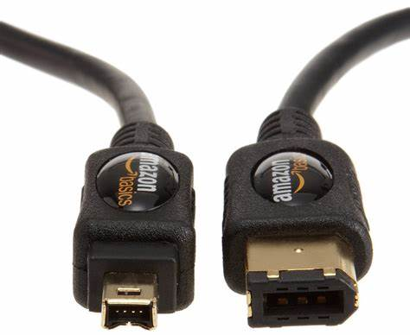

Slide 13
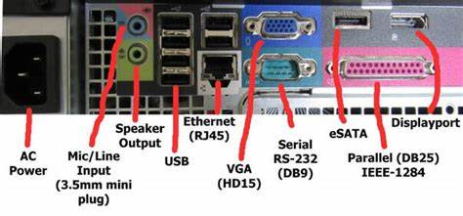
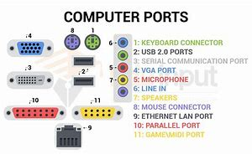

Slide 14
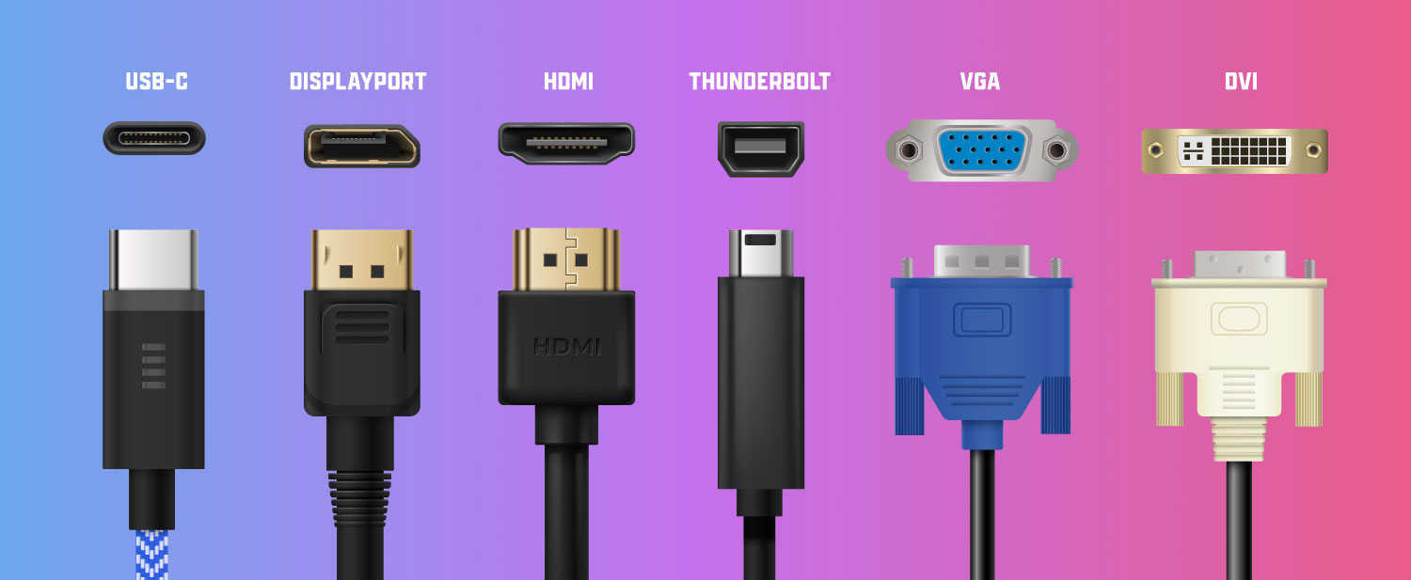
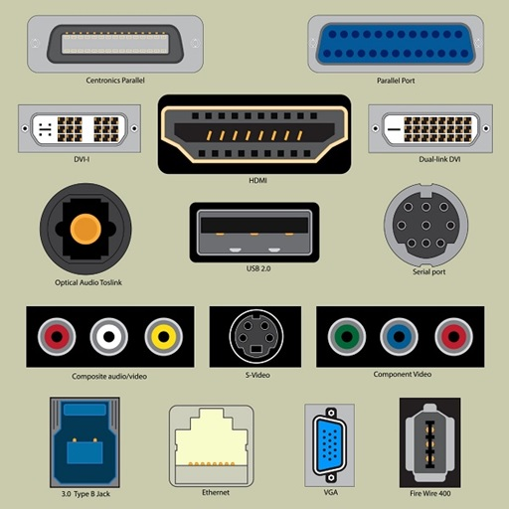

Slide 15
Buses
1. System Bus
Components: Data bus, address bus, control bus.
Function: Connects CPU to RAM and other system components.
2. I/O Buses
ISA (Industry Standard Architecture): Older technology, slower speeds.
PCI (Peripheral Component Interconnect): Widely used for expansion cards.
3. USB: Versatile, hot-swappable, and widely used for peripherals.

Slide 16
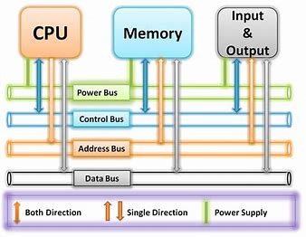

Slide 18
Central Processing Unit (CPU)
Definition: The brain of the computer that performs instructions defined by software.
Function: Executes instructions from software by performing basic arithmetic, logic, control, and input/output operations.

Slide 19
CPUs
AMD & Intel
AMD: Known for Ryzen and EPYC processors.
Intel: Known for Core, Xeon, and Pentium processors.
CPU Technologies
Multi-core Processors: Multiple processing cores on a single chip.
Hyper-Threading: Simultaneous multi-threading to improve efficiency.
Cache Memory: L1, L2, and L3 caches for faster data access.

Slide 20
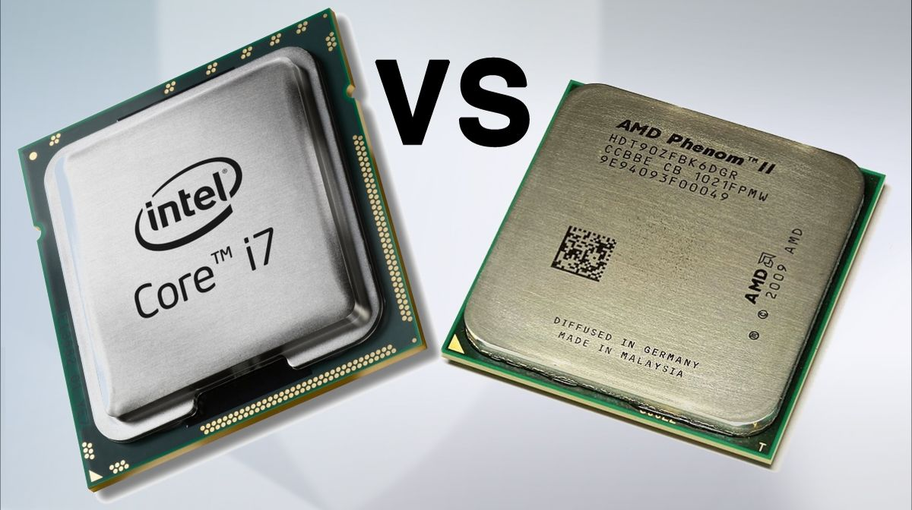
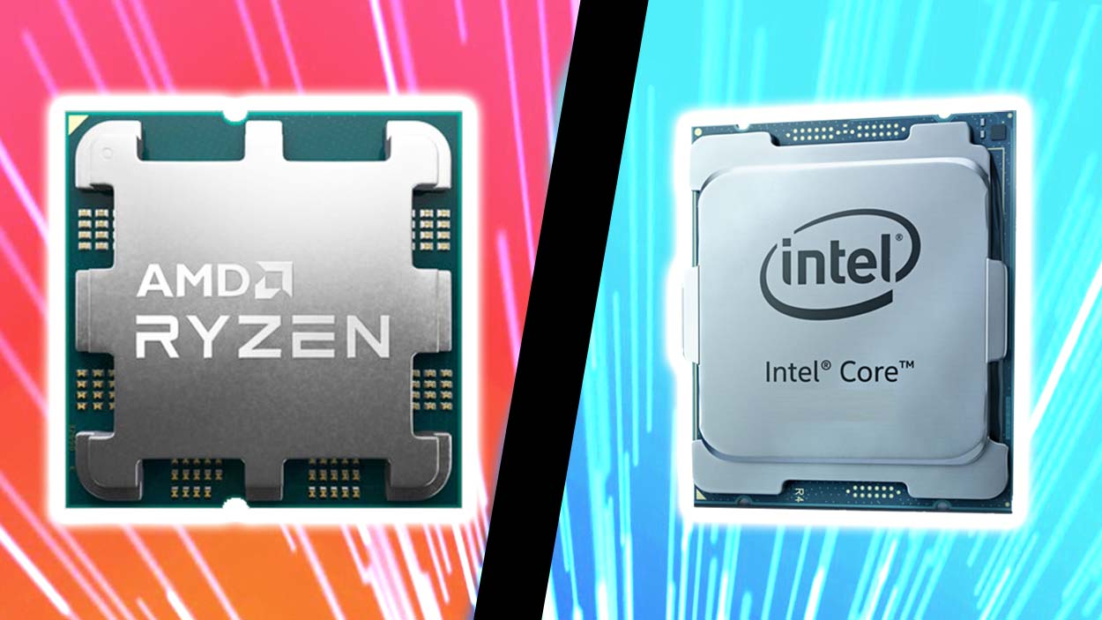

Slide 21
CPU Components
Arithmetic Logic Unit (ALU): Performs arithmetic and logical operations.
Control Unit (CU): Directs operations of the processor by telling the ALU, memory, and I/O devices how to respond to the instructions.
Cache Memory: Small, fast memory located inside or very close to the CPU for quick access to frequently used data.

Slide 22
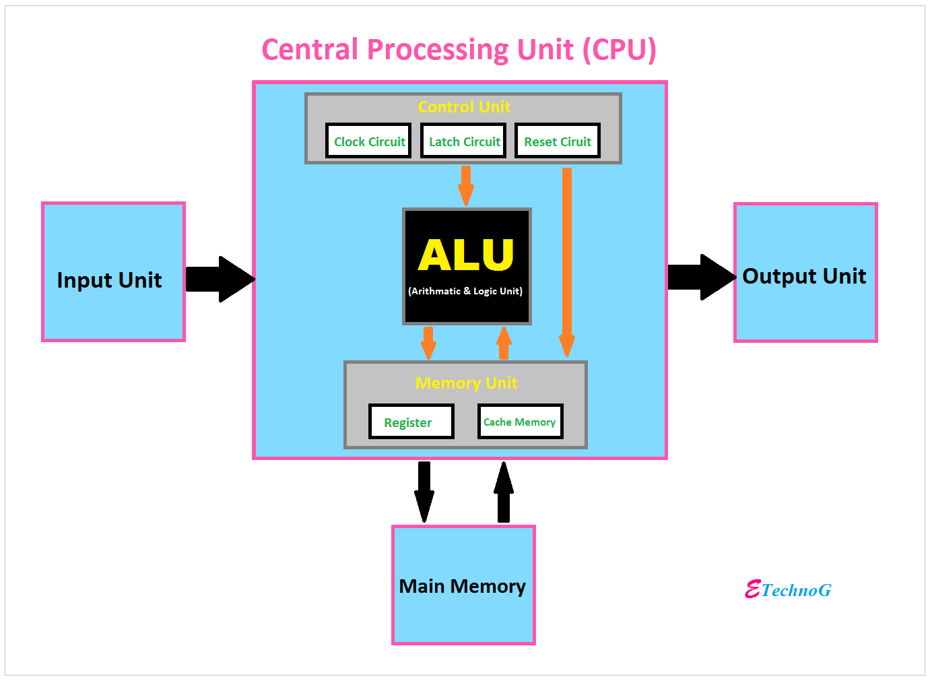

Slide 23
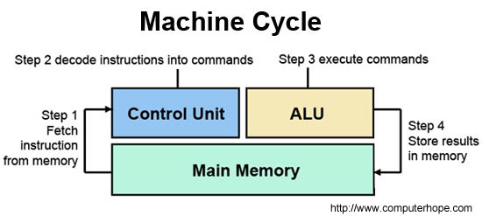

Slide 24
Memory (RAM):
Memory (RAM): Temporary storage used by the CPU to store data and instructions during processing.
Function: Stores data temporarily for quick access by the CPU.

Slide 25
Memory
Types of RAM
DRAM (Dynamic RAM):
Volatile, needs a constant refresh, Common in PCs.
2. SRAM (Static RAM):
Faster, more expensive, no refresh needed, Used in cache memory.
3. SDRAM (Synchronous DRAM): Synchronized with the system clock.
Includes DDR (Double Data Rate) versions (DDR, DDR2, DDR3, DDR4, DDR5).

Slide 26
Types of Memory (RAM)
DRAM (Dynamic RAM): Most common type of memory found in computers.
SRAM (Static RAM): Faster and more expensive than DRAM, used for cache memory.

Slide 27
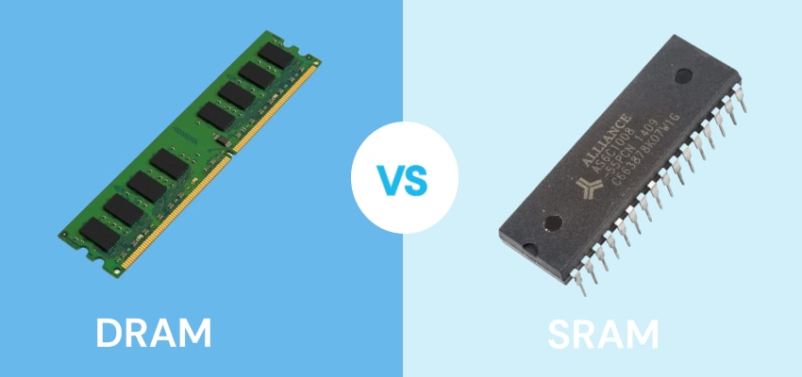

Slide 28
Storage Device
1. Hard Disk Drives (HDD)
Installation: Secure in case, connect power and data cables.
Configuration: BIOS/UEFI recognition, partitioning, formatting.
2. Solid State Drives (SSD)
Installation: Similar to HDDs, often mounted differently.
Configuration: BIOS/UEFI settings, partitioning, formatting.

Slide 29
Storage Device Cont’d
3. Floppy Drives
Installation: Secure in case, connect power and data cables.
Configuration: BIOS recognition.
4. CD-ROM Drives
Installation: Secure in case, connect power and data cables.
Configuration: BIOS/UEFI settings.

Slide 31
Display Devices
1. Projectors
Types: LCD, DLP.
Uses: Presentations, media display.
2. CRT (Cathode Ray Tube) Monitors
Characteristics: Bulky, high power consumption, now obsolete.
3. LCD (Liquid Crystal Display) Monitors
Characteristics: Slim, energy-efficient, widely used.
Types: TN, IPS, VA panels.

Slide 32
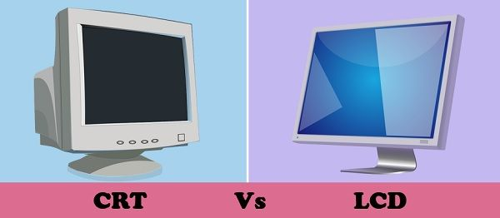
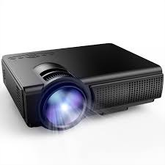

Slide 33
Installation and Configuration of Personal Computer Components
Installation
Components: CPU, RAM, GPU, storage devices.
Software: Operating system, drivers.
Configuration
BIOS/UEFI Settings: Boot order, hardware recognition.
Operating System Configuration: Driver installation, and system updates.

Slide 34
Identifying Personal Computer Components
Major Components
Motherboard: Main circuit board.
CPU: Central processing unit.
RAM: Random access memory.
Storage Devices: HDD, SSD.
Power Supply: Provides power to all components.
GPU: Graphics Processing Unit.
Cooling: Fans, heat sinks, liquid cooling.

Slide 35
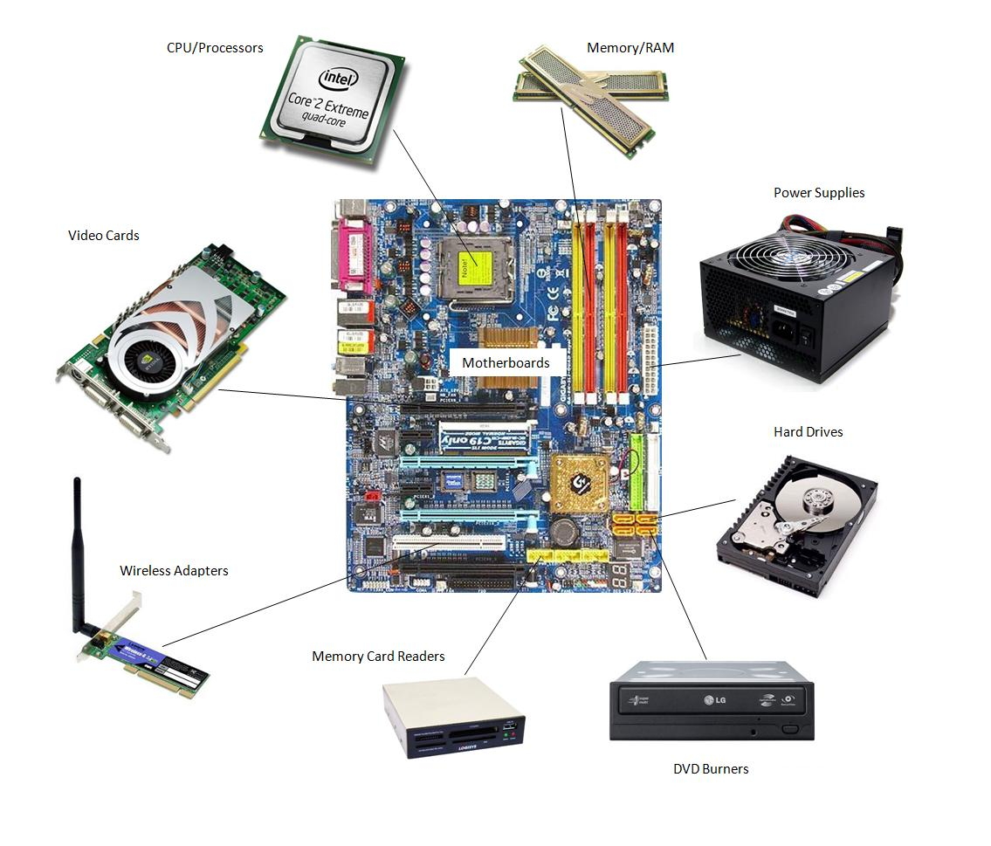

Slide 36
Peripheral Components
Monitor: Display output.
Keyboard and Mouse: Input devices.
Printers and Scanners: Output and input devices.

Slide 38
PC COMPONENTS, FEATURES AND SYSTEM DESIGN
Assembling & Disassembling of Computer Systems

Slide 39
Disassembling a Computer System
1. Preparation:
Ensure the system is powered off and unplugged.
Ground yourself with an anti-static wrist strap.

Slide 40
2. Steps
Open the Case: Remove screws and panels.
Disconnect Power: Unplug power cables from all components.
Remove Components: Sequentially remove the GPU, storage devices, RAM, CPU cooler, CPU, and finally the motherboard.
Organize Parts: Keep screws and small parts in labelled containers for reassembly.

Slide 41
Assembling a Computer System
1. Preparation:
Gather all components: case, motherboard, CPU, RAM, storage, power supply, GPU, cooling, peripherals.
Ensure a clean, static-free workspace.
Have tools ready: screwdrivers, thermal paste, anti-static wrist strap.

Slide 42
2. Steps
Install the Power Supply: Secure the power supply in the case.
Mount the Motherboard: Place standoffs in the case, align the motherboard, and secure it.
Install the CPU: Open the CPU socket, place the CPU, close the socket, and apply thermal paste.
Attach the CPU Cooler: Mount the cooler and connect the fan to the motherboard.
Install RAM: Insert RAM modules into the motherboard slots.

Slide 43
Assembling Steps Cont’d
Install Storage Devices: Secure HDDs/SSDs and connect power and data cables.
Install the GPU: Place the GPU in the appropriate PCIe slot and secure it.
Connect Power Cables: Attach power cables to the motherboard, GPU, storage devices, and peripherals.
Connect Front Panel Cables: Connect USB, audio, and power/reset buttons to the motherboard.
Final Checks: Ensure all connections are secure, then close the case.

Slide 44
END

